Slide 1
Evolving Data Processing in the Statistics Centre – Abu Dhabi
Dragica Sarich and Maitha Al Junaibi

Slide 2
Outline
About SCAD and its surveys
Advantages and disadvantages of data editing
SCAD's experience with data editing
Overcoming challenges
Notes:
Establishments complete survey via:
Web
hardcopy questionnaire (mail or fax completed questionnaire to SCAD)

Slide 3
Statistics Centre – Abu Dhabi (SCAD)
Commenced operation in 2009
Only official authority for collection, preparation, compilation and dissemination of statistics for Emirate of Abu Dhabi
SCAD’s Economic Surveys consist of:
Annual Economic Survey
Foreign Investment Survey
Yearly Environmental Survey
Collect data from establishments across 3 regions on annual basis
Measures:
structure and performance of business sectors in economy
volume, flow, source and role of foreign investments
environmental, health and safety issues
Notes:
Establishments complete survey via:
Web
hardcopy questionnaire (mail or fax completed questionnaire to SCAD)

Slide 4
SCAD’s Economic Surveys
* Mixed mode data collection

Slide 5
Economic Surveys: Automated error detection
Purpose:
check establishments’ data
identify and flag erroneous data in unit record file
Input from subject matter experts:
Experience with:
expected responses to questions
quality of data
Developed written set of validation rules for each economic survey
Validation rules: guideline for checking data, identifying and flagging erroneous/ anomalous data, and for making edits

Slide 6
Economic Surveys: Automated error detection
Developed using SAS Enterprise Guide and R
Translate validation rules into these packages’ languages
Create flags for identification of pass / fail
Functions:
Error detection
Outlier detection
Managing coding of free-text responses
Producing reports
Producing log of outcomes for each establishment for each validation rule
Preparation of unit record file
Quality assurance of system
Notes:
Also programmed and created identifier variables or ‘flags’ in the data file to identify those records that did not meet each validation rule and/or did not pass what was deemed as critical or tolerable validation rules by the experts

Slide 7
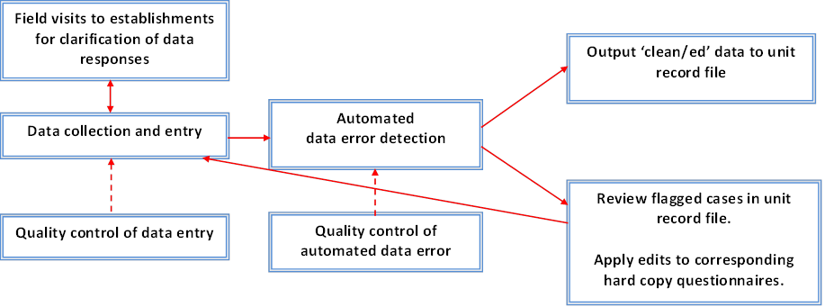
Data cycle

Slide 8
Issue: Number of validation rules
Strategies
Consult and review with subject matter experts set validation rules Remove those considered of a ‘low weight’ by experts Prioritize validation rules by status: critical or tolerable Create rules (where necessary) Develop automated error detection system based on revised rules
Outcomes
Revised smaller set of validation rules produced and incorporated into system
Data inflow voluminous: approaching 90% consent rate
Few establishments flagged needing review and editing
Reduced respondent burden and attrition
Increased staff availability to attend to other survey project tasks

Slide 9
Conclusion
Automated data editing improved quality and efficiency of surveys in SCAD
SCAD is investigating methods for handling missing and anomalous data in establishments surveys.
Thank you

