Slide 1
Global Assessments and Integrated Economic Statistics from products towards processes
United Nations Economic Commission for Europe
Statistical Division
Agenda item 4d
Presentation by UNECE
Workshop on Implementation of the 2008 SNA
Kiev, 29 November - 2 December 2011

Slide 2
Aim of Global Assessments
The aim of a global assessment of the national statistical system is to provide a clear picture of the state of development of official statistics in the country.
The NSO to plan long-term development of statistics
National authorities to better understand the role and the mission of official statistics and ultimately to allocate additional financial and human resources
International partners to have a better knowledge of the state of development of the statistical system in the country for planning capacity building programmes
2

Slide 3
2009 EECCA Seminar in Yalta /1
Management Seminar on Global Assessments for EECCA countries organized by EFTA-Eurostat-UNECE in September 2009 in Yalta
Heads and deputy heads of 11 national statistical institutes participated: Armenia, Azerbaijan, Belarus, Georgia, Kazakhstan, Kyrgyzstan, Moldova, Mongolia, Russia, Tajikistan, Ukraine
Experts from international organizations and from Iceland, the former Yugoslav Republic of Macedonia and Norway
3

Slide 4
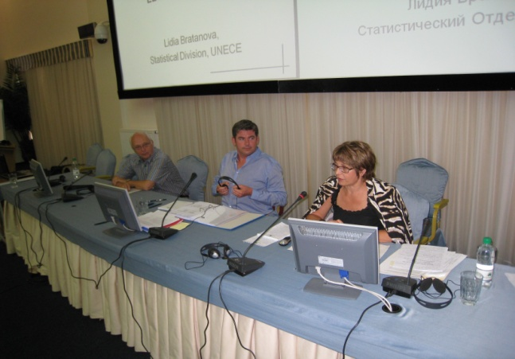
2009 EECCA Seminar in Yalta /2
4

Slide 5
2009 EECCA Seminar in Yalta /3
Participants and organizers agreed on the following:
The National Statistical Systems of the EECCA countries could largely benefit from Global Assessments
EFTA-Eurostat-UNECE offer to conduct global assessments in the region in a coordinated way
Global assessments would be conducted under the strict condition that the country request it (demand-driven)
Eurostat shall be the leading organization for the ENP-East countries (EEC) and UNECE for Central Asia countries (CA)
EEC countries send their requests to Eurostat and CA countries to UNECE
5

Slide 6
The 5 Stages of a Global Assessment /1
Stage 1 – Preparatory work
Available reference and information materials about the NSS are collected through an assessment guidance questionnaire
Stage 2 – First Assessment mission
5-day global assessment mission from EFTA – Eurostat – UNECE experts to collect in-depth information from producers and users of statistical information about the NSS
Stage 3 – Interim consultations – Draft report
Production of a draft report submitted to the National Statistical Institute for consultation and, if necessary, ongoing ad-hoc consultation with producers and users in the country
6

Slide 7
The 5 Stages of a Global Assessment /2
Stage 4 – Second Assessment mission
Discuss the draft report with the National Statistical Institutes and other stakeholders and propose recommendations
Stage 5 – Final reporting
The final global assessment report including recommendations to be approved by the assessors and the National statistical Institutes
7

Slide 8
Next Challenges for National Statistical Systems
Increasing demand for relevant, quality and timely statistics to monitor economic, monetary, social and environmental policies
Economic and financial crises with additional budget constraints for national administrations
Budget cuts for technical cooperation at international level
Pressure to further reduce response burden
___________________________________________________________________________
Streamlining statistical production processes from the data collection to the dissemination
8

Slide 9
What Does Streamlining Mean?
Streamlining can be defined as adapting the business and technology infrastructure in order to deliver statistical information that meets user’s requirements in a more effective and efficient way.
Effective:
Adequate to accomplish a purpose; producing the intended or expected result: an effective decision
Efficient:
Performing or functioning in the best possible manner with the least waste of time and resources (human and financial)
9

Slide 10
Integrated Economic Statistics: from Products towards Processes
Integrated economic statistics approach does not focus only on products or services but also on the means to achieve them
Effective design and improvement of processes that ensure that products and services are fit for their purpose and meet their specification (Quality management)
Quality management is also referred to as business management or integrated management
More ex-ante quality assurance built into the production process rather than a ex-post quality control on products
10

Slide 11
From the Stovepipe Model …
The stovepipe model is an organisation of the production where each substantive department has exclusive ownership over the production process of one or more specific statistical product
Excessive burden on respondent: each statistical product relies on its own data sources
Inefficient: this model does not allow to standardize statistical production and to deploy common IT platform and tools
Inconsistent: the same statistical information from different sources are not systematically reconciled and might diverge;
One-dimensional: the model is not well adapted to the primary data collection on statistical domains that cover multiple dimensions, such as national accounts, globalization or environment.
11

Slide 12
… to the Integrated Model
The integrated model is based on common and standardised processes, transforming a combination of primary data into statistical products
Vertical integration (simplification of the production chain):
Reducing the unnecessary layers and tasks between the data collection and the dissemination
Horizontal integration (economy of scale):
Increasing the operational coordination of the National Statistical System by organizing jointly the collection of primary statistical data and avoiding duplication of tasks
12

Slide 13
Coverage of Global Assessments
The legal and institutional aspects of the national statistical system
Fundamental principles of Official Statistics and the European Statistics Code of Practice
The technical and organizational capacity to produce and disseminate official statistics in all relevant areas:
Data collection mechanisms, data processing and editing, quality monitoring, registers and dissemination
The compliance of statistical output with international standards, norms and recommendations
13

Slide 14
International standards / nomenclatures / guidelines
Coherent
SNA
BoP
Business processes
Sectoral statistics
STS – SBS – CPI – ETS – GFS …
Statistical registers
Data warehouse
Editing and processing (quality control)
Integrated
Data collection
Administrative data – Surveys – Censuses
Effective
Legal / institutional / organizational framework

Slide 15
Conclusions
Global assessments address all elements of quality, coherence and efficiency of statistical systems and contribute to an integrated approach of the statistical production
The consistency and exhaustiveness of national accounts data can substantially benefit from a more integrated production of economic statistics
In return, the national accounts, as the overarching framework for economic statistics, is an essential tool for improving the coherence of major sectoral statistics
Streamlining statistical production is an ongoing task since economic statistics must constantly adapt to the evolving environment (e.g.: globalization)
15

Slide 16
Processes are embedded in products

Slide 17
Thank you for your attention.

