Slide 1
The Consultation Institute Quintin Oliver, Chair
Energy-related planning in the United Kingdom

Slide 2
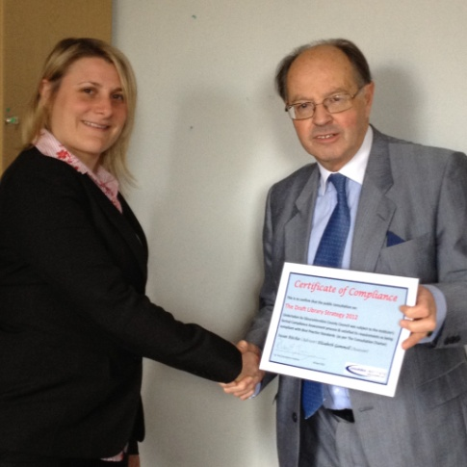
The Consultation Institute Not-for-profit; Best Practice organisation; founded 2003
Consultation & Public Engagement ‘Think Tank’
UK & beyond
Quality Assurance
Advice & Guidance
Risk Assessment
Publications; thought leadership & events
CPD & APC
1,187+ members
www.consultationinstitute.org

Slide 3
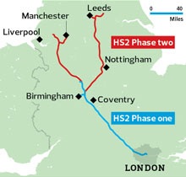
Aarhus & the UK

Slide 4
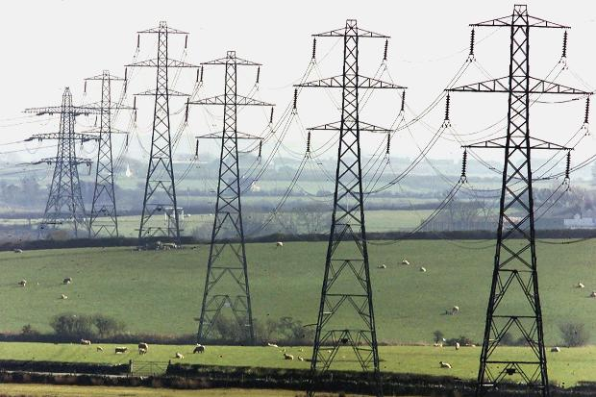
Why is energy so important?
Politics
Technology
Environment

Slide 5
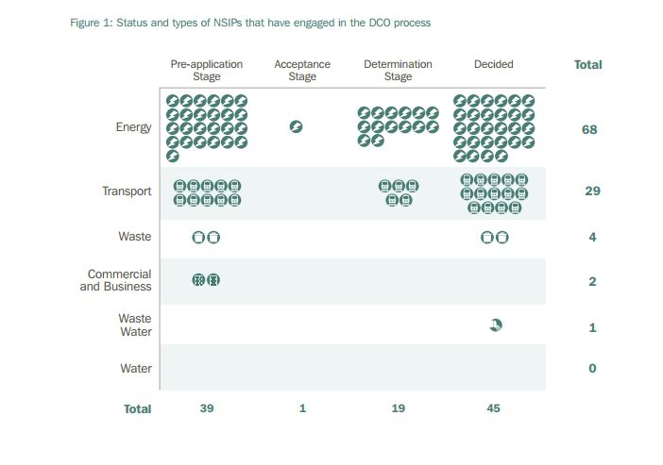
UK Energy Planning Policy
2008 Planning Act:
Introduction of Nationally Significant Infrastructure Projects (NSIP)
Fast tracking consent procedure
Statement of Community Consultation
Small-scale developments fall under Local Authorities’ remit
Cutting corners on Public Participation?

Slide 6
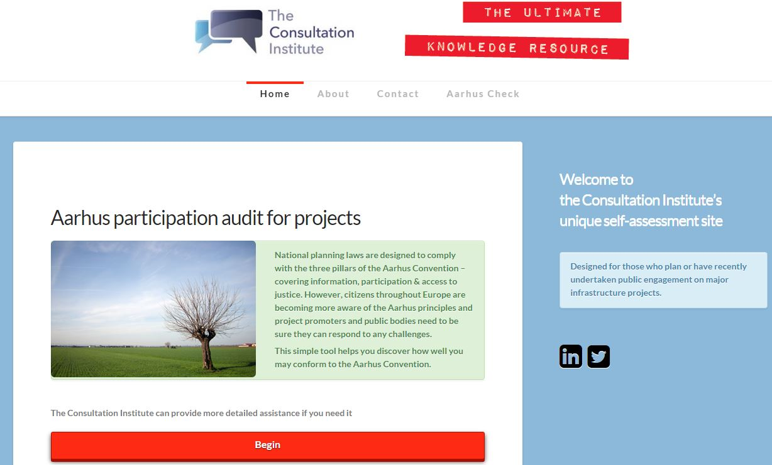
AarhusCheck
Participation audit
Free risk assessment
tool
For all stages of development
www.tcitoolbox.com

Slide 7
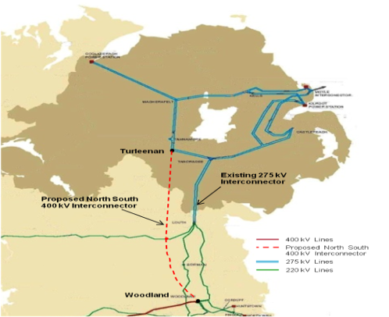
Perils of Pylons
Cross-border electricity
interconnector
Communities objected due
to lack of consultation
Led to major external
participation inquiry

Slide 8
More information @TCInews / @QuintinOliver The Consultation Institute consultationinstitute.org

