Slide 1
Future Ideas for Regulation 151
Submitted by the expert from Germany
Informal document GRSG-119-05
(119th GRSG, 6-9 October 2020,
Agenda item 4b)
Patrick Seiniger, BASt

Slide 2
Motivation
Regulation 151-00 guarantees that drivers of heavy vehicles are notified about endangered bicyclists in due time.
Main critisicm: Information signal is given too early
Focus of this presentation: reasons and proposed improvements
Presented for first feedback from GRSG members

Slide 3

Possible information signal timings
1 before potential swerving (as implemented in current R151)
2 for comfortable stopping (as proposed in initial document)
3 possible auto-brake activation
Figure qualitative
1
2
3
Sufficient
to initiate braking
Sufficient
for Auto-Brake!

Slide 4
R151 requirements …
The BSIS shall inform the driver about nearby bicycles that might be endangered during a potential turn, by means of an optical signal, so that the vehicle can be stopped before crossing the bicycle trajectory.
It shall also inform the driver about approaching bicycles while the vehicle is stationary before the bicycle reaches the vehicle front, taking into account a reaction time of 1.4 seconds. This shall be tested according to paragraph 6.6.
The BSIS shall warn the driver, by means of an optical signal, acoustical signal, haptic signal or any combination of these signals, when the risk of a collision increases.
Needs additional
definitions or at
least interpretation
Clear performance
requirement
Needs interpretation

Slide 5
… & pass-fail criteria
Test Case | v_{bicyclee} [km/h] | v_{Vehicle} [km/h] | d_{lateral} [m] | d_{a} [m] | d_{b} [m] | d_{c} [m] | d_{d} [m] | d_{bicycle} [m] | l_{corridor} [m] | d_{corridor} [m] | For information only (not influencing test parameters)
 |  |  |  |  |  |  |  |  |  |  | Impact Position [m] | Turn Radius [m]
1 | 20 | 10 | 1.25 | 44.4 | 15.8 | 15 | 26.1 | 65 | 80 | vehicle width + 1 m | 6 | 5
2 | 20 | 10 |  |  | 22 | 15 | 32.3 |  |  |  | 0 | 10
3 | 20 | 20 |  |  | 38.3 | 38.3 | 65 |  |  |  | 6 | 25
4 | 10 | 20 | 4.25 | 22.2 | 43.5 | 15 | 43.2 |  |  |  | 0 | 25
5 | 10 | 10 |  |  | 19.8 | 19.8 | 65 |  |  |  | 0 | 5
6 | 20 | 10 |  | 44.4 | 14.7 | 15 | 26.1 |  |  |  | 6 | 10
7 |  |  |  |  | 17.7 |  | 29.1 |  |  |  | 3 | 10
Add. Assumption: Signal activated
before outside swerve (since that‘s not tested,
as requested by Industry)

Slide 6
Original pass-fail criteria, including turning
New Test Case | r_{turn} | v_{vehicle} [km/h] | v_{Bicycle} [km/h] | d_{lateral} [m] | d_{c} [m] | d_{bicycle} [m] | l_{corridor} [m] | d_{corridor} [m] | d_{corridor,outer} [m] | Include cone to account for initial swerving?
1 | 5 | 10 | 20 | 1.5 | 4.3 | < 55 | > 70 | vehicle width + 1m | 5 | Yes
2 | 10 | 10 | 20 |  | 4.4 |  |  |  | 2 | Yes
3 | 25 | 20 | 20 |  | 10.7 |  |  |  | 1 | No
4 | 25 | 20 | 10 | 4.5 | 10 |  |  |  | 1 | No
5 | 5 | 10 | 10 |  | 2.4 |  |  |  | 6 | Yes
6 | 10 | 10 | 20 |  | 3.4 |  |  |  | 3 | Yes
7 |  |  |  |  |  |  |  |  | 2 | Yes
8 | 5 | 10 | 20 | 1.5 | 4.3 |  |  |  | 1 | No
9 | 10 | 10 | 20 |  | 4.4 |  |  |  |  | No
10 | 5 | 10 | 10 | 4.5 | 2.4 |  |  |  |  | No
11 | 10 | 10 | 20 |  | 3.4 |  |  |  |  | No
12 | 10 | 10 | 20 |  |  |  |  |  |  | No

Slide 7
Idea: What If We Could Verify The System With Robot Testing?
The BSIS shall inform the driver about nearby bicycles that might be endangered during a potential turn, by means of an optical signal, so that the vehicle can be stopped before crossing the bicycle trajectory.
Reaction time
Braking
Vehicle stopped
before crossing
trajectory
Signal given
Brake applicatoin
1.4s
5 m/s²
Total stopping distance

Slide 8
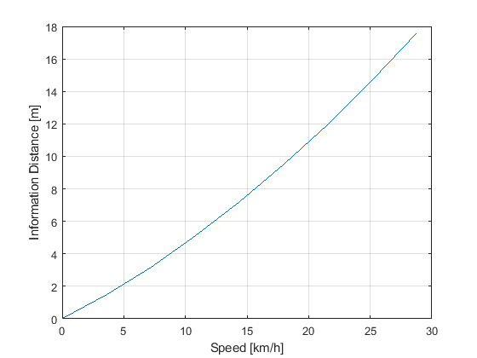
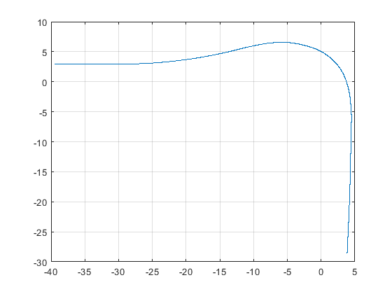
Vehicle Speed and Information Signal Timing
10 km/h
20 km/h
Radius corresponds to
total stopping distance from
left diagram.

Slide 9
Paradigm Change: Require requirements
Verification Approach
Current R151 & almost all other regulations define specs (e.g. inform at this distance)
Specifications will be verified in a test
This limits manufacturer flexibility and requires assumptions for the system design
Validation Approach
Define Requirements (e.g. inform in time to stop, given the driver reaction time, possibly given the vehicle deceleration)
Validate requirements a posteriori (after impact)
This gives maximum flexibility but also responsibility to manufacturer

Slide 10
Proposal for alternative test method
1. When using driving and dummy robots, all vehicle movements are pre-programmed
2. Every vehicle location is known at all times
3. It is possible to verify the signal activation without impact to the dummy
4. It is possible to verify the signal activation in more realistic scenarios (including swerving to the outside)
5. It is safe to return to the „old“ pass-fail-criteria!
6. NO changes to actual specification section in R151 required

Slide 11
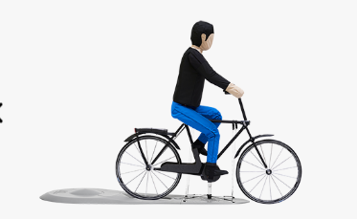
How does it look like?

Slide 12
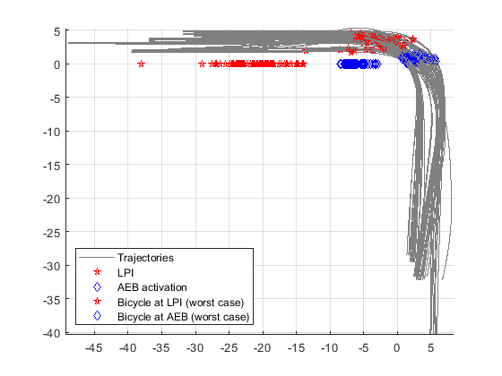
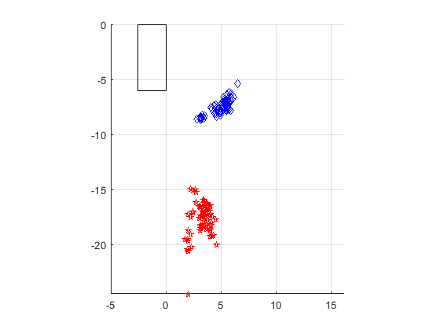
Possible BSIS and AEB timings in example trajectories
Truck positions
Bicycle positions
Bicycle positions
relative to truck at LPI & AEB

Slide 13
Conclusions
When sufficiently-advanced technology is available, it will be possible to test requirements instead of specifications
This will give the manufacturer much more flexiblity and responsibility
This approach should be possible with introducing an alternative testing annex into R151 (no change in specs in core text!)
Auto-brake could possibly be included as an alternative to the warning strategy (more requirements for AEB to be discussed intensively)

