Slide 1
Working Party on Pollution and Energy (GRPE) Highlights of the March 2020 sessions of WP.29 and ITC session Feb 2020
Note by the secretariat
Informal document GRPE-81-07-Rev.1
81st GRPE, 9-11 June 2020
Agenda item 2
WP.29 was held as a hybrid meeting (with part of the audience attending remotely).
AC.3 (for vote of the 98 Agreement) did not reach the quorum and could not convene and vote on UN GTR amendments (none were coming from GRPE). AC.1 and AC.4 adopted all proposals submitted by GRs (except Suppl. 2 to UN Reg. 144).
AC.2 provided a new simplified template for GR priorities (GRPE-81-06).
UN Road Safety Fund financing a project on “Safer and Cleaner Used Vehicles for Africa” led by UNEP with the support of ECA, ECE, WHO, the ITF as well as CITA. This project supported by the outcome of WP.29's work, eg. with activities under the 1997 Agreement. WP.29 ready to support this activity.
For more details see: ECE/TRANS/WP.29/1151

Slide 2
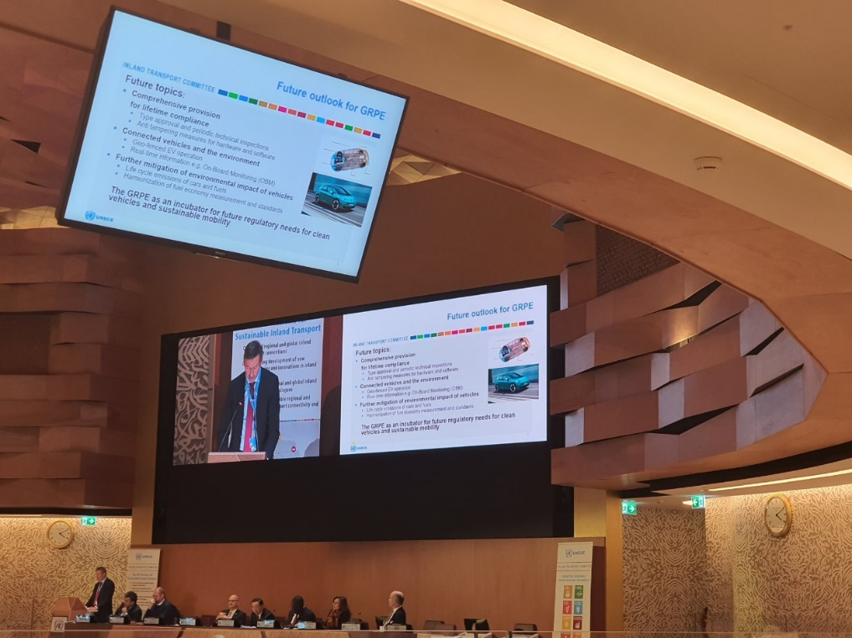
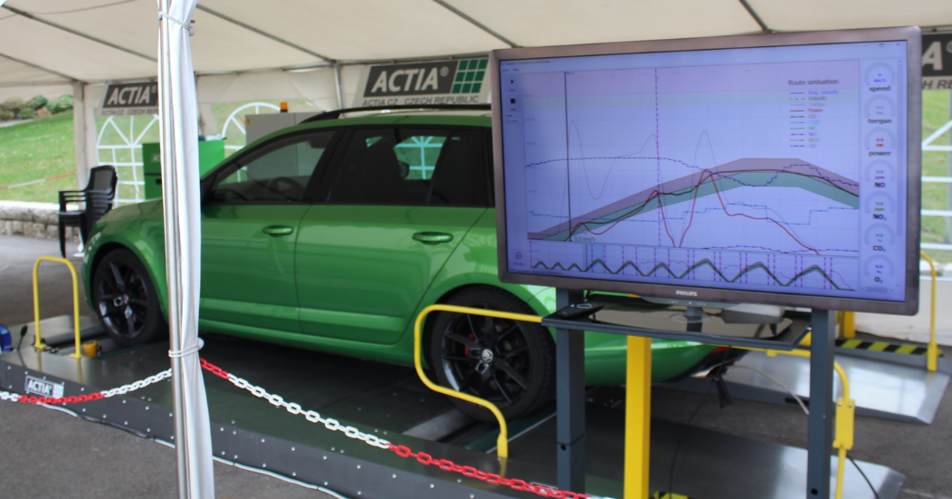
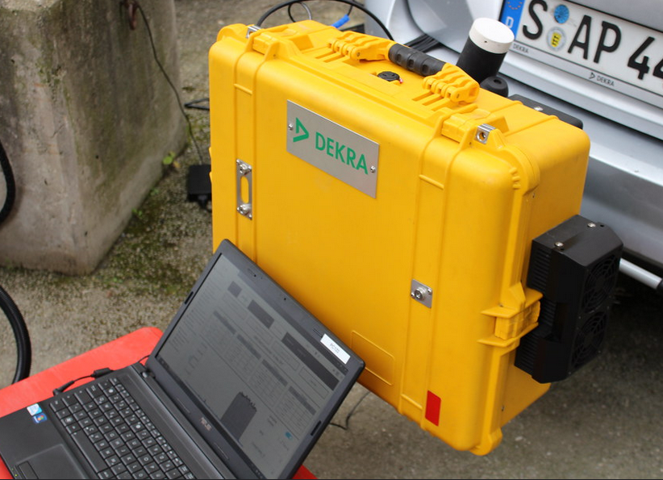
Working Party on Pollution and Energy (GRPE) Highlights of the March 2020 sessions of WP.29 and ITC session Feb 2020
Note by the secretariat
Informal document GRPE-81-07-Rev.1
81st GRPE, 9-11 June 2020
Agenda item 2
Highlights ITC session of February 2020:
In decision No. 52, ITC reiterated its support for hosting of DETA at ECE, and for the request for financing of DETA under the United Nations regular budget.
GRPE Chair presentations in a side event on safer and cleaner used vehicles and during High-level Policy Segment on “Environmental challenges to sustainable inland transport“
“Demonstration of cutting-edge emissions testing technologies both in laboratory and real-world conditions by DEKRA”

