Slide 1
Informal document GRPE-80-28
80th GRPE, 14-17 January 2020
Agenda item 7

Slide 2
79th UNECE GRPE session
PMP IWG Progress Report
Informal document GRPE-80-28
80th GRPE, 14-17 January 2020
Agenda item 7
Geneva, 13th -17th January 2020
UNITED NATIONS

Slide 3
PMP meetings in 2019
2019-01-08: PMP 49th (GRPE Geneva summary)
2019-04-3/4 PMP 50th
2019-10-29/30 PMP 51st
NEXT F-2-F MEETING: 2nd – 3rd April 2020 (Location: JRC Ispra - tbc)

Slide 4
EXHAUST PARTICLE EMISSIONS

Slide 5
Exhaust emissions: Sub-23nm development
Sub-23nm development
  Exercises
    Light-duty
    Raw exhaust sampling for HD testing
  Proposal for Sub-23nm additions
    Losses in PN-systems
    PNC parameters
    VPR type (catalyzed or non-catalyzed evaporation tube)
    General

Slide 6
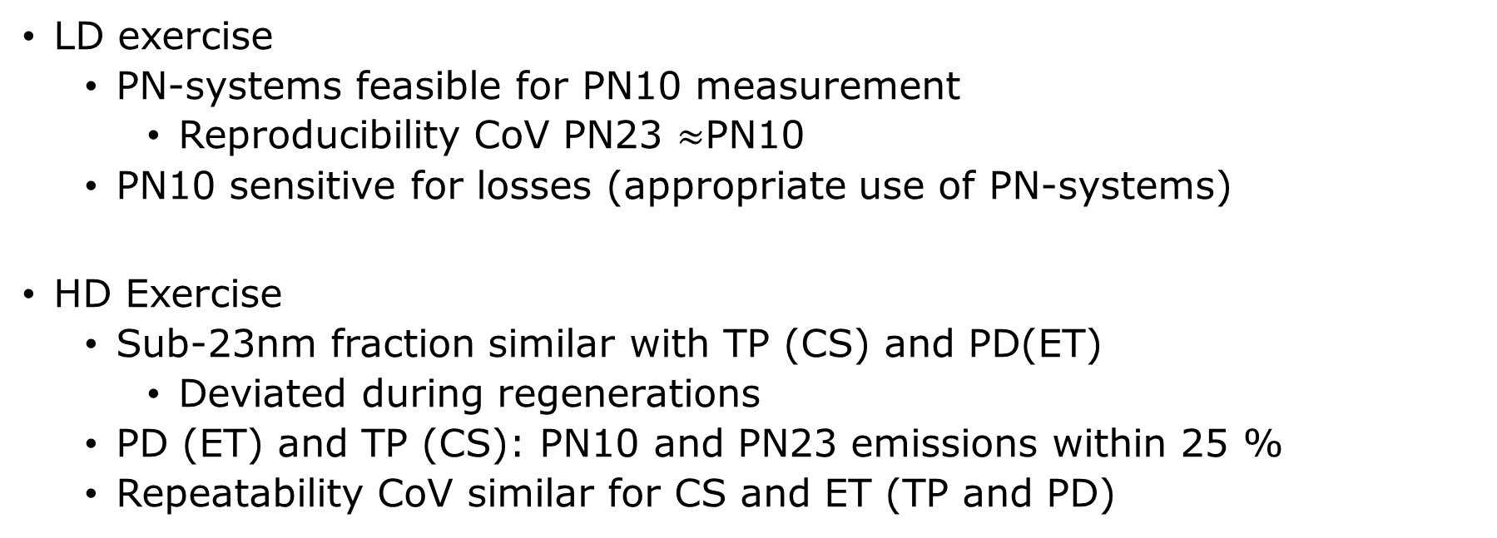
Exercise conclusions
LD exercise
  PN-systems feasible for PN10 measurement
    Reproducibility CoV PN23 $≈$PN10
  PN10 sensitive for losses (appropriate use of PN-systems)
HD Exercise
  Sub-23nm fraction similar with TP (CS) and PD(ET)
    Deviated during regenerations
  PD (ET) and TP (CS): PN10 and PN23 emissions within 25 %
  Repeatability CoV similar for CS and ET (TP and PD)

Slide 7
Sub-23nm PN measurement proposal
The following few slides present the proposal for Sub-23nm PN-measurement parameters
The proposal follows closely the current PN-systems and PNCs used in the exercises and in the laboratories
A document with the proposed changes to the test procedure is available on the PMP website.

Slide 8
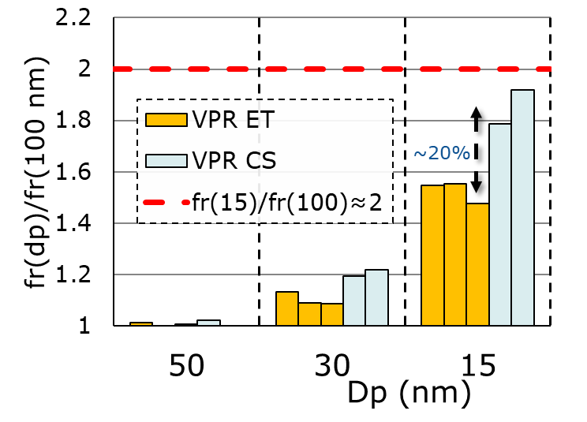
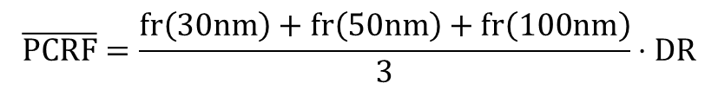
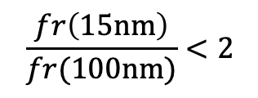
Losses in PN-systems
GTR: Penetration P for 100 nm particles
P(100 nm)≥70 %→ P(15 nm)>35%
Requirement: losses for 15 nm particles less than 2x losses for 100 nm particles
  Limited to 15 nm as 10 nm particle generation is challenging
Catalytic Stripper(CS) losses ~20 % higher than current systems
$$\frac{fr\left(15nm\right)}{fr(100nm)}<2$$
Manufacturers planning to have CS in PN10 systems
PCRF is proposed to be kept as before
Spark-generators produce high enough Graphite particle concentrations @ 15nm
$$\overline{PCRF}=\frac{fr\left(30nm\right)+fr\left(50nm\right)+fr\left(100nm\right)}{3}⋅DR$$

Slide 9
PNC parameters
dp (nm) | eff. (%)
10 ±1 | 65 ±15
15 ±1 | > 90
PNC parameters from current 10 nm PNCs
  Real dp(50%) at around 7 nm
  The parameters adapted from PNC10s used in the exercises and comprehensively in the field
  PNC10 detection efficiency less sensitive to particle material (PNC exercise)
Calibration with Soot-like or PAO particles
  A PNC with 65 % efficiency at 10 nm independent on particle material
  Soot uncertainty ~3% due to multiple charges
    Wide distributions

Slide 10
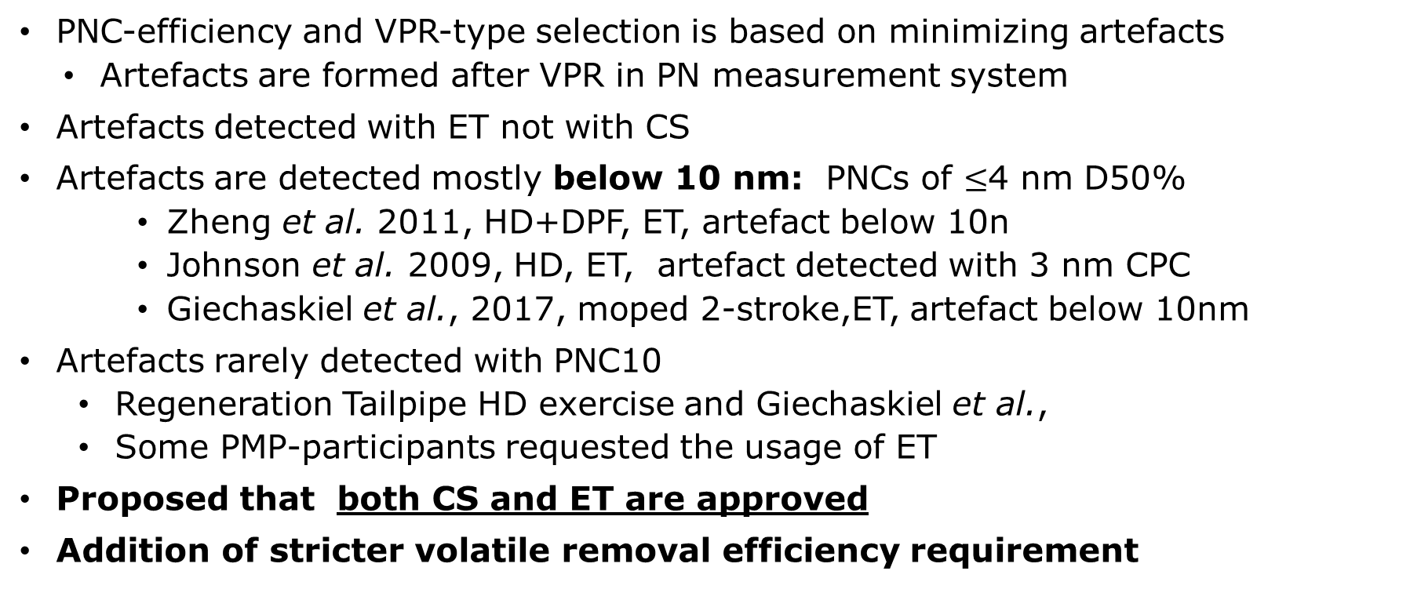
VPR: catalyzed or not
PNC-efficiency and VPR-type selection is based on minimizing artefacts
  Artefacts are formed after VPR in PN measurement system
Artefacts detected with ET not with CS
Artefacts are detected mostly below 10 nm: PNCs of $≤$4 nm D50%
    Zheng et al. 2011, HD+DPF, ET, artefact below 10n
    Johnson et al. 2009, HD, ET, artefact detected with 3 nm CPC
    Giechaskiel et al., 2017, moped 2-stroke,ET, artefact below 10nm
Artefacts rarely detected with PNC10
  Regeneration Tailpipe HD exercise and Giechaskiel et al.,
  Some PMP-participants requested the usage of ET
Proposed that both CS and ET are approved
Addition of stricter volatile removal efficiency requirement

Slide 11
Wrap-up
dp (nm) | eff. (%)
10 ±1 | 65 ±15
15 ±1 | > 90
Proposal for Sub-23nm
  PNC 65 % counting efficiency at 10 nm
    Current systems in the market
  Losses at 15 nm < 2x losses at 100 nm
    Current systems comply with the requirement
  Both catalyzed and non-catalyzed evaporation tube approved
    Request in PMP IWG
    Artefacts rarely detected in above 10 nm

Slide 12
Question from PMP IWG
Could the PN10 emission measurement cover also PN23 emission measurement in regulatory measurements?
  If the vehicle passes the possible future PN10 limits could it be considered to pass also PN23-limit, although PN10 limits may not be valid in the region?
The aim is to avoid double measurements
PNC10
PNC23

Slide 13
HORIZON 2020 projects
The group is monitoring the progress of the three projects funded by EU under the H2020 scheme
  DownToTen
  PEMS4nano
  SUREAL-23
Projects are in finalizing stage
  Reporting in progress
  Input used later for Sub-23nm development

Slide 14
Sub-23 nm exhaust particles
Objective: Address the still open points in the next weeks and freeze the proposal in the next PMP meeting (April/2020)
Subsequent administrative steps:
  Amendment to GTR 15 or to Reg. 83/49?
  Two different procedures in GTR 15: >23 and <23 nm
Following months to collect and process data on emission levels of latest vehicle models
  To support the assessment of the PN-limits

Slide 15
NON-EXHAUST PARTICLE EMISSIONS

Slide 16
BRAKE PARTICLE EMISSIONS
METHOD FOR MEASURING BRAKE WEAR PARTICLES
OVERVIEW OF THE LATEST ACTIVITIES
The development of the novel cycle has been concluded and the cycle has been evaluated through an extensive Round Robin campaign – The most important results and conclusions have been reported to the 50th PMP Meeting and the 79th GRPE Meeting
The measurement results of the Round Robin were further analyzed with the aim of providing recommendations regarding the correct application of brake dyno parameters for emissions measurement – Detailed analysis has been provided to the 51st PMP Meeting
The most important parameters are the adjustment of the cooling air flowrate, the application of soak times between the 10 trips of the WLTP-based cycle, the proposed methodology for the temperature measurement and the definition of the climatic controls – 51st PMP Meeting

Slide 17
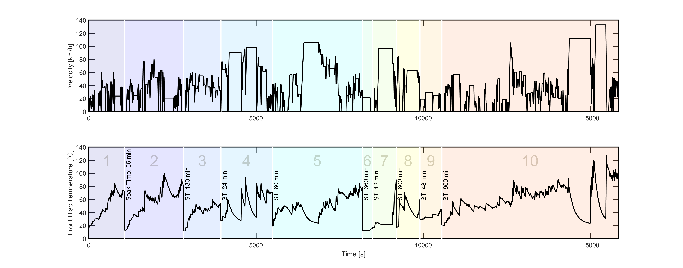
ACHIEVED MILESTONES
BRAKE CYCLE
Novel cycle release: Ford took over the development of the cycle based on PMP initial work in close collaboration with PMP TF1. Development phase lasted almost 2 years including vehicle and lab validation
The number of publications on brake emission studies adopting the novel cycle is continuously increasing. The cycle is freely available at: https://data.mendeley.com/datasets/dkp376g3m8/1

Slide 18
METHOD FOR MEASURING BRAKE WEAR PARTICLES
ACHIEVED MILESTONES
1. Cooling air adjustment: Definition of the problem – The application of non-comparable cooling air flowrates to different dynos/labs results in discrepancies of the recorded brake temperature regimes. This has a negative effect on the quality of PN measurements as well as on the reproducibility of results among the labs
The proposed methodology for the adjustment of the cooling air flowrate is relatively simple, not much time and resource consuming and accessible to all labs with a certain level of technical capacity. The method applies for all brakes featured in passenger cars - Detailed description has been provided to the 51st PMP Meeting
2. Definition of climatic controls: Definition of the problem – Cooling air temperature and RH of the incoming air have been demonstrated to be important factors affecting the brake temperature. Therefore they should be controlled. Not proper control has a negative effect on the quality of PN and PM measurements
Cooling air is proposed to be adjusted to 20°C±2°C and 50%±5% RH. These values refer to the averages during the whole cycle duration. Labs need to make sure they stay as close to the target value as possible

Slide 19
METHOD FOR MEASURING BRAKE WEAR PARTICLES
ACHIEVED MILESTONES
3. Temperature measurement: Definition of the problem – Brake temperature on the dyno can be measured by means of embedded or sliding thermocouples. The two methods do not provide the same level of accuracy. It has been demonstrated that incorrect/inaccurate temperature measurement has a negative effect on the quality of PN measurements
Disc temperature measurement and subsequent analysis shall be performed by means of embedded thermocouples. Recommendations on the correct installation and use of the TCs will be provided by TF1
4. Soak times: Definition of the problem – Long soak times required for the brake to reach the starting temperature of each trip result in a substantial prolongation of the cycle. Additionally, long soak times might introduce artefacts in the PM measurement as air flow is applied in order to cool down the brakes faster
It has been shown that the application of 35-40°C as initial test temperature does not affect PN emissions. It is recommended to adjust the soak time of the cycle to the temperature of 40°C when conducting emissions tests

Slide 20
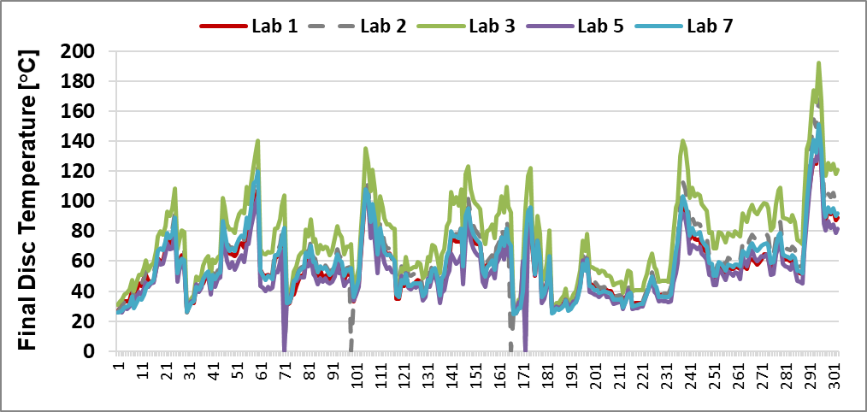
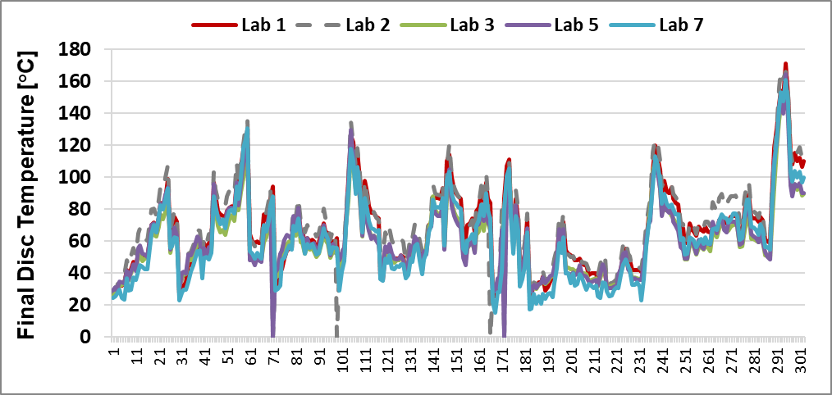
ACHIEVED MILESTONES
TEMPERATURE MEASUREMENT
DEFINITION OF THE PROBLEM – Brake temperature can be measured with embedded or/and sliding TC. The two methods do not provide the same level of accuracy. Round Robin data were used to evaluate the differences
Final disc temperature profile measured by sliding TCs over the 1st repetition of T1 for 5 different labs
Final disc temperature profile measured by embedded TCs over the 1st repetition of T1 for 5 different labs
Disc temperature measurement and subsequent analysis shall be performed by means of embedded thermocouples. Recommendations on the correct installation and use of the TCs will be provided by TF1

Slide 21
ACHIEVED MILESTONES
SOAK TIMES
DEFINITION OF THE PROBLEM – Long soak times required for the brake to reach the starting temperature of each trip result in a substantial prolongation of the cycle. Additionally, long soak times might introduce artefacts in the PM measurement as air flow is applied in order to cool down the brakes faster
TU Ilmenau Data – TF2 | Cooling air speed: 50kph - mean temperature per section [°C] |  |  |  |  |  |  |  |  |  | mean (total) [°C] | time (total)
 | 1 | 2 | 3 | 4 | 5 | 6 | 7 | 8 | 9 | 10
w/o soak time | 57.8 | 74.1 | 67.2 | 66.7 | 61.8 | 59.0 | 39.5 | 75.9 | 44.1 | 61.5 | 62.5 | 4h24min
Init 35Grad | 55.6 | 67.4 | 56.2 | 63.3 | 58.6 | 30.4 | 34.7 | 53.5 | 30.3 | 61.8 | 57.7 | 5h09min
w soak time | 55.0 | 64.8 | 53.2 | 60.3 | 57.3 | 21.3 | 30.9 | 49.4 | 24.3 | 60.7 | 55.7 | 41h24min
It has been shown that the application of 35-40°C as initial test temperature does not affect the brake temperature significantly. It is recommended to adjust the soak time of the cycle to the temperature of 40°C when conducting emissions tests. This will significantly reduce testing time

Slide 22
METHOD FOR MEASURING BRAKE WEAR PARTICLES
OPEN ITEMS – ON-GOING/FUTURE ACTIVITIES
1. Particle background concentration: Definition of the problem – Background concentrations higher than ~100 #/cm³ can lead to overestimation of PN emissions at some parts of the cycle. Background contribution increases with increasing tunnel flow. Minimum requirements for the background concentration should be set
2. Brake enclosure: Definition of the problem – The geometry of the brake enclosure highly affects the transport efficiency of the sampling system. It is recommended to define at least some basic design guidelines and technical requirements for the brake enclosure in order to minimize particle losses
3. PM & PN measurement: Definition of the problem(s) – Lack of detailed specifications for PM measurement (i.e. cyclone, filter media and required efficiency, detailed weighting protocol, etc.) and PN measurement (i.e. solid vs total PN concentration, calibration procedure, volatile background, etc.). Round robin validation exercise and possible adjustments will be required once the methods are accurately defined

Slide 23
TYRE WEAR PARTICLE EMISSIONS
CURRENT STATUS AND FUTURE OUTLOOK
No experimental results were presented to the 50th and the 51st PMP Meeting. Results from two on-going campaigns had been presented to the 48th PMP Meeting
Research interest as well as updated results on tyre wear emissions will come up with the initiation of the funded H2020 LC-MG-1-14-2020 call
The EC has mandated the development of a methodology for measuring tyres abrasion rate. ETRMA has presented its proposal to the COM. The proposal will become available from ETRMA after some adjustments that will take place in the next months. It is expected to be presented to the next PMP Meeting
After the development of the methodology the PMP is willing to investigate the relationship between tyre wear PM emissions and their abrasion rate

Slide 24
Changes to PMP mandate?

Slide 25
Requests from contracting Parties
Request from RDE IWG: Extension of the scope of the PMP IWG to PEMS-PN (10 nm)
EC & UK:
  Non-exhaust emissions (brake wear): Extension of the mandate of the PMP IWG to include the development of a methodology that can be used for regulatory purpose

Slide 26
Any questions?
You can find me at giorgio.martini@ec.europa.eu

