Slide 1
IWG ASEP
Revision of ASEP
Transmitted by the Chair of IWG ASEP
Informal document GRBP-71-24
(71st GRBP, January 28-31, 2020,
agenda item 3.)
Future Concept of Real Driving – ASEP
Based on a Statistical Sound Expectation Model
GRBP 71 – January 2020

Slide 2
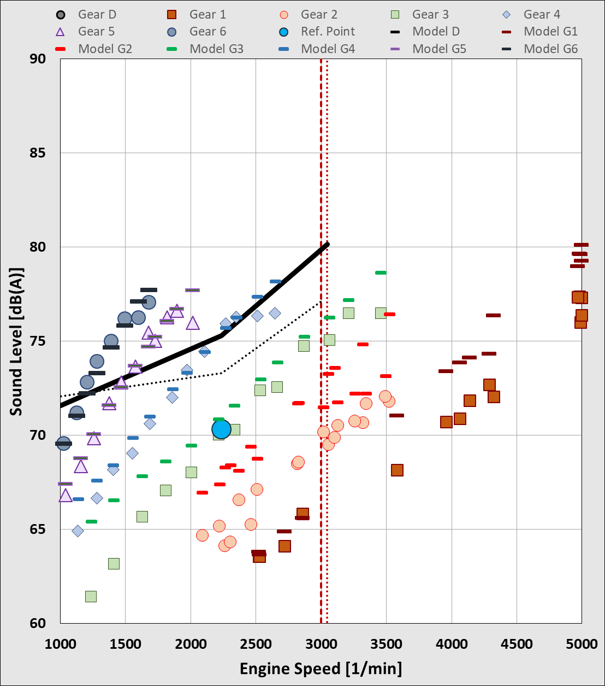
Current ASEP Concept Implemented in UN R51.03
Example for ASEP according UN R51.03
The current concept for Additional Sound Emission Provisions (ASEP) was developed in the years 2005 to 2010.
At that time the focus was on existing technologies with the aim to cover higher engine speeds and loads compared to the test method of Annex 3 (see TRANS/WP.29/GRB40 page 11: ToR for IWG ASEP).
The scope, but as well restrictions in data acquisition, testing and assessment capabilities limited the application of ASEP to full load test conditions at low gears, up to the lower type approval gear of Annex 3.
The actual ASEP
cannot assess
higher gears

Slide 3
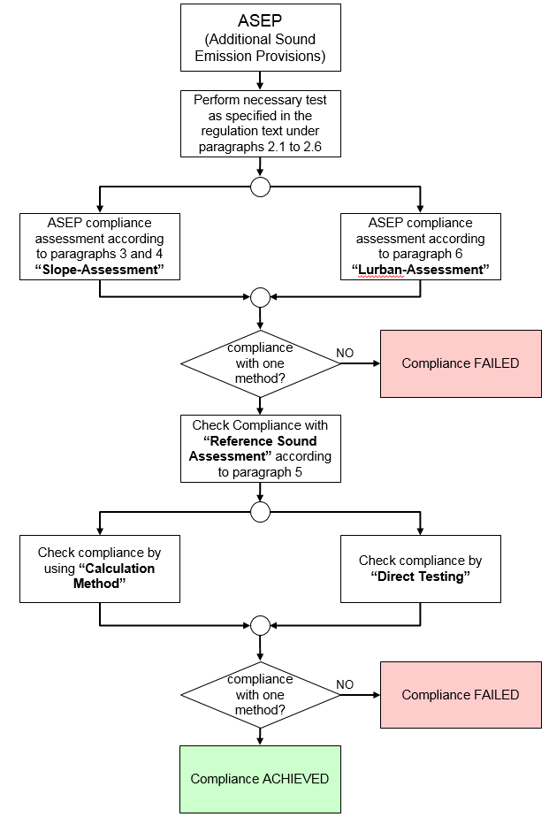
Current ASEP Concept Implemented in UN R51.03
The current ASEP concepts consists of several modules.
For compliance, the manufacturer can select from each block (B1 and B2) one way of compliance.
The requirements of Block B2 are design restrictive especially for products that are designed to meet ultimate emission standards.
The manufacturer is not obliged to carry out these tests, but will have to provide a statement of compliance.
The current ASEP concept is complicated, time consuming and non-transparent.
B1
B2
ASEP Flowchart, UN R51.03 Supplement 2

Slide 4
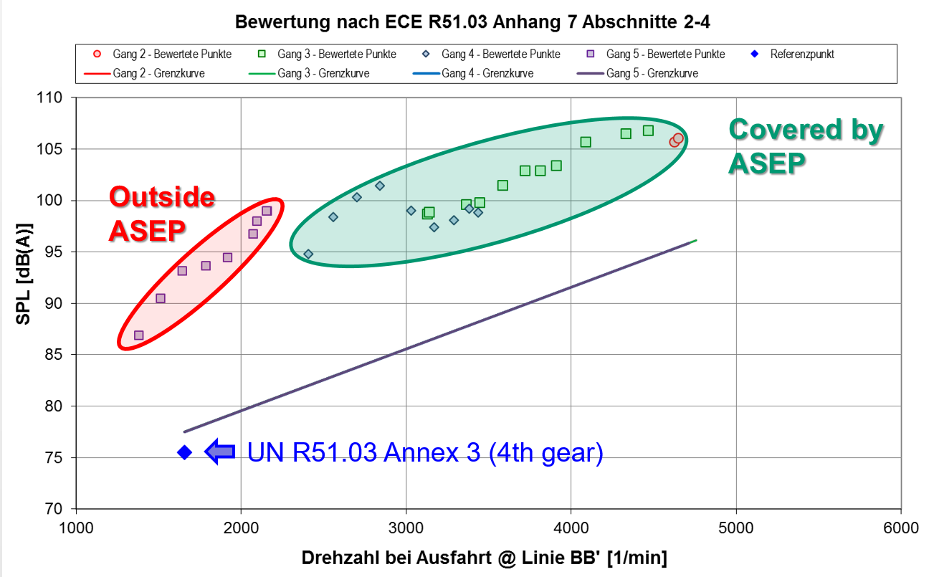
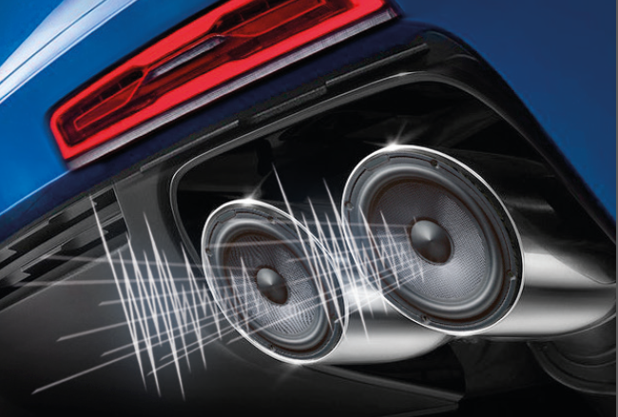
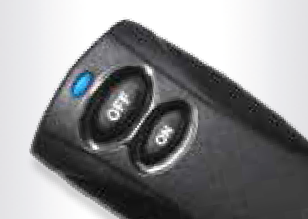
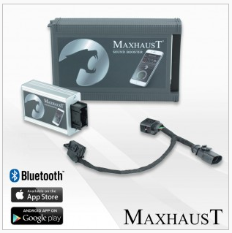
Current ASEP Concept Implemented in UN R51.03
Progress in technology made it necessary to reconsider the ASEP concept and to extend the its application range.
Practical experience shows, that vehicles are rarely driven in real traffic under the ASEP test conditions.
Relevant and frequently used operation conditions are not covered by the current ASEP.
New technologies make it possible to design sound independent from operation condition.
The testing range shall be expanded to overcome the gap in the regulation.

Slide 5
Real Driving ASEP (RD-ASEP) - Expectations
Contracting Parties
Automotive Industry
Improve efficiency of ASEP
ASEP be mandatory during Type Approval
Broaden the boundary conditions
  Any gear be tested
  Speed range 0 km/h to 100 km/h
  Up to 80% rated engine speed
Simplify ASEP
Reduce work load
Safe qualification about ASEP compliance, especially with “normal” products
ASEP shall follow physical principles
Extended tolerances for extreme driving situations
It is a challenge find a test concept, that is capable to integrate all these aspects.

Slide 6
ASEP Test Burden of UN R51.03
Estimated Work Load for Testing Annex 3 and Annex 7
Annex 3 tests are typically performed within 30 min without considering the vehicle preparation. Today’s ASEP tests require easily up to 2 hours. The driving distance can be more than 10 km.
An extended ASEP with a broadened control range at any gear and mode can end in more than a day testing at more than a 100 km/h. This is unrealistic for Conformity of Production (CoP) tests.

Slide 7
RD- ASEP Concept Based on a Physical Expectation Model
The compromise between all expectations will be feasible, when tests are selected randomly and a direct compliance assessment per run is available.
Some elements of the today’s ASEP assessment can be used for this approach:
Physical Behavior
(Origin: „Slope Method“)
Direct assessment based on a physical expectation model, referenced to the type approval result of Annex 3
Direct Assessment
(Origin: „L_{urban} Method“)
Based on Annex 3 Results
(Origin: „Slope & L_{urban} Method“)
Engine Speed Based
(Origin: „Slope Method“)
Find a Solution for BEV, HEV, which might fall under RD-ASEP, if they are equipped with sound enhancement systems exceeding the application range on UN R138.01

Slide 8
Sound Prediction Model - Basic Considerations
Tyre
The two elements together create the “physical” base model for a behavior of any internal combustion engine vehicle.
These two models will form the minimum sound emission of a vehicle.
This sound emission is given by physics and qualified / justified by the type approval test according to Annex 3 which is subject to the applicable limit values.
1
Base Mechanics
2
Dynamic
The dynamic model covers all sound behavior, that is linked to acceleration (performance) conditions
It covers tyre torque effects, powertrain dynamics and gas flow dynamics.
3

Slide 9
Introduction to the Principles of the Sound Model
1
Tyre Rolling Sound Modelling

Slide 10
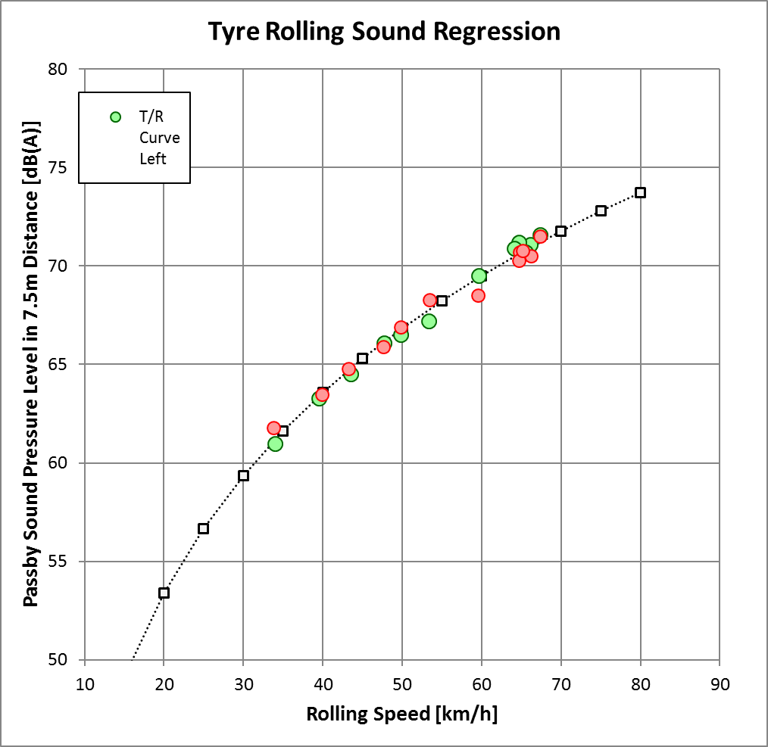
1
Tyre Rolling Sound - Modelling
Tyre rolling sound can be described with good accuracy by a logarithmic regression.
Tyres may as well have smaller resonances, but the typical deviation from the regression is rather small.
Typical regression qualities are R² > 0.98
L_tyre = Slope * LOG(v/50) + L@50

Slide 11
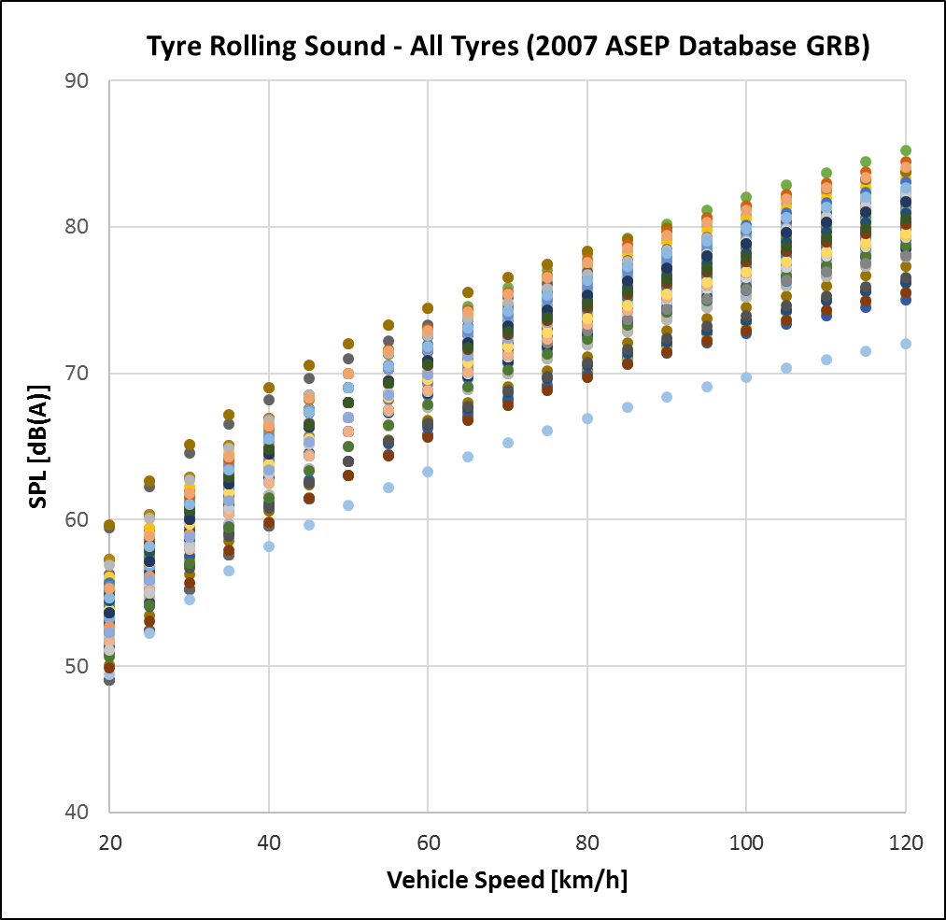
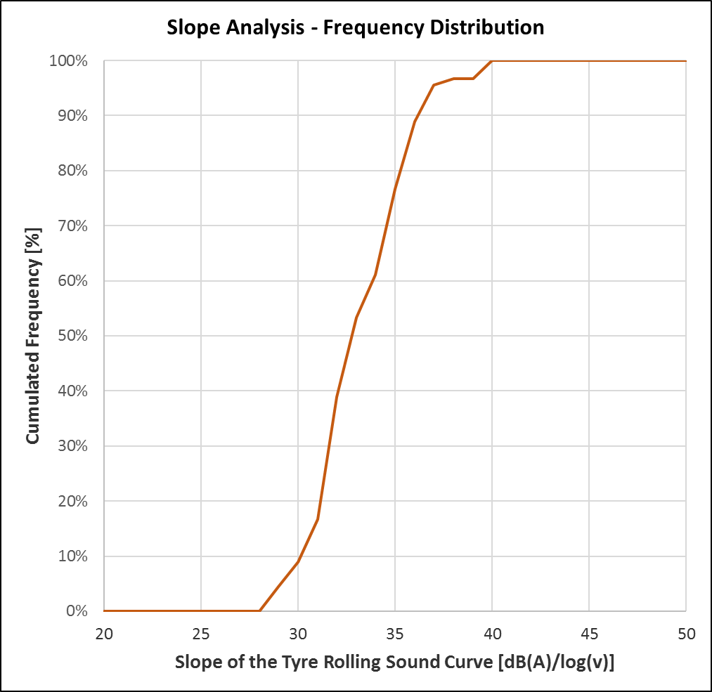
1
Tyre Rolling Sound
A vehicle manufacturer can only select tyres with an approval according UN R117. Any sound behavior of an approved tyre shall be acceptable.
The model will select a minimum and a maximum slope, dependent of the driving speed.
max.
slope
Analysis of 90 set of tyres measured for the 2007 ASEP Database
min.
slope

Slide 12
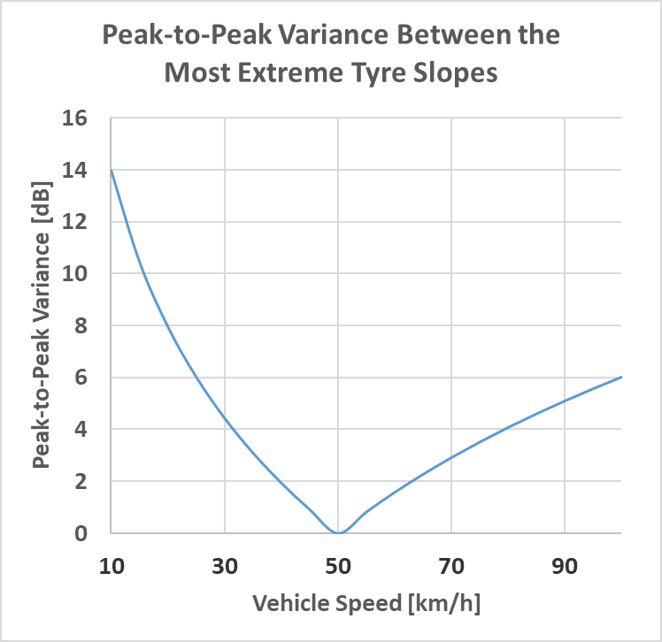
1
Tyre Rolling Sound
Different Rolling Sound Curves
-
Reference to 50 km/h
The model needs to consider a sufficient spread of technologies.
Therefore, two slopes are introduced
  a lower slope at speeds below 50 km/h, and
  a higher slope at speeds above 50 km/h
With these two slopes, variations in tyre technology are covered.
➔ THIS CONCEPT OF TWO SLOPES IS USED NOT ONLY FOR THE TYRE MODEL; BUT FOR ALL FOLLOWING MODELS AS WELL.
80
75
70
max. slope
SPL [dB(A)]
65
min. slope
60
55
50
0
20
40
60
80
100
120
Vehicle Speed [km/h]

Slide 13
1
The “Prediction Model” for the Tyre Rolling Sound
The mathematical function is:
L_{TR,NL} = slope_{TR} * LOG₁₀( v_{test} / 50 ) + L_{REF,TR}
There will be a slope_{TR,min} for test speeds below 50 km/h and a slope_{TR,max} for speeds above 50 km/h.
The differentiation accounts for the unknown behaviour of the tyre rolling sound.
The L_{REF,TR} is a fraction of the steady speed test result of Annex 3 L_{CRS,i}.
L_{REF,TR} = 10 * LOG₁₀(x%*10^{(Lcrs,i/10)} )
How much percent (x%) of the steady speed result is used, needs further investigation and might be defined differently for the vehicle categories.
The tyre rolling sound’s load dependency is covered under the dynamic model .
3

Slide 14
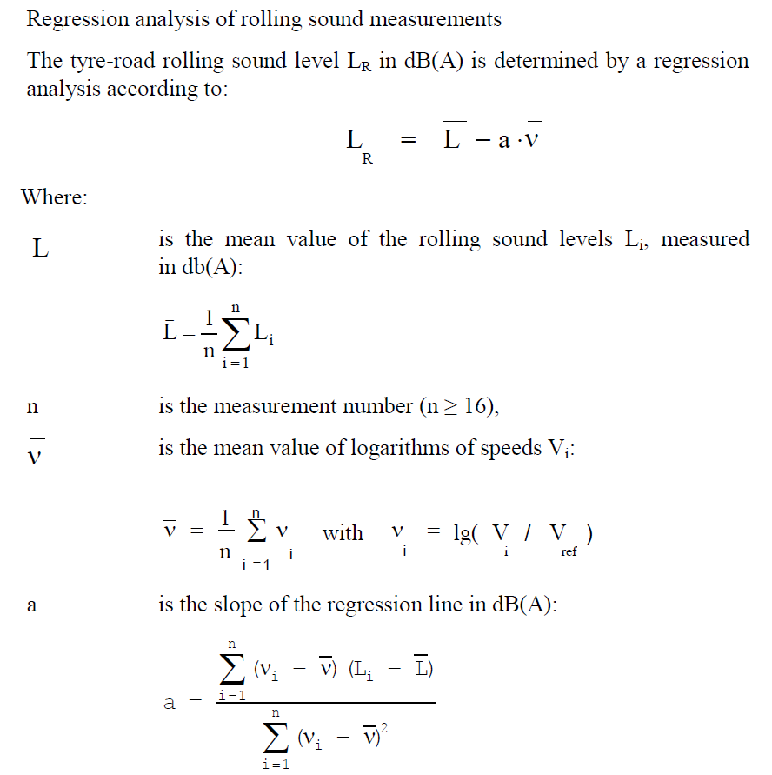
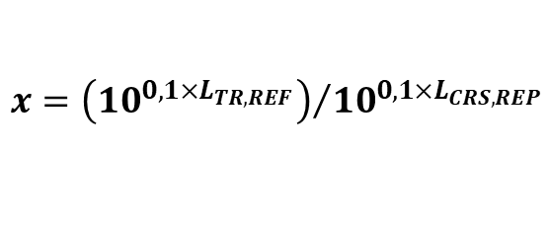
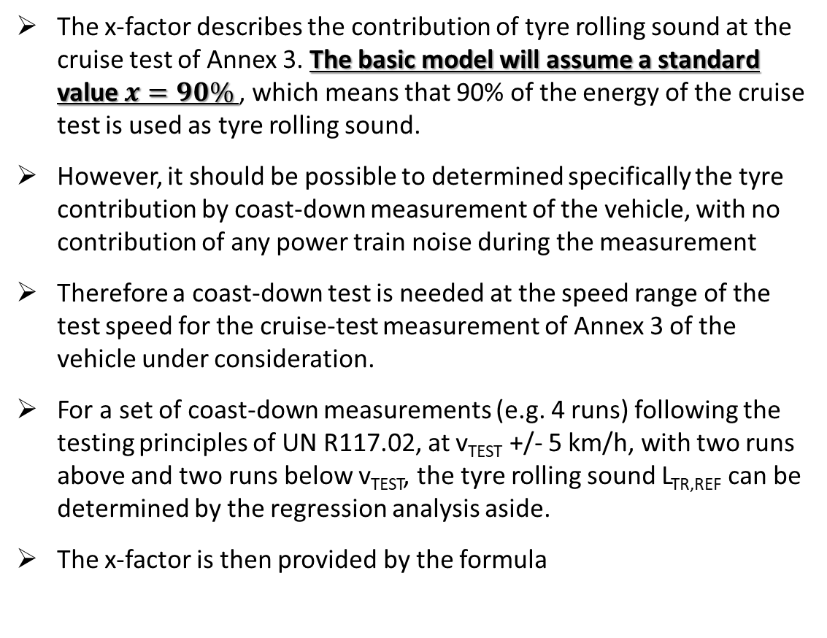
1
Tyre Rolling Sound – Determination of the Tyre Share (x-factor)
The x-factor describes the contribution of tyre rolling sound at the cruise test of Annex 3. The basic model will assume a standard value $x=90\%$, which means that 90% of the energy of the cruise test is used as tyre rolling sound.
However, it should be possible to determined specifically the tyre contribution by coast-down measurement of the vehicle, with no contribution of any power train noise during the measurement
Therefore a coast-down test is needed at the speed range of the test speed for the cruise-test measurement of Annex 3 of the vehicle under consideration.
For a set of coast-down measurements (e.g. 4 runs) following the testing principles of UN R117.02, at v_{TEST} +/- 5 km/h, with two runs above and two runs below v_{TEST}, the tyre rolling sound L_{TR,REF} can be determined by the regression analysis aside.
The x-factor is then provided by the formula
Assessment procedure of UN R117.02
$$x={\left({10}^{{0,1×L}_{TR,REF}}\right)}/{{10}^{{0,1×L}_{CRS,REP}}}$$

Slide 15
Introduction to the Principles of the Sound Model
2
Power Train Base Sound
Modelling

Slide 16
2
The Base Mechanic Model for the Power Train
The power train sound behavior appears on a first look as a linear function.
However, the regression calculation shows, that a shifted logarithm provides best accuracy.
Based on stationary run-up, where no power train dynamic and no tyre rolling sound contributes to the measurement,
a minimum slope and a maximum slope can be determined to define a range of standard power train behavior.
The model for the power train base mechanic follows the same principle as for the tyre rolling sound.
R² = 0,9609
R² = 0,987
Analysis of the slope variation for the powertrain is made on approx. 12 dataset

Slide 17
2
The “Prediction Model” for the Power Train (No Load)
The mathematical function is:
L_{PT,NL} = slope_{PT,NL} * LOG₁₀( n_{test} + n_{shift} ) / (n_{wot,ref} + n_{shift} )) + L_{REF,NL}
A slope_{PT,min} for test engine speeds below n_{BB’,REF} and a slope_{PT,max} for speeds above n_{BB’,REF} is introduced.
The differentiation accounts for the unknown behaviour of the power train.
An engine speed shift component n_{shift} is introduced for an optimized curve fitting for the power train model
The parameter L_{REF,NL} is the remaining part of the steady speed test of Annex 3 L_{CRS,i} that was not used in the tyre model before.
L_{REF,NL} = 10*LOG((100%-X%)*10^{(LCRS,i/10)})
The load dependency of the power train base mechanic will be covered under the dynamic model .
3

Slide 18
Introduction to the Principles of the Sound Model
3
Power Train Dynamic
Modelling

Slide 19
3
The Dynamic Model
The dynamic model covers all additional energy generated under load, respectively acceleration:
  All gas flow components (intake and exhaust), no load and load
  Change of the power train mechanic sound with the load
  Tyre torque effects during acceleration
  Performance of the vehicle described by vehicle speed and acceleration

Slide 20
3
The Dynamic Model
The dynamic model consists engine speed dependent model, a no load basis and a dynamic component that is dependent on the load.
  a) A “no load” basis L_{DYN,NL}
  There must be a basis for the dynamic model, otherwise the dynamic would be undefined. One could chose the base mechanic model for simplicity, but practical experience suggests an individual approach with a separate “slope”.
b) A transient behavior between “no load” and “maximum load” ΔL_{DYN} that describes the sound dynamic between cruising and maximum performance.

Slide 21
3
The Dynamic Model
See next slide
See slide 23
The mathematical function is:
L_{DYN} = slope_{DYN,NL} * LOG₁₀( n_{test}+ n_{shift} )/(n_{wot,ref} + n_{shift} )) + L_{REF,DYN, NL} + ΔL_{DYN}
A slope_{DYN,min} for test engine speeds below n_{BB’,REF} and a slope_{DYN,max} for speeds above n_{BB’,REF} is introduced.
The differentiation accounts for the unknown behaviour of the power train.
An engine speed shift component n_{shift} is introduced for an optimized curve fitting for the dynamic model
n_{BB’,REF} = n_{BB’,WOT,i}

Slide 22
3
The Dynamic Model – The Reference L_{REF,DYN,NL} for Calculation
The “no load” condition of the dynamic model covers the gas flow under no load condition. Even under cruise condition, there is still a gas flow, but its sound output is typically very low.
The dynamic no load reference of the model is calculated by:
L_{REF,DYN,NL} = L_{PT,NL} - L_{DYN,NL}
By setting L_{DYN,NL} = 15 dB(A), the dynamic components do not contribute to the cruise test result L_{CRS,REP} .
For values lower than 15 dB(A), the dynamic component would contribute as well to cruise conditions and the model would have an increased uncertainty.
One could select value greater than 15 dB(A), but this would not change the model behavior. The reference would become lower and the dynamic would increase accordingly.

Slide 23
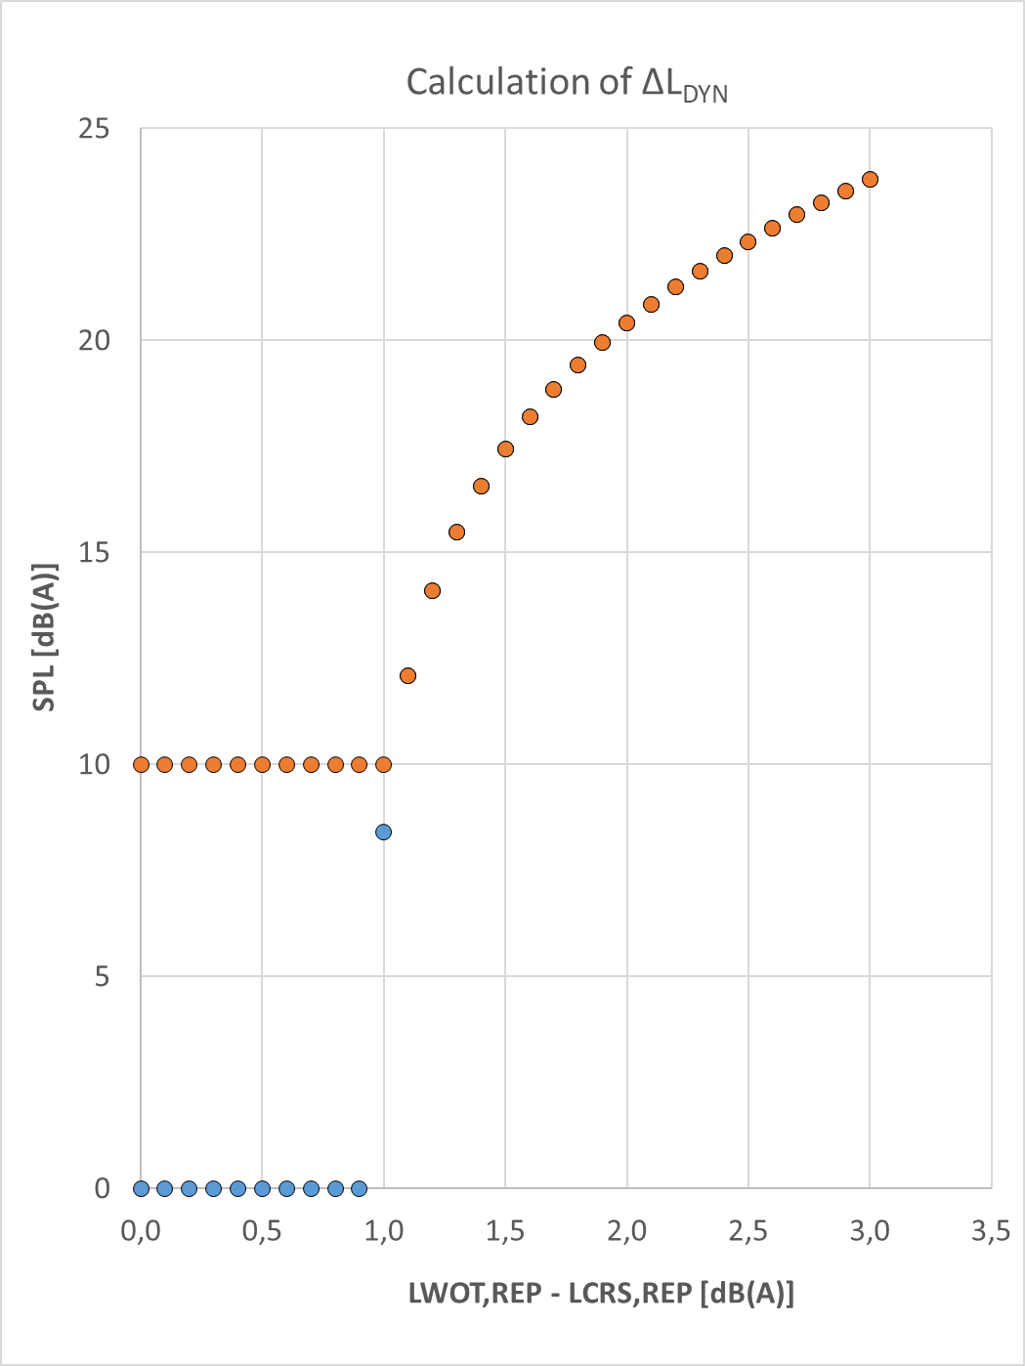
3
The Dynamic Model – The Dynamic Part ΔL_{DYN}
The Dynamic Part ΔL_{DYN} describes the variation of load and performance, between cruising (no load) and maximum acceleration (full load) at any engine speed condition.
The dynamic part ΔL_{DYN} is a combination of the dynamic load at the tpre approval condition ΔL_{DYN,BASIC} , plus an additional dynamic part ΔL_{DYN ,VA} for test conditions, where the performance is the vehicle exceeds the type approval performance.
ΔL_{DYN,BASIC} is set in this model to a constant value over engine speed.
This enables to calculate the dynamic L_{DYN,FL} from the type approval test results:
L_{DYN,FL} = [ Lwot,i – Lcrs,i ]
However, cruise and acceleration during type approval do not happen at the same speed and engine speed. By using the already existing model components L_{TR,NL} and L_{PT,NL}, one can adjust the cruise test results to match with the acceleration test condition:
ΔL_{DYN,BASIC} = [ Lwot,i – L_{TR,NL}(V_{BB’,WOT,i}) – L_{PT,NL}(N_{BB’,WOT,i}) ] – L_{REF,DYN,NL}
ΔL_{DYN} is set to a minimum dynamic of 10 dB(A) to avoid a collapse of the model, as in some cases the difference between L_{WOT,REP} and L_{CRS,REP} is very low.
This is the dynamic part under full load L_{DYN,FL}
at the type approval acceleration test condition

Slide 24
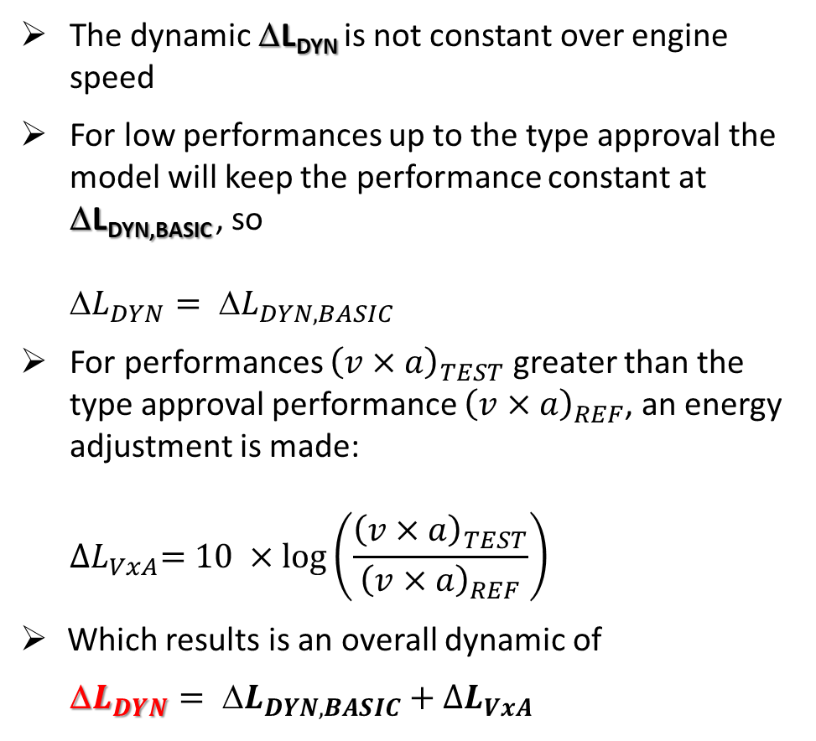

3
The Dynamic Model – The Dynamic Part ΔL_{DYN,VxA}
Performance Add-On by ${∆L}_{VxA}$
The dynamic ΔL_{DYN} is not constant over engine speed
  For low performances up to the type approval the model will keep the performance constant at ΔL_{DYN,BASIC} , so
  Δ$L_{DYN}= {L}_{DYN,BASIC}$
  For performances ${\left(v×a\right)}_{TEST}$ greater than the type approval performance ${\left(v×a\right)}_{REF}$, an energy adjustment is made:
    $${∆L}_{VxA}=10 ×\log\left(\frac{{\left(v×a\right)}_{TEST}}{{\left(v×a\right)}_{REF}}\right)$$
  Which results is an overall dynamic of
    Δ$L_{DYN}= {L}_{DYN,BASIC}+{∆L}_{VxA}$
This dynamic change potential between cruise and maximum load is now subject to the partial load model

Slide 25
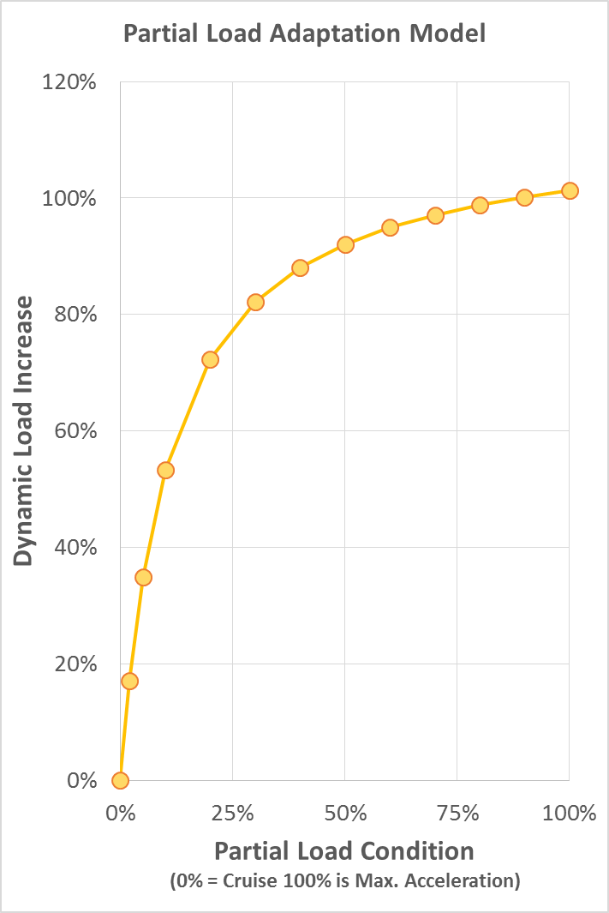
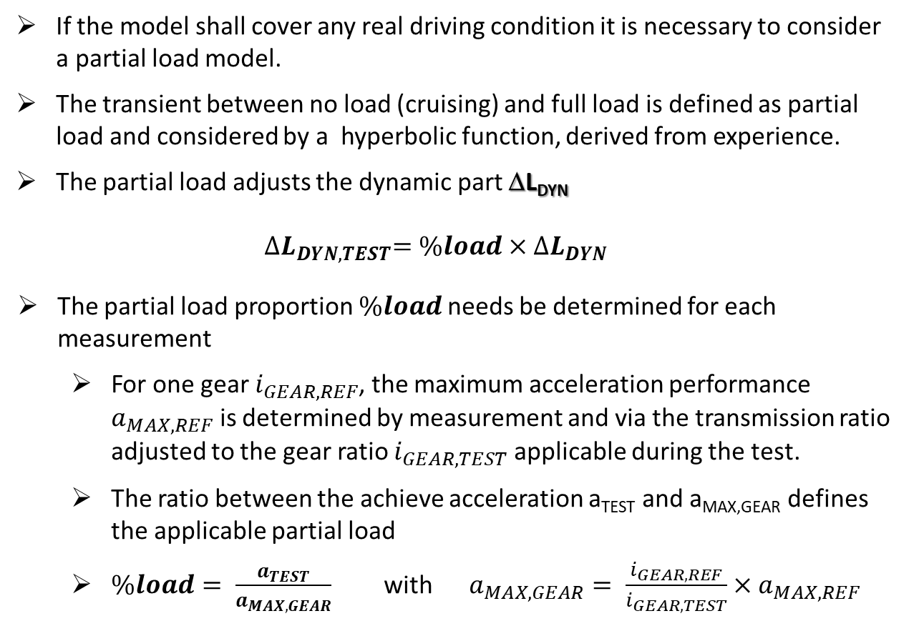
3
The Dynamic Model – The Partial Throttle Model
If the model shall cover any real driving condition it is necessary to consider a partial load model.
The transient between no load (cruising) and full load is defined as partial load and considered by a hyperbolic function, derived from experience.
The partial load adjusts the dynamic part ΔL_{DYN}
$${∆L}_{DYN,TEST}=\%load×{∆L}_{DYN}$$
The partial load proportion $\%load$needs be determined for each measurement
  For one gear $i_{GEAR,REF}$, the maximum acceleration performance $a_{MAX,REF}$ is determined by measurement and via the transmission ratio adjusted to the gear ratio $i_{GEAR,TEST}$ applicable during the test.
  The ratio between the achieve acceleration a_{TEST} and a_{MAX,GEAR} defines the applicable partial load
  $\%load= \frac{a_{TEST}}{a_{MAX,GEAR}}$ with $a_{MAX,GEAR}= \frac{i_{GEAR,REF}}{i_{GEAR,TEST}}×a_{MAX,REF}$
ΔL_{partial} = (1-0,111/(0,111+Load%/100)/(1-0,111)

Slide 26
Integration of all Modules
Before the ASEP evaluation, it is necessary to carry out the Annex 3 type approval test
  The parameter to be reported are: L_{wot} and L_{crs} from the lower or single gear, the acceleration (actually PP-BB), the vehicle speed v_{BB}, the engine speed n_{BB}.
  For the gear ratio, the maximum acceleration must be known to determine the load condition.
The expectation level is then calculated inclusive a general tolerance for the model accuracy
L_{EXP} = 10 * LOG (10^{0,1*LTR,NL} + 10^{0,1*LPT,NL} + 10^{0,1*(LDYN,NL + ΔLDYN}) + 2 dB(A)
Compliance is achieved when
L_{TEST} (v_{TEST}, a_{TEST}, n_{TEST}) < L_{EXP} (v_{TEST}, a_{TEST}, n_{TEST})

Slide 27
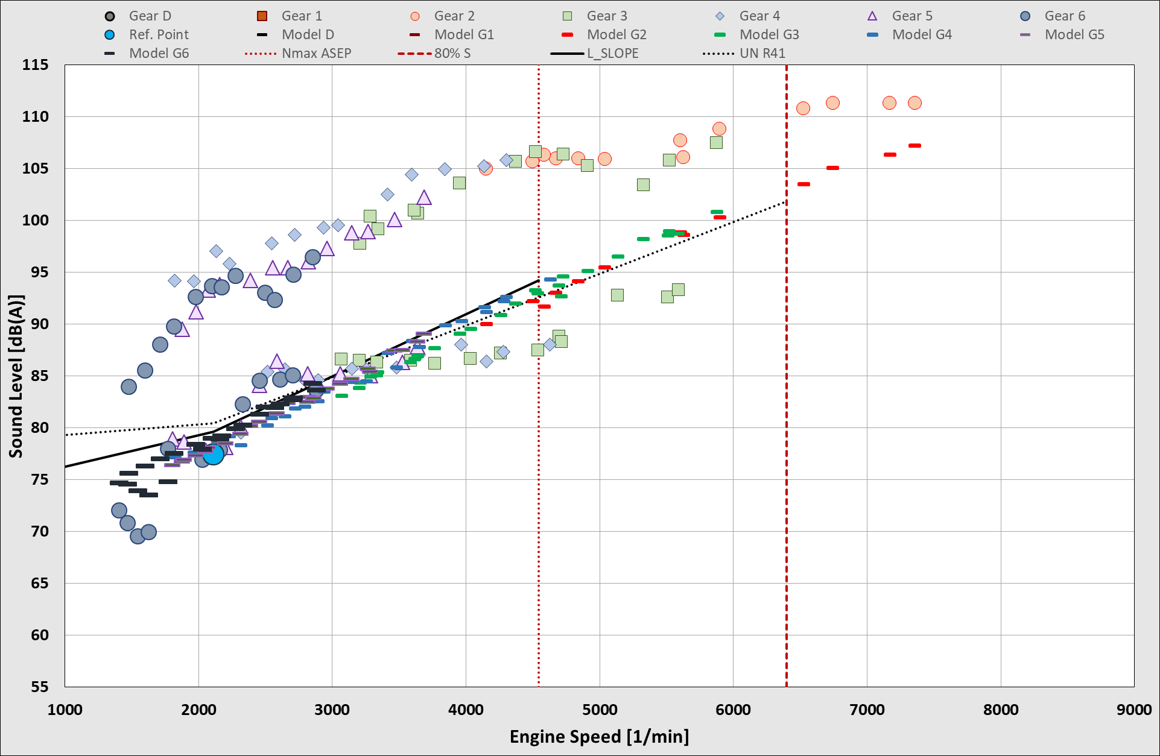
Expected Physical Sound Behavior
The model considers a range of physically “normal” behaviors.
If a vehicle has a sound behavior within the expectation range, the model will describe the vehicle very ell.
Vehicles with a sound behaviour outside the expected range are not compatible to the model.
If a vehicle is louder than expected by the model, it will fail the test.
Vehicle No. 47
of the IWG ASEP Database

Slide 28
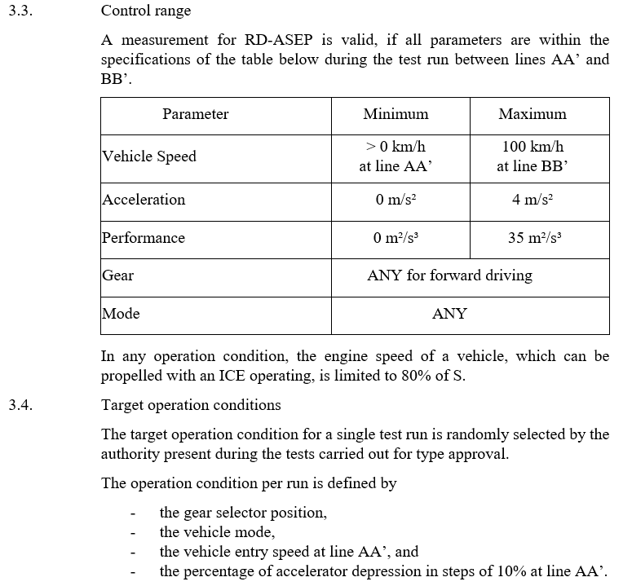
Control Range
The model works in a wide range of vehicle operation condition.
However, it must be noted, that the model extrapolates from one single type approval condition to any potential operation condition of the vehicle.
  Thus, the more the operation condition deviates from the type approval condition, the bigger the uncertainty becomes. Therefore the control range must be limited.
  In addition, todays test tracks are limited in their capability to perform any tests.
  Not only high vehicle speed create an issue, as well partial load requires a long approach path to enable the requested operation condition.
Therefore the RD-ASEP provide a control range, which is a compromise between necessary completeness and practicability.
IWG-ASEP-14 Draft UN R51.04 ASEP

Slide 29
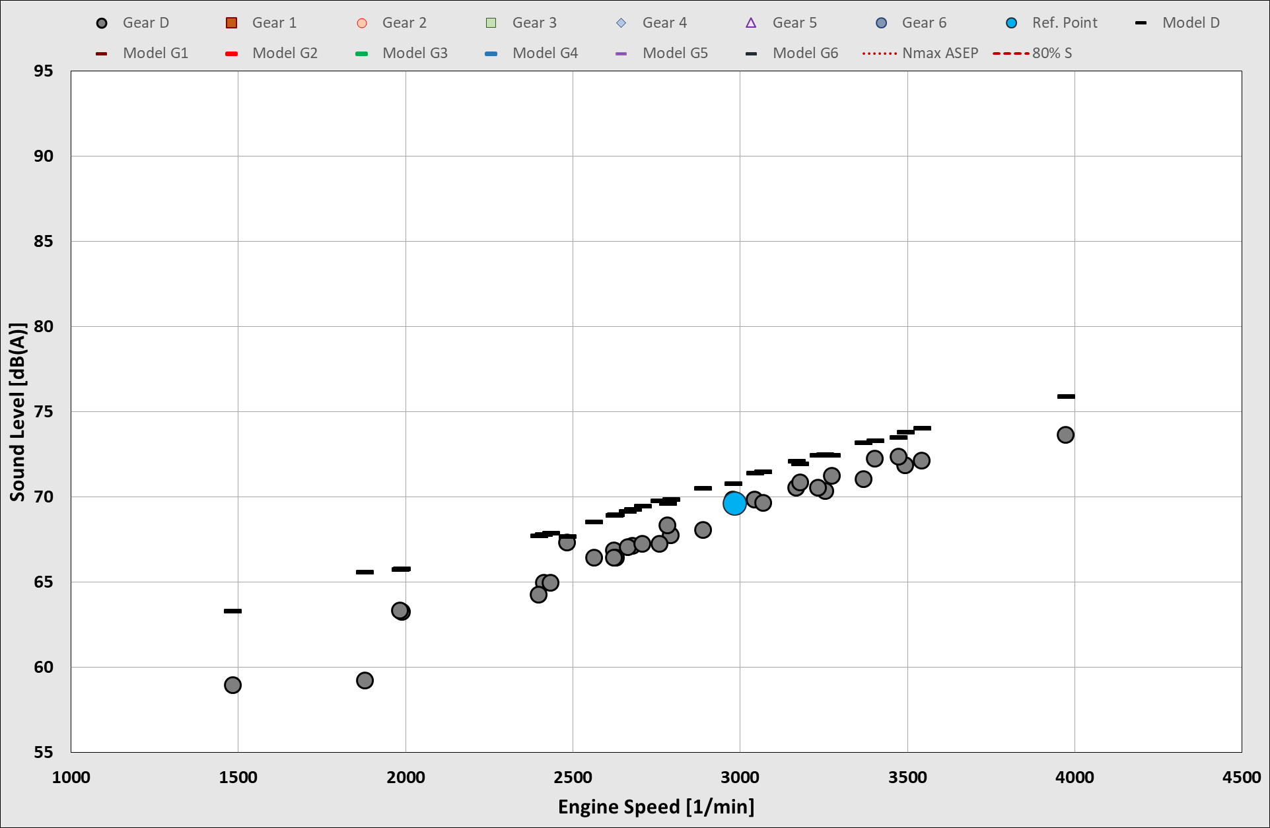
Special Cases – Electric Vehicles
The sound model is made for combustion engines and is therefore based on engine speed.
Electric vehicles do not provide a meaningful engine speed, however EVs have only one gear.
Thus the engine speed and the vehicle speed have a fixed correlation.
By chosing a fixed gear ratio, the model can be applied to full electric vehicles as well.
Vehicle No. 24 of the IWG ASEP Database
(remark: full model applied, inclusive PT meachanics and load dynamics)

Slide 30
Work Forecast
Determination of tyre/rolling sound component (x-factor) by direct measurement
  Determine test procedure and check feasibility for products
Validation of the partial load model, especially in the low load area.
  Validation still pending, in lack of sufficient data
Assessment of hybrid vehicles that have been testing in Annex 3 partly in electric mode.
  Assign an engine speed to the Annex 3 tests.
  Add powertrain components based statistics
Vehicles that have been driven under partial load in Annex 3 according to supplement 4 and supplement 5 to UN R51.03
Vehicle with PMR < 25 do not provide a cruise test result in Annex 3
  Consider direct measurement or simulation
Fine tuning of the model parameters and elaboration of a parameter table

