Slide 1
R41 ASEP Revision
Transmitted by the experts from IMMA Informal document GRBP-71-19-Rev.1
(71st GRBP, 28-31 January 2020,
agenda item 2)
GRBP-71-19r1 2020-01-28

Slide 2
History:
Starting point for the R51 revision:
GRB-64-16 (FR) with the result of a questionnaire to CP’s, NGO’s and manufacturers about ASEP in R51 & R41.
Conclusion (slide 15):
Lot of comments on ASEP for ECE51.03. Further work is needed.
Only few comments and questions on ASEP for ECE41.04. It seems that no need for further work
Starting point for the R41 revision:
GRB-67-03 (DE) “Problems with noise emissions from L-cat”
Identified areas of concern:
NORESS
“Grey Areas” (=flaps) in UNECE
IWG ASEP established for R51 revision
IMMA started working on a revised R41 ASEP test procedure, independently from IWG ASEP

Slide 3
Revision Focus: Real Driving
Test range expanded
Grey areas covered = aggressive exhaust flap controls avoided
Covers any acceleration, in any mode
Mandatory for Type Approval

Slide 4
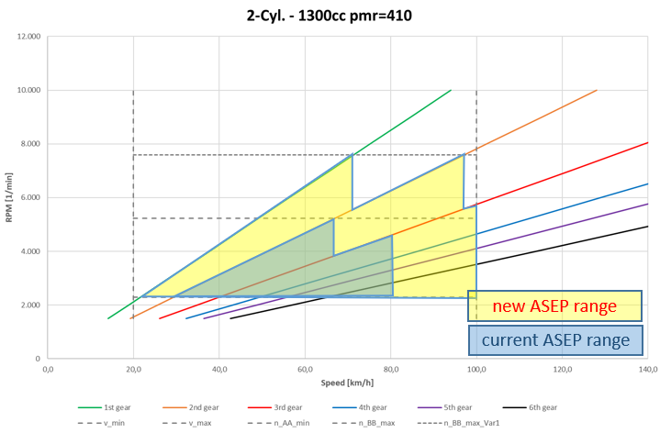
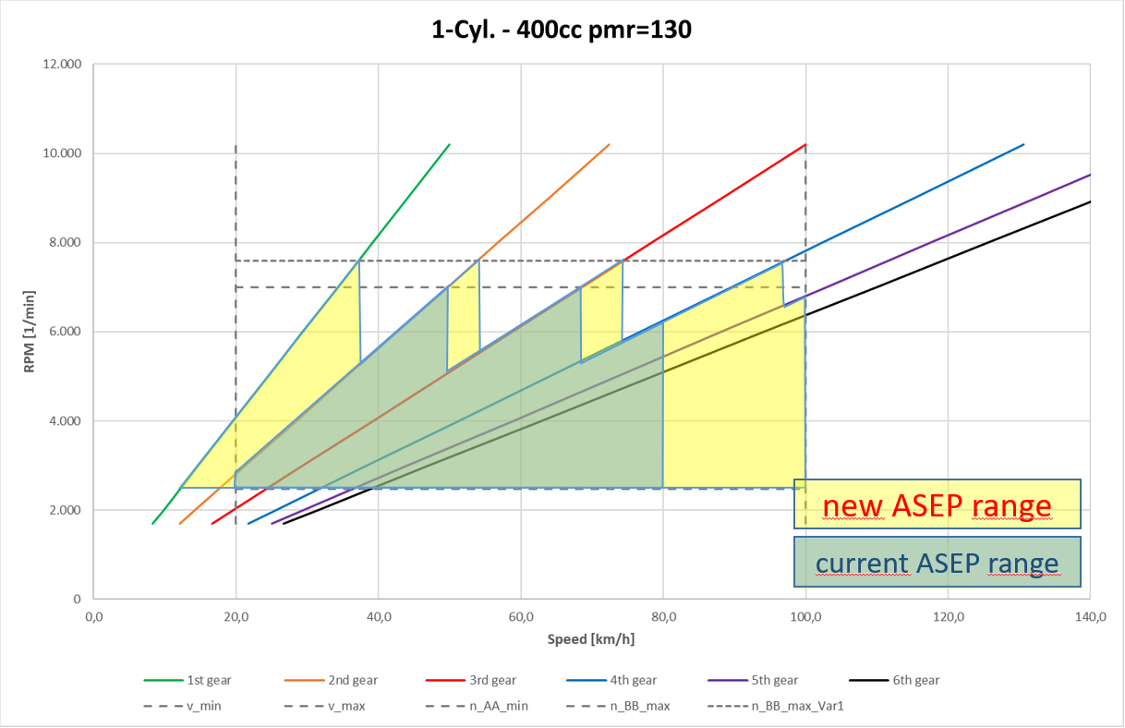
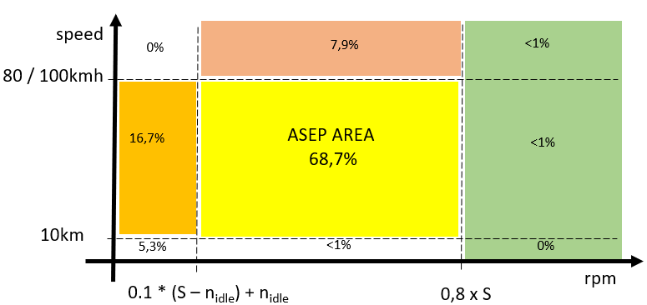
Expanded ASEP test range:
New ASEP engine map coverage
New ASEP real world coverage (%time)
Highway speeds
New ASEP: any throttle
Low rpm
R41/04: only WOT
ASEP’s enlarged rpm & speed range increases the engine map coverage
ASEP test range covers ~69% of real world conditions. Remaining conditions are in non-critical areas: low rpm, highway speeds
With the expanded test range,
ASEP now has have major coverage of conditions possible in real driving

Slide 5
ASEP comparison:
 | R41/04 | R41 new ASEP proposal | R51 new ASEP proposal
Speed range | 20 – 80 km/h | 10 – 100km/h (for PMR ≥ 150) | 0 – 100km/h
Max rpm | 3.4 * PMR^{-0.33} * (S – n_{idle}) +n_{idle} | 0,8 x S (= increased) | 0,8 x S (= increased)
Gears tested | Fixed gear (not including 1st) | Any gear (including 1st) | Any gear (including 1st)
Throttle operation (between AA’ & BB’) | WOT only | Any constant throttle | Any constant throttle
Approach (pre AA’) | Constant speed | Any approach (constant speed, acceleration, deceleration) | Constant speed
Applicability | All (PMR>50) | All (PMR>50) | Vehicles with flap systems or sound generators
ASEP limits | Established for R41/04 based on fleet data | Established for R41/04 based on fleet data | ASEP sound expectation model
Alignment
IMMA’s approach for ASEP revision: Expand current test range
= straightforward & ready for implementation

Slide 6
Current R41 ASEP WOT Test:
L_{max}
WOT Only
100
v_{max} @ BB‘
[%], [km/h]
throttle operation
speed / rpm
n_{PP‘}
v_{test}
+/- 1 kph
approach AA‘ at constant speed
0
AA‘
PP‘
BB‘
„constant speed“ approach
measurement area

Slide 7
Proposal for a Revised R41 ASEP (example 1):
100
L_{max}
[%], [km/h]
Any constant throttle
throttle operation
speed / rpm
v_{max} @ BB‘
n_{PP‘}
approach AA‘ at variable speed
v_{test}
+/- [ 5 ] km/h
0
AA‘
PP‘
BB‘
pre-measurement area
measurement area
„real driving“

Slide 8
Proposal for a Revised R41 ASEP (example 2):
L_{max}
throttle operation
speed / rpm
Any constant throttle
(could also be WOT)
100
v_{max} @ BB‘
[%], [km/h]
n_{PP‘}
v_{test}
+/- [ 5 ] km/h
approach AA‘ at variable speed
0
AA‘
PP‘
BB‘
pre-measurement area
measurement area
„real driving“

Slide 9
IWG ASEP different approach for R51:
IMMA is aware that the R51 proposal is introducing a new approach based on a sound expectation model.
IMMA’s preliminary investigation of this (car-based) model reveals that substantial modifications are necessary for the model to be suitable for motorcycles.
To cover for the motor-cycle specific characteristics (less tyre noise but more mechanical noise due to exposed engine, shorter and exposed exhaust, chain drive, different transmission & clutch, …),
at least following items need adjusting:
Tyre noise calculation,
Mechanical no load,
Partial load transient functions (e.g. form factor α)
Dynamic load slopes,
Performance factor v x a,
Motorcycle (R41) specific formulas needed for Awotref, Aurban, Nmax, …
The R51 model approach in its current from is not suitable for motorcycles.
IMMA requests adequate time to investigate the necessary adjustments for potential future application on motorcycles.
Until that time, implementing IMMA’s ASEP proposal as a 1st step will already solve the existing ‘grey zones’ in current R41 ASEP test procedure.

Slide 10
Thank you.

