Slide 1
UNECE GRPE Informal Group on Environmental and Propulsion Performance Requirements of L-cat Vehicles (EPPR L-cat)
State of Play
Informal document GRPE-79-24e
79th GRPE, 21-24 May 2019
Agenda item 8(b)
Adolfo Perujo (IWG chairman)

Slide 2
EPPR meetings in 2019
• 08-09 Jan 2019: EPPR 26th (GRPE Geneva summary; GTR2 & OBD2)
• 19-22 Feb 2019: EPPR 27th (JRC Ispra; GTR2 & OBD2)
• 26-29 Mar 2019: EPPR 28th (Geneva; GTR2 & OBD2)
• 22-23 May 2019: EPPR 29th (Geneva; GTR2 & OBD2)
Web conferences
NEXT F-2-F MEETING: EPPR 30th 15–18 October 2019 (Location: CARB- tbc)

Slide 3
Amendment 4 to UN GTR 2
Renewed mandate to the IWG EPPR L-cat (45th session)
  AC.3 adopted ECE/TRANS/WP.29/2015/113 (ECE/TRANS/WP.29/AC.3/36/Rev.1)
  Mandate was extended for the period 2016 - 2020
Mandate:
  harmonized test procedures^{(§)} for two-wheeled vehicles equipped with conventional combustion engine technology but the objectives also includes three-wheeled vehicles and other propulsion types in the next stage of work.
  the scope of discussions does not cover light four-wheeled vehicles on emission related GTRs
^{(§)}to establish amendments to UN Global Technical Regulation (UN GTR) No. 2 (Worldwide harmonized Motorcycle emissions Certification/test procedure (WMTC)) with respect to Environmental and Propulsion unit Performance Requirements (EPPR),

Slide 4
Amendment 4 to UN GTR 2
Mandate (cont.):
  the IWG will continue to first develop requirements for 2-wheeled vehicles with conventional combustion engine technology.
  Progressively other vehicles categories and other propulsion unit types will be considered to be included.

Slide 5
Amendment 4 to UN GTR 2
Status:
  The IWG has issued Informal Documents (draft text) indicating the progress toward issuing an amended GTR2
  The IWG has issued a working document (formal text) containing the Amendment 4 to UN GTR No. 2^{(*)} for consideration at the following session of GRPE (May 2019) (ECE/TRANS/WP.29/GRPE/2019/12)
  http://www.unece.org/fileadmin/DAM/trans/doc/2019/wp29grpe/ECE-TRANS-WP29-GRPE-2019-12e.pdf
  Informal document GRPE–79-21e: Consolidated version with the editorial corrections and the inclusion of the Statement of technical rationale and justification
  Informal document GRPE-79-22: Technical report on the development of Amendment 4 to global technical regulation No. 2
    (*) on the measurement procedure for two-wheeled motor cycles equipped with a positive or compression ignition engine with regard to the emissions of gaseous pollutants, CO₂ emissions and fuel consumption.

Slide 6
Amendment 4 to UN GTR 2
Purpose:
  entire revision of GTR No 2 to dedicate separate sections to test types I (tailpipe emission after cold start), II (idle / free acceleration emissions) and VII (energy efficiency)
  update the GTR for technical progress.
  text as closed as possible to EURO 5^{(*,+)} (based text provided by the European Commission - EPPR-11-15^{(§)} )
^{(*)} Reg.(EU) No.168/2013 of the European Parliament and of the council of 15 January 2013 on the approval and market surveillance of two- or three-wheel vehicles and quadricycles.
⁽⁺⁾COMMISSION DELEGATED REGULATION (EU) No 134/2014 of 16 December 2013 supplementing Regulation (EU) No 168/2013 of the European Parliament and of the Council with regard to environmental and propulsion unit performance requirements and amending Annex V thereof.
^{(§)} https://wiki.unece.org/download/attachments/25267103/EPPR-11-15-Rev1e.doc?api=v2

Slide 7
Amendment 4 to UN GTR 2 - Scope
Two-wheeled motor vehicles equipped with a propulsion unit in accordance with the following table:
The EPPR IWG may add other vehicle types in a second stage

Slide 8
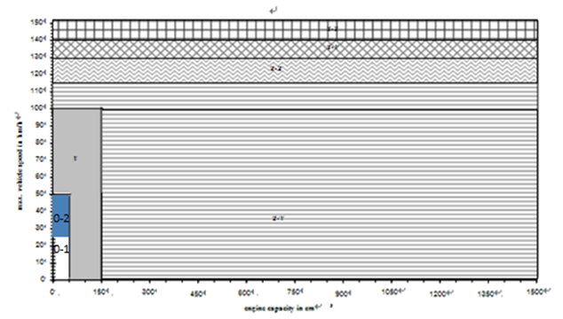
Amendment 4 to UN GTR 2
Vehicle categories for environmental testing
Some CPs were having concerns for implementing Class 0 vehicle in domestic regulation due to different maximum speed. Hence it was decided to leave the details of Class 0 vehicles as Contracting Party option
Vehicle sub-classification for environmental testing, test types I and VII

Slide 9
Amendment 4 to UN GTR 2
Performance Requirements:
Due to the disparity of level of stringencies present in different regions of the world, it was decided to define performance requirements at two levels:
  Principal performance requirements (or the most stringent ones for two-wheeled motorcycles)GTR 2 is largely harmonised with Reg. (EU) 168/2013 (EURO 5)
  Alternative performance requirements (or less stringent) and corresponding to performances already in application in some Contracting Parties.

Slide 10
Amendment 4 to UN GTR 2
Reference fuel.
The principal performance requirements of this UN GTR are based on the use of reference fuels:
  For Type I Principal norms, the reference fuel for PI vehicles shall be either E0 or E5.
  For Alternate norms, regional reference fuels available with contracting parties can be used for Type I test (Alt A = India BS IV, Alt B = Euro 4 Alt C = Euro 3).

Slide 11
Amendment of UN GTR 18 to include OBD 2
Purpose:
  To develop functional aspects of On-Board Diagnostic (OBD) systems.
Mode of Operation:
  Creation of a “Corresponding Group” within the IWG EPPR L-Cat (agreed by all parties) to concentrate in the development of OBD 2
  The speed up of the process necessary because of a CP (i.e. JPN) required the development of OBD 2 for regional legislation (timing)
  The CG is lead by a vice-chair (Mr MATSUKAWA - JPN)
  The base document is again the text referring to OBD 2 in EURO 5
  Final responsibility of the work and the submission of Informal/Working documents remains with the EPPR IWG

Slide 12
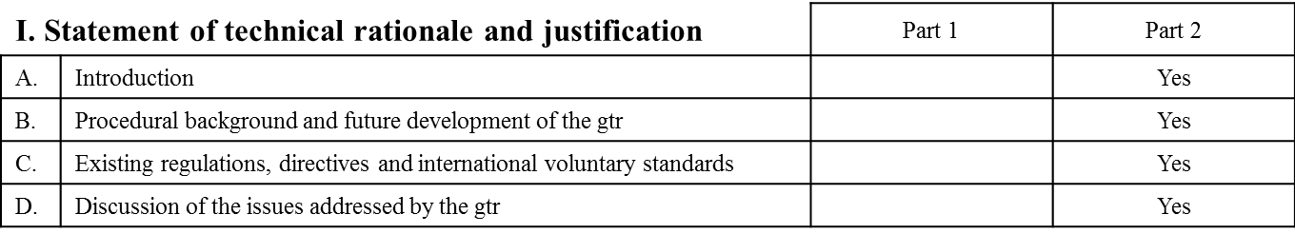
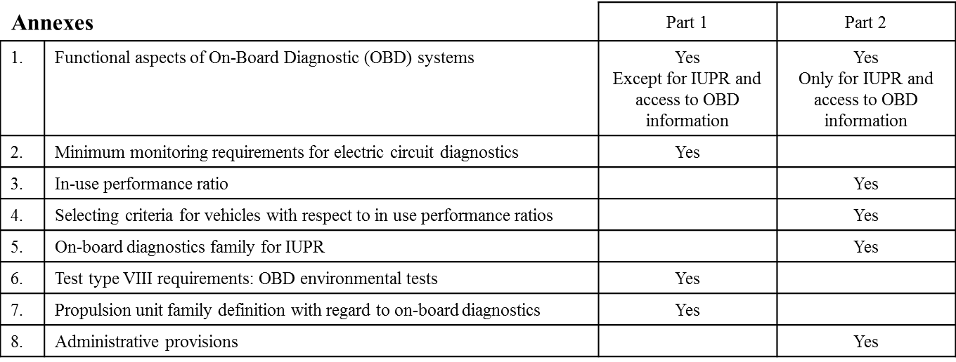
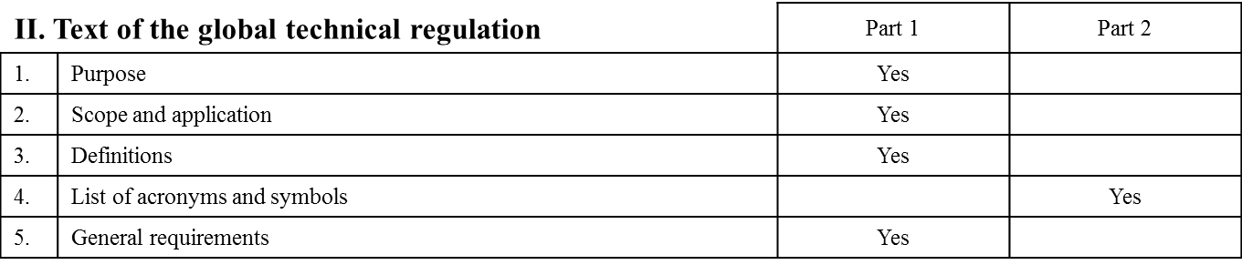
Amendment of UN GTR 18 to include OBD 2
Content:
  The work of the OBD 2 (amendment to GTR 18) is also based on the European EURO5 regulation

Slide 13
Amendment of UN GTR 18 to include OBD 2
Progress:
  Informal document GRPE-79-23: This is the consolidated document addressing the phase 1 of the work of the IWG and in particular of the work of the Correspondent Group as defined by the IWG in is formation (EPPR-24and its term of reference
  Discussion of phase 2 is divided into 3 sessions and is planned to be completed by Mar 2020
  Working document including phase 1 and 2 is planned to be submitted to GRPE in Jan 2021.
  Amendment of GTR No.18 is planned to be adopted by WP29 in Jun 2021.

Slide 14
IWG EPPR L-cat work outlook
Next areas of activities:
  Durability – Decided by CPs & stakeholders
  Propulsion Unit Performance
  GTRs to be transposed into UN Regulations (?)
Possibly in parallel
  https://wiki.unece.org/pages/viewpage.action?pageId=63308245

Slide 15

Any questions?
You can find me at adolfo.perujo@ec.europa.eu

