Slide 1
Efforts to improve freight competitiveness between Europe and Asia
Dr. Alberto Grisone –
Director Business development Russia, CIS, Far East and Middle East
Geneve, 30.10.2019

Slide 2
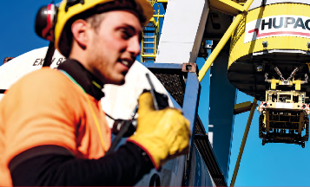
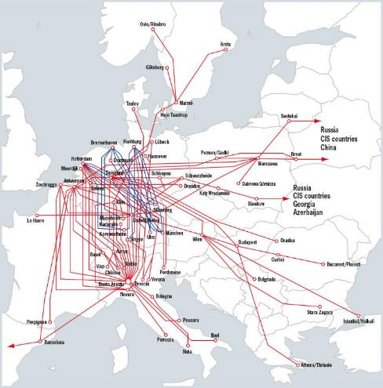
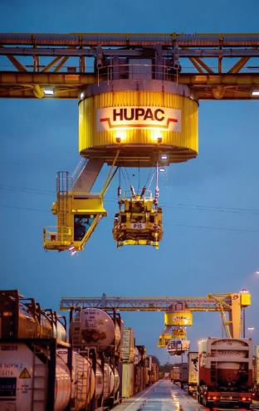
Leading network operator in combined transport
926,000 road consignments
1,720,000 TEUs
130 trains per day
526 employees
6,900 rail platforms
100% low-noise wagon fleet
CHF 580 million turnover
EUR 500 million turnover

Slide 3
Hupac Group companies – Market presence
Hupac Ltd
Chiasso Parent company
Asset Management
Hupac Intermodal Ltd
Chiasso
Sales & operations
Terminal operations
Hupac SpA Busto Arsizio Terminal operations Railway operations
Hupac Intermodal Italia Srl
Busto Arsizio
Sales
Hupac Terminal Brwinów
Warszawa
Terminal construction
Termi Ltd
Chiasso Terminal construction
Facility management
Fidia SpA
Milano Terminal operations
Warehouse logistics
Hupac Intermodal NV
Rotterdam
Service provider
Intermodal Express LLC
Moscow Sales & operations
Centro Intermodale SpA
Milano
Terminal construction
Facility management
Hupac Intermodal BVBA Antwerp
Terminal operations
Facility management
Hupac LLC
Moscow Rolling stock management
Terminal Piacenza Intermodale Srl
Piacenza Terminal operations
Hupac GmbH
Singen Service provider
Hupac International
Logistics (Shanghai) Co. Shanghai
Sales & operations
Piacenza Intermodale Srl
Piacenza
Facility management
Warehouse logistics
Hupac Maritime
Logistics GmbH
Duisburg
Maritime service
Termi SpA
Busto Arsizio Terminal construction
Facility management
ERS Railways BV
Rotterdam; branch office Hamburg
Maritime services
Switzerland
West Europe
East Europe & Far East

Slide 4
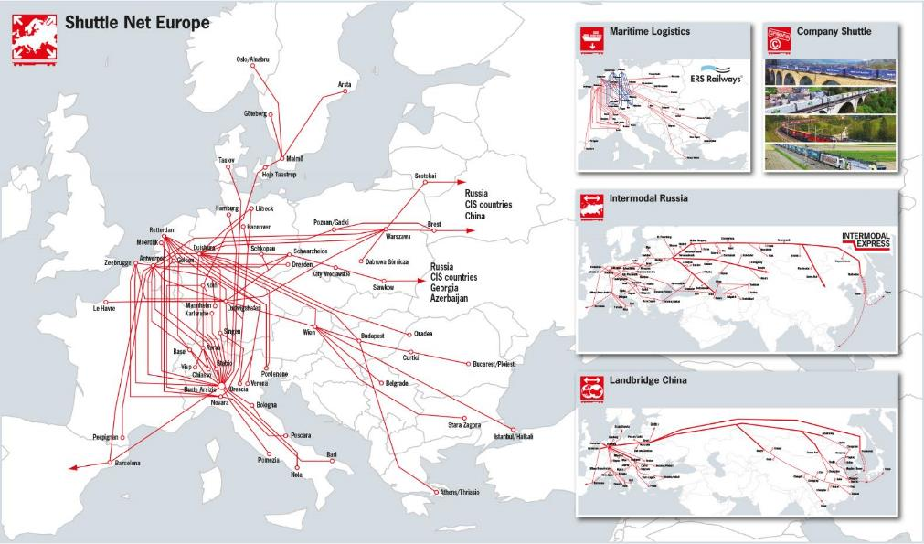
Hupac Group – combined advantage for logistics

Slide 5
European network connecting the Eurasian railways network
Train per week
Main connections after Slawkow
Slawkow  Antwerp 2
Slawkow  Ludwigshafen 2
Slawkow  Duisburg 2
Slawkow  Busto 2
Slawkow  Rotterdam 2
Slawkow  Barcelona 2
Slawkow  Le Havre 2
Main connections after Brest/Sestokai /Pruszkow
Pruszkow  Antwerp 3
Pruszkow  Ludwigshafen 3
Pruszkow  Duisburg 3
Pruszkow  Busto 5
Pruszkow  Rotterdam 3
Pruszkow  Barcelona 3
Pruszkow  Le Havre 2
Nizhnij
Novgorod
Moscow
Vladimir
Sestokai
Warszawa/
Pruszkow
Novomoskovsk
Rotterdam
Brest
Antwerp
Duisburg
Schwarzheide
Slawkow
Schkopau
Katy
Wroklawski
Le Havre
Ludwigshafen
Wien
Chop
Singen
Budapest
Oradea
Curtici
Ploiesti
Zagreb
Busto
Rijeka
Belgrade
La Coruna
Bologna
Stara Zagora
Istanbul
Leixoes
Pomezia
Bari
Barcellona
Marcianise
Madrid
Lisbon
Sevilla

Slide 6
New Connections via Kaliningrad
Nizhny Novgorod
Ekaterinburg
Krasnoyarsk
Moscow
Vladimir
Omsk
Tomsk
Kazan
Novosibirsk
Kaliningrad
Novomoskovsk
Sterlitamak
Kokchetav
Bijsk
Hamburg
Irkutsk
Blagovescensk
Lebedyan
Samara
Karagandy
Tambov
Dostyk
Volszky
Ulaanbaatar
Atyrau
Almaty
Urumqi
Zamyn-Uud
Vladivostok
Nürnberg
Singen
Ulm
München
Aktau
Tashkent
Korla
Novorossiysk
Krasnodar
Budyonnovsk
Busto
Brescia
Poti
Baku
Busan
Nagoya
Yokohama
Ashgabat
Galaba
Astara
Osaka
Serhetabad
Shanghai
Chongqing

Slide 7
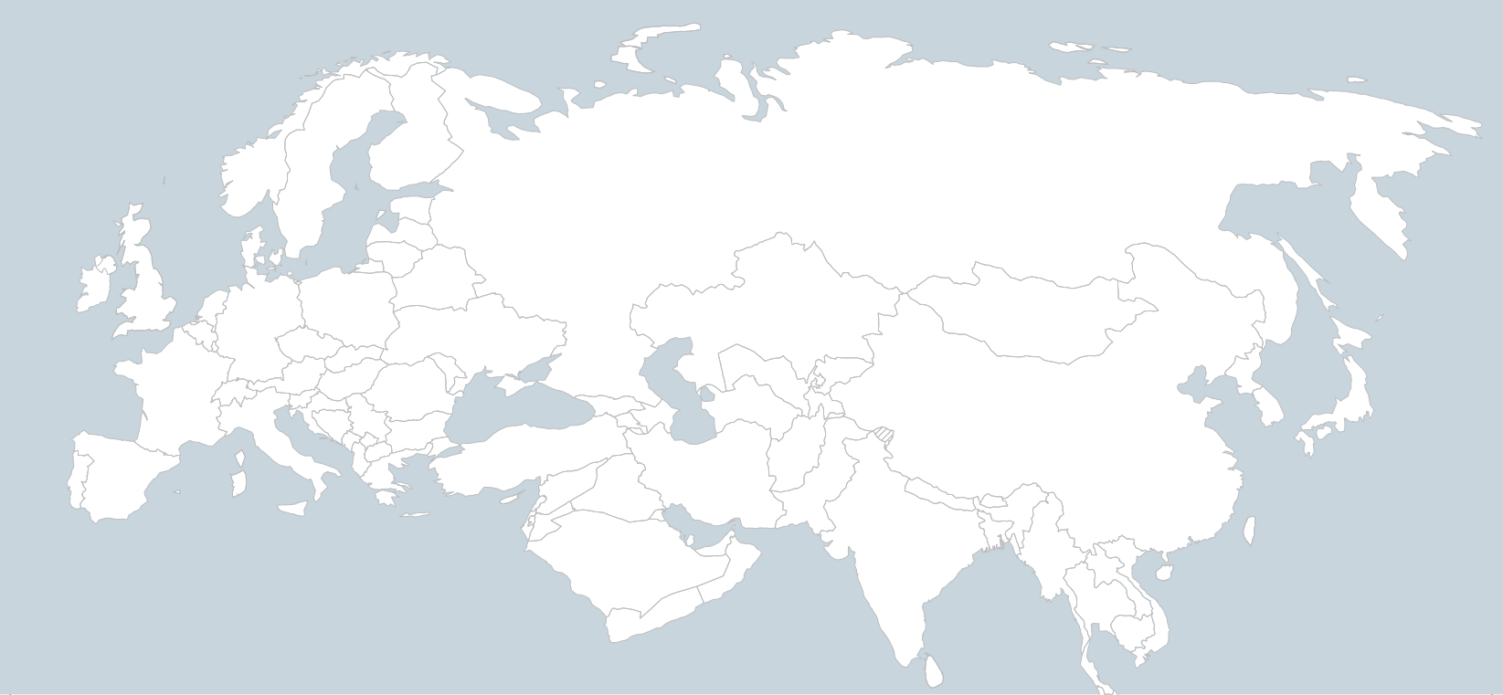
Connections Europe  Japan/South Korea
Moscow
Warszawa
Rotterdam
Brest
Antwerp
Duisburg
Vladivostok
Ludwigshafen
Wien
Singen
Budapest
Oradea
Busto
(Milan)
Ploiesti
Busan
Yokohama
Belgrade
Stara Zagora
Hakata
Kobe
Istanbul
Barcelona
Pomezia
(Rome)

Slide 8
Service Map of Intermodal Express
S. Peterburg
Nizhny Novgorod
Ekaterinburg
Krasnoyarsk
Riga
Moscow
Vladimir
Omsk
Tomsk
Kazan
Novosibirsk
Kaliningrad
Novomoskovsk
Sterlitamak
Kokchetav
Bijsk
Hamburg
Irkutsk
Blagovescensk
Rotterdam
Warsaw
Lebedyan
Samara
Karagandy
Duisburg
Brest
Tambov
Dostyk
Antwerp
slawkow
Ulaanbaatar
Schwarzheide
Dnipro
Volszky
Urumqi
Vladivostok
Nürnberg
Kiev
Atyrau
Almaty
Zamyn-Uud
Ludwigshafen
Brno
Singen
Ulm
Wien
Chop
Aktau
Korla
München
Budapest
Novorossiysk
Budyonnovsk
Tashkent
Krasnodar
Ploiesti
Yokohama
Busto
Brescia
Poti
Baku
Galaba
Busan
Nagoya
Stara Zagora
Astara
Ashgabat
Halkali / Istanbul
Serhetabad
Osaka
Barcelona
Bari
Shanghai
Chongqing
hong Kong

Slide 9
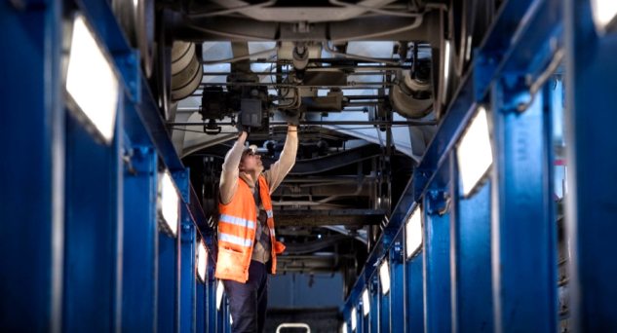
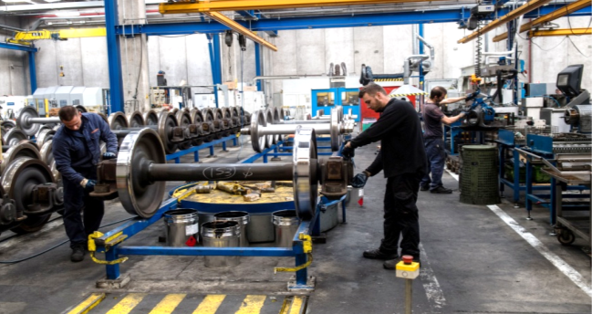
Rolling stock maintenance in Busto Arsizio
Rolling stock availability in %
 | Workshop | Wheelset refurbishing center
Opening | July 2010 | September 2012
Area | 20,000 m² | 9,000 m²
Activity | Repair and preventive maintenance of medium level | Wheelset reconditioning and non-destructive testing
Investment | EUR 7.5 million | EUR 8 million
Operator | RIFER | RIFER
Max. output | 30 wagons a day | 45 wheelsets per work shift

Slide 10
Strategy 2016-2020: Hupac invests CHF 280 million
Terminals
CHF 130 million
Rolling stock
CHF 130 million
IT & others
CHF 20 million

Slide 11
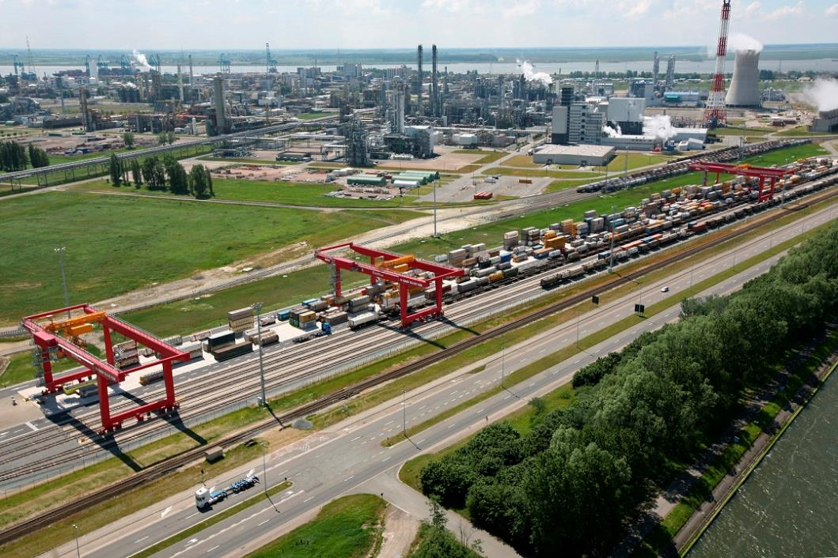
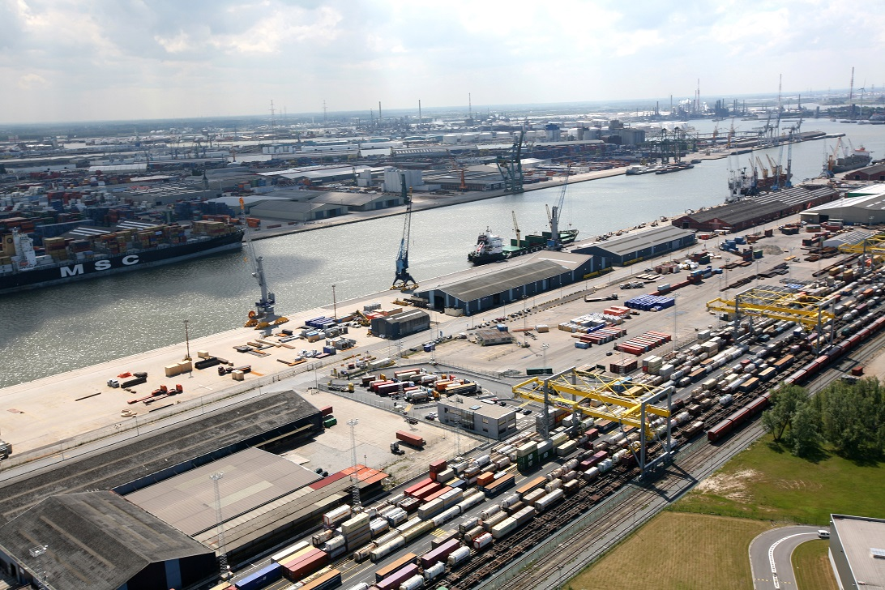

Slide 12
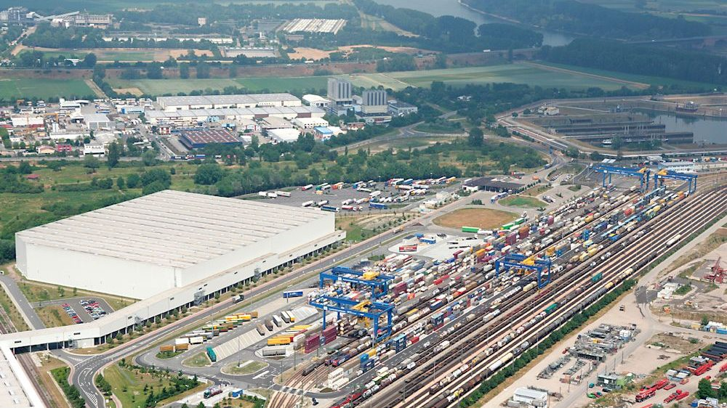
Terminal KTL When Industry logistics and railway meets for intermodal terminal infrastructures

Slide 13
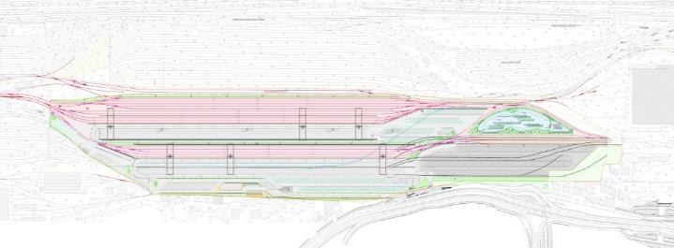
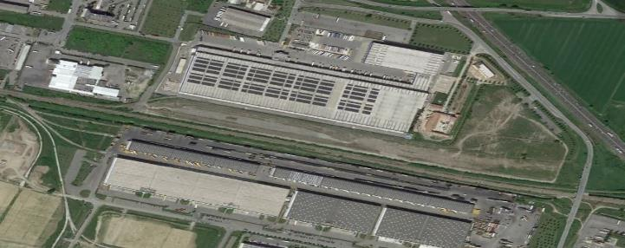
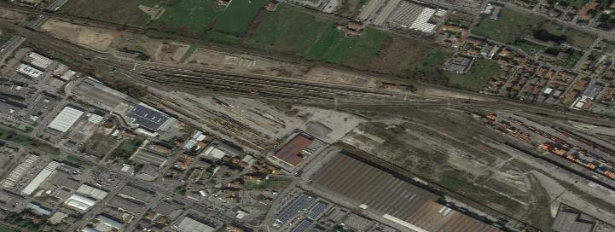
Projecting new terminal Heart of logistics park, fast reloading of trains, high frequency of trains
 | Milano Smistamento In attesa di inizio lavori Stato del progetto: definitivo Capacità massima annuale: ca. 390.000 UTI Finanziamento della fase 1 confermato dall’Ufficio Federale dei Trasporti (UFT)
 | Piacenza Possibile inizio lavori: 2016 Stato del progetto: in fase di valutazione Capacità massima annuale: ca. 190.000 UTI Presentazione domanda di finanziamento all’UFT: 2015
 | Brescia Possibile inizio lavori: 2018 Stato del progetto: in fase di valutazione Capacità massima annuale: ca. 190.000 UTI Presentazione domanda di finanziamento all’UFT: 2017

Slide 14
Six steps help get the digital transformation going together with customers
Mission
Start from the customer: Prioritize key customer journeys and digitize end to end
Break your functional silos: Build a cross-functional team with a clear mandate and digital talent
Create measurable targets: Develop quantitative targets for each team/projects
Translate digital ambition into resource allocations and budgets: Significantly reallocate investments
Focus on talent: Infuse new leaders into organization; retain existing digital talent
Maximize value of two-speed IT: Digitally enable your legacy infrastructure
Ground control
Booster
Source: McKinsey Analysis

Slide 15
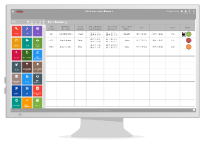
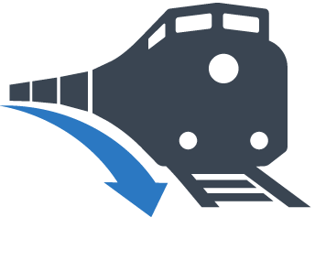
New Digital concepts and solutions
Data Source
Data Processing
Data Distribution
Railway Undertaken
Hupac WOLF
Customer
Wagon monitoring
Train run
Train ETA
Unit ETP
GPS devices
Data consolidation, integration and harmonization
Terminal
Operators
EDIGES
Train run and ETA/ETP are collected from the RUs, Terminals and other sources (EDIGES or semi-automatic)
Train's current position is shown regularly via a GPS receiver every ten minutes (Nexiot)
Hupac data centers receive data related to the trains in real-time
Big data architecture support the data collection
Hupac WOLF core software analyzes and transforms the data into useful business information
This is then made available on a WOLF online portal, via CESAR or via EDIGES data interfaces
Integration with the customers and partners

Slide 16
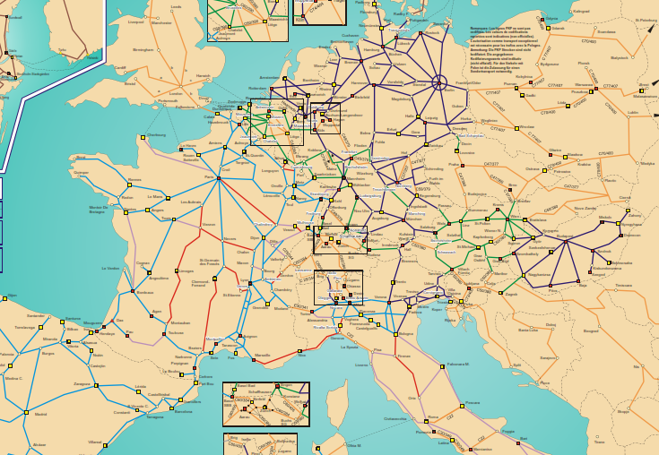
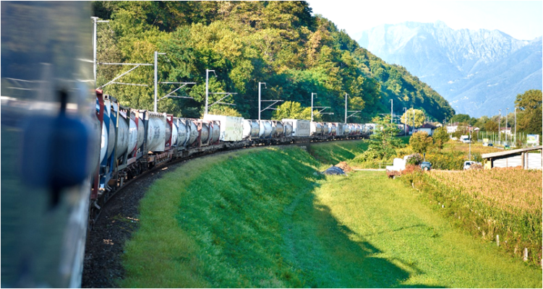
Combined transport – future-oriented system
EU target: transportation > 300 km on rail or ship; 2030 = 30%, 2050 = 50%
Transiberian route Target: 2 Mio. Teus in transit within 2025
Standardized system | Advantages for all
Hundreds of thousands of standard loading units (containers, swap bodies, semi-trailers) 700 terminals and ports 60,000 rail platform 2,000 cargo locomotives Long-term system commitment | 5.9 billion EUR turnover 41,000 jobs 18.1 million tons CO₂ reduction 2.2 billion EUR less external costs
Source: UIC Report on Combined Transport 2014

Slide 17
Germany border bottlenecks – examples of difficult railway infrastructure
Aachen
Rastatt

Slide 18
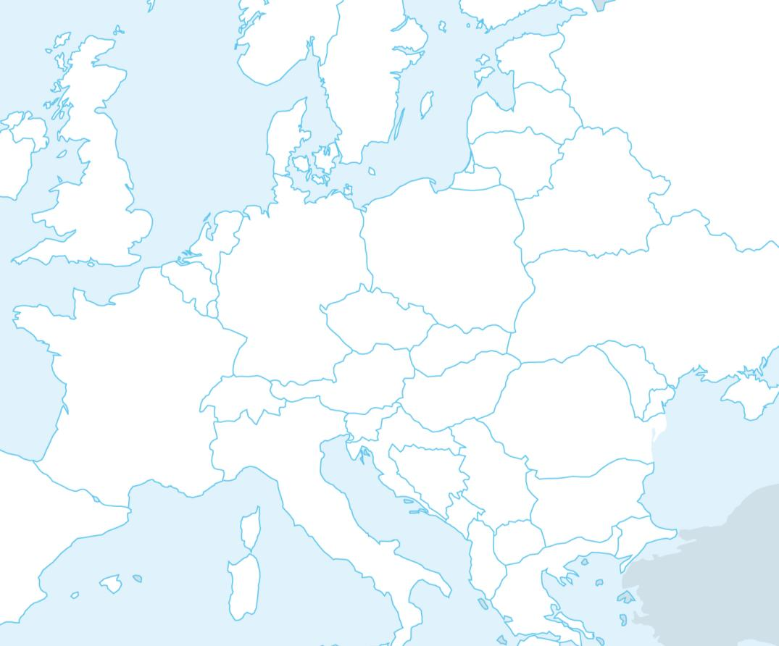
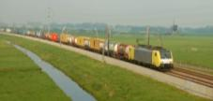
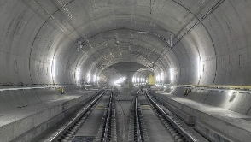
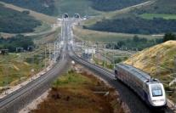
The usage of new railway infrastructures and the readiness for new ones
Oresund bridge
Betuwe route
Slawkow
Wien
1520
Alptransit
Perthus Tunnel

Slide 19
Increase of the productivity of Multimodal transport
Infrastructure
Longer and heavier trains: in addition harmonisation in Europe as well as between 1435 EU, 1520 and in China
Simplification of communication among the railways in the Eurasian platform
Telegraph…….among all the railways…..solutions to overtake this system
Customs clearance operations: please just one language and one form.
Cost of empty positioning
A reduction of costs for empty container and empty wagon positioning
Harmonization of rules
Harmonization among all railway networks
BIG DREAM
Even Russian RZD locomotive running in Europe

Slide 20
Solutions
All stakeholders from the market shall cooperate to push Chinese Railways and Railway Ministry
To follow the standard of the international agreements that they accepted:
Acceptance all the ISO CERTIFICATE OF TANK and any tank certified.
Opening of all terminal for transportation of tank for Domestic and International connections
Accepting the mixed loaded of box and tank container in the international block trains
Recognized the international MSDS paperwork
Finally authorize the transport of DG Cargo accoring to SMGS General Terms and RID.
WE NEED TO BE TOGETHER –
ANY LEVEL OF THE LOGISTICS SUPPLY CHAIN INCLUDING CARGO SHIPPERS AND OWNER WE NEED TO WORK TOGETHER
THE ONLY WAY FOR A STANDARDIZATION OF THIS TRANSPORT TECHNOLOGY.

Slide 21
Thank you for your attention!

