Slide 1
Transmitted by IWG SLR
Informal document GRE-79-28
(79th GRE, 24-28 April 2018,
agenda item 4)
Simplification of the UN Lighting and Light-signalling Regulations
Progress report on the Stage 1 and Stage 2
and harmonization with
Chinese simplification of GB standards

Slide 2
Workload and meeting pace
23 meetings held until now:
11 September 2014 in Brussels (BE)
23 October 2014 in Geneva (CH)
14 January 2015 in Brussels (BE)
13 April 2015 in Geneva (CH)
13 October 2015 in Brussels (BE)
5-6 November 2015 in Brussels (BE)
15-16 December 2015 in Brussels (BE)
13-14 January 2016 in Brussels (BE)
29 February & 1 March 2016 in Brussels (BE)
14-15 April 2016 in Brussels (BE)
9-10 June 2016 in Brussels (BE)
5-7 September 2016 in Brussels (BE)
5-7 October 2016 in Brussels (BE)
5-7 December 2016 in Brussels (BE)
21-23 February 2017 in Brussels (BE)
22-24 March 2017 in Brussels (BE)
16-18 May 2017 in Tokyo (JP)
13-15 June 2017 in Brussels (BE)
12-14 July 2017 in Brussels (BE)
4-6 October 2017 in Brussels (BE)
18-21 December 2017 in Brussels (BE)
29 Jan / 1 Feb 2018 in Shenzhen (CN)
4-6 April 2018 in Brussels (BE)
Next meetings:
SLR-24 on 30 May / 1 June 2018 in Brussels (BE)
SLR-25 on 24-26 September 2018 in Brussels (BE)

Slide 3
Simplification to be delivered in two stages
STAGE 1
“Editorial simplification”
STAGE 2
“Performance based / Technology neutral”
REDUCE 41 UN REGULATIONS TO
14 + 1 RESOLUTION
REWRITE THE NEW REGULATIONS WITH UPDATED PERFORMANCE BASED TECHNICAL REQUIREMENTS
SUITABLE FOR THE FUTURE
Provide a structure that limits to a minimum the number of parallel amendments necessary to achieve a regulatory change
Reduce the number of active/non-frozen regulations
Reduce the administrative burden (caused by maintenance of Regulations) on the Contracting Parties, the UNECE secretariat (and associated UN services) and the affected industrial sector
Reduce ambiguity in the provisions to provide consistent interpretation
Define the essential requirements in performance (technology neutral) terms to provide opportunities for innovation
Determine whether the current regulatory text presents barriers to innovation and whether safety considerations are addressed
Develop, as far as possible, performance-based and technology-neutral requirements to ensure freedom for technical innovation within a framework of safety principles

Slide 4
GRE Regulations after Stage 1 of simplification
R4
R38
R19
R119
R3
R70
R37, (R2),
R99,
R128,
Resolution
Already adopted by GRE-75
R6
R77
R98
R123
R69
R104
R7
R87
R112
(R1),
(R8),
(R20)
R113
(R56),
(R57),
(R72),
(R76),
(R82)
R27
R23
R91
(R5),
(R31),
R48*,
R53*,
R74*,
R86*,
R10,
R45,
R65,
R88,
R50
9
6
5
8
R xxx
(NEW 1)
Light Signalling Devices
R xxx
(NEW 2)
Road Illumination Devices
R xxx
(NEW 3)
Retro-Reflective Devices
NOT ON SLR AGENDA FOR STAGE 1
* Definitions and other minor editorial adjustments / synchronisation will be addressed
Regulations in parenthesis are frozen already.
4

Slide 5
SLR “Stage 1”
The complete package
NEW SIMPLIFIED UN REGULATIONS
Light Signalling Devices (LSD) → (GRE/2018/02)
Road Illumination Devices (RID) → (GRE/2018/03)
Retro-Reflective Devices (RRD) → (GRE/2018/04)
Transitional Provisions
Coll. Amd. for Regs Nos. 3, 4, 6, 7, 19, 23, 27, 38, 50, 69, 70, 77, 87, 91, 98, 104, 112, 113, 119 and 123
(GRE/2018/11)
+ GRE-79-10
GRE-79-14
UPDATED REFERENCES TO DEVICE REGS.
R48, series 03, 04, 05 and 06 of amendments (GRE/2018/30, …/08, …/07, …/06)
R53, series 01 and 02 of amendments (GRE/2018/17, GRE/2018/15)
R74, series 01 of amendments (GRE/2018/14)
R86, series 00 and 01 of amendments (GRE/2018/10, GRE/2018/09)
Reorganized and grouped definitions
R48-06, R53-02, R74-01, R86-01 (GRE/2018/13, GRE-79-08, GRE-79-09, GRE/2018/12)
+ GRE-79-13
Use of ”Change Index” and its definition
R48-06 + Coll. Amd. for R53-02, R74-01 and R86-01
(GRE/2018/16, GRE/2018/18, GRE-79-11, GRE-79-12)

Slide 6
SLR “Stage 2”
and harmonization with
Chinese simplification of GB standards

Slide 7
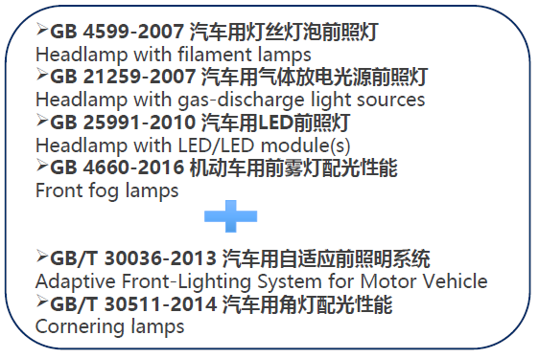
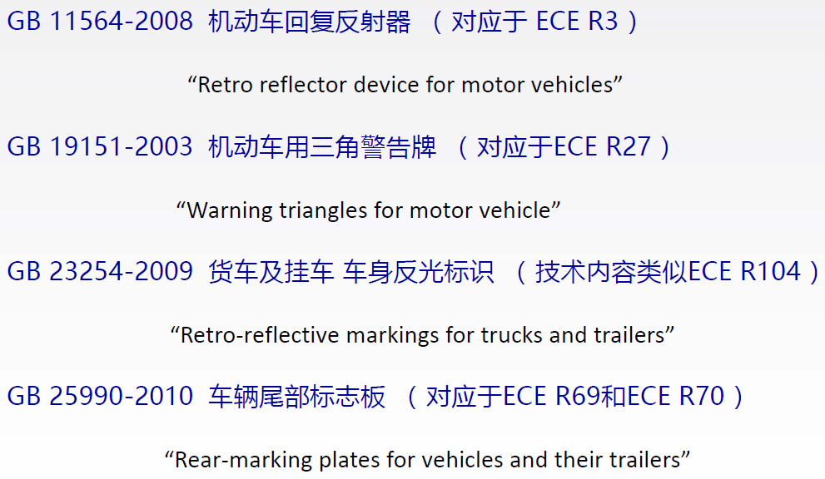
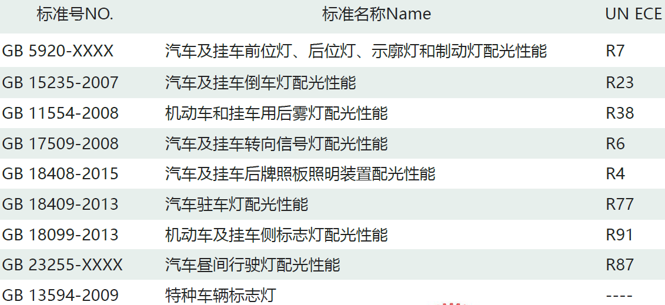
CHINESE SIMPLIFICATION OF GB STANDARDS
SIGNAL LIGHTING
FRONT LIGHTING
RETRO-REFLECTIVE DEVICES

Slide 8
STAGE 2 = SIMPLIFIED REGULATIONS
with technology neutral and performance based requirements
Improve the simplified UN device Regulations resulting from Stage 1 (i.e. LSD, RID and RRD) with regards to:
technology neutral
performance based requirements
objectively testable provisions
Align all changes with the progress of the corresponding simplified Chinese GB Standards
Minor amendments to installation will be necessary
STEP 1
What realistically can be achieved by the end of 2019
STEP 2
What will be delivered afterwards (not because less important but because requiring more time!)
Simplify UN installation Regulations (48, 53, 74, 86) and harmonise with corresponding Chinese GB Standards.

Slide 9
Timeline for Stage 2
- Step 1 and Step 2 -
Today
March 2018
Possibly
Mid-2024
End of 2019
STEP 1
STAGE 2
STEP 2
Timing to be discussed according to the earliest date that a further update to GB4785 (installation) could be submitted for publication

Slide 10
Synchronisation with Chinese GB Standards
Window of Opportunity
GRE
83
WP29 Nov 2020
GRE
79
GRE
80
GRE
81
GRE
82
2017 | 2018 | 2019 | 2020 | 2021
SLR 22
Shenzhen
Ongoing SLR Meetings
Meetings to be synchronised with GRE sessions
UNECE
09-2021
UN Entry into force
Draft plan for Stage 2
GRE-83 deadline
GRE Adoption
W29 Adoption
12-2019 draft for approval
06-2020 China
Adoption
12-2020
China Entry into Force
CHINA

