Slide 1
Task Force on Electro-Magnetic Compatibility
(TF EMC)
Status report to GRE-79
Friday, 27. April 2018
Submitted by TF EMC
Informal document GRE-79-04
(79th GRE, 24-27 April 2018, agenda item 7(a))

Slide 2
TF EMC Status Report
TF EMC had its 13th meeting on Wednesday, 3rd of April 2018
TF EMC will report on the work, which led to the “GRE/2018/05 - (TF EMC) Proposal for the 06 series of amendments to Regulation No. 10 (Electromagnetic compatibility)“ which was submitted by January 25th
TF EMC is asking for the adoption of this proposal including the final approval of the reworked Transitional Provisions
TF EMC will inform about an update on Regulation No. 10-06 until July 2018
TF EMC will inform about the status of the proposals prepared by Spain and India and the topics, discussed by Netherlands at GRE-78

Slide 3
TF EMC Status Report – UN R10.06 Development
Status of the work
Because of the technical changes and the updated TPs,
at GRE 78 the decision was done, to publish a new series of UN R10; not any longer Proposal for Supplement 2 to the 05 series of amendments to Regulation No. 10
Several proposals of TPs, delivered by OICA or the EU were discusssed
With Netherland‘s objection regarding the deletion of usage of „Open Test Sites“ for ESA-Test was withdrawn (and updated to „Open Area Test Sites“)
The proposal, delivered from India about changes of figures of motorcycles, was implemented
It was decided to implement updated definitions and figures taken from CISPR12 regarding the testing of charging systems
The TF EMC reviewed the update of normative references
A proposal dealing with the Spanish topic regarding vehicle in DC charging mode was included
122 modification proposals were discussed
  98 modifications were incorporated in the working draft of UN R10.06; including the 87 already reported ones
  22 of the proposals have been included in a roadmap for a UN R10.07 series
  2 proposals were not accepted due to a contradiction with international standards

Slide 4
TF EMC Status Report – UN R10.06 Development Status of Transitional Provisions
The GRE TF EMC decided to follow the Revision 3 of 1958 Agreement
(Guideline WP.29/2017/107 + corr.1) to apply Transitional Provisions
A proposal, based on this “Draft General Guidelines for United Nations regulatory procedures and transitional provisions in UN Regulations” using Annex 1 paragraph II “Aide-mémoire” guidelines V.1., V.2. and V.9. was implemented in GRE-document “GRE/2018/05 - (TF EMC) Proposal for the 06 series of amendments to Regulation No. 10 (Electromagnetic compatibility)”
Contents
  Suppression of TPs concerning the 03 and 04 series of amendments
  replacement of the single TP concerning the 05 series of amendments by TPs concerning the 05 series of amendments and consideration of extensions and vehicle types which are not equipped with a coupling system to charge REESS, or component or separate technical unit which does not include a coupling part to charge the REESS for proposed TPs
  new TPs concerning the 06 series of amendments
  change of the relative periods of time into exact calendar dates
Additional informal proposal (GRE-79-05)
  Addition in TPS for R10.06 of consideration of component or separate technical unit which does not include a coupling part to charge the REESS for proposed TPs

Slide 5
TF EMC Status Report – UN R10.06 Development Status of Transitional Provisions

Slide 6
TF EMC Status Report – UN R10.06 Development Spanish Proposal regarding DC charging mode (reminder)
The needs for charging of heavy vehicles as trucks or buses in short time leads to high charging current
In the present version of UN R10.05 a test procedure is defined to test at a current level of at least 80%.
Many laboratories are not able to fulfil the resulting requirements for DC charging mode regarding the energy supply and test equipment.
For the time being, the test requirements can not be fulfilled by the majority of laboratories. So for each test, the technical service has to consult the national regulation authority.
Therefore the TF EMC has prepared a proposal for DC charging mode and a justification for an adoption of the test setup and requirements.

Slide 7
TF EMC Status Report – UN R10.06 Development Spanish Proposal regarding DC charging mode (Status)
Several countries support the Spanish proposal to allow the reduction of a
DC charging current if the minimum 80% of nominal current value can not be achieved (e.g an electric bus with a 700 A nominal charging current would lead to a test with at least 560 A current which is not achievable in EMC test facilities)
Preliminary measurement data has been provided (Germany, Spain) which do not show significant differences of measurement results for different values of charging current (e.g for buses, passenger cars with DC charging mode).
The TF EMC suggests the following change in UN R10 for series 06 for the time being:
  If the current consumption can be adjusted, then the current shall be set to at least 80 per cent of its nominal value.
  If the current consumption can be adjusted, then the current shall be set to at least 80 per cent of its nominal value for AC charging.
  If the current consumption can be adjusted, then the current shall be set to at least 80 per cent of its nominal value for DC charging unless another value is agreed with the type approval authorities.
The topic will be followed up continuously

Slide 8
TF EMC Status Report – UN R10.06 Development Next Steps
The TF EMC will deliver the final draft of UN R10-06 in July 2018 to be approved in GRE 80 in October
Goal for the publication of UN R10-06 is September 1st, 2019
Open work items until July
  Implementing the final CISPR12 updated topics
  Implementing the additional chapter of TP, like shown in the informal document GRE-79-05
  Eventually a note about Trolley buses

Slide 9
Thank you for your attention

Slide 10
Annex

Slide 11
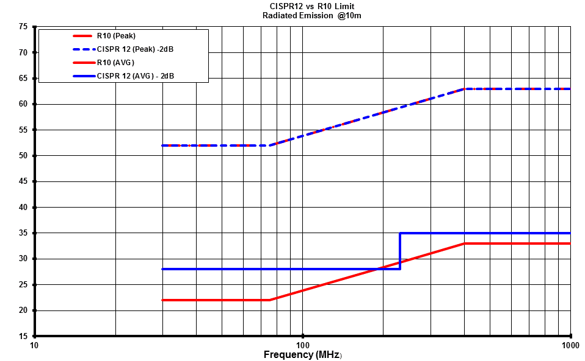
TF EMC Status Report – R10.06 Development Details
(Change of the R10-05 narrow band limit consistent with CISPR 12)
It has been precised that in order to get a R10-05 vehicle narrowband emission limit consistent with the CISPR 12 vehicle narrowband limit, the new R10.06 limit should be the CISPR12-limit minus 2dB to take into consideration this 2dB more stringent requirement as defined in CISPR 12 for type approval.
  For information:
  This figure shows also the consistence between the R10-05 and CISPR12 broadband peak limits.
  The proposal for new R10-06 narrowband limit is shown in blue, in comparison to the present R10-05 narrowband limit in red.

