Slide 1
Informal document GRB-68-15
(68th GRB, 12-14 September 2018,
agenda item 6)
Transmitted by the expert from ETRTO
WET GRIP TEST METHOD IMPROVEMENT for Passenger Car Tyres (C1)
Overview of Tyre Industry / ISO activities
GRBP 68th session
Geneva September 12-14th, 2018

Slide 2
CURRENT REGULATORY FRAMEWORK
CURRENT WET GRIP PROCEDURE - TECHNICAL PRINCIPLES
ISO ACTIVITIES - TECHNICAL DIRECTIONS
TIMELINE

Slide 3
CURRENT REGULATORY FRAMEWORK
CURRENT WET GRIP PROCEDURE - TECHNICAL PRINCIPLES
ISO ACTIVITIES - TECHNICAL DIRECTIONS
TIMELINE

Slide 4
CURRENT REGULATORY FRAMEWORK
TYRE LABELLING
Europe EC 1222/2009 - Test method in Annex V (Reg. 228/2011) * … but also Brazil, Korea, Japan, … *UNDER REVISION direct reference to UN R117 will be made for wet grip test method
ISO 23671:2015 Passenger car tyres — Method for measuring relative wet grip performance
UNDER REVISION
TYPE approval - UN R117.02 – Test method in Annex 5(a)
(minimum requirement on WET grip for homologation)
GTR16 Global Technical regulation
ISO test method for PSR wet grip is currently a key reference for several regulations in Europe and worldwide
This standard is under revision: the experience accumulated so far by the Industry and by the EU Member States Authorities indicated an opportunity for developing further improvements on the accuracy of the test method (see slide #10).

Slide 5
CURRENT REGULATORY FRAMEWORK
CURRENT WET GRIP PROCEDURE - TECHNICAL PRINCIPLES
ISO ACTIVITIES - TECHNICAL DIRECTIONS
TIMELINE

Slide 6
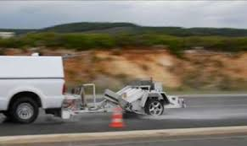
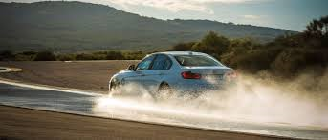
CURRENT WET GRIP TEST - TECHNICAL PRINCIPLES
For the calculation of the wet grip index of a candidate tyre, the wet grip performance of the candidate tyre is compared to the reference tyre ASTM SRTT 16’’ (Standard Reference Tyre Test).
→ Thus it is a COMPARISON TEST.
The wet grip index can be measured with one of the 2 following methodologies (today considered as equivalent):
TRAILER using a trailer towed by a vehicle
VEHICLE
using an instrumented passenger car
1 tyre mounted on a specific tool
OUTPUT peak braking force coefficient (μ peak)
highest value of the ratio braking force / vertical load
1 set of 4 tyres mounted on a commercialized vehicle
OUTPUT Average Deceleration (AD)
measured during braking

Slide 7
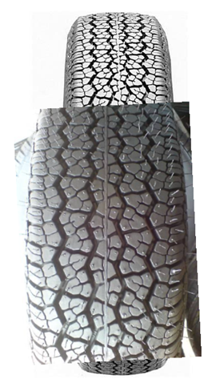
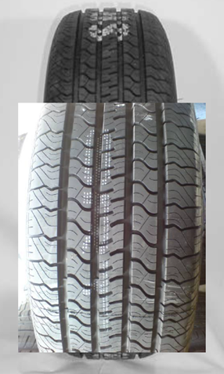
CURRENT WET GRIP TEST - APPLICABLE REFERENCE TYRES (ASTM)
SRTT 16’’
ASTM F2493 P225/60R16
SRTT 14’’
ASTM E1136 P195/75R14
Will be discontinued
Must be used as reference tyre to determine the relative wet grip performance of the candidate tyre
It can be used to verify / certify
track friction properties
(one of the 2 possible methods)

Slide 8
CURRENT WET GRIP TEST - TECHNICAL PRINCIPLES
Mathematical corrections are applied to align the results when the tests are performed in different conditions: i.e. different test locations (tracks) or different weather conditions (temperatures).
$$G\left(T\right)= \frac{μ_{candidate tyre}}{μ_{SRTT16}}1,25 +A·\left(Temp−T_{0}\right)+B·\left(µ_{SRTT16}−µ_{0}\right)$$
This ratio is a raw index of the measured friction of the candidate tyre vs the SRTT16’’ at the tests conditions (Temp, µ_{SRTT16})
Linear correction in friction to estimate the value of the index at the reference friction (track) µ₀
Linear correction in temperature to estimate the value of the index at the reference temperature T₀
The mathematical corrections (coefficient A and B) depend on category of use of the candidate tyre:
- Normal Tyres
- Snow Tyres (all tyres marked M+S, including the tyres marked also 3PMSF)

Slide 9
REPRODUCIBILITY OF THE CURRENT WET GRIP TEST
The current wet grip test method allows the necessary flexibility in terms of testing conditions: possibility to test using different tools (vehicle/trailer), on different tracks (wide friction range for tracks), and in different periods of the year (wide temperature range).
When the test was firstly developed, it appeared to grant both a good repeatability (same test conditions = same test results) and a good reproducibility (different test conditions = same grade).
Anyhow the reproducibility of the test is not in line with the initial evaluations.
In other words, when different set of testing conditions (within the allowed ranges) are adopted to test the same tyre, the same grade might not be always granted.

Slide 10
REPRODUCIBILITY OF THE CURRENT WET GRIP TEST
This problem was identified in the Final Report on the Review study on the Regulation (EC) No 1222/2009 on the labelling of tyres (March 2016):
8.4 Improvement of test standards and conditions
Several sources, including independent consumer organizations, indicate that there is incoherence between the labelled performance and the measured performance of a tyre. Tests performed by Member States Authorities (“MSAs”) confirm the lack of reproducibility of the tests, hinted by third parties. This also implies that in disputes, MSAs might have difficulties to prove incorrect labelling due to the low reproducibility of results.
According to MSAs, a large part of this problem is due to different conditions for the tests […] Especially the braking test on wet surface for measuring wet grip gives rise to large differences in test results.
Following the experience accumulated after the implementation of EU label Reg. 1222, Tyre Industry progressively recognized the problem and indicated opportunities for improvements in the same Review Study
8.4.1 Wet grip test standard
The experience accumulated so far by the Industry and by the MSAs on wet grip test standards is indicating an opportunity for developing further improvements on the accuracy of the test method.
[…]
Due to the wide intervals of allowed test conditions, a number of correction factors were adopted for calculating the wet grip. Examples of this are the correction factors for the surface friction coefficient (‘b’ = μ/grip) and temperature (‘a’) that are not working as intended and have a large influence on the result. Hence, there is a large difference in results if a tyre is tested at different conditions and correction factors are used to make results comparable.

Slide 11
CURRENT REGULATORY FRAMEWORK
CURRENT WET GRIP PROCEDURE - TECHNICAL PRINCIPLES
ISO ACTIVITIES - TECHNICAL DIRECTIONS
TIMELINE

Slide 12
Following preliminary collaboration among EUROPE, USA and JAPAN, the revision of the existing ISO 23671:2015 for PSR was launched last Sept 14th, 2017;
An ISO (global) “technical table” is currently in place: The WET GRIP Working Group (TC31/WG12) was established with the aim to
By priority
1. Improve the reproducibility of the current ISO,
2. Try to keep on average similar wet grip indexes values and ratings as current test procedure (minimize gaps with the current worldwide regulations)
3. Drive the global standardization & promote harmonization worldwide

Slide 13
ISO TECHNICAL ACTIVITIES
Step 1 – Identification of the parameters affecting the dispersion of the test
✓ ✓ completed
Step 2 - three Round Robin Tests using TRAILER methodology
✓tests activities completed
… analysis almost finalized
(ref. ETRTO / ISO)
Step 3 – 1 Round Robin Tests Using VEHICLE methodology
… tests activities completed
Analysis ongoing

Slide 14
Step 1 – Identification of the parameters affecting the dispersion
The parameters having an influence on the variability of test method were listed exhaustively
The ones to be analyzed to be better controlled in the future test method were identified:
 | CURRENT ISO TEST METHOD
Tyre typologies | Normal tyres | Snow tyres (M+S)
 |  | Including severe snow (M+S & 3PMSF)
Methodologies | Vehicle method Trailer method
Conditioning of test tyres | break-in = 2 braking runs
Wet Track Grip | MTD = 0,7 ± 0,3 mm BPN = 42-60 or µSRTT14 = 0,7 ± 0,1
Wet Track Temperature | 5-35 °C | 2-20 °C
Correction equation & coefficients | TRAILER: $G(T) = \frac{μ_{test}}{μ_{SRTT16}}1.25 + a⋅\text{Δ}\text{T} + b⋅\text{Δ}\text{μ}$ $_{0−SRTT16}=0,85$ VEHICLE: $G(T) = \frac{{BFC}_{test}}{{BFC}_{SRTT16}}1.25 + a⋅\text{Δ}\text{T} + b⋅\text{Δ}\text{μ}$ ${BFC}_{0−SRTT16}=0,68$
 | a= – 0,4232 b= – 8,297 | a = 0,7721 b = 31,18

Slide 15
Step 2 - Two Round Robin Tests using TRAILER methodology
Three huge tire testing plans were carried out for a total of 37 tires - 1163 results!
Tyres were tested on different tracks, using the trailer of each participant, in different periods of the years, for a total of 16 different test sites/trailer in EU (ETRTO), Japan (JATMA) and USA (USTMA).
Agreed direction
Stabilization of the tyre performance prior testing
Better definition of the track surface (one method)
Consider the specificity of tyre typologies for the temperature conditions and the corrections formulas

Slide 16
TYRE BREAK-IN (CONDITIONING)
Tyre Break-In (conditioning) was identified as an important source of variability
- The 2 braking runs considered by current regulation are not enough
Proposed approach:
The tyres should be stabilized in performance prior testing. In all cases, tyre designed tread depth and designed tread block or rib integrity shall not change significantly with break-in, which means the pace and “severity” of the break-in needs to be carefully controlled to avoid such changes.

Slide 17
TRACK GRIP
In the current method, the grip of the track can be controlled with one of two criteria BPN _{[42-60]} or μ _{SRTT14”} _{[0,6-0,8]} Anyhow there is no correlation between the 2 criteria → this point is an important source of variability between different test centers. Also the reference tyre SRTT14’’ will be discontinued
SRTT 16’’ will be used NOT ONLY AS REFERENCE TYRE, BUT ALSO FOR TRACK VALIDATION IN PLACE OF [SRTT 14 or BPN]
Replacement of SRTT14 and discontinuation of BPN measurement
A source of variability eliminated
Recent EU-USA agreement for friction range μ _{SRTT16”} [0.65 ; 0.90 ]

Slide 18
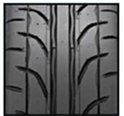
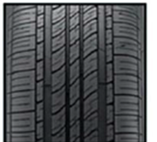
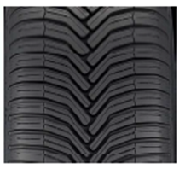
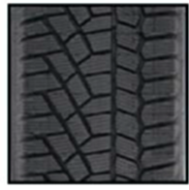
TYRE TYPOLOGIES
3 different typologies of tyres should be treated differently within the wet grip test procedure
R117 category of use / markings
Normal
-
Snow
M+S - not 3PMSF
Snow for use in severe snow conditions
M+S and 3PMSF
Examples of commercialized products and intended performance
e.g. tyres named
SUMMER
e.g. tyres named
ALL SEASON in USA
e.g. tyres named ALL SEASON in EU
e.g. tyres named WINTER
intended to perform across most temperature ranges. They are designed also for use in lower temperatures but not at the level of a Severe Snow (Winter) tire. They can operate at higher temperatures, without the typical limitations of Severe Snow (Winter) tires
guarantee the min snow traction of a Severe Snow (Winter) tire. They are also designed to operate at higher temperatures, without the typical traction limitations of Severe Snow (Winter) tires
Severe Snow tires are designed to perform best in severe cold weather conditions and are not typically used during extended warm weather conditions
Designed to perform best in warm weather and are not typically used at low temperature
WET GRIP test
CONDITIONS
T ref = 20
T ref = 15
T ref = 10
12-35 ˚C
5-35˚C
5-20 ˚C
each tyre typology has its own behavior vs friction & temperature
→specific /different correction formulas and coefficients shall be applied

Slide 19
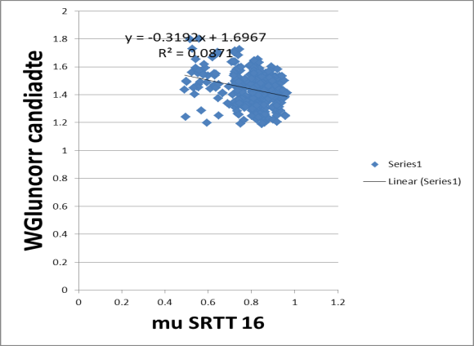
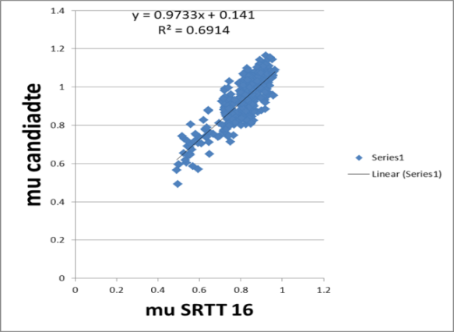
CORRECTION FORMULAS – BASIC IDEA
WGI raw = $\frac{μ_{candidate tyre}}{μ_{SRTT16}}$ $_{candidate tyre}$
WGI raw
No relation between
Ratio WGI raw and µ-SRTT16
Correction should NOT be applied
to WGI raw (as done today)
Evident linear relation between
µ-cand and µ-SRTT16 (track friction)
Correction should be applied directly to µ-cand tyre

Slide 20
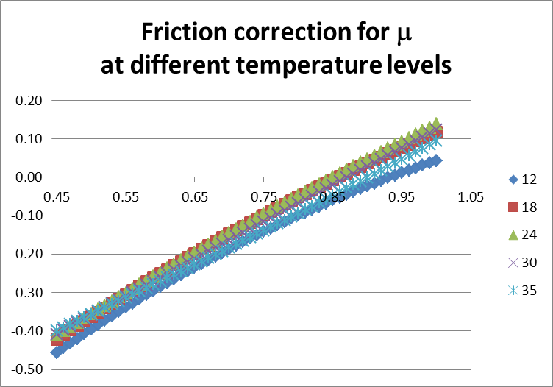
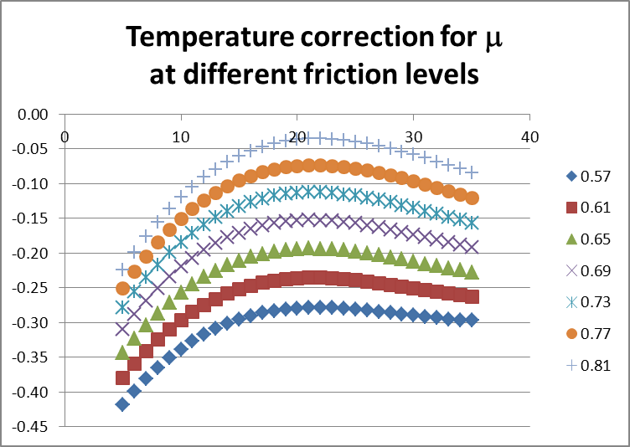
CORRECTION FORMULAS – BASIC IDEA
The grip of the track has a strong influence on the results. The MTD (Mean Texture Depth) has also a minor influence (linear)
µ(test) vs track grip µ(SRTT16) approximately linear
Example for Normal
The temperature (especially the low temperature for normal tyres) has also an influence (even if lower than the grip)
µ(test) vs Track temperature T approximately quadratic
Example for Normal
a, b, …, e different depending on tyres typologies
$$correction= f\left(\text{}\text{T}\text{,} \text{μ}\text{,}\text{MTD}\right)=a\text{μ}\text{+}\text{b}\text{}\text{T}\text{+}\text{c}{\text{}\text{T}}^{2}\text{+}(d{\text{μ}}^{2}\text{}\text{T}\text{)}\text{+}\text{e}\text{MTD}$$

Slide 21
CORRECTION FORMULAS
G(T) must NOT be based on: raw µ candidate / raw µ SRTT16” (as done today),
but be based on: µ candidate at reference conditions / µ SRTT16” at reference conditions
FROM
$$CURRENT G(T) = \frac{μ_{test}}{μ_{SRTT16}}1.25 + a⋅\text{Δ}\text{T} + b⋅\text{Δ}\text{μ}$$
TO
$$NEW G\left(T\right)=K∗\left[μ_{test} −\left(a Δ\text{μ} \text{+} \text{b} \text{Δ}\text{T} \text{+}\text{c}{ \text{Δ}\text{T}}^{2} \text{+} \text{e}Δ\text{MTD}\right)\right]$$
a, b, c, e different depending on tyres typologies
ΔT = T_{test} – T ref where: Δμ = μ_{SRTT16} – 0.85 ΔMTD = MTD – 0,8
K is a factor to grant consistency between future revised standard and current standard
K value under confirmation

Slide 22
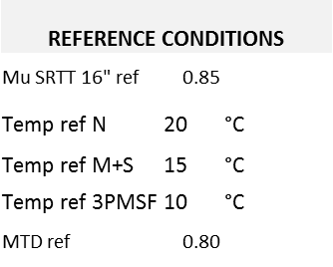
CORRECTION FORMULAS
Correction coefficients [a, b, c, e] are optimized for each tyre typology: They minimize the dispersion using all Round Robin Test measurements 1163 data points of 37 different tires (18 “Normal”, 9 “M+S”, 10 “3PMSF”)
The d coefficient of the term Δμ²ΔT was recently removed after confirmation that it is not statistically significant
a
b
c
d
e

Slide 23
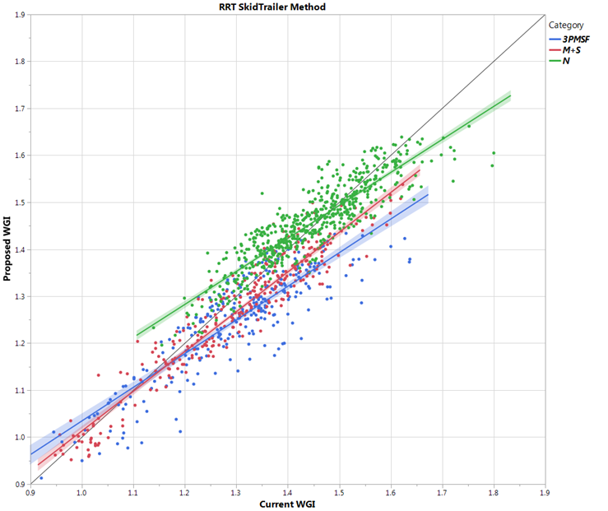
DISPERSION and WET GRIP VALUES – PROPOSED vs CURRENT procedure
With the new proposed approach, the dispersion of the test is significantly reduced for each tyre typology
Proposed v/s Current Wet Grip Index (WGI) values
On average, similar WGI values as current procedure
The proposed procedure grants more stability (vs tests conditions) than current procedure: possible differences in WGI (proposed and current) on single tests results depend on the conditions
K factor can be further optimized also to align proposed and current procedure
Proposed WGI
Current WGI

Slide 24
Step 3 – Round Robin Tests Using VEHICLE methodology
Some of - but not all - the technical findings on trailer can be automatically transposed to vehicle methodology.
ETRTO (EU only) is carrying-out dedicated test campaign on vehicle; main purposes are:
to compare the variability of both TRAILER and VEHICLE methodologies
to check the correlation between the two modified methods (both methods should give same Index)
Based on today information, the directions for the VEHICLE method could be similar to the trailer:
Better definition of the track surface
Restricting the testing conditions ranges
Revised mathematical corrections formulas (different from the trailer ones)
Stabilizing of the tyre prior the Wet Grip test
Tyres Inflation Pressure adjusted depending on actual load of the vehicle
Technical specification for vehicle to be used and further limitations
ACTIVITY ONGOING

Slide 25
CURRENT REGULATORY FRAMEWORK
CURRENT WET GRIP PROCEDURE - TECHNICAL PRINCIPLES
ISO ACTIVITIES - TECHNICAL DIRECTIONS
TIMELINE

Slide 26
TIMELINE
ACTIVITIES ENLARGED AT ISO level - Robust technical approach - Worldwide Harmonization
2015 |  | 2016 |  |  |  | 2017 |  |  |  | 2018 |  |  |  | 2019 |  |  |  | 2020
3Q | 4Q | 1Q | 2Q | 3Q | 4Q | 1Q | 2Q | 3Q | 4Q | 1Q | 2Q | 3Q | 4Q | 1Q | 2Q | 3Q | 4Q | 1Q | 2Q
EC 1222 Review study Reproducibility to be improved!
TRAILER activities
ETRTO (EU) & JATMA (Jap)
TRAILER activities
RMA (USA) test + ETRTO (EU) analysis
VEHICLE testing activities
ETRTO (EU)
Completion of data analysis

Slide 27
APPENDIX

Slide 28
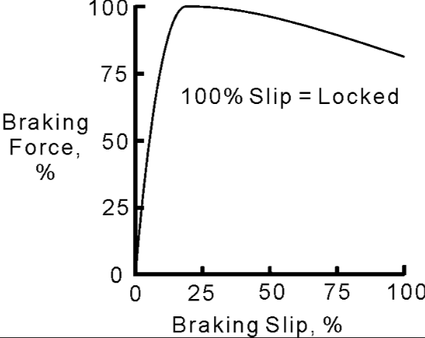
WET GRIP TEST METHOD - CURRENT REGULATORY FRAMEWORK
TRAILER METHODOLOGY
The tyre to be tested is fitted on a specific position for measurements (test position)
The brake in the test position is applied maintaining the specified speed (65 km/h) and the specified Load (depending on the Load Index of the tyre) until test-tyre lock-up
The ratio braking force / vertical load is acquired in real time: the highest value of this ratio provide the wet grip performance of the tyre. It is called tyre peak braking force coefficient (μ peak )

Slide 29
WET GRIP TEST METHOD - CURRENT REGULATORY FRAMEWORK
VEHICLE METHODOLOGY
An instrumented passenger car, equipped with an Antilock Braking System (ABS). Starting with a defined initial speed, the brakes are applied on four wheels at the same time to activate the ABS
The average deceleration is calculated between two pre-defined speeds (80→20km/h).
VEHICLE METHODOLOGY USING CONTROL TYRE SET (BRIDGE TEST)
Where the candidate tyre size is significantly different from that of the reference tyre (SRTT), a direct comparison on the same instrumented passenger car may not be possible.
In that case the comparison between a candidate tyre and a reference tyre is obtained through the use of a control tyre set (so called “bridge”) and two different instrumented passenger cars.
CAR 1
Control
Vs
SRTT
CAR 2
Candidate Tyre
Vs Control
Candidate Tyre
Vs SRTT
+

