Slide 1
62nd Session of GRSP
Submitted by the expert from CLEPA | Informal document GRSP-62-28 (62nd GRSP, 12-15 December 2017 agenda item 17)
ECE R129 Phase 3
Pierre CASTAING - UTAC CERAM

Slide 2
Summary
History of Regulation ECE R129
Phase 1 => Principles & Achievements
Phase 2 => Principles & Achievements
Phase 3 => Principles
Phase 3 => Challenges
Phase 3 => Achievement at date
Next steps

Slide 3
History of Regulation ECE R129

Slide 4
GRSP 62nd Session R129 documents
Original version
  ECE/TRANS/WP.29/GRSP/2017/31 (Supplement 7 to R129-00)
  ECE/TRANS/WP.29/GRSP/2017/34 (Supplement 7 to R129-00)
  ECE/TRANS/WP.29/GRSP/2017/44 (Supplement 7 to R129-00)
01 Series
  ECE/TRANS/WP.29/GRSP/2017/27 (Supplement 4 to R129-01)
  ECE/TRANS/WP.29/GRSP/2017/32 (Supplement 4 to R129-01)
  ECE/TRANS/WP.29/GRSP/2017/35 (Supplement 4 to R129-01)
  ECE/TRANS/WP.29/GRSP/2017/43 (Supplement 4 to R129-01)
  GRSP-62-22 (Supplement 5 to R129-01)
02 Series
  ECE/TRANS/WP.29/GRSP/2017/27 (Supplement 3 to R129-02)
  ECE/TRANS/WP.29/GRSP/2017/29 (Supplement 3 to R129-02)
  ECE/TRANS/WP.29/GRSP/2017/30 (Supplement 3 to R129-02)
  ECE/TRANS/WP.29/GRSP/2017/36 (Supplement 3 to R129-02)
  ECE/TRANS/WP.29/GRSP/2017/42 (Supplement 3 to R129-02)
  GRSP-62-21(Supplement 4 to R129-02)
03 Series
  ECE/TRANS/WP.29/GRSP/2017/41(03 series of amendments (Phase 3) to R129)
  ECE/TRANS/WP.29/GRSP/2017/27 to be included also in 03 Series if agreed
  ECE/TRANS/WP.29/GRSP/2017/30 to be included also in 03 Series if agreed
  ECE/TRANS/WP.29/GRSP/2017/36 to be included also in 03 Series if agreed
  GRSP-62-20 (Supplement 1 to R129-03)

Slide 5
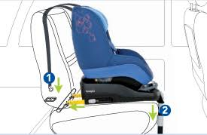

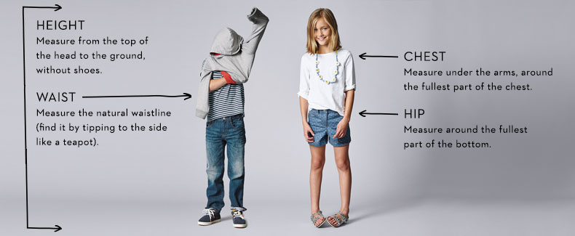
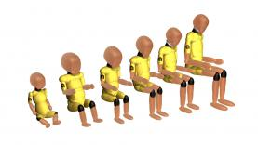
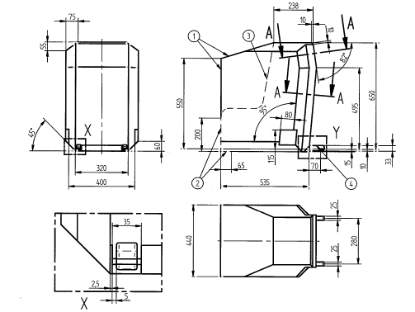
Phase 1 => Principles & Achievements
Phase 1
ISOFIX Integral Universal
RF 15 months Mandatory
Side Impact
Classification using child size
New Dummies & Performance Criteria & Test Bench
Better Compatibility
i-Size

Slide 6
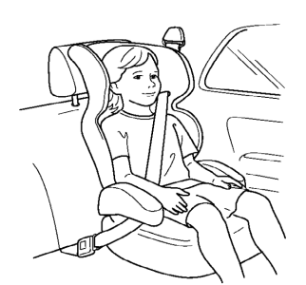
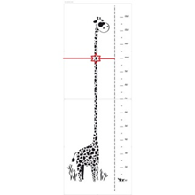
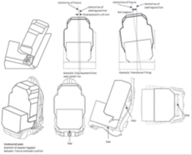
Phase 2 => Principles & Achievements
Phase 2
Non-Integral Universal
Only for stature ≥ 1 meter
Side Impact
Classification using child size
New Dummies & Performance Criteria & Test Bench
Better Compatibility
i-Size
Booster Seat

Slide 7
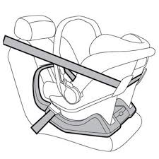
Phase 3 => Principles
Phase 3
Integral Universal Belted
RF 15 months Mandatory
Side Impact
Classification using child size
New Dummies & Performance Criteria & Test Bench
Better Compatibility
Universal Belted

Slide 8
Phase 3 => Challenges
Do we want to authorize combination of ECRS types ?:
  ISOFIX (including I-Size) & Universal Belted
  Universal (i- Size Integral ISOFIX, i-Size Booster Seat, Universal Belted)& Specific to vehicle
  Integral & Non-Integral
  Rearward & Forward
Do we want to authorize the sales of ECRS “not ready for use” ?:
  Not permanently fixed
    support leg
    top tether
    Shield
    Backrest
    Anti-rebound bar
    …
Do we want to authorize the use of “add-on” fixing points other than ?:
  ISOFIX anchorages with support leg or top tether for I-Size & ISOFIX products
  Adult 3 points belt for Universal belted ECRS
Guiding principles
  Avoid misuse
  Avoid confusion for the parents
  Plug &Play system

Slide 9
Phase 3 => achievement at date
ISOFIX (including I-Size) & Universal Belted (integral)
  Only for Modular Integral ECRS if only one belt route on the module to be used as a stand alone product.
Universal (i- Size Integral ISOFIX, i-Size Booster Seat, Universal Belted) & Specific to vehicle
  Only for extension of size range, beyond I-Size size range
Integral & Non-Integral
  Only if there is a reversibility of the transformation (the integral restraint system of the child must stay on the ECRS)
Rearward & Forward
  ISOFIX or Belted base associated with modules or rotating chair and for belted ECRS only one adult belt route by ECRS
Not permanently fixed
  Support leg, Top tether, Backrest & Anti-rebound bar must be assembled when put to the market
  Shield must be labelled
“add-on” fixing points to ISOFIX anchorages system
  No possibility to use ISOFIX anchorage system and Adult safety belt simultaneously for Integral ECRS
  The product must be type approved in the worst case condition (W/O “add-on”)
“add-on” fixing points to adult 3 points belt for Universal belted ECRS
  Low tether anchorage are not yet defined

Slide 10
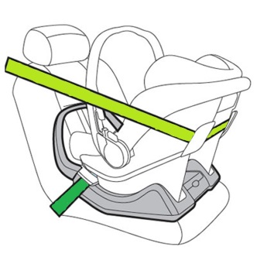
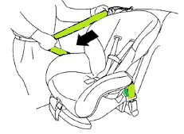




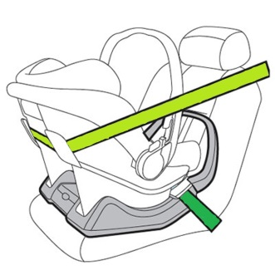
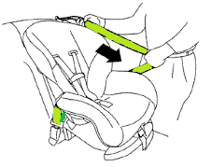
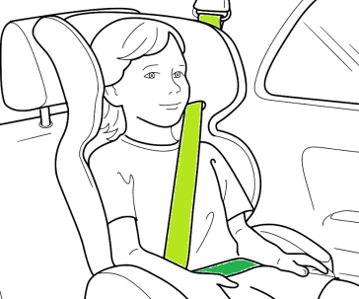



One belt route
What is plug and play for belted integral ECRS ?
Try to found a common way to fix the ECRS on the vehicle by the adult safety belt
Identify clearly the webbing paths for lap belt and diagonal belt
Icons for use on/near
belt guide
Icons for use on installation label
or
A
B
C

Slide 11
Next steps
Endorsement of Phase 3 by GRSP at its 62nd Session. ECE/TRANS/WP.29/GRSP/2017/41
Found a new chairman for the IWG ECRS if needed.
Upgrade the current text to suppress any ambiguity for Type Approval Authorities and Technical Services.
Include provisions for Lower Tether Anchorage (LTA) based on ISO work (GRSP-62-20, GRSP-62-21 & GRSP-62-22)
Include provisions for booster cushions still in Regulation R44
Repeal the Regulation R44

Slide 12



Next steps
Continue to study the possible authorised multi-configurations:
  “One fit all” is perhaps not the best solution

Slide 13
Thank you for your attention
Pierre CASTAING
pierre.castaing.externe@utacceram.com

