Slide 1
Informal Working Group ACSF ACSF of Category C
Informal document GRRF-85-06
85th GRRF, 11 December 2017
Agenda item 2
www.bmvi.de

Slide 2
Activities of the IWG ACSF
3 meetings for ACSF of category C since the 84th session of GRRF
24th Oct. 2017 Meeting in Solihull, UK
(only Contracting Parties)
17th Nov. 2017 Webex Conference
22nd – 24th Nov. 2017 IWG ACSF Meeting in Bonn, GER

Slide 3
Activities of the IWG ACSF
Following major issues have been solved within the IWG ACSF:
reaction time value
minimum distance (S_{rear})
minimum operation speed (V_{smin})
critical situation (S_{critical})
Test target (L3e vehicle)
Type approval test requirements

Slide 4
a) reaction time value
www.bmvi.de

Slide 5
a) reaction time value - State of discussion
Already in 84th session of GRRF the IWG had a fundamental consensus regarding the principles of
minimum distance (S_{rear})
minimum operation speed (V_{smin})
critical situation (S_{critical})
The remaining discussion points were:
When will the reaction of the driver in the rear vehicle start
(somewhere between activation of the direction indicators and
the start of the lane change manoeuvre)?
Which reaction time component value shall be take into the calculation (0.4 or 1.2 s after start of the lane change manoeuvre)?

Slide 6
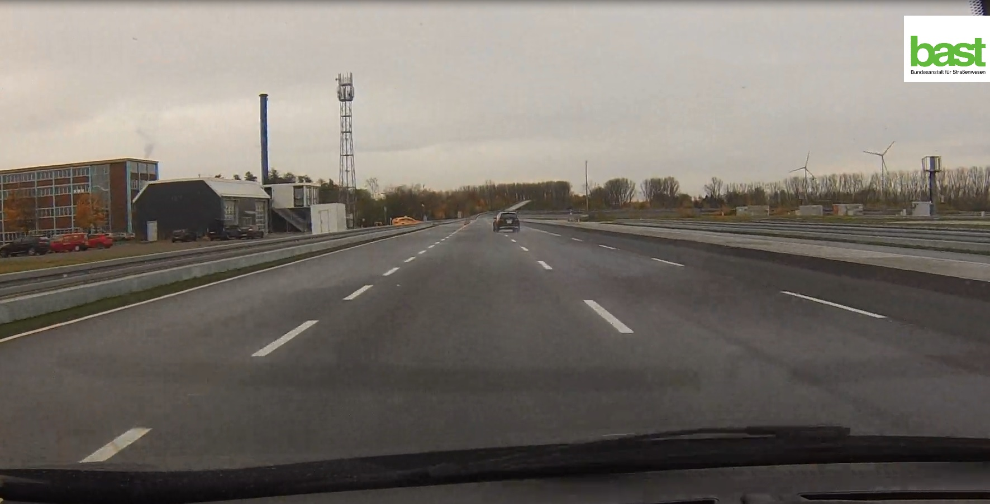
a) reaction time value - Simulation on test track done by BASt
V_{ACSF} = 80 km/h
V_{rear} = 130 km/h
S ~ 60m (S_{critical})
Braking starts 0.4 s after start of LCM with 3 m/s²
Remaining safety gap = 1 s

Slide 7
a) reaction time value - continuous lateral movement
The driver in the rear vehicle can see the flashing direction indicators of the ACSF car at least 3 s before the start of the lane change manoeuvre
The IWG ACSF came to the conclusion, that the lateral movement of the ACSF car to the lane marking in combination with the flashing direction indicators is a clear signal to the driver in the rear vehicle that the ACSF vehicle will change the lane
To have a clear visible lateral movement it is important, that the ACSF vehicle is not already driving closed to the lane marking at the beginning of the lane change procedure
Therefore requirements for a continuous lateral movement and lane centering were added

Slide 8
a) reaction time value - continuous lateral movement
new § 5.6.4.6.4.
The lateral movement of the vehicle towards the intended lane shall not start earlier
than 1 s after the start of the lane change procedure. Additionally the lateral movement
to approach the lane marking and the lateral movement necessary to complete the lane
change manoeuvre, shall be completed as one continuous movement.
new § 5.6.4.1.2.
When the ACSF of Cat. C is activated (stand by) the system shall aim to center the
vehicle in the lane. […]
min. 1 s
One continuous movement,
lateral acceleration max. 1 m/s²,
3 - 5 s
max. 5 s

Slide 9
a) reaction time value - continuous lateral movement
The mandatory continuous lateral movement achieves that we have a total reaction time of at least 1.4 s, which is comparable to the AEBS reaction time (approximately 1 – 2 s before LCM + 0.4 s after LCM).
total reaction time
appr.1 – 2 s
0.4 s

Slide 10
a) reaction time value - conclusion
In summary the IWG ACSF came to the conclusion that due to the mandatory continuous lateral movement a value of 0.4 s as the reaction time component after the lane change manoeuvre has started is a reasonable value.
0.4 s shall be used in the formula as t_{B}
$$S_{critical}=\left(V_{rear}−V_{ACSF}\right)∙t_{B}+\frac{{\left(v_{rear}−v_{ACSF}\right)}^{2}}{2∙a}+V_{ACSF}∙t_{G}$$
$$V_{smin}=a∙\left(t_{B}−t_{G}\right)+V_{app}−\sqrt{a^{2}∙{\left(t_{B}−t_{G}\right)}^{2}−2∙a∙(V_{app}∙t_{G}−S_{rear}) }$$

Slide 11
b) Test target (L3e vehicle)
www.bmvi.de

Slide 12
b) Test target (L3e vehicle) - continuous lateral movement
Sensor performance shall be tested at the worst case scenario, which is a motorcycle (L3e) coming from the rear
Unfortunately no standardized test target for L3e vehicle is available
IWG ACSF agreed to following solution:
new Annex 8, § 3.5.5.1
For the approaching vehicle in the test a type approved high volume
series production L3 motorcycle with an engine capacity not
exceeding 600 ccm without front fairing nor windscreen shall be
used.
(until a standardized test target is defined)
Source: StVO § 39

Slide 13
c) Type approval test requirements
www.bmvi.de

Slide 14
c) Type approval test requirements - Test overview (7 tests)
Lane change functional test
Minimum activation speed test V_{smin}
Overriding test
Lane change procedure suppression test
Sensor performance test
Sensor blindness test
Engine start/ run cycle test

Slide 15
c) Type approval test requirements - General test requirements
Straight test track with
at least two lanes,
same direction of travel,
road markings on each side of the lanes
Vehicle test speed defined in each test as V_{test}
Based on minimum specified speed V_{smin}
Assumed max. speed of approaching vehicle V_{app} = 130 km/h ^{(*)}
Test requirements must be fulfilled in whole speed range
Demonstration to satisfaction of technical service (appropriate documentation)
(*) If not otherwise specified in test

Slide 16
c) Type approval test requirements - (1) Lane change functional test
Objective
Verification lane change procedure
Test procedure
$$V_{test}=V_{smin}+10 km/h$$
Activation ACSF of Category C (standby mode) by driver
Recording lateral acceleration & lateral jerk
Approaching vehicle passes vehicle under test entirely
Repetition of test: 2x
Lane change procedure initiated by driver (indicator)

Slide 17
c) Type approval test requirements - (1) Lane change functional test
Objective
Verification lane change procedure
Test fulfilled:
Min. 1 s
Max. 0.5 s
3 - 5 s
Max. 5 s ⁽*⁾
One continuous movement,
lateral acceleration max. 1 m/s²,
lateral jerk max. 5 m/s³
Automatic resumption ACSF of Cat. B1
!
Information provided to driver indicating LCP on-going
⁽*⁾ Max. 5 s for M₁, N₁ and max. 10 s for M₂, M₃, N₂, N₃

Slide 18
c) Type approval test requirements - (2) Minimum activation speed test Vsmin
Objective
Verification no system activation below specified minimum speed
Test procedure
$$V_{test}=V_{smin}−10 km/h$$
Activation ACSF of Cat. C (standby mode) by driver
Test fulfilled
Approaching vehicle passes vehicle under test entirely
Lane change manoeuvre is not performed.
Lane change procedure initiated by driver (indicator)

Slide 19
c) Type approval test requirements - (2) Minimum activation speed test Vsmin
Objective
Verification no system activation below specified minimum speed
Test procedure
Additional testing
$$V_{test}=V_{smin}±10 km/h$$
In case Vsmin is calculated based on country specific general maximum speed other than 130 km/h:
In addition test procedure with
Test fulfilled: Lane change procedure is not performed.
In addition test procedure with
Test fulfilled: Lane change procedure is performed.
$$V_{test}=V_{smin}−10 km/h$$
$$V_{test}=V_{smin}+10 km/h$$
Simulation country of operation allowed.
Detection country of operation and knowledge of country specific general maximum speed limit shall be demonstrated to technical service.

Slide 20
c) Type approval test requirements - (3) Overriding test
Objective
Verification overriding force needed by driver
Test procedure
$$V_{test}=V_{smin}+10 km/h$$
Driver firmly maintains steering control in straight direction
Measurement force applied by driver on steering control
Repetition of test: 2x
Test fulfilled:
Measured overriding force ≤ 50 N

Slide 21
c) Type approval test requirements - (4) Lane change procedure suppression test
Objective
Verification conditions to suppress lane change procedure
Test procedure
$$V_{test}=V_{smin}+10 km/h$$
Test repeated for following conditions, which shall occur before lane change manoeuvre has started:
Driver’s actions:
removed hands from steering control and hands-off warning initiated
manual deactivation direction indicator lamps
overrides system
switches system off
Vehicle speed reduced to
Begin lane change manoeuvre ≥ 5 s
$$V ≤V_{smin}−10 km/h$$
Test fulfilled:
Suppression lane change procedure in each test case above

Slide 22
c) Type approval test requirements - (5) Sensor performance test
Objective
Verification of minimum distance Srear declared by manufacturer
Test procedure
$$V_{test}=V_{smin}+10 km/h$$
Approaching vehicle
Type approved high volume series production L3 motorcylce
Engine capacity ≤ 600 cm³
w/o front fairing nor windscreen
Shall aim to drive middle of lane
$$V_{app}=120 km/h$$
$$S_{rear}$$
Source: StVO § 39

Slide 23
c) Type approval test requirements - (5) Sensor performance test
Objective
Verification of minimum distance Srear declared by manufacturer
Test procedure
$$V_{test}=V_{smin}+10 km/h$$
Distance measured
Distance rear end test vehicle and front end of approaching vehicle measured (e.g. differential GPS)
Value the system detects approaching vehicle noted
$$V_{app}=120 km/h$$
$$S_{rear}$$
Test fulfilled:
System detects approaching vehicle latest at distance declared by manufacturer Srear

Slide 24
c) Type approval test requirements - (6) Sensor blindness test
Objective
Verification system detection sensor blindness
Test procedure
Making rear sensor(s) blind
$$V_{test}=V_{smin}+10 km/h$$
Means agreed between vehicle manufacturer and technical service (documented in report)
Standstill (no new engine start/ run cycle!)
Continued test procedure
Vehicle speed
Initiation lane change procedure
$$V_{test}=V_{smin}+10 km/h$$

Slide 25
c) Type approval test requirements - (6) Sensor blindness test
Objective
Verification system detection sensor blindness
Test fulfilled
System detects sensor blindness
System provides warning to driver
Lane change manoeuvre is not performed
!
Additionally
Vehicle manufacturer demonstrates to satisfaction of technical service requirements also fulfilled under different driving scenarios. May be achieved by documentation.

Slide 26
c) Type approval test requirements - (7) Engine start/ run cycle test – Phase I
Objective
Verification default-off status
Test procedure
Engine start/ run cycle
$$V_{test}=V_{smin}+10 km/h$$
No activation ACSF of Cat. C (off mode) by driver
Test fulfilled
Lane change manoeuvre is not performed.
Approaching vehicle passes vehicle under test entirely
Lane change procedure initiated by driver (indicator)

Slide 27
c) Type approval test requirements - (7) Engine start/ run cycle test – Phase II
Objective
Verification required object detection for system activation
Test procedure
Engine start/ run cycle
$$V_{test}=V_{smin}+10 km/h$$
Activation ACSF of Cat. C (standby mode) by driver
Test fulfilled
Lane change manoeuvre is not performed.
No approaching vehicle!
Lane change procedure initiated by driver (indicator)

Slide 28
c) Type approval test requirements - (7) Engine start/ run cycle test – Phase III
Objective
Verification lane change enabling conditions
Test procedure
$$V_{test}=V_{smin}+10 km/h$$
Approaching vehicle
$$S_{rear}$$
Type approved high volume series production vehicle
Source: StVO § 39

Slide 29
c) Type approval test requirements - Engine start/ run cycle test – Phase III
Objective
Verification lane change enabling conditions
Test procedure
Distance measured
$$V_{test}=V_{smin}+10 km/h$$
Distance rear end test vehicle and front end of approaching vehicle measured (e.g. differential GPS)
Value the system detects approaching vehicle noted
$$S_{rear}$$
Test fulfilled:
System detects approaching vehicle latest at distance declared by manufacturer Srear

Slide 30
Thank you for your attention!
Federal Ministry of Transport
and Digital Infrastructure
Invalidenstraße 44
D-10115 Berlin
www.bmvi.de

