Slide 1
Transmitted by the expert from the Republic of Korea
Informal document GRB-65-19
(65th GRB, 15-17 February 2017,
agenda item 2)
Reversing Alarm
Park Jinwoo, Chief Researcher
(truehelp@ts2020.kr)
KOTSA (Korea Transportation Safety Authority)
KATRI (Korea Automobile Testing & Research Institute)

Slide 2
Accidents due to reversing
Accident video

Slide 3
Accidents due to reversing (2010~2012)
Who was involved in the accident and dead?

Slide 4
Accidents due to reversing (2010~2012)
Which vehicles involved in accidents

Slide 5
Accidents due to reversing (2010~2012)
Place of accident due to reversing
General fatal accidents occurred mainly in the evening but the deaths by reversing accidents occurred mainly during daytime rather than night time.

Slide 6
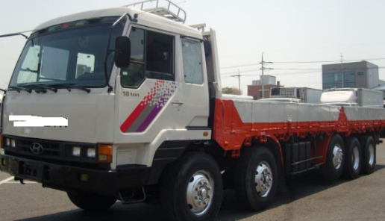
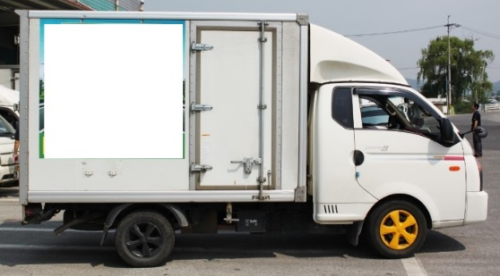
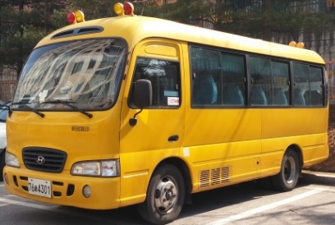
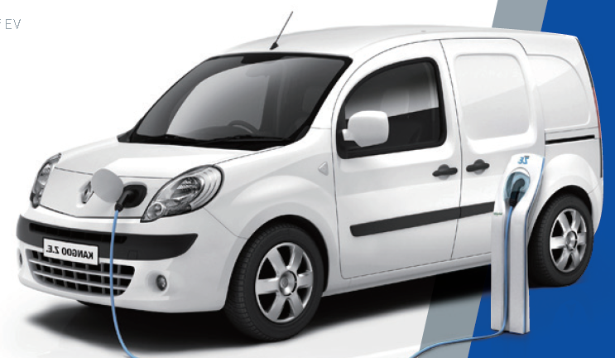
Reversing alarm in KMVSS
Reversing alarm regulation in Korea
The vehicles(N3, Van, Box truck, school bus) shall have rear view camera or rear detecting sensor(Alarm signal for driver) or reversing alarm device when it move to backward.
N3 & Van
Box type
School bus

Slide 7
Conclusion
Proposal
Scope : Include N2, M2, School bus, Box-type truck besides N3 and M3.(If it is possible, include N1 also)
Pause switch : prohibited.
In case of school-bus, the vehicle should have both rear view camera and reversing alarm for preventing accident of children.
Microphone height : One point(ex : 1.2m)
Reversing alarm sound is beep sound not continuous sound, so it is not easy to find the maximum or minimum sound between 0.5m and 1.5m.

Slide 8
Thank you!

