Slide 1
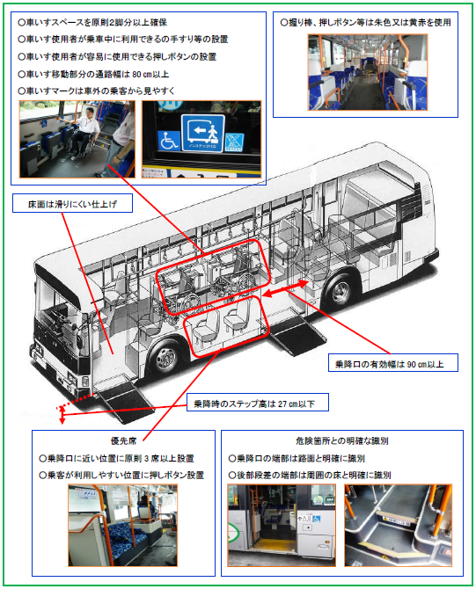
Efforts in Japan for a Barrier-Free Public Transit System
Informal document GRSG-111-28
(111th GRSG, 11-14 October 2016,
Agenda item 2)
https://wwwtb.mlit.go.jp/tohoku/kk/report1-2.pdf

Slide 2
Act for a Barrier-Free Public Transit System
- 2000: The ABFPTS* enacted.
- 2004: Standard Specification Non-Step Buses established.
- 2005: The Procedure revised.
- 2015: The Procedure revised.
* Officially called the Act on Facilitation of Mobility of the Elderly, Disabled, and Other Vulnerable People through Public Transit System

Slide 3
Outline of Standard Specification Non-Step Buses
- Boarding gates
- Handrails
- Getting-off buttons
- Wheelchair friendliness (slopes, spaces)
- Priority seating
- Coloring in the cabin
and more…

Slide 4
Coloring in the Cabin
- The seats, vertical bars, aisles, and areas of caution must be colored in a way easy to find even for the elderly and visually impaired.
Part of equipment that has to be easily spotted even for the elderly and colorblind, such as vertical bars, getting-off buttons, etc. must be colored in orange red or yellow red.
Areas that serve as the background for the seats, vertical bars, aisles, and areas of caution, such as ceiling, floor, walls, etc. must be colored with sufficient difference in luminosity.

Slide 5
Examples of Coloring in Non-Step Bus Cabins

