Slide 1
Submitted by TF-R46
Informal document GRSG-111-22
Agenda item 5
Report
Task Force UNR46 5th Meeting
OICA Paris, 26-27th September 2016

Slide 2
Summary
Background
Progress report
Next Steps

Slide 3
Background
106th GRSG Session（May 2014）
Establish the Task Force R46 to improve vehicle’s indirect vision for preventing of pedestrian accidents
1st Task Force meeting （September 2014, Geneva）
2nd Task Force meeting （ May 2015, Geneva ）
3rd Task Force meeting （ September 2015, Geneva ）
4th Task Force meeting （ April 2016, Geneva ）
110th GRSG Session（April 2016）
Japan proposed amendments focusing on 360° vision/detection around the vehicle
5th Task Force meeting（September 2016, Paris）
Japan proposed new requirements focusing on rear vision. This proposal was discussed in the meeting.

Slide 4
Attendance
Chair: Mr. Naono (JASIC, Japan)
Secretary: Mr. Miki (JASIC, Japan)
UTAC, France
MLIT, NTSEL, Japan
OICA
Total: 13 persons

Slide 5
Report of discussion
Items discussed at 5th TF-R46
Reversing vehicles accidents data in Japan (Japan)
Proposal for amendments to UN R46 (Japan)
Reversing vehicles accidents data in US(Reference/ Japan)
Comments to Japan’s proposal （OICA）

Slide 6
Roadmap to the Introduction of Requirements for the View of the Vehicle’s Surroundings and the View of Its Close-Proximity Rear
 |  |  | 2016 |  | 2017 |  | 2018-
 | Requirement for the view of the vehicle’s surroundings and rear was proposed. ↓
 |  | PHASE 1 The view of the close-proximity rear to be proposed
 |  | PHASE 2 The view of the surroundings to be proposed
Discussed at TF & GRSG (110th)
R46TF-05-10
Requirement divided into: the view of the surroundings and the view of the close-proximity rear
To be discussed at TF; Informal document to be submitted to
GRSG (111th)
Working document to be submitted to
GRSG (112th)
Applicable vehicle categories, etc. to be verified; To be discussed at TF, as necessary, based on the result of the verification. Proposals or presentations will be submitted to GRSG.

Slide 7
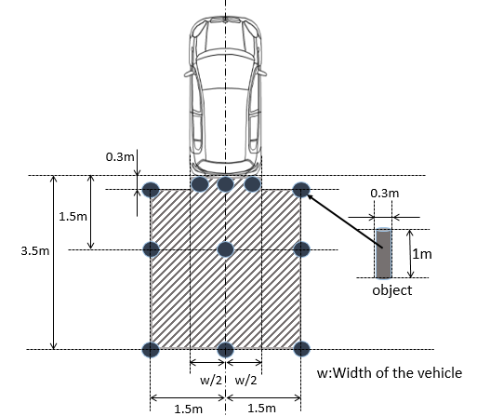
Proposal for amendment to R46【GRSG-111-XX】
Requirement for the view of the vehicle’s close-proximity rear
Purpose: To prevent accidents by enabling the driver to notice any pedestrians around or behind the vehicle.
Requirement: The close-proximity rear-view device shall be such that the driver can detect objects (with a height of 1,000mm and a diameter of 300mm) located within the areas defined in Figure, using a mirror, camera, sonar, etc.

Slide 8
Main discussion at TF46
TF discussed draft of amendment to R46 proposed by Japan mainly about the following points;
Detection means: technology neutral requirements should permit any detection technology
Do accident data differ among regions? (Japan, US, Germany, others?)
Regulatory approach at GRSG level:
→ “UN R46 amendment” vs “New regulation”? (or other solutions?)
Scope (requirements may differ according to the vehicle category)
Provisions addressing obstruction
Alignment with FMVSS111
Test procedure for obstruction proximity of the vehicle

Slide 9
1. Asking guidance for TF future work
Amendment to R46 or New regulation?
Establish an IWG ?
2. Question to CPs
Will CPs apply provisions on a mandatory basis in their territory, even if there are regional differences in accident data?
→It is not a matter of UNR but domestic regulation.
(refer an approach of UNR34-03)
3. Request to CPs on accident data
TF is pleased to ask CPs and the other members to provide accident data on reversing vehicles, if existing.

Slide 10
Next Steps (earliest scenario)
111th GRSG session, October 2016
Discussion on draft of amendments to UN R46
112th GRSG session, April 2017
Submission of working document
173rd WP29 session, November 2017
Submission of working document

Slide 11
Thank you very much for your kind attention

