Slide 1
Informations and comments on
ECE-TRANS-WP.29-GRB-2016-02e
Transmitted by the expert from France
Informal document GRB-63-16
(63rd GRB, 16-18 February 2016,
agenda item 2)
Louis-Ferdinand PARDO (France)

Slide 2
Part I – Anechoic environment (§6,2)
The test facility in anechoic and hemi-anechoic chamber shall meet the requirements of ISO 26101:2012 with the following qualification criteria and measurement requirements appropriate to this test method. For qualifying the acoustic space, the following evaluation shall be conducted:
Sound source location shall be placed in position of the audible warning device to be tested;
Sound source shall provide a broadband input for measurement;
Evaluation shall be conducted in one‐third‐octave bands;
Microphone locations for evaluation shall be on a line from the source location to position of the microphone used for measurement. This is commonly referred to as the microphone transverse;
A minimum of 10 points shall be used for evaluation on the microphone transverse line;
The one‐third‐octave bands used to establish hemi‐anechoic qualification shall be defined to cover the spectral range of interest.
The test facility shall have a cut-off frequency, as defined in ISO 26101:2012, lower than the lowest frequency of interest. The lowest frequency of interest is the frequency below which there is no signal content relevant to the measurement of sound emission for the audible warning device. For the purpose of this Regulation the lowest frequency of interest is 200 Hz.
Why a reference to ISO 26101 with some additional criteria ?

Slide 3
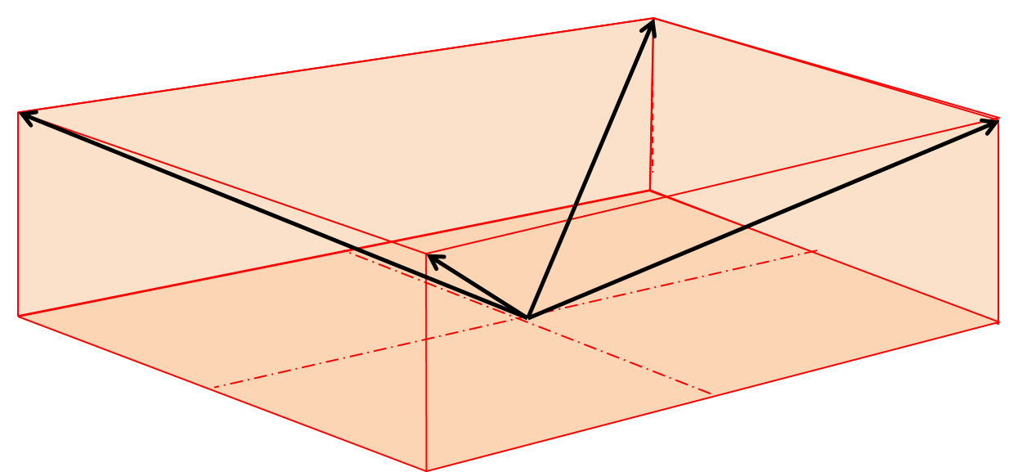
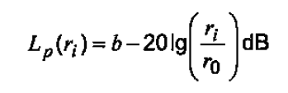
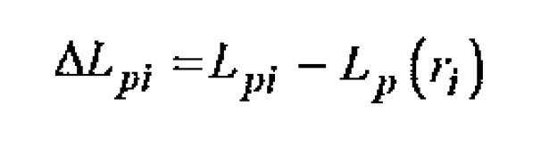
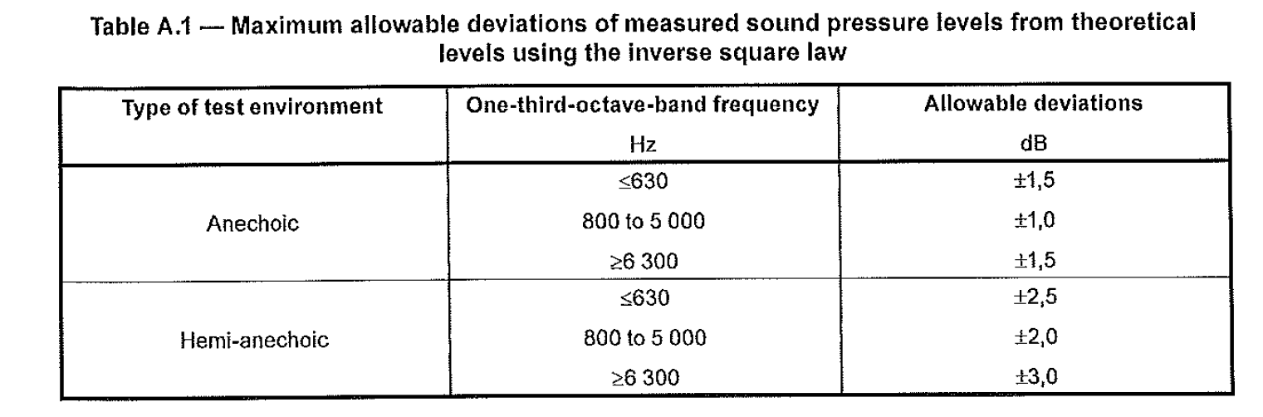
Part I – Anechoic environment (§6.2)
  A brief information on ISO 26101

Slide 4
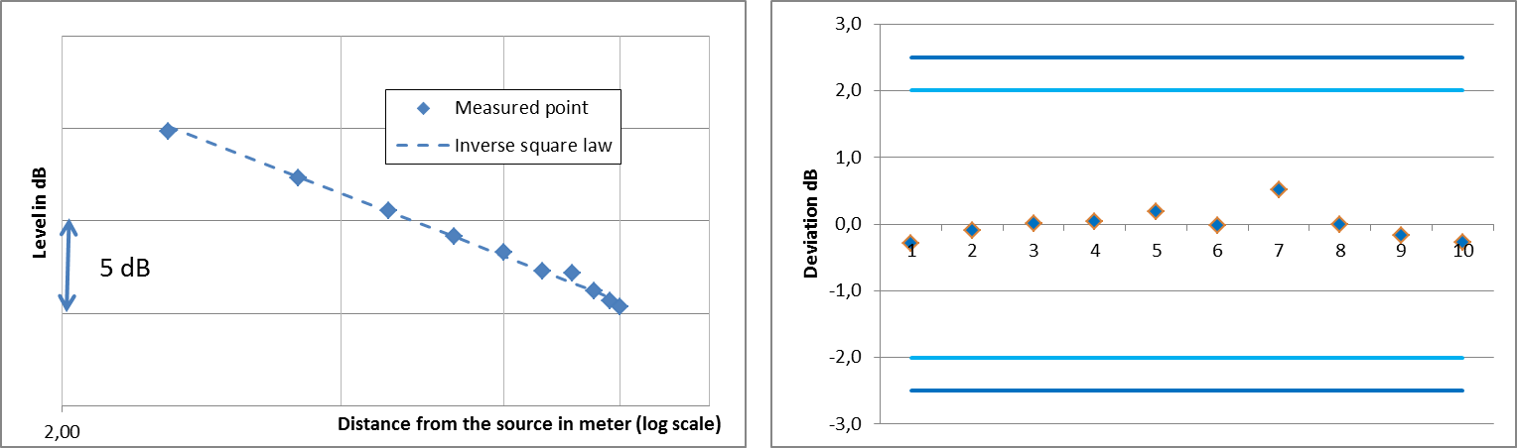
Part I – Anechoic environment (§6.2)
A brief information on ISO 26101

Slide 5
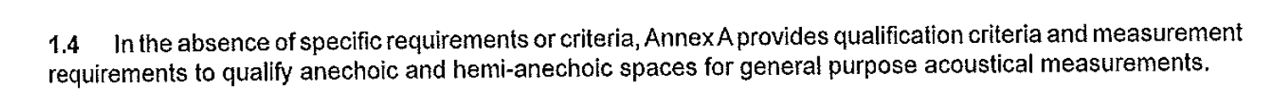
Part I – Anechoic environment (§6,2)
A brief information on ISO 26101
  ISO 26101.2012 is equivalent to Annex A from ISO 3745.2003.
  Project ISO 3745/A1 : Replace Annex A by reference to ISO 26101:2012
    Annex A from ISO 3745.2003 is dedicated to room qualification for sound power level (source on floor, …)
For other application ISO 26101 permit to define specifics requirements :

Slide 6
Part I – Anechoic environment (§6.2)
These specific requirements are :
Space to be deemed anechoïc :
  Annex A : No specification – It can be the full room
Test sound source location :
  Annex A : centre of room, on the floor)
Microphone transverses :
  Annex A : 5 transverse path – Usually from center to corner of the room
Qualification bandwith :
  Typical of the spectral characteristic of the type of sources that will be measured
Generation of sound
  Discrete-frequency noise or random
Spatial resolution of measurement :
  Annex A : One-tenth waveleght < 1kHz and 25 mn > 1 kHz

Slide 7
Part II (§14.3.2)
The sound pressure level and other measurements shall be made according to the conditions specified in paragraph 6.2. of this Regulation.
→ 6.2 refers to anechoic environment only. Reference on open space are only on in a note :
The site may take the form, for instance, of an open space of 50 meters radius, the central part of which must be practically horizontal over a radius of at least 20 meters, the surface being of concrete, asphalt or a similar material, which must not be covered with powdery snow, tall weeds, or loose soil or cinders.
→Test could be done in open space or in semi-anechoic chamber

Slide 8
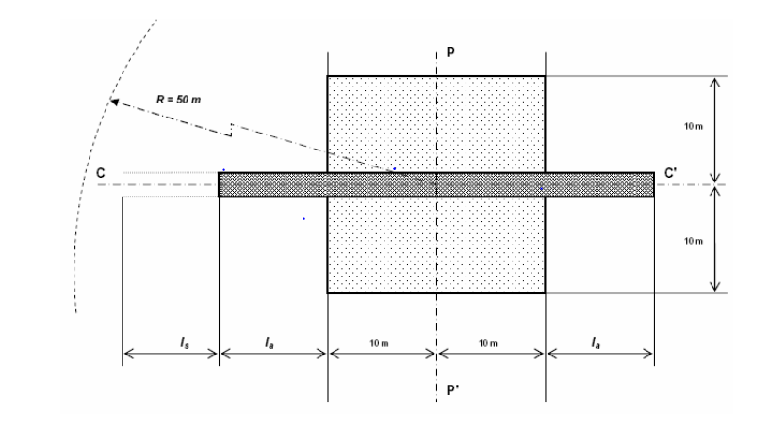
Part II (§14.3.2)
Definition of open space in ISO 10844.2014 :
Within a radius of 50 m around the centre of the track,, the space shall be free of large reflecting objects such as fences, rocks, bridge or building.
Question : What is a large reflecting objects ?

Slide 9
Part II (§14.3.2)
Definition of open space in Regulation ECE117, ECE41, ECE63 :
The test site shall be such that the conditions of a free sound field between the sound source and the microphone are attained to within 1dB(A). These conditions shall be deemed to be met if there is no large sound reflecting object such as fences, rocks, bridges or building within 50 m of the centre of the measuring section.
Question : What is a free sound field attained to within 1dB(A) ?

Slide 10
Part II (§14.3.2)
For semi-anechoic, ISO 26101 is applicable
→ Question : Is it applicable also to open space ?

Slide 11
Part I – 6.3.2.
The device to be tested and the microphone shall be placed at the same height.
This height shall 1.20 ± 0.05 m.
→ In an anechoic environment, only the distance between the device and microphone is important if :
  minimum distance to the absorber (λ/4) is respected,
  it corresponds to a microphone transverse.

Slide 12
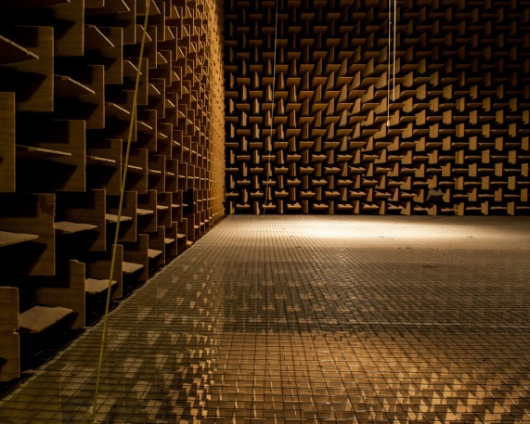
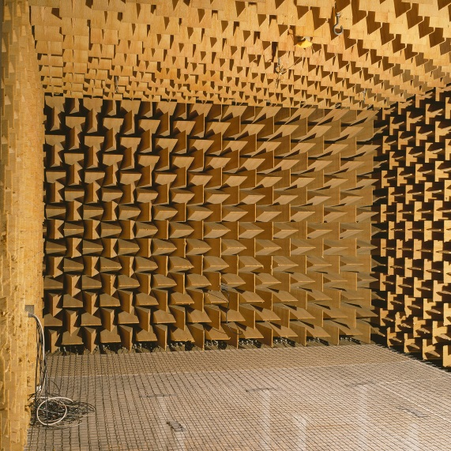
Part I – 6.3.2.
Which floor to be considered ?
1,2 m
1,2 m

Slide 13
Part I – 6.3.2.
Both example should be valid :
> λ/4
2 m
> λ/4
2 m

Slide 14
IEC 61672 – Sound level meter
IEC 61672 :
IEC-651.1979 and IEC 804.1985
IEC-61672-1.2002 - Specifications
IEC 61672-2.2003 - Pattern evaluation tests
IEC 61672-3.2006 - Periodic tests
IEC 61672-1:2013- Specifications
IEC 61672-2.2013 - Pattern evaluation tests
IEC 61672-3.2013 - Periodic tests

Slide 15
IEC 61672 – Sound level meter
Brief information on IEC 61672
Performance specifications :
Frequency weightings, Level linearity, Self-generated noise, Time weightings F and S, Toneburst response, Response to repeated tonebursts, Overload indication, Peak C sound level
Adjustments to indicated levels, Directional response, Under-range indication, Reset, Thresholds, Display, Analogue or digital output, Timing facilities, Radio frequency emissions and disturbances to a public power supply, Crosstalk, Power supply
Environmental, electrostatic, and radio frequency criteria :
Static pressure, Air temperature, Humidity, Electrostatic discharge, AC power frequency and radio frequency fields
IEC 61672-3
IEC 61672-1

Slide 16
IEC 61672 – Sound level meter
Example on Level linearity :
Frequency
Level

Slide 17
IEC 61672 – Sound level meter
Question : Why IEC 61672-3 ?
The procedures defined in IEC 61672-3 were intended to “… assure the user that the performance of a sound level meter conforms to the requirements of IEC 61672-1:2002 for a limited set of key tests …”
No environmental tests, electrostatic tests, radio frequency tests, …

Slide 18
IEC 61672 – Sound level meter
Question : Difference between IEC 61672.2002/2006 and IEC 61672.2013 ?
First information :
New techniques for assessing compliance with the allowable tolerance of the measurement data provided
  Reduction of the allowable tolerance and increase of maximum expanded uncertainties
Additional tests :
  Long term stability of the SLM (25 to 35 min) at 1 kHz
  Stability of the SLM when measuring high noise levels at 1 kHz
It seems that there is potential for some instruments to fail a given test when assessed in accordance with 2013 version compared to 2002/2006 version.
→ It has to checked more precisely to conclude.

Slide 19
IEC 61672 – Sound level meter
Question : Why using IEC 61672-3 instead of IEC 61672-1 for compliance ?
It is economically impossible to verify the whole IEC 61672-1 standard requirements one each item of an computerized data acquisition systems model. Until now, it seems that no IEC 61672-1 conformity has been given to computerized data acquisition systems on the market and the users cannot prove the instrumentation conformity required by the test code.
Additional Proposal :
When no general statement or conclusion can be made about conformance of the sound level meter model to the full specifications of IEC 61672-1, the apparatus used for measuring the sound pressure level shall be a sound level meter or equivalent measurement system meeting the requirements of Class 1 instruments as described in IEC 61672-3.

