Slide 1
Informal document GRSG-109-25
(109th GRSG, 29 Sept.-2 October 2015,
agenda item 17)
Report to GRSG from ambassador to IWVTA
Olivier Fontaine / Ignacio Lafuente

Slide 2
Report to GRRF from ambassador to IWVTA
Summary
01_ Meeting calendar
02_ March 2015 meeting
03_ June 2015 meeting
04_ September 2015 meeting
05_ Question form IWVTA to GRSG

Slide 3
Report to GRSG from ambassador to IWVTA
Meeting calendar - updated
IWVTA meetings held between the 108th and the 109th GRSG sessions.
108th GRSG
109th GRSG
WP29 166th session
Reference document: SGR0-16-07

Slide 4
Report to GRSG from ambassador to IWVTA
List of highlighted documents – March 2015
London, March 2015: 15th SGR0 and SGR58 sessions
15th SGR0
SGR0-16-01 Major results and Action items
15th SG58
SGR58-16-01 Major results and Action items
17th IWVTA Meeting
IWVTA-18-01 Minutes of the 16th Session of the Informal Group of IWVTA

Slide 5
Report to GRSG from ambassador to IWVTA
List of highlighted documents – June 2015
Berlin, June 2015: 16th SGR0 and SGR58 sessions
16th SGR0
SGR0-17-01 Major results and Action items
16th SG58
SGR58-17-01 Major results and Action items
18th IWVTA Meeting
IWVTA-19-01 Minutes of the 18th Session of the Informal Group of IWVTA

Slide 6
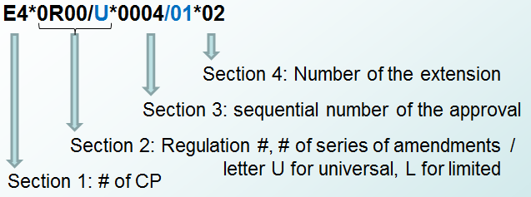
Report to GRRF from ambassador to IWVTA
Relevant facts – March & June 2015
London, March 2015: 15th SGR0 and SGR58 sessions
Berlin, June 2015: 16th SGR0 and SGR58 sessions
Definitions were introduced: SGR0-16-12
“vehicle type” which could contain all variants regardless of their level of conformity
“IWVTA type” which contains variants with one level of conformity within the vehicle type.
IWVTA approval number:

Slide 7
Report to GRSG from ambassador to IWVTA
Relevant facts – March & June 2015
London, March 2015: 15th SGR0 and SGR58 sessions
Berlin, June 2015: 16th SGR0 and SGR58 sessions
The possibility of changing between U-IWVTA and L-IWVTA has been excluded from the communication form. (UNR0 - Annex 1) SGR0-17-04
Inclusion of the composition of the type approval number. (explanation: UNR0 - Annex 8) SGR0-17-04

Slide 8
Report to GRSG from ambassador to IWVTA
Relevant facts – March & June 2015
London, March 2015: 15th SGR0 and SGR58 sessions
Berlin, June 2015: 16th SGR0 and SGR58 sessions
Germany will coordinate in a pre-test for UN R0 which includes application for approval, granting of approval, etc. By SGR0-17 meeting a detailed plan for pre-testing will be defined.
Agreement on exclude UN R0 from the use of unique identifier as approval marking because it has not added value. SGR0-16-04
Agreement on reserving the provisions on masses and dimensions of vehicles until the establishment of harmonized procedures.
A name has to be found for the permanent informal group. Final decision on September meeting.
DETA software will provide a query by the type approval number, not by the VIN as was first suggested.

Slide 9
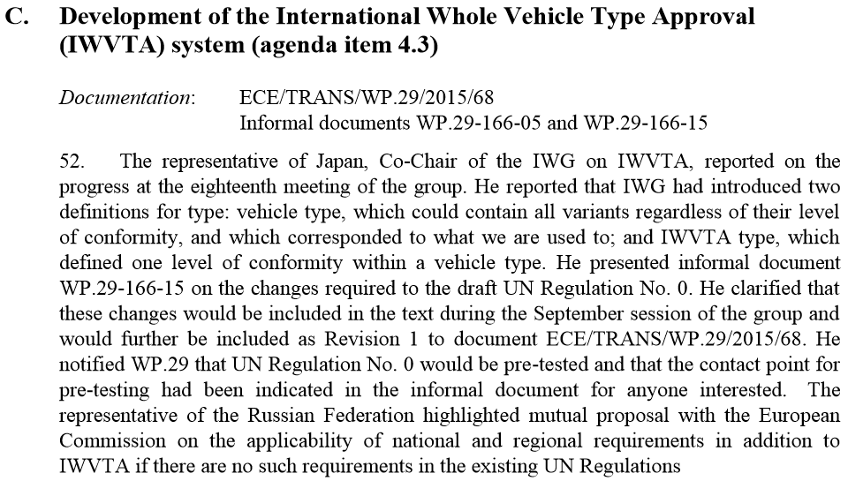
Report to GRSG from ambassador to IWVTA
List of highlighted documents – June 2015
Geneva, June 2015: WP29 166th session

Slide 10
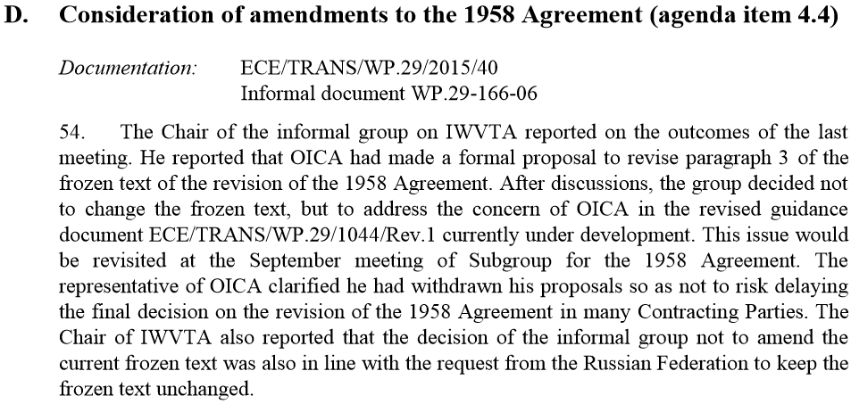
Report to GRSG from ambassador to IWVTA
List of highlighted documents – June 2015
Geneva, June 2015: WP29 166th session

Slide 11
Report to GRSG from ambassador to IWVTA
List of highlighted documents – September 2015
Brussels, September 2015: 17th SGR0 and SGR58 sessions
17th SGR0
SGR0-18-01 Major results and Action items
17th SG58
SGR58-18-01 Major results and Action items

Slide 12
Report to GRSG from ambassador to IWVTA
Relevant facts – September 2015
Brussels, September 2015: 17th SGR0 and SGR58 sessions
Pre-testing task force:
In the first meeting there were a lot of participants and test cases were argued.
First step: issue of initial approvals
1. U-IWVTA
2. L-IWVTA
Second and third steps:
Exercise any other possibility: issue only U-IWVTA or L-IWVTA.
→ extend from U-IWVTA to U-IWVTA or from L to L
→ split U-IWVTA into to U-IWVTA and L-IWVTA.
→ Degrade from U to L, upgrade from L to U….

Slide 13
Report to GRSG from ambassador to IWVTA
Relevant facts – September 2015
Brussels, September 2015: 17th SGR0 and SGR58 sessions
At the next meeting (November):
It will be discussed whether these two cases are enough.
Each Approval Authority willing to participate in the pre-testing task force will have to look for at least one manufacturer to collaborate with.
Each Approval Authority will do all cases proposed.

Slide 14
Report to GRSG from ambassador to IWVTA
Question from IWVTA to GRSG
Update the regulations under GRSG responsibility on list B (SGR0-16-08-rev.2)
.
 |  |  | Outline of the proposed amendments and the expected date of agreement on the proposal
No. | Topic | UN-R | Doc. No. | Sponsor or Author | Outline of the amendments | Expected agreement date by GR | Expected agreement date by WP.29 | Note
5 | Fuel tanks | 34 | GRSG-106-20 & 39 | Japan | Extension of scope for mandating rear collision test to vehicles of category M1&N1 < 2,8t | May, 2014 | November 2014 | Note: R34-03 was approved by WP.29 at its 164th session. R34-03 would be proposed to be included in List A (Annex 4, Section I of UN R0) at 173th WP.29 session (November, 2017).
6 | Indirect vision devices | 46 | GRSG/2014/26 GRSG-108-17-Rev.1 | Japan | Inserts a provision to the scope such that the regulation does not apply to devices other than those covered by the regulation | May, 2015 | November, 2015 | Proposal per document TRANS/WP.29/2015/84 by GRSG to be adopted at WP.29-167 as Suppl.2 to R46.04.
*Note: IWVTA Informal Group sought the advice of 165th WP.29 on resolving the uncertainty in applying R116. (SG R0 members do not have common understanding on whether immobilizer system would be mandatory or not by the current text of R116.)

Slide 15
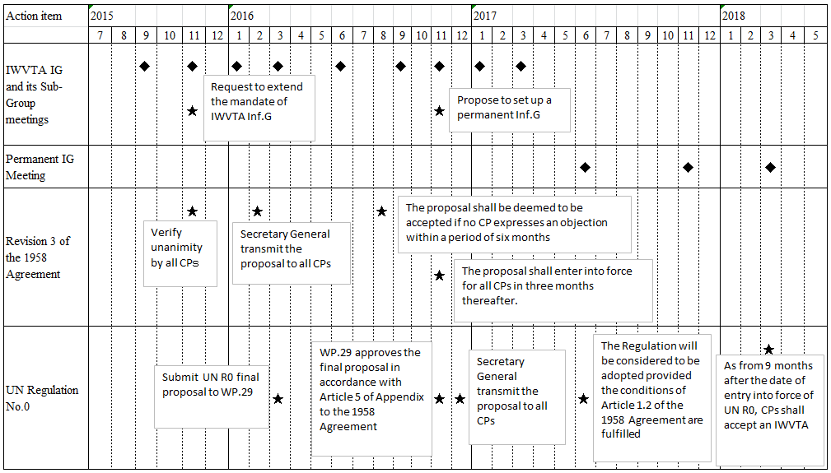
Report to GRSG from ambassador to IWVTA
IWVTA informal group working schedule
IWVTA-19-04

Slide 16
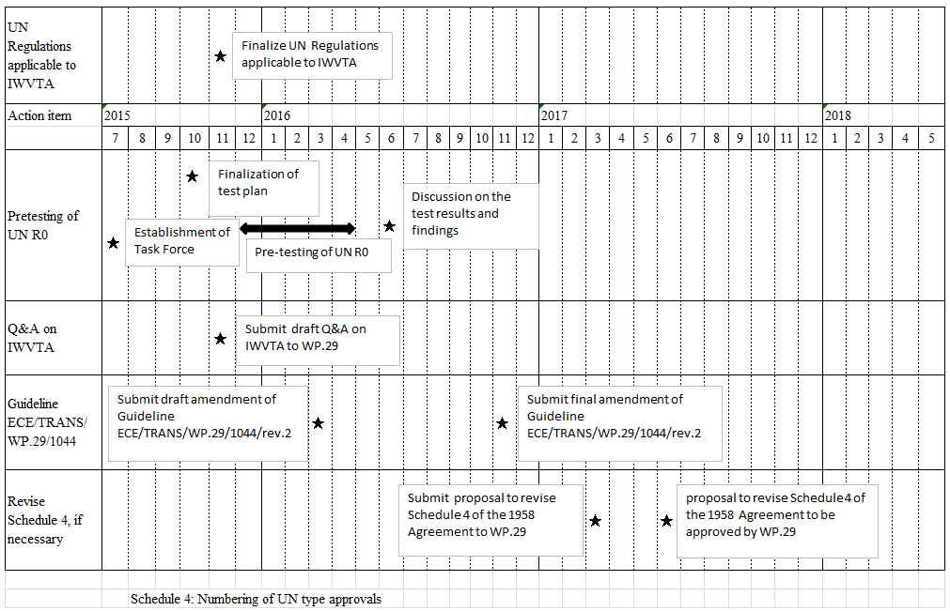
Report to GRSG from ambassador to IWVTA
IWVTA informal group working schedule (cont.)

Slide 17
Thank you very much for your kind attention
Questions?
Olivier Fontaine
GRSG ambassador to IWVTA
ofontaine@oica.net

