Slide 1
Background of the Proposals for amending R49 Rev 6 (Document TRANS/WP.29/GRPE/2014/12)
Informal document GRPE-69-08
(69th GRPE, 5-6 June 2014
agenda item 4(b))

Slide 2
List of the proposed amendments
Transposing the latest EU OTLs and their date of application
Deletion of the obligation to monitor urea consumption
Improvement of the definition of CDmin
Stop-start and hybrid vehicles – OBD changes
Alternative service mode for LNG dual-fuel vehicles

Slide 3
Transposing the latest EU OTLs and their date of application
Introduction of the CO OTL for gas engines as from “letter B”
Introduction of the PM OTL (“soot sensor”) as from “letter C”
For LCVs: introduction of the optional OTL equivalency with the ones of the cars (alternative type-approval)

Slide 4
Deletion of the obligation to monitor urea consumption
Current state of technology: usage of close-loop strategies
In particular there is constant adaptation of the reagent demand to the actual NOx reduction need, whatever the root cause.
Current world-wide regulatory state: no urea consumption monitoring
True in particular in the very recent EU rules for non-road mobile machineries
Current manufacturers state of experience: no report from the field of actions aiming at tampering the urea consumption
Manipulation of the diagnostic systems is clearly the preferred tampering means
Would need substantial hardware changes → Risks at PTI and for the warranty
All other tampering monitoring requirements are kept unchanged:
not refilling of the reagent tank,
interrupting the dosing activity,
using an improper reagent concentration,
monitoring failures that may be attributed to tampering (incl. failures of the anti-tampering monitoring system)

Slide 5
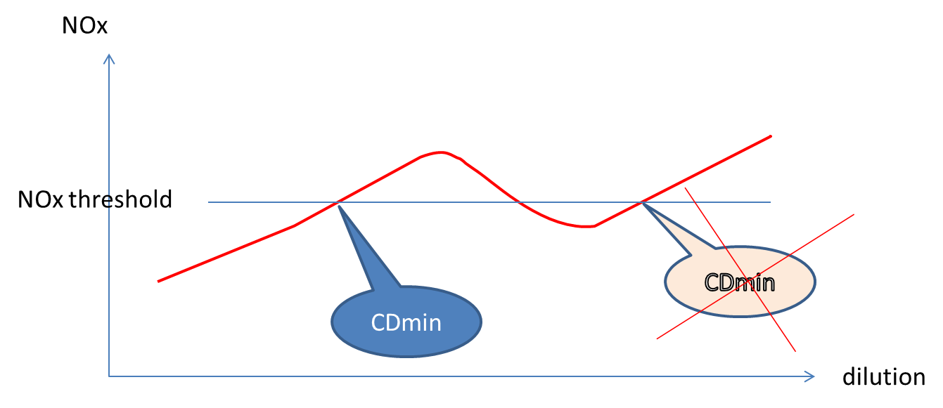
Improvement of the definition of CDmin
Current text: no close-loop systems, no place for “strange strategies”
In line with the Nov 2013 certification guideline from the US EPA

Slide 6
Stop-start and hybrid vehicles OBD changes
Modification of OBD requirements to permit these technologies
Typical examples of modifications:
For vehicles that employ engine shut-off strategies that are commanded by the engine control system (for example hybrid bus with engine shut-off at idle) and that are followed by an engine cranking, the (engine shut-off – engine cranking) sequence shall be considered as part of the existing operating sequence.
In the case of a hybrid vehicle, the operating sequence shall start at the time of the engine start or at the time when the vehicle starts moving, whichever occurs first

Slide 7
Alternative service mode for LNG dual-fuel vehicles
Limit the power of the engine to 20% of the declared maximum power in dual-fuel mode
Would apply only in the case when the gas has been drained out for repair reasons
Would apply only to Type A dual-fuel engines (No Diesel mode)
Rationale: Very poor density of LNG filling stations in some areas would oblige either towing or long distance operating at 20km/h

