Slide 1

Submitted by the expert from the European Association of Automotive Suppliers (CLEPA) | Informal document GRVA-09-06 9th GRVA, 1-5 February 2021 Provisional agenda item 8(b)
UN R13 and Electro Mechanical Brakes

Slide 2
UN R13 and Electro Mechanical Brakes (EMB)
Introduction
UN Regulation 13 defines:
Transmission means the combination of components comprised between the control and the brake and linking them functionally. The transmission may be mechanical, hydraulic, pneumatic, electric or mixed.
Control Transmission - means the combination of the components of the transmission which control the operation of the brakes, including the control function and the necessary reserve(s) of energy.
Energy Transmission - means the combination of the components which supply to the brakes the necessary energy for their function, including the reserve(s) of energy necessary for the operation of the brakes.
→ The transmission may be mechanical, hydraulic, pneumatic, electric or mixed.
UN R13 was updated in 1990s to account for an electronic “Control Transmission” but still assumes Pneumatic “Energy Transmission” in the service braking system.
Pneumatic Energy limitation is shown in two ways:
Design Specifications – E.g. Where limits are in kPa.
Design Limitations – E.g. Where it is assumed air is the medium.
Electro Mechanical Brake Technology is being developed by the industry using Electric Energy Transmission in the service braking system and the UN R13 needs to be updated accordingly.

Slide 3

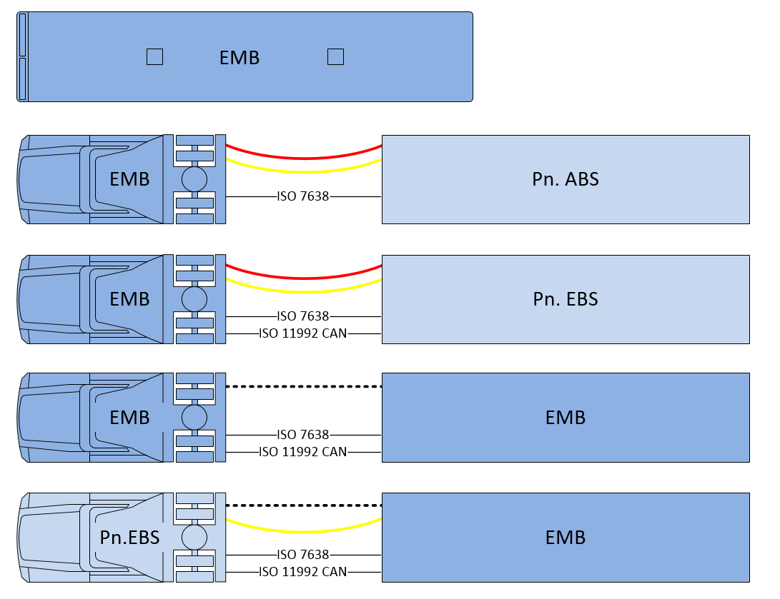
UN R13 and Electro Mechanical Brakes (EMB)
Amendment scope and motivation
Motor vehicle with EMB brakes on all axles (not mixed with Pneumatic Or Hydraulic systems)
Motor vehicle with EMB brakes with “conventional” trailer interface according to UN R13
Trailers with EMB excluded from scope
UN R13-H not included but considered, in particular when creating new definitions
Advantages and possibilities by amending Electric Energy Transmission to UN R13
Improved energy efficiency in EV´s (vs. air compressor)
Improved braking control
Elimination of noise emissions from pneumatics

Slide 4
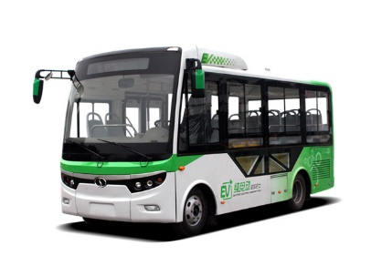
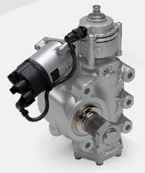
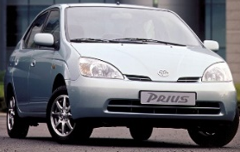
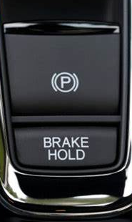
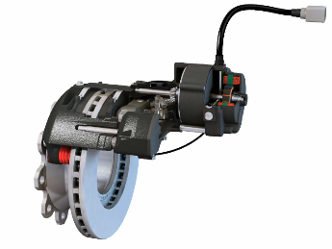
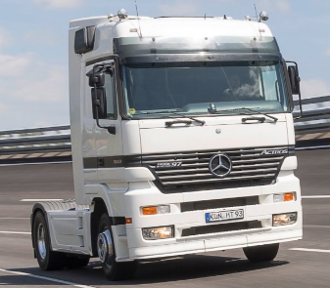
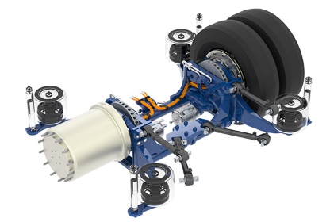
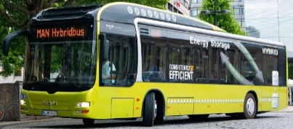
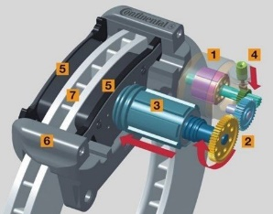
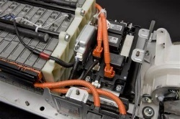
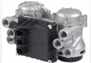
UN R13 and Electro Mechanical Brakes (EMB)
Electrification Development
Improved Vehicle Dynamics Control
Emission reduction
Energy efficiency
EMB in Commercial vehicles – (electronic control transmission and electric service braking)
Full Electric Vehicles
Electric Power Steering
Electric parking brake
Hybrid Electric vehicles
EBS in Commercial vehicles – (electronic control transmission)
1995
2025

Slide 5
UN R13 and Electro Mechanical Brakes (EMB)
Electrification Development
Improved Vehicle Dynamics Control
  Reduced response time enhancing braking performance.
  Optimized control of safety functions like ABS, ESP, AEBS or Traction control.
Emission reduction
  Reduction of noise vs. pneumatic brake systems.
Energy efficiency
  Significant higher energy efficiency vs. pneumatic brake systems.
  Potential to reduce CO2.
Other
  Weight and space savings
  Easier packaging

Slide 6
ECE-R13 and Electro Mechanical Brakes (EMB)
Main parts to be amended
2. Definitions
New paragraphs defining Electric Energy Transmission ( e,g Energy Source, Electrical Storage device, Electrical Supply device)
5.1.4.6 Reference Braking forces
New paragraph 5.1.4.6.2.
Reference braking forces for electro-mechanical braking system using a roller brake tester shall be defined according to the following requirements.
5.2 Characteristics of Braking Systems.
New paragraph 5.2.1.34.
Special additional requirements for service braking systems with electric control and energy transmissions.
Annex 7, (provisions relating to energy supply and storage)
New Part D
Electro-mechanical Braking system

Slide 7
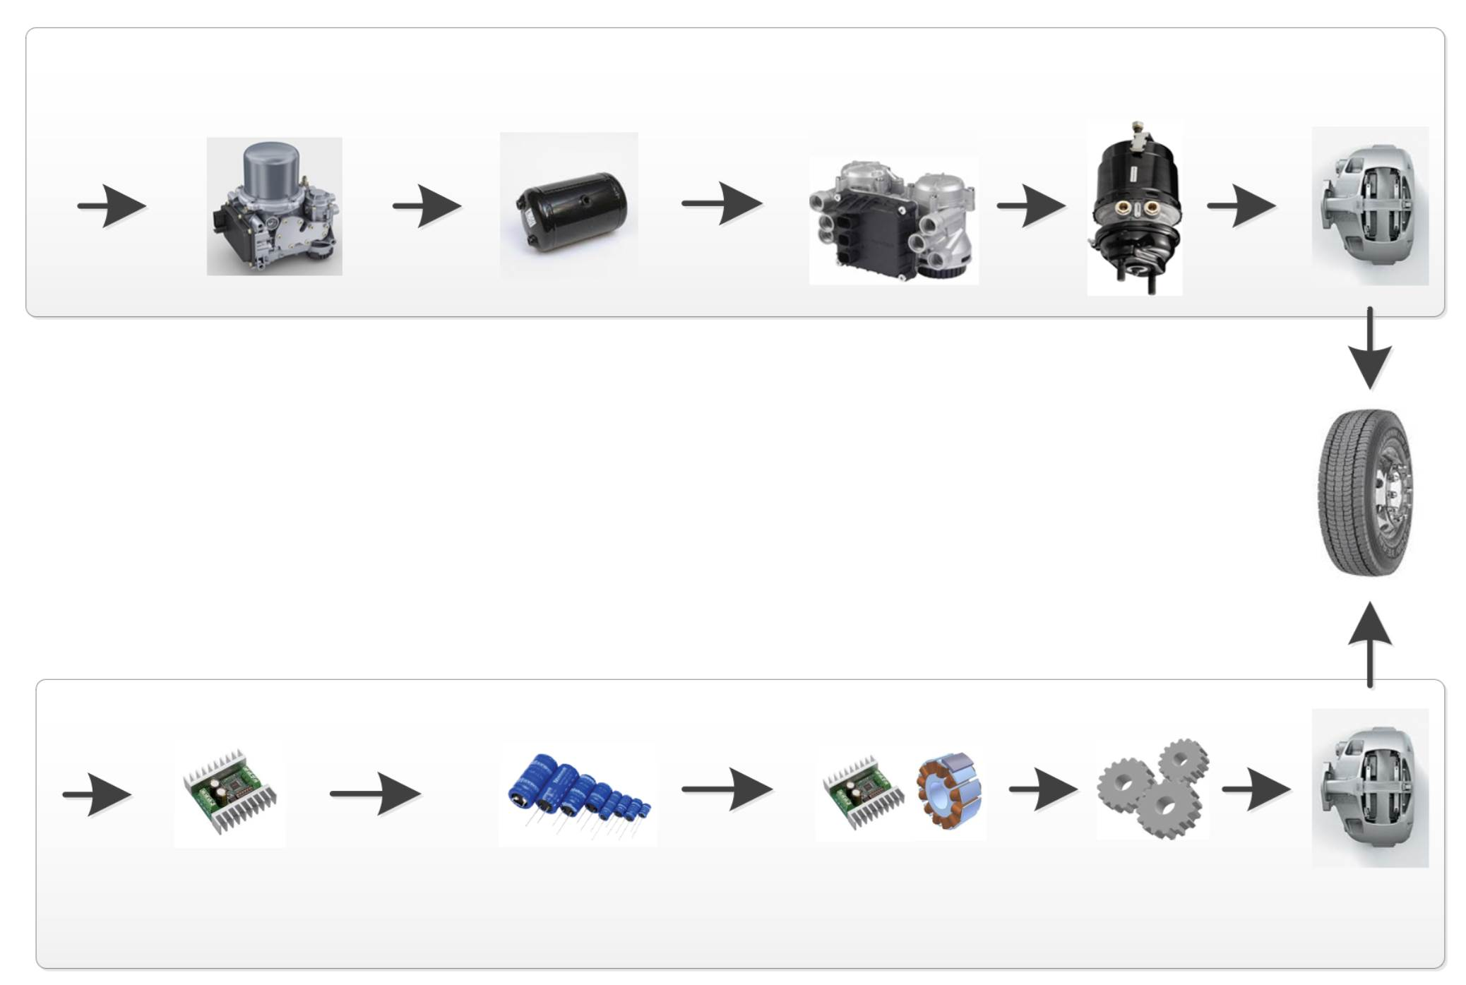
UN R13 and Electro Mechanical Brakes (EMB)
Energy Transmission principles (Pneumatic vs. Electric)
E-APU
Pneumatic energy
storage
EBS Modulator
Actuator
Caliper
Pneumatic
Energy
EBS
Annex 7 part A
Energy supply
Energy storage
Actuation
EMB
Annex 7 new part D
New 5.2.1.34.
Electric
Energy
DC/DC
Electric energy storage
Drive and Motor
Gears
Caliper
7

Slide 8
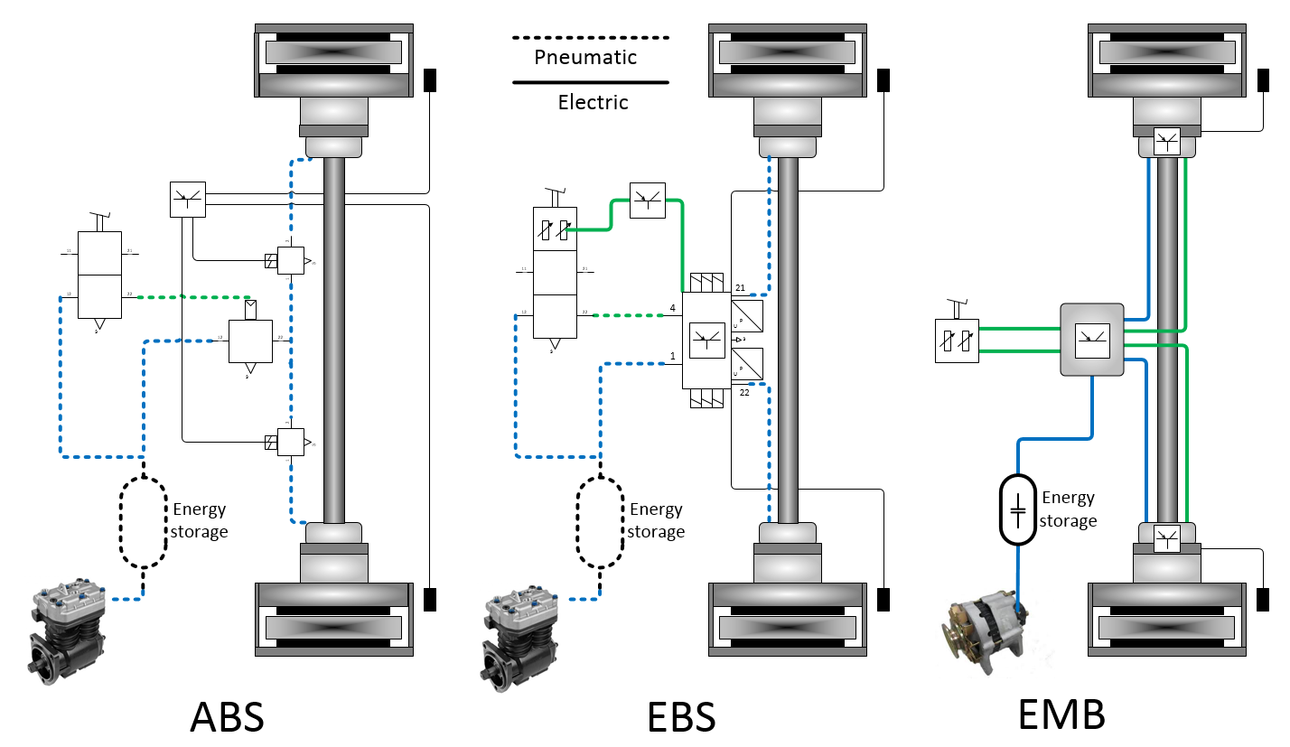
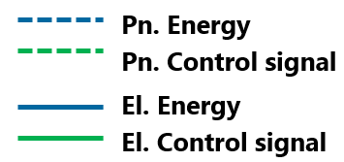
UN R13 and Electro Mechanical Brakes (EMB)
Development steps comparison
Principal layouts shown

Slide 9
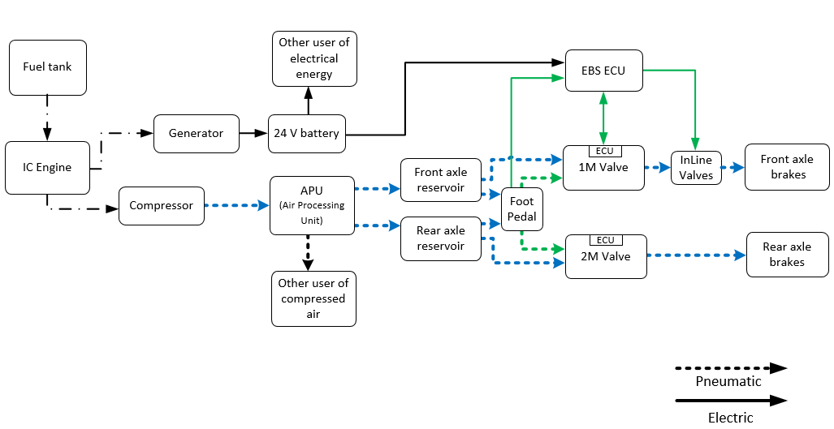
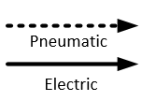
System Description
Example EBS system of today in vehicle with combustion engine
Control Transmission
(example shown only front axle)
Energy Source
p1
Energy Source
p2
Pneumatic
Storage Device
Energy Transmission
p1 and p2: Pneumatic energy monitoring and warning if storage falls below a certain level.

Slide 10
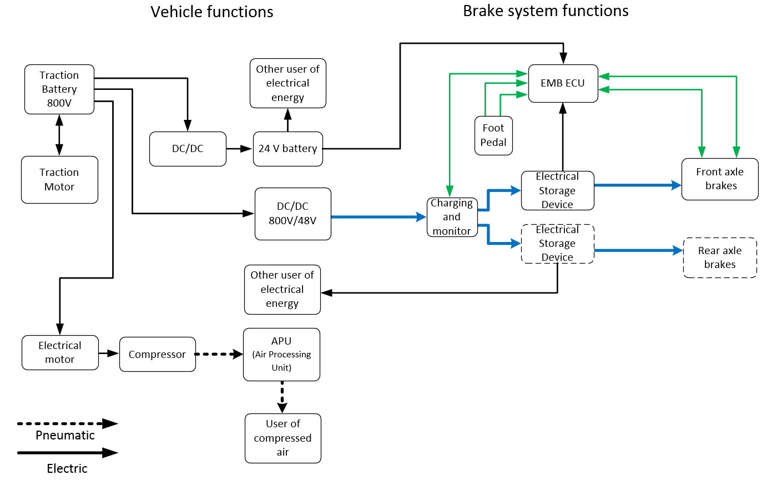
System Description
Example EMB system in electric vehicle
Control Transmission
(example shown only front axle)
ew1
Pw
Energy Supply Device
ew2
Energy Source
Electrical Storage Device
Energy Transmission
Pw: Electric energy monitoring and warning if charging demand cannot be met and if below a certain level.
ew: Electric energy monitoring and warning if storage falls below a certain level.

Slide 11
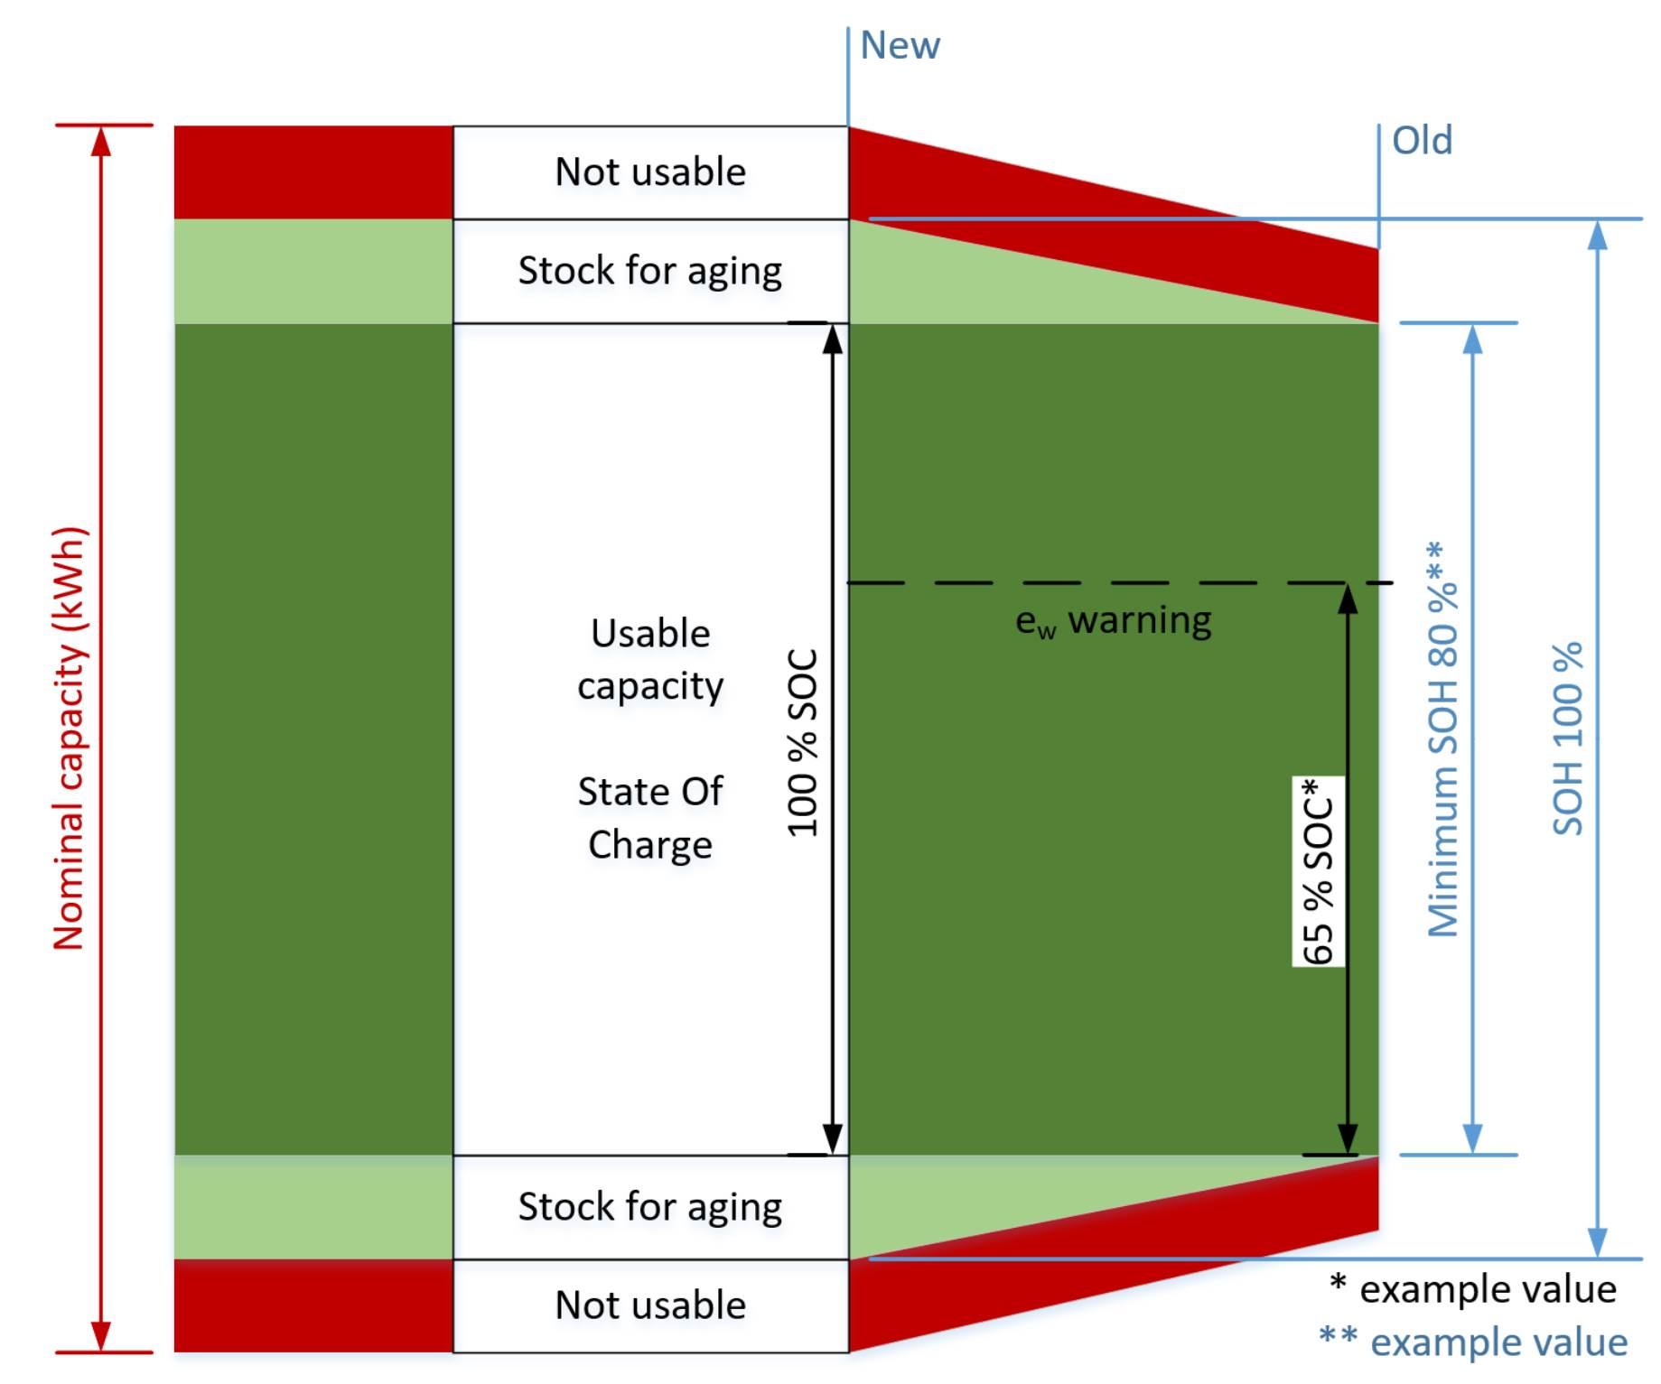
System Description
Energy content of electric storage device – example battery
Usable capacity taking battery ageing into account.
SOC reference (100%) remains constant.
Minimum SOH defines usable capacity.

Slide 12
UN R13 and Electro Mechanical Brakes (EMB)
Status and open topics still to be discussed
Comments and feedback collected until December 2020 have been captured and incorporated in the informal document distributed.
Recent comments and feedback collected during January 2021 will be reviewed during the next coming months in separate workshops.
Main topics to review and define further:
The principles for PTI.
Clarification to open questions related to Electrical Energy Storage devices vs. a Pneumatic Reservoir.

