Slide 1
Status Report to the 8th GRVA Session
Informal document GRVA-08-19 8th GRVA session, 14-16 December 2020 Agenda item 3(a)
Remote Virtual Session
14 December 2020

Slide 2
FRAV Sessions
Eight sessions held to date
Last session held on 8 December
Next session scheduled for 12 January
About 80-90 participants per session
Excellent engagement during the sessions
Diverse expertise contributing to robust discussions
Agreed on strategy to enable safety requirements applicable to any ADS configuration
Baseline requirements covering all aspects of safety
Application of requirements dependent upon individual ADS intended uses and limitations
Understanding of individual ADS enabled by uniform approach to ADS description, including measurable/verifiable ODD boundaries

Slide 3
Review of FRAV Points of Consensus (1/2)
“Automated Driving System” (ADS) means the hardware and software that are collectively capable of operating a vehicle on a sustained basis.
FRAV requirements specifically regard the ADS and its performance in the operation of a vehicle.
Operational Design Domain (ODD) refers to the operating conditions under which an ADS is designed to function.
ADS may be designed to function under more than one discrete set of operating conditions (i.e., more than one ODD).
“(ADS) feature” means an application of ADS hardware and software designed specifically for use within an ODD.
An ADS may have one or more features as defined by their unique ODD.
“Operational Design Domain” means the operating conditions under which an ADS feature is specifically designed to function.
In operation, the ADS continuously controls the vehicle motion, monitors the vehicle environment, interacts with other road users, and determines responses to road and traffic conditions (collectively known as the Dynamic Driving Task (DDT)).
The ADS has functions that collectively perform the entire DDT while the ADS is in use.
The ADS monitors the functions and safely manages failure modes when detected.
The ADS functions enable the features to operate the vehicle within the ODD of the feature.
An ADS feature may use all or some of the functions of the ADS.
ADS features may share ADS functions.
An ADS should be assessed based on its intended use(s) and limitations on the use of its features.
ADS requirements should be technology-neutral and performance-based.

Slide 4
Review of FRAV Points of Consensus (2/2)
ADS requirements should be applicable across the anticipated diversity of configurations (i.e., features and functions).
ADS assessments require information specific to the configuration of the ADS (i.e., features, functions, ODD, other usage specifications).
Manufacturers provide the information specific to the ADS design and intended uses.
FRAV will define mandatory requirements for ADS descriptions (i.e., ODD elements, other usage specifications).
The manufacturer description of the ADS provides a means to determine the application of the ADS performance requirements.
The NATM process should begin with a review of the ADS description to verify fulfillment of the mandatory description requirements and to determine the application of the performance requirements.
The ADS requirements should be derived from the following safety perspectives:
The ADS should drive safely.
The ADS should interact safely with the user.
The ADS should manage safety-critical situations.
The ADS should safely manage failure modes.
The ADS should maintain a safe operational state.

Slide 5
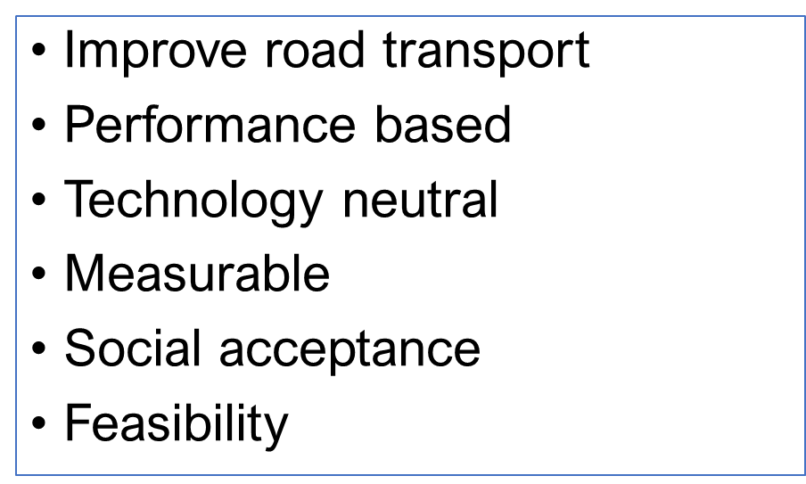
Main Areas of Current Discussion
Definitions
Especially “User” and variations on roles/responsibilities
Principles for Overall Level of ADS Safety
Deployment in human-dominated traffic
Elimination of human errors in crash causation
Prevention of unreasonable new risks
Top-Down Elaboration of Safety Requirements
Five starting points based on critical safety perspectives
ADS should drive safely
ADS should interact safely with the user
ADS should manage safety-critical situations
ADS should safely manage failure modes
ADS should maintain a safe operational state
40 subtopics identified for detailed discussion

Slide 6
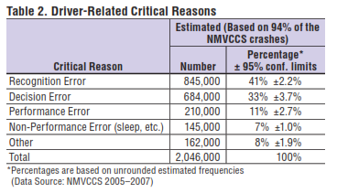
Overall Level of Safety
ADS performance should be consistent with safe human driving behaviors while avoiding human recognition, decision, and performance errors and the introduction of unreasonable ADS-specific risks.
“Careful and competent human driver”
Build out data on human responses to traffic situations
“State-of-the-art” based on technological feasibility
Define technical parameters within range of optimal human behaviors
“Safety envelope”
Mathematical formulas based on technical parameters and conditions
Statistical “positive risk balance”
Optimal human behaviors omitting human errors

Slide 7
FRAV Subtopics
The ADS should perform the entire Dynamic Driving Task.
The ADS should control the longitudinal and lateral motion of the vehicle.
The ADS should recognize the ODD conditions and boundaries of the ODD of its feature(s).
The ADS should detect, recognize, classify, and prepare to respond to objects and events in the traffic environment.
The ADS should respect traffic rules.
The ADS should interact safely with other road users.
The ADS should adapt its behavior in line with safety risks.
The ADS should adapt its behavior to the surrounding traffic conditions.
The ADS should not disrupt the flow of traffic.
The ADS behavior should not be the critical factor in causation of a collision.
Activation of an ADS feature should only be possible when the conditions of its ODD have been met.
The ADS should signal when conditions indicate a probable ODD exit.
The user should be permitted to override the ADS to assume full control over the vehicle.
The ADS should safely manage transitions of full control to the user.
Prior to a transition of control to the user, the ADS should verify the availability of the user to assume control.
Pursuant to a transition, the ADS should verify full control of the vehicle by the user prior to deactivation.
The ADS should tolerate user input errors.
The ADS should provide feedback to the user on its operational status.
The ADS should warn the user of failures to fulfill user roles and responsibilities.
The user should be provided with information regarding user roles and responsibilities for the safe use of the ADS.

Slide 8
FRAV Subtopics
The ADS should recognize and respond to road-safety agents.
The ADS should mitigate the effects of road hazards.
The ADS should execute a Minimal Risk Maneuver (MRM) as conditions warrant.
In the absence of a fallback-ready user, the ADS should fall back directly to an MRM.
The ADS should execute an MRM in the event of a failed transition of full control to the user.
Pursuant to an MRM, the ADS should place the vehicle in a Minimal Risk Condition (MRC) prior to deactivation.
The ADS should signal an MRM.
Upon completion of an MRM, a user may be permitted to assume control of the vehicle.
ADS vehicles that may operate without a user-in-charge should provide means for occupant communication with a remote operator.
The ADS should manage short-duration transitions between ODD.
Pursuant to a collision, the ADS should stop the vehicle and deactivate.
The ADS should detect system malfunctions and abnormalities.
The ADS should execute a safe fallback response upon detection of a failure that compromises performance of the DDT.
Provided a failure does not compromise ADS performance of the entire DDT, the ADS should respond safely to the presence of a fault in the system.
The ADS should signal faults and resulting operational status.
The ADS should be permanently disabled in the event of obsolescence.
Pursuant to a collision and/or a failure detected in DDT-related functions, ADS activation should not be possible until the safe operational state of the ADS has been verified.
The ADS should signal required system maintenance to the user.
The ADS should be accessible for the purposes of maintenance and repair to authorized persons.
ADS safety should be ensured in the event of discontinued production/support/maintenance.

Slide 9
Anticipated Work Plan
Build out understanding of human driver behaviors
Build out understanding of ADS capabilities vis-à-vis crash causation
Discuss safety subtopics in detail towards defining measurable/verifiable performance criteria
ODD conditions in measurable/verifiable terms
Other operational constraints on ADS use
Commonality in human-machine interfaces
Driving behavior (nominal and safety-critical conditions)
Transitions of control and fallbacks in the event of failures (user and system)
Combine data on human driving performance and ADS capabilities to determine optimal ADS performance limits

Slide 10
Documentation
FRAV has developed two documentation tools to support work
Document 4: Record of discussions and decisions
Document 5: Working text based on interim consensus and current draft provisions
Tools for documentation only—FRAV will prepare eventual proposals as separate documents based on Documents 4 and 5
FRAV intends to prepare submission(s) for February GRVA session
Explanation of strategy to enable safety requirements applicable to any ADS configuration (i.e., regardless of individual ADS ODD)
Update on topics identified as basis for elaborating requirements
Update on efforts to define criteria and methods for validating criteria
Expectations for deliverables

Slide 11
Thank you for your attention

