Slide 1
Electric Vehicles and the Environment (EVE IWG)
Submitted by the EVE informal working group
Informal document GRPE-82-36
82nd GRPE, 12-15 January 2021
Agenda item 9 (c)
Report to GRPE 82nd Session

Slide 2
EVE Mandate Items
In-vehicle battery durability
The EVE IWG continues to work diligently to meet tight timelines for the new UN GTR on battery durability.
Key framework components are still under discussion within the EVE IWG with the goal to remain on schedule.
An additional 1-year extension that has been granted is available should more time be required.
Hybrid power determination
New GTR on determination of power in electrified vehicles was accepted by WP. 29 in November 2020.
The EVE IWG will continue to monitor the status of the GTR as changes become needed
Method of stating energy consumption
The Group of Experts on Energy Efficiency (GEEE) was identified to take over the leadership of this work starting in 2020.

Slide 3
Status of In-Vehicle Battery Durability
Review of general goals of a durability GTR:
Establish minimum durability requirements
Prevent substandard products from entering the market
Allow continued development of the GTR as the industry evolves
Implement a data collection mechanism for improving the GTR in the future

Slide 4
Status of In-Vehicle Battery Durability
Previously EVE reported that the GTR would include four specific provisions:
State of Health monitor (SOH)
Minimum performance requirement (PR)
In service conformity checks (ISC)
Adoption of vehicle normal usage indices (NUI)
Note, EVE has not included NUI in the draft GTR, but depending on the final MPR value and form NUI may be required.
Working document has been submitted for this GRPE: GRPE-82-27e

Slide 5
State-of-Health Monitors
EVE has agreed to adopt (2) state-of-health monitors
SOCE – State of Certified Energy
Based on Usable Battery Energy (UBE)
SOCE = UBE_{current}/UBE_{Type Approval}
Used as the basis for MPR for the Phase 1 GTR
SOCR – State of Certified Range
Based on the initial range estimation for a vehicle
SOCR = Range_{current}/Range_{Type Approval}
GTR will not prescribe the algorithm for determining the SOCR
No MPR for SOCR in Phase 1
Monitor SOCR to inform a Phase 2 GTR

Slide 6
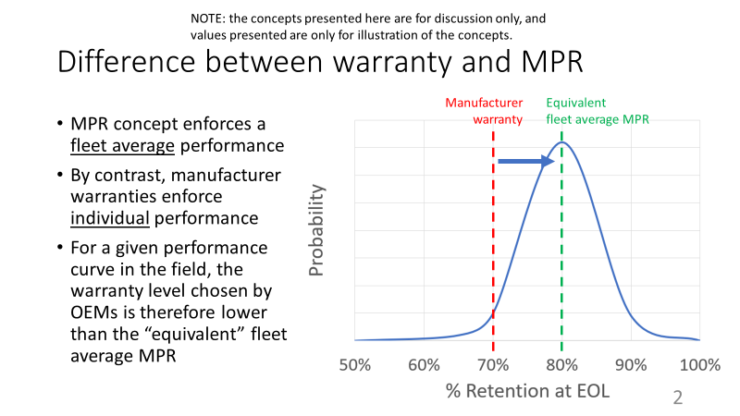
Minimum Performance Requirement (MPR)
EVE has agreed to adopt a single MPR for Phase 1 based on UBE
MPR expressed in percent UBE retained for x number of years or y distance traveled
No consensus reached on the exact value(s) for the MPR or the format of the requirements

Slide 7
MPR - Continued
EVE is considering sources of publicly available data as well as all other stakeholder input to inform the MPR
Warranty analysis
JRC TEMA Model
Geotab Data*
Presentations from Japan, European Commission, USEPA, Environment and Climate Change Canada and OICA
* Geotab data is a third-party estimate of remaining capacity, most likely derived from current and voltage and SOC readings that are accessed through the OBD. The Geotab data do not represent any manufacturer’s SOH.
www.geotab.com

Slide 8
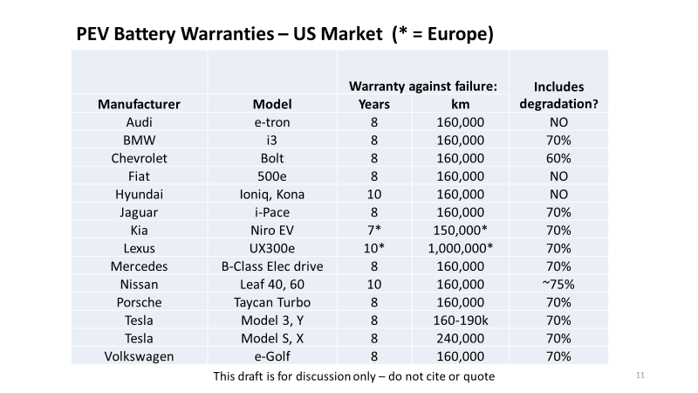
Warranty Analysis
Review of manufacturer warranties shows batteries are covered for failure for 7 to 10 years and 160,000 to 1 M km’s and degradation between 60 and 75%.

Slide 9
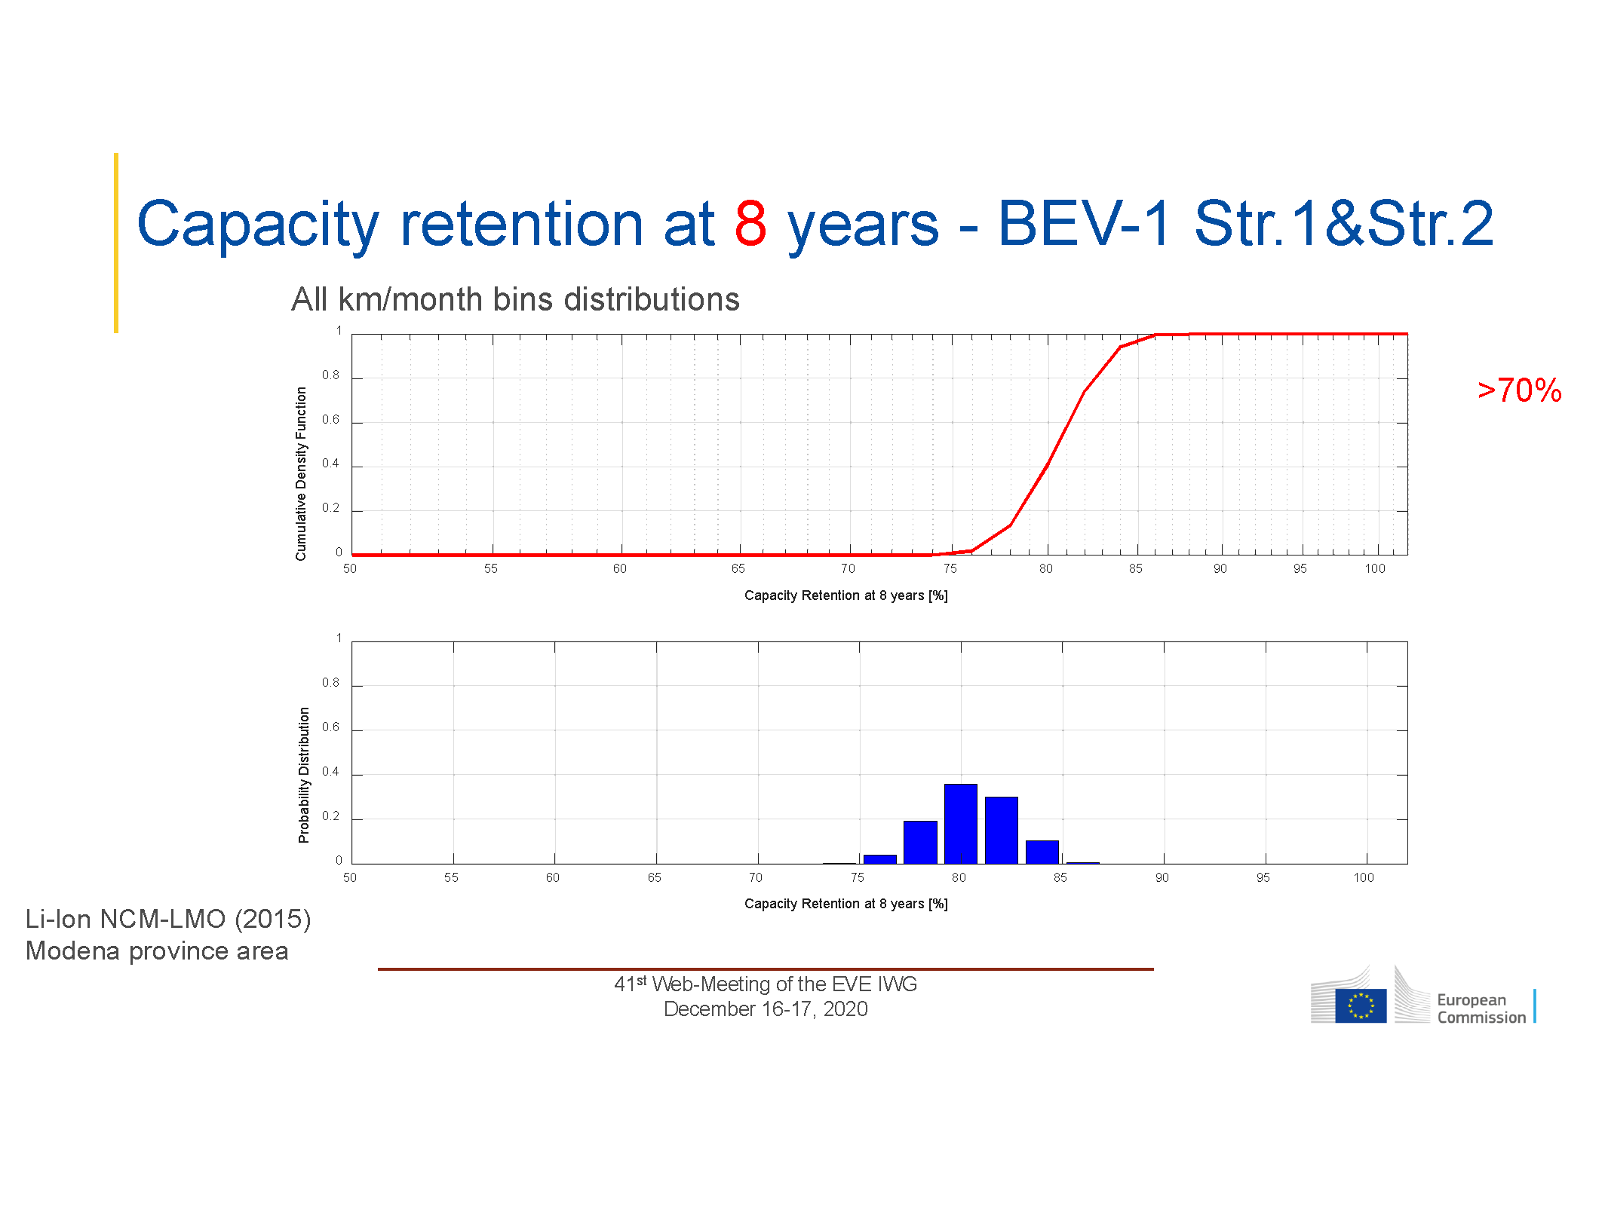
JRC TEMA Modeling Results
TEMA modeling results for two different BEV configurations show greater than 70% capacity retention after 8 years.
EVE-41-03e
(example analysis)

Slide 10
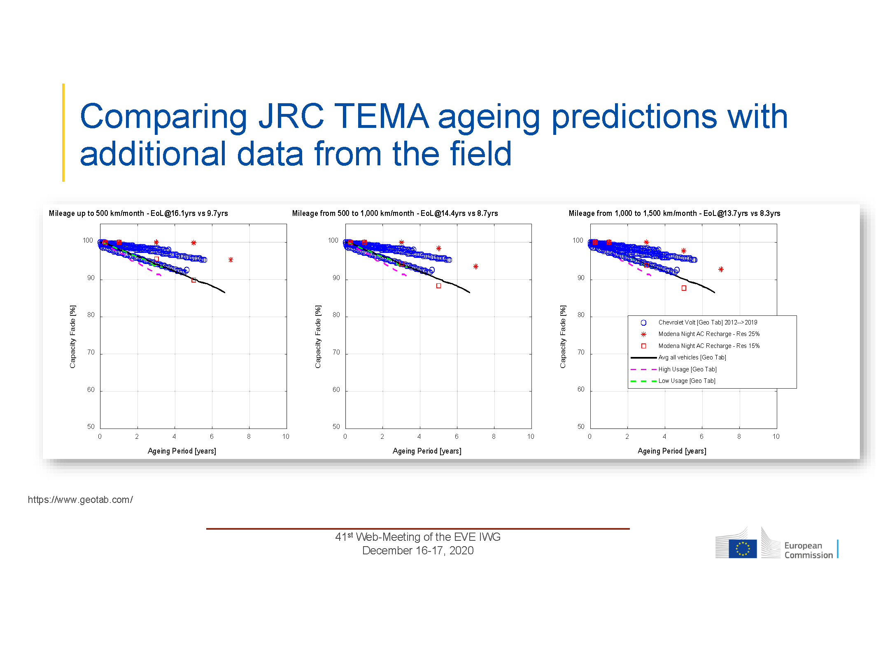
Comparison of TEMA Model Results to Geotab
Comparing the TEMA model results with Geotab data also shows good correlation.
EVE-41-03e

Slide 11
Japanese Position on MPR
Japan has requested additional discussion within the IWG on various issues below, before making a decision on the appropriate value and structure of the MPR
More information on the Geotab data before relying on it to inform the value of the MPR or to decide between a backstop concept vs. a fleet average.
Japan would like to know about the “shape of the curve” i.e. distribution of the results, and the distribution of temperatures and power rates.
Additional consideration of battery reserve and how reserve impacts durability
Prefers that CPs may select either the 5-year or 8-year MPR, and not need to pass both
Supports allowing CPs to choose the MPR, subject to a minimum “substandard” limit – rather than having it defined in the GTR
Conduct case studies on the vehicle selection procedure for Part A once it is written.
If EVE adopts a backstop concept and not a fleet average, Japan suggests NUI may still be needed for Part B, to eliminate severely used vehicles (the fleet average concept would not require this).

Slide 12
EC/ECCC/EPA MPR Proposal
Based on warranty analysis, TEMA modeling and Geotab data, three CP’s proposed the following
EVE-41-03e

Slide 13
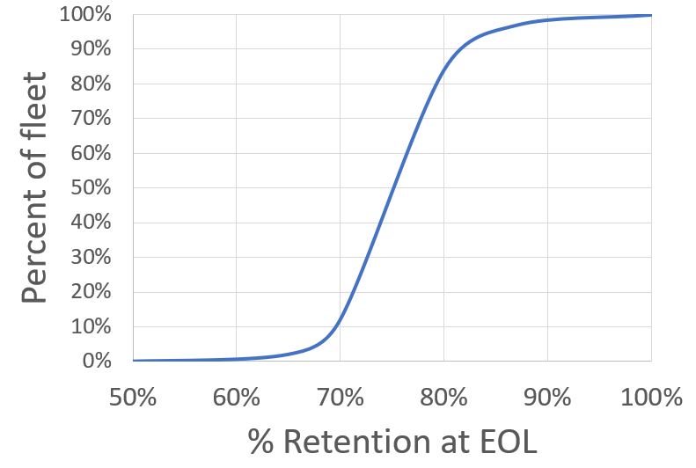
Possible “backstop” concept for MPR structure
EC/ECCC/EPA MPR Proposal
Backstop
criterion
Set minimum absolute performance instead of fleet average
As illustrated
Not more than 5 % of fleet can achieve less than 70% retention
Roughly analogous to a warranty concept
>70% @ 160,000 km or 8 years
With no more than 5%
of vehicles less than 70%
(No fleet average)

Slide 14
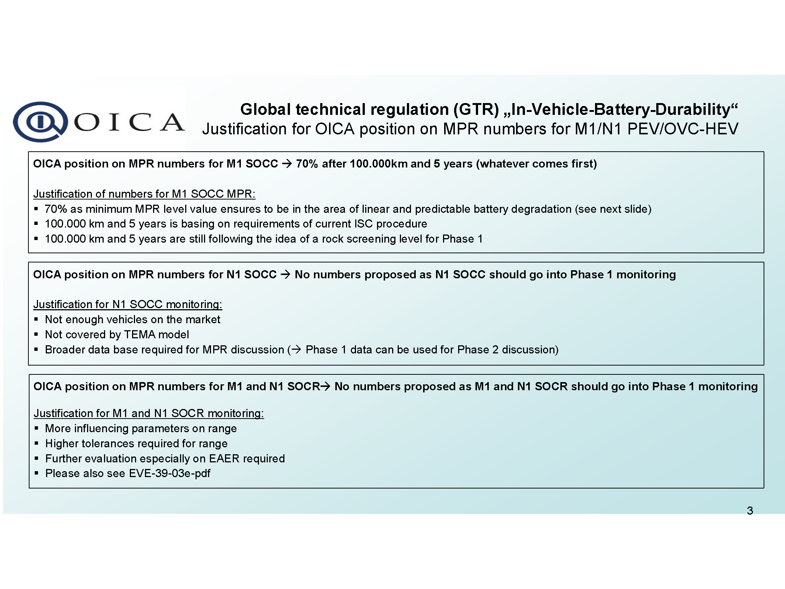
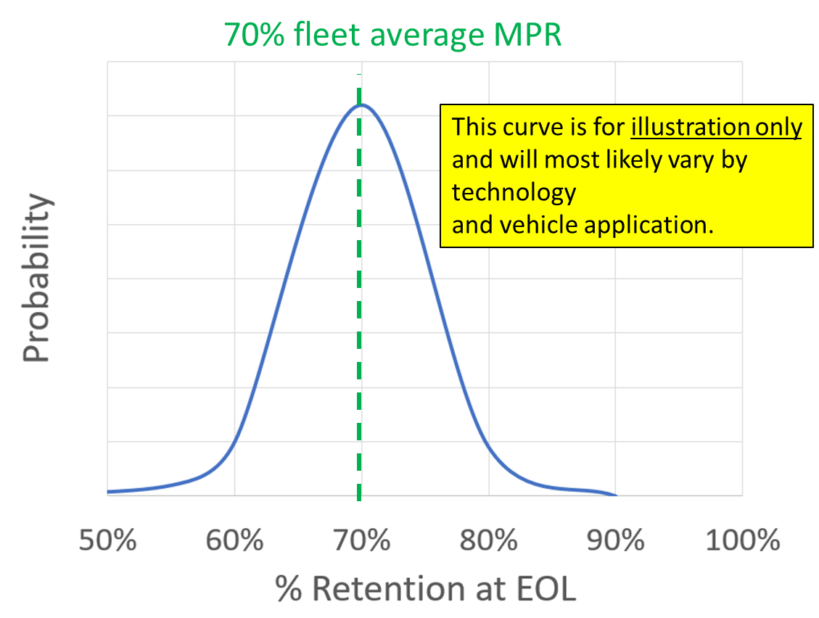
OICA Position on MPR
OICA proposes a 70% MPR value after 100,000 km or 5 years.
Average MPR with no backstop.
OICA also has concerns with proposed data sources
EVE-41-02e

Slide 15
Family Definitions
Only vehicles that are identical with respect to the following elements may be part of the same monitor family:
(a) Algorithm for SOH calculation, including software version*
(b) Sensor configuration (for sensors used in the SOH calculation)
(c) Type of cell
(d) Battery management system (BMS)*
(e) Type of vehicle (PEVs or OVC-HEVs)
Monitor Family 1 |  |  | Monitor Family 2 |  |  | Monitor Family 3
DF1 | DF2 | DF3 | DF4 | DF5 | DF6 | DF7 | DF8 | DF9
Only vehicles that are identical with respect to the following electric powertrain/transmission characteristics may be part of the same battery durability family:
(a) Type and number of electric machines: construction type (asynchronous/ synchronous, etc.), type of coolant (air, liquid) and any other characteristics having a non-negligible influence on electric energy consumption and certified range;
(b) Type of traction REESS (size, type of cell, including material, format and chemistry, capacity (Ampere-hour), nominal voltage, nominal power, type of coolant (air, liquid));
(c) Battery management system (BMS)
(d) Worst case energy efficiency of the vehicle (if different); Insulation/packaging of the battery should be the same
(e) Transmission type (e.g. manual, automatic, CVT) and transmission model (e.g. torque rating, number of gears, numbers of clutches, etc.);
(f) Number of powered axles;
(g) Type of electric energy converter between the electric machine and traction REESS, between the traction REESS and low voltage power supply and between the recharge-plug-in and traction REESS, and any other characteristics having a non-negligible influence on electric energy consumption and range under WLTP conditions;
(h) Operation strategy of all components influencing the electric energy consumption within the powertrain;
(i) n/v ratios (engine rotational speed divided by vehicle speed). This requirement shall be considered fulfilled if, for all transmission ratios concerned, the difference with respect to the n/v ratios of the most commonly installed transmission type and model is within 8 per cent

Slide 16
Other Open Issues
In addition to the value and the form of the MPR there are several other open issues:
Quantity of samples for both part A and part B of the ISC
Balance testing burden with the need to verify the GTR requirements
Enforcement is also a concern, what action will be required for vehicles that fail part B?

Slide 17
Original proposed mandate timeline
(i) March 2020: Approval of mandate from AC.3
(ii) January 2020 – June 2020: EVE IWG formulates new drafting group, and begins drafting GTR with elements agreed upon by EVE IWG
(iii) June 2020: EVE IWG provides update to GRPE outlining details of draft outline of GTR
(iv) June 2020 – December 2020: EVE begins validation testing of relevant aspects of the proposed procedure, assesses results and makes changes to GTR
(v) January 2021: EVE IWG submits first draft proposal for the GTR as an informal document to January 2021 session of GRPE for further discussion and recommendation.
(vi) January 2021- March 2021
a. EVE revises draft proposal based on recommendations from GRPE
b. Transmission of the draft GTR as an informal document twelve weeks before the June 2021 session of GRPE;
c. Endorsement of the draft GTR based on an informal document by GRPE.
(vii) June 2021: EVE presents the final GTR to GRPE
(viii) November 2021: establishment of the GTR by AC.3 in the Global Registry.
(ix) January 2021-January 2024: EVE IWG continues information gathering on possible modifications to the GTR and develops amendments to the GTR for consideration by WP.29 and AC.3, as deemed appropriate.

Slide 18
Next Steps For Electrified Vehicle Durability
(a) January 2020: IWG on EVE presents timeline and framework for mandate request in GRPE.
(b) June 2020: Request for authorization submitted to AC.3; ✓
(c) January 2020 – June 2020: IWG on EVE formulates drafting group and begins drafting UN GTR with elements agreed upon ✓
(d) June 2020: IWG on EVE provides an update to the June 2020 meeting of GRPE with the detailed elements and proposed timelines to be pursued; ✓
(e) June 2020 – December 2020: IWG on EVE begins validation testing of relevant aspects of the proposed procedure, assesses test results and makes further UN GTR changes as necessary (No validation necessary for phase 1, more time being spent on drafting and framework)
(f) January 2021: IWG on EVE presents to GRPE
(i) A status update of the first UN GTR validation results; ECE/TRANS/WP.29/AC.3/57 5 (Not needed)
(ii) First draft UN GTR proposal, both as informal documents for the January 2021 session of GRPE for further discussion and recommendation. ✓
(g) January 2021 – March 2021:
(i) IWG on EVE revises draft proposal based on discussions and recommendations from GRPE and;
(ii) Submits the draft UN GTR for transmission as a formal document for the June 2021 GRPE session (The aim is to achieve this, but there is a risk EVE IWG will need the additional time with a goal to submit in October prior to January 2022 GPRE)
(h) June 2021: IWG on EVE presents Final UN GTR to GRPE at June 2021 meeting for endorsement.
(i) November 2021: establishment of the UN GTR by AC.3 in the Global Registry.
(j) June 2021-January 2024: IWG on EVE continues information gathering on possible modifications to the UN GTR and develops amendments to the UN GTR for consideration by WP.29 and AC.3, as deemed appropriate.

Slide 19
Status of EVE Framework Progress
(e) June 2020 – December 2020: IWG on EVE begins validation testing of relevant aspects of the proposed procedure, assesses test results and makes further UN GTR changes as necessary
(f) January 2021: IWG on EVE presents to GRPE
(i) A status update of the first UN GTR validation results; ECE/TRANS/WP.29/AC.3/57 5
(ii) First draft UN GTR proposal, both as informal documents for the January 2021 session of GRPE for further discussion and recommendation.
(g) January 2021 – March 2021:
(i) IWG on EVE revises draft proposal based on discussions and recommendations from GRPE and;
(ii) Submits the draft UN GTR for transmission as a formal document for the June 2021 GRPE session
The EVE IWG has made a draft UN GTR on in-vehicle battery durability available
The EVE IWG continues to make progress on the overall framework which includes discussions on:
Determining an appropriate MPR value with available data and modelling that can agree with most vehicles in the predicted market (rock screening)
Tolerances of state of range and energy monitors
clarification of definitions (Useable Battery Energy for example)
Clarifying family definitions, intake survey details and data to be gathered, other…

Slide 20
Requirements to meet proposed schedule
The proposed schedule is very ambitious
EVE IWG has increased cadence of meetings to improve the chances of meeting the schedule, but several significant open issues remain.
The draft GTR is now available for review and comment.
Mandate request includes possibility of an additional year if necessary

Slide 21
EVE Meetings
Regular meetings concurrent with GRPE each January and June
EVE IWG has conducted regular monthly and bimonthly meetings since September 2020 to diligently work within the in-vehicle battery durability GTR timelines
10-11 April 2017 – Ann Arbor, USA
24-25 October 2017 – Vienna, Austria
27-28 March 2018 – Tokyo, Japan
16-18 October 2018 – Ottawa, Canada
8-10 April 2019 – Stockholm, Sweden
8-9 October 2019 – Brussels, Belgium
24-26 March 2020– WebEx
(7-8 September, 7-8th October , 9-10 and 30 November, 1 and 15-16 December), 2020 and January 8th, 2021 – All on WebEx

Slide 22
Proposed Meetings for EVE IWG
February 3-4, 2021 - WebEX
February 26 and March 2^{nd,} 2021 - WebEx
March 25th and 26th, 2021 - WebEx

