Slide 1
CORE: a concrete implementation of the CSPA architecture
Marco Silipo
ISTAT (Italian National Statistical Institute)
Joint work with:
Rolando Duma, Mauro Bruno and Giulia Vaste
Workshop on the Modernisation of Statistical Production
Geneva, Switzerland
17 April 2015

Slide 2
A brief history
CORE
Common Reference Environment
CSPA
Common Statistical Production Architecture
Environment for:
i) executing standard statistical processes
ii) defining processes in terms of abstract statistical services
iii) mapping services to specific IT tools
Reference architecture based on:
i) existing standard models, such as GSBPM and GSIM, as shared vocabulary
ii) the “plug and play” approach in designing, implementing and sharing statistical software solutions
ESSNet CORA
ESSNet CORE
CORE in Istat
2009
2010
2011
2012
2013
2014
2015
CORE in Istat:
CSPA
specification
CSPA
implementation
Platform for the execution of statistical processes according to CSPA principles
CORE, Marco Silipo – Geneva, 15-17 April 2015
Notes:
CORE Essnet, CSPA Unece

Slide 3
CORE concepts match CSPA ones
Service definition
Definition of a service at a conceptual level in terms of GSBPM subprocess, of the business function, of GSIM input/output.
Pl/sql
Sas
Service implementation
Definition of a service at a physical level.
A service definition can have one or more implementations
Tool
…
Process
Compose: compose a process with available service definitions
Configure: bind each service with one of its available implementations
Execute
CORE, Marco Silipo – Geneva, 15-17 April 2015

Slide 4
CORE architecture
CORE
engine
Pl/sql
Sas
R
Java
Shell
CORE
tools
CORE is a Java web application
i) implements a workflow engine
ii) stores process executions
iii) allows editing tool scripts
iv) displays runtime logs
CORE, Marco Silipo – Geneva, 15-17 April 2015

Slide 5
COmmon Reference Environment
demo
CORE, Marco Silipo – Geneva, 15-17 April 2015

Slide 6
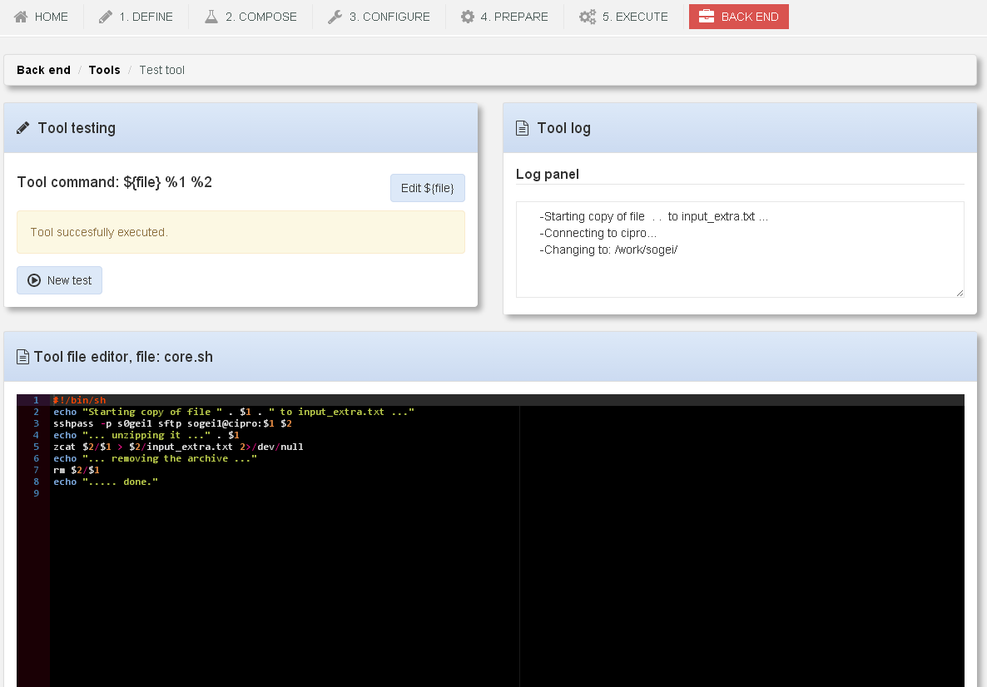
CORE
tools
CORE allows editing tool scripts (R, Sas, Pl/sql, shell) stored on the server, through an editing panel
CORE, Marco Silipo – Geneva, 15-17 April 2015

