Slide 1
Enterprise Architecture
Project
Engaging with the Future
Enterprise Architecture
Ben Humberstone
Office for National Statistics, UK
Workshop on the Modernisation of Statistical Production
15-17 April 2015

Slide 2
What is Enterprise Architecture?
Definition : Enterprise Architecture
is about understanding all of the different elements that go to make up the enterprise and how those elements interrelate.
It is an approach to enabling the vision and strategy of an organisation, by providing a clear, cohesive, and achievable picture of what’s required to get there.
(UNECE CSPA)
Enterprise Architecture consists of:
Business Architecture (main focus of EA project)
Information Architecture
Application Architecture
Technology Architecture

Slide 3
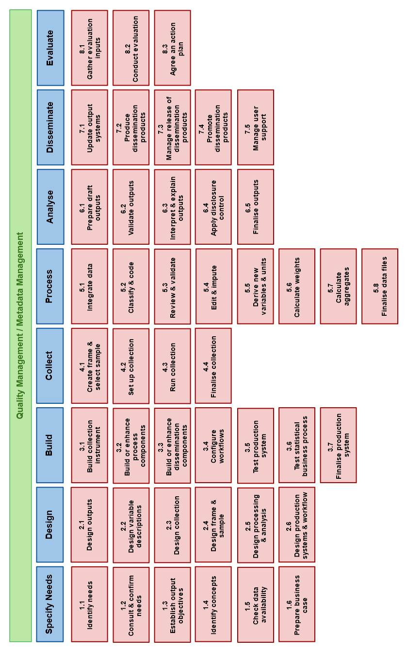
Our Approach Using end to end statistical business processes (mapped to GSBPM) by output area to identify Business Functions to identify common Business Services
Census
Business stats
Social stats
Business Change
To use
Service
Common Functions
GSBPM
Reference
Model
Role
Input GSIM)
Function
Output GSIM)
Responsibility
Catalogue of Business Services
CSPA
Reference
Model
Business Service A
Business Service B
Business Service C
…

Slide 4
A Business Service: appropriate interaction of People, Process and Technology to realise a business function
Process
Description of related
Roles / Activities
/ Decisions
/ Tools
People are assigned a role to carry out their work according to an activity / decision description
Specific steps are automated / enabled by technology
Business Service
Realized business function
Technology
With appropriate
Workspace,
Functions and
User interface
People
With relevant Skills,
knowledge, experience,
attitudes and
behaviours
People interact with technology to improve their productivity and accuracy of their work.
A key focus is ease of use

Slide 5
What we did
>30 workshops across output areas and systems
Business and Social surveys
Census
National Accounts
Registers, metadata
Platforms (CORA, CASPA, CORD, Pretium etc)
Identifying business functions, gaps/overlaps
Creating coherent services
Input to existing projects and programmes

Slide 6
Programme Types: Output / Service Customers and Service Providers
Statistical Output Areas
GSBPM
ESA10 / BPM6
Census 2021
FRIBS
Full Set of Outputs.
Business Services to Support Output
Using an End to End GSBPM View
National Accts
Labour
Market
Census
...
Bus Surveys
Social Surveys
List of Sbusiness Services
Dissemination
Dissemination
Service
Production
Production
Process and
Analysis
Services
Electronic Data Collection
Collection
Services
Admin Data Programme
Data Mgt
Register Mgt
Change
Change
Change
Services
...
Corporate
Services

Slide 7
Change Required
From output silo oriented to reusable service oriented
Focus on corporate developments
Ensure EA at the heart of change programmes
Drives revision of Strategic Roadmap – what does ONS look like at each stage of delivery?
Ensure that projects/programmes are aligned to deliver and/or utilise corporate services where appropriate

Slide 8
Future State: Statistical Programmes and Shared Services.
Change
“Statistical Programme Design / Build”
Production
“Statistical Program Cycle”
Transition
Fully integrated shared services
Design / Build Services
Survey Collection
Non Survey Data Collection
Data Integration
Statistical Data Processing
Statistical Output
Dissemination
Integrate and Test
Collection Services
Survey Data
Non-survey data
Process and Analysis Services
Data Integration
Statistical Data Processing
Statistical Output Production
Dissemination Service
Release, API
Website
Transition
DIGITAL
MISSION IT
DIGITAL
Supporting Statistical Services
Quality Management, Metadata and Data Management
Roadmap / Transitions

Slide 9
Why Common Reusable Services?
This definition comes from GSIM -
“A means of performing a Business Function (an ability that an organization possesses, typically expressed in general and high level terms and requiring a combination of organization, people, processes and technology to achieve).
Why?
Improved efficiency
Reduce cost to deliver and maintain
Improvements made once; reused many places.
Common interface and bounded functions

Slide 10
How EA Business Services model has been used in practise
Main focus has been on Data Collection business services
Assessment of scope of current programmes to EA Business Services model e.g. Electronic Data Collection (EDC), Census Transformation Programme (CTP)
Identifying of gaps / overlaps across programmes by using a common reference model e.g. ADP / CTP and EDC / CTP
Identifying potential gaps in the “Roadmap” e.g. Integrated Registers, Metadata Management
Help define the role and scope of metadata and its support to the statistical business processes
Supporting business areas develop their business change plans e.g. Social Surveys, Pricing
Supports dialogue with other NSI’s via a common reference model and supports the goal of sharing common software / services
The model developed has been validated / enhanced as part of supporting the change programmes

Slide 11
Enterprise Architecture
Project
Engaging with the Future
Enterprise Architecture
Ben Humberstone
Office for National Statistics, UK
Workshop on the Modernisation of Statistical Production
15-17 April 2015

