Slide 1
Methodology Architecture
Allyson Seyb, Jeni Darnbrough and Rosemary McGrath
Workshop on the Modernisation of Statistical Production – April 2015
Notes:
both

Slide 2


Slide 3
What was the problem?
  Trying to answer these questions…
    What evidence is there that proves that the work you are engaged in is directly aligned to the organisation’s goals?
    Where do you go to find the suite of validated methods?
    Where do you go to find the set of validated tools?
    How do you know what methods we will need in the future?
    Are we doing the right research for our future needs?
    Are we building expertise in the right areas?
    Goals like automation, standardisation, admin data first have implications for research, methods, tools and capability; what is the transformation plan for methodology?
Notes:
both

Slide 4
What would success look like?
The ability to make valuable and vital cost-benefit decisions across our statistical processes
A guarantee that robust methods are available and easily discoverable when needed
That when new methods are needed, research into the details of the new methods is planned and executed in time for it to be used
We are addressing competing demands, managing trade-offs between cost and quality and successfully balancing statistical excellence with fitness for purpose
We are retaining and develop our methodology staff, and building overall capability

Slide 5
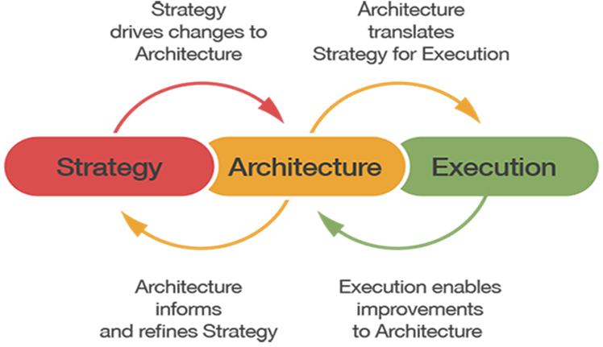
So why a Methodology ARCHITECTURE?

Slide 6
Statistics NZ’s Methodology Architecture
The Methodology Architecture’s purpose is to support decision making and promote effective investment by ensuring statistical methods and tools used in the production of statistics support the organisation’s vision and goals.
Our Methodology Architecture will provide a framework that ensures organisational goals are met through aligning research, methods, tools and expertise.
Notes:
both

Slide 7
Key Contents

Slide 8
The decisions it helps you make

Slide 9
The Value
MA
Promotion of reuseable tools
Transparency and clarity of validated methods
Value realised
Reduced costs
Supports Standardisation
Complex answers available to difficult questions
Identification and elimination of multiple efforts of the same capability
Redundancy eliminated
Easier/faster to implement new capabilities

Slide 10
What’s in it for me?
ELT
Effective long-term planning
Used for evidence-based decision making
Chief Methodologist
Ensures professional development is linked to methodology needs.
Stats Methods
Suite of validated methods and tools
Link to vision of the organisation
Roadmap for ensuring methodology is aligned to business needs
Blueprint for research planning
Medium-term planning
Blueprint for career planning
Ensures research is aligned to future methodology needs
Framework used for Design Authority
Notes:
Jeni

Slide 11
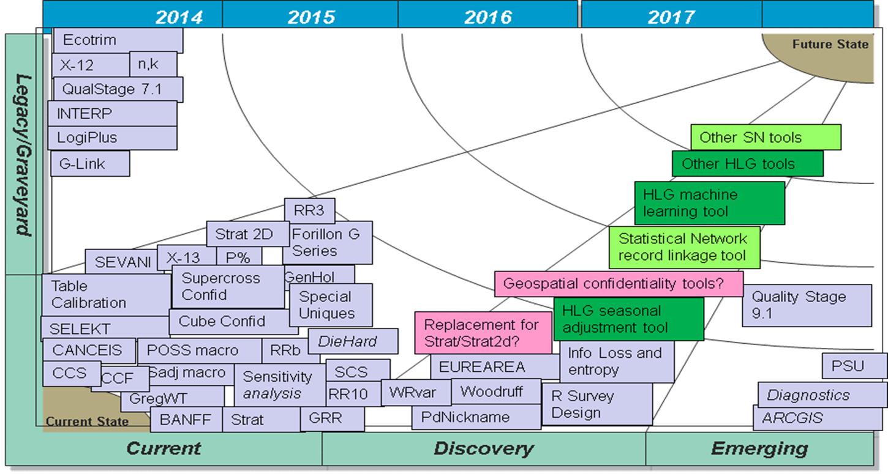
An example of the views we can provide

Slide 12
Thank You ☺

