Slide 1
To become cspa compliant
Answer: join business analysis and methodology and…

Slide 2
What is CSPA compliant?
NONE | Function or code not CSPA
Locally Specific | Service conforms to the CSPA interface, but is only relevant for one statistical process
Locally Generic | Service conforms to the CSPA interface and relevant to multiple processes but one NSI
Globally Specific | Country independent but specific to one statistical stovepipe
Globally Generic | Conforms to the CSPA interface and is generic to multiple processes and NSI's

Slide 3
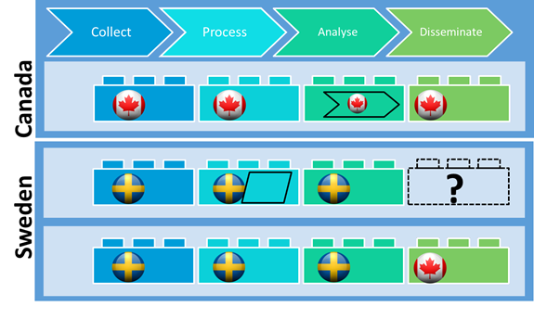
Service conforms to the CSPA-interface and is globally relevant

Slide 4
GSIM & CSPA
Inputs
Outputs
Statistical service
GSIM
Objects
GSIM
Objects
Conforms to CSPA-interface

Slide 5
The S of Statistical
Statistical services
GSIM objects
CSPA-interfaces
Are about
Statistical Data
Statistical Methodology
Statistical Processes

Slide 6
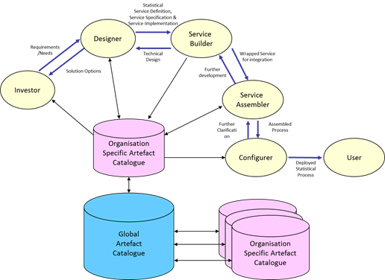
CSPA is about concepts
Developing a statistical production process
Look for compromise
Creating statistical services
Such that they are CSPA-compliant
not about plumbing

Slide 7
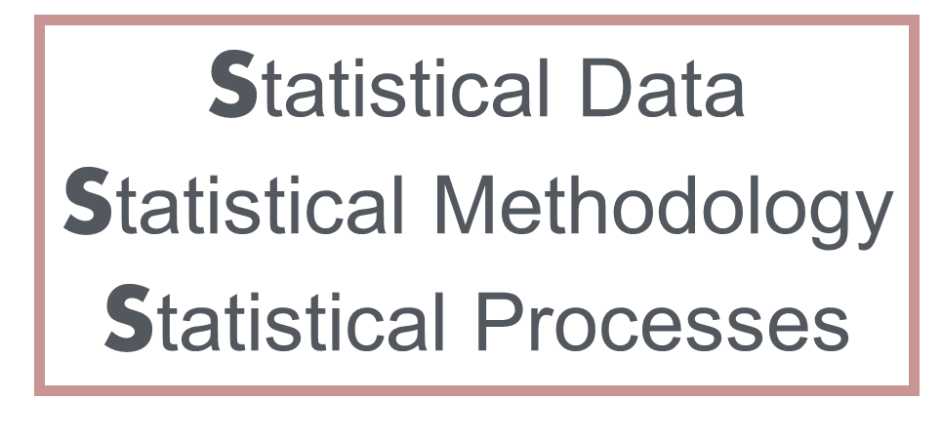
Two faceS of CSPA :
Using statistical services
Assembler
Configurer
User
Creating statistical services
Designer
Builder
Supply side
Demand side
Is about
Is about
Design ← → Use&run

Slide 8
Demand side
Developing statistical processes (triple S):
By using statistical services → make shopping list
Developing teams
Templates (BAD/MAD)
Courses with real life examples
Compromise

Slide 9
Matching supply and demand
Demand: developing teams use statistical services
Supply: creating statistical services is demand driven
Shopping list
match
Catalogue

Slide 10
Developing teams
Developing team is multidisciplinary
Methodologists, business analysts, software architects, business users, …
All people needed for compromise are present
All together can iterate, find sweet spot

Slide 11
The real value of compromise
Simplification of methodology
Standardizing
Lowering process complexity
Negotiate output v.s. process
Important compromises early in design process

Slide 12
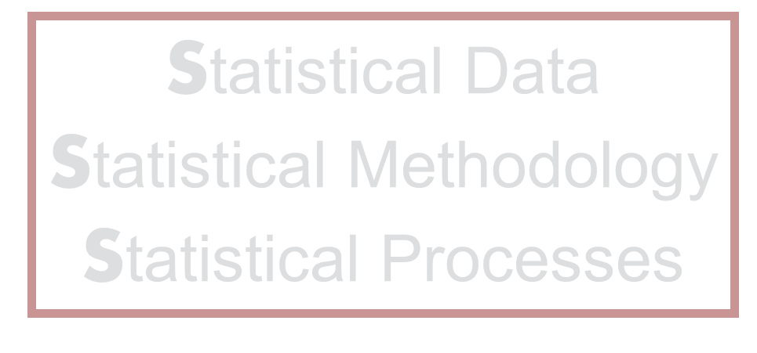
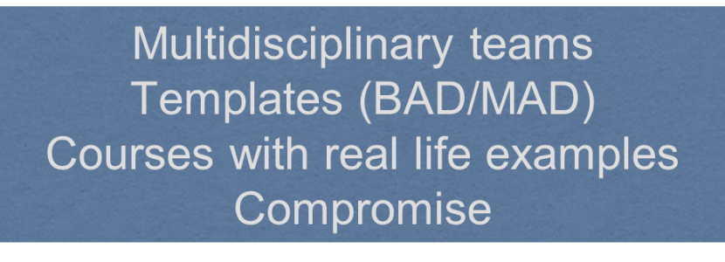
You become cspa compliant
Demand & Supply
Shopping list & Catalogue
Compromise
By joining business analysis and methodology in multidisciplinary developing teams and compromise

Slide 13
Is that the whole story?
Basically, YES
The rest will follow out of necessity:
Programming
Administration
Deployment of VM's or Docker containers

Slide 14
So what do you need?
Make CSPA obligatory in Architecture
Educate process and method designers
Form multidisciplinary teams (including business)
Put the CSPA admin procedures in place
Educate IT Teams in using CSPA
Make infrastructure provisions for using services

Slide 15
Thank You

