Slide 1
Development and Implementation of Case Management Services at a Federal Statistical Agency
By
Lorna J. Drennen
Joseph L. Parsons

Slide 2
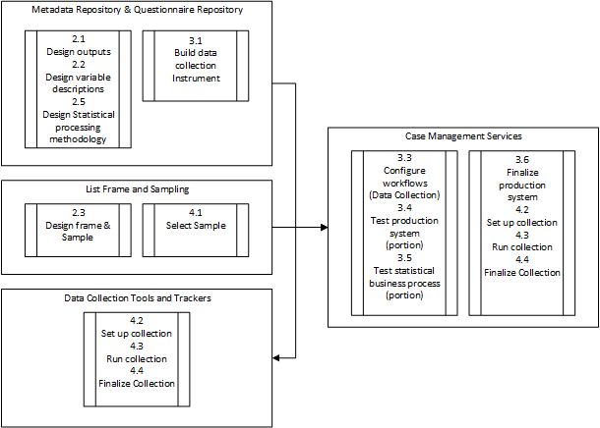
Case Management Services Overview
Relationship to Generic Statistical Business Process Model

Slide 3
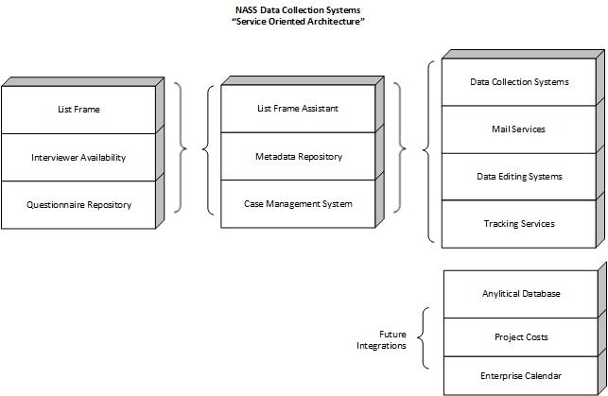
Service Oriented Architecture
Multi-System and Database Interaction

Slide 4
Service Highlights
This system has joined 9 systems/services together removing human intervention with data transfer
Allows for automated responsive design practices
Brings all information together into once place for enhanced management practices
Allows for controlled treatment to the whole sample and tracking/research of respondent behavior over time

Slide 5
Design Considerations
NASS CMS – Combination of Services and multi-database interactions
Where feasible we have written services that service other systems, however with legacy applications that is not always possible.
We have found there are things that you can do between databases (triggers/views/functions)that you cannot do as efficiently with a service
Efficient use of centralized structured databases allows for less duplication of data and an fairly easy lift into our analytical databases

Slide 6
Advantages for Survey Data Collection
Reduced duplication of work
All data is centrally located and accessible
Allows for respondent loyalty management, considering the repeated exposure to NASS surveys
Increased oversight
Potential for future growth and the implementation of innovative data collection management solutions is endless
Overall this system is a combination of service that have been developed over the last five years and will help NASS to more efficiently manage surveys

Slide 7
Questions/Discussion

