Slide 1
Agile capabilities
Jakob Engdahl (jakob.engdahl@scb.se)

Slide 2

New targets for programs
Notes:
Picture credit: https://www.flickr.com/photos/86530412@N02/7987532186/in/photolist-daQc3b-2sw1ZT-8idFK8-aWHxDz-aWHsjP-aWHqVX-5FsXUT-5FsY2k-fbVH7B-cosUHs-4w3QXv-cLFFFo-nnxSTH-6KxDww-4xT5Qg-5qf3gR-94uDkj-3proWu-6eW5eN-3pmUyn-4URjg1-7sNeCk-5pCqHE-4GW8S4-5Sitkd-mjEvm-9PskjK-aW9ayX-8GbLvP-4B283S-jxtJDh-pFvMp-9TKYq1-aQUzkH-8GTBtd-67aPmS-uoHZi-5E21kz-eR4doX-9EbLp7-aNktAp-aNks7Z-aNktA6-aNks7M-aNks7D-aNktAc-aNktzP-aNktA2-aNks8c-81nEKY/

Slide 3

Treated as something special

Slide 4

”
The only thing that is constant is change
”
Notes:
Photo credit: https://www.flickr.com/photos/bigpinkcookie/22716359

Slide 5
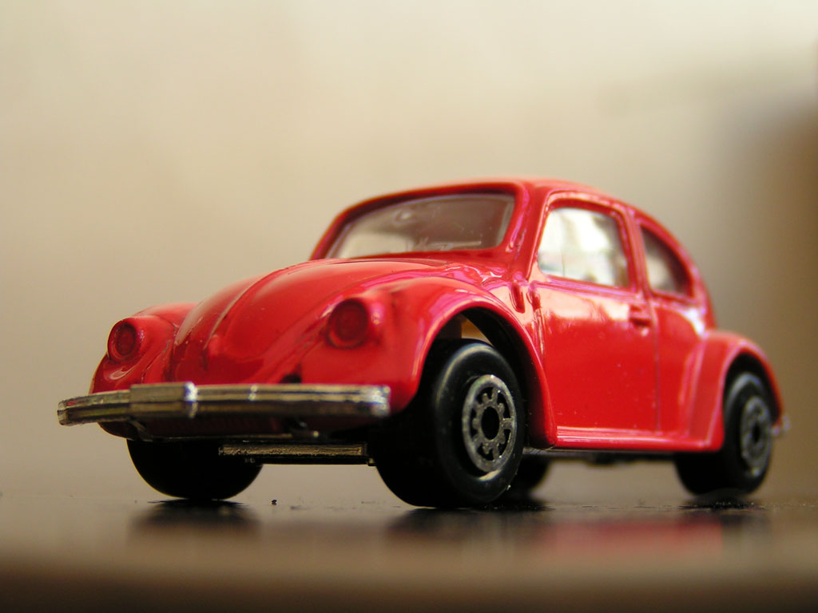
Are we there yet?!?!
Notes:
Photo credit: https://www.flickr.com/photos/toy_cars/34166458/

Slide 6
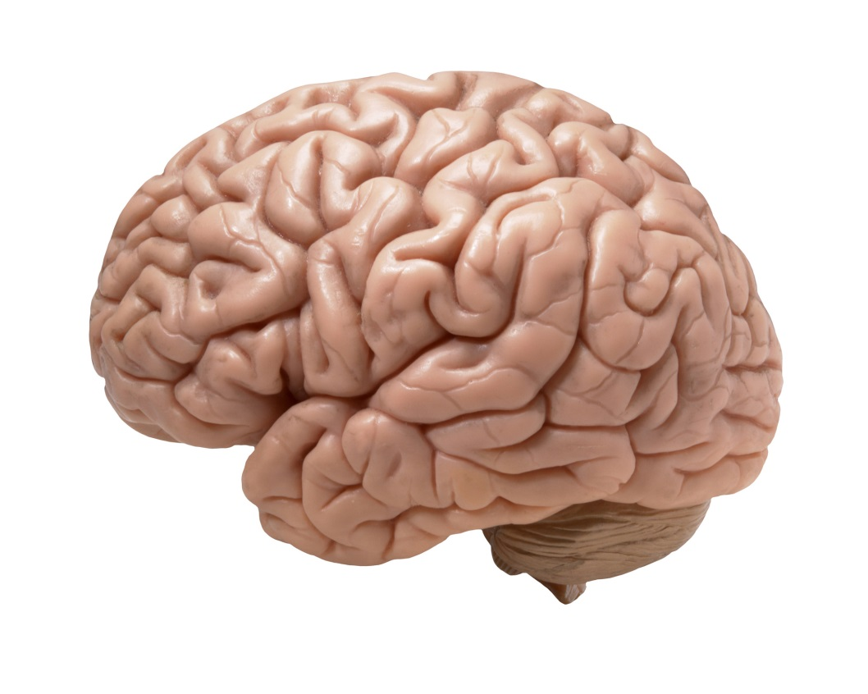
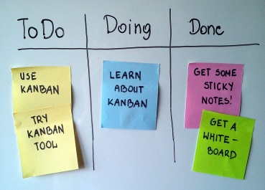
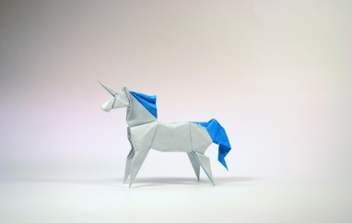
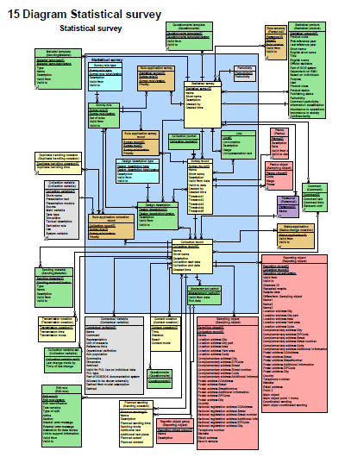
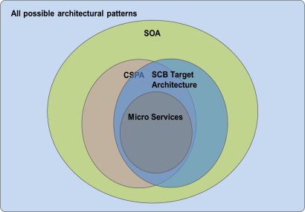
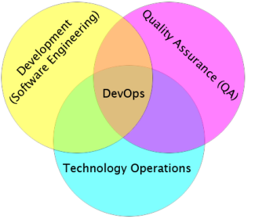
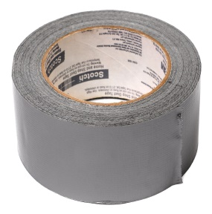
Requires a new mindset
Agile capabilities
How
What
Notes:
Photo credit: https://www.flickr.com/photos/flamephoenix1991/8376271918/

Slide 7
Process & Information models
Notes:
Photo credit: https://www.flickr.com/photos/flamephoenix1991/8376271918/

Slide 8

Development teams
Notes:
Photo credit: http://en.wikipedia.org/wiki/Scrum_ban#/media/File:Simple-kanban-board-.jpg

Slide 9
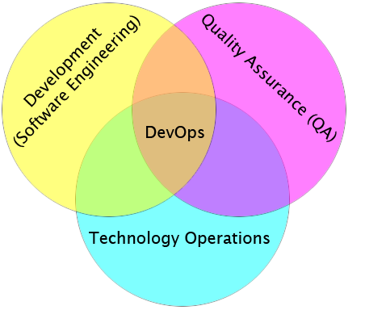
DevOps
Notes:
Photo credit: http://en.wikipedia.org/wiki/DevOps

Slide 10
Statistical Services
All possible architectural patterns
SOA
CSPA
SCB Target
Architecture
Micro Services

Slide 11

Temporary…
becomes permanent
Notes:
Picture credit: http://en.wikipedia.org/wiki/Duct_tape#/media/File:Duct-tape.jpg

Slide 12

Beware the unicorns
”Everything will become easy once we have this”
Check your dependencies!
Notes:
https://www.flickr.com/photos/hamur0w0/6984884135/

Slide 13
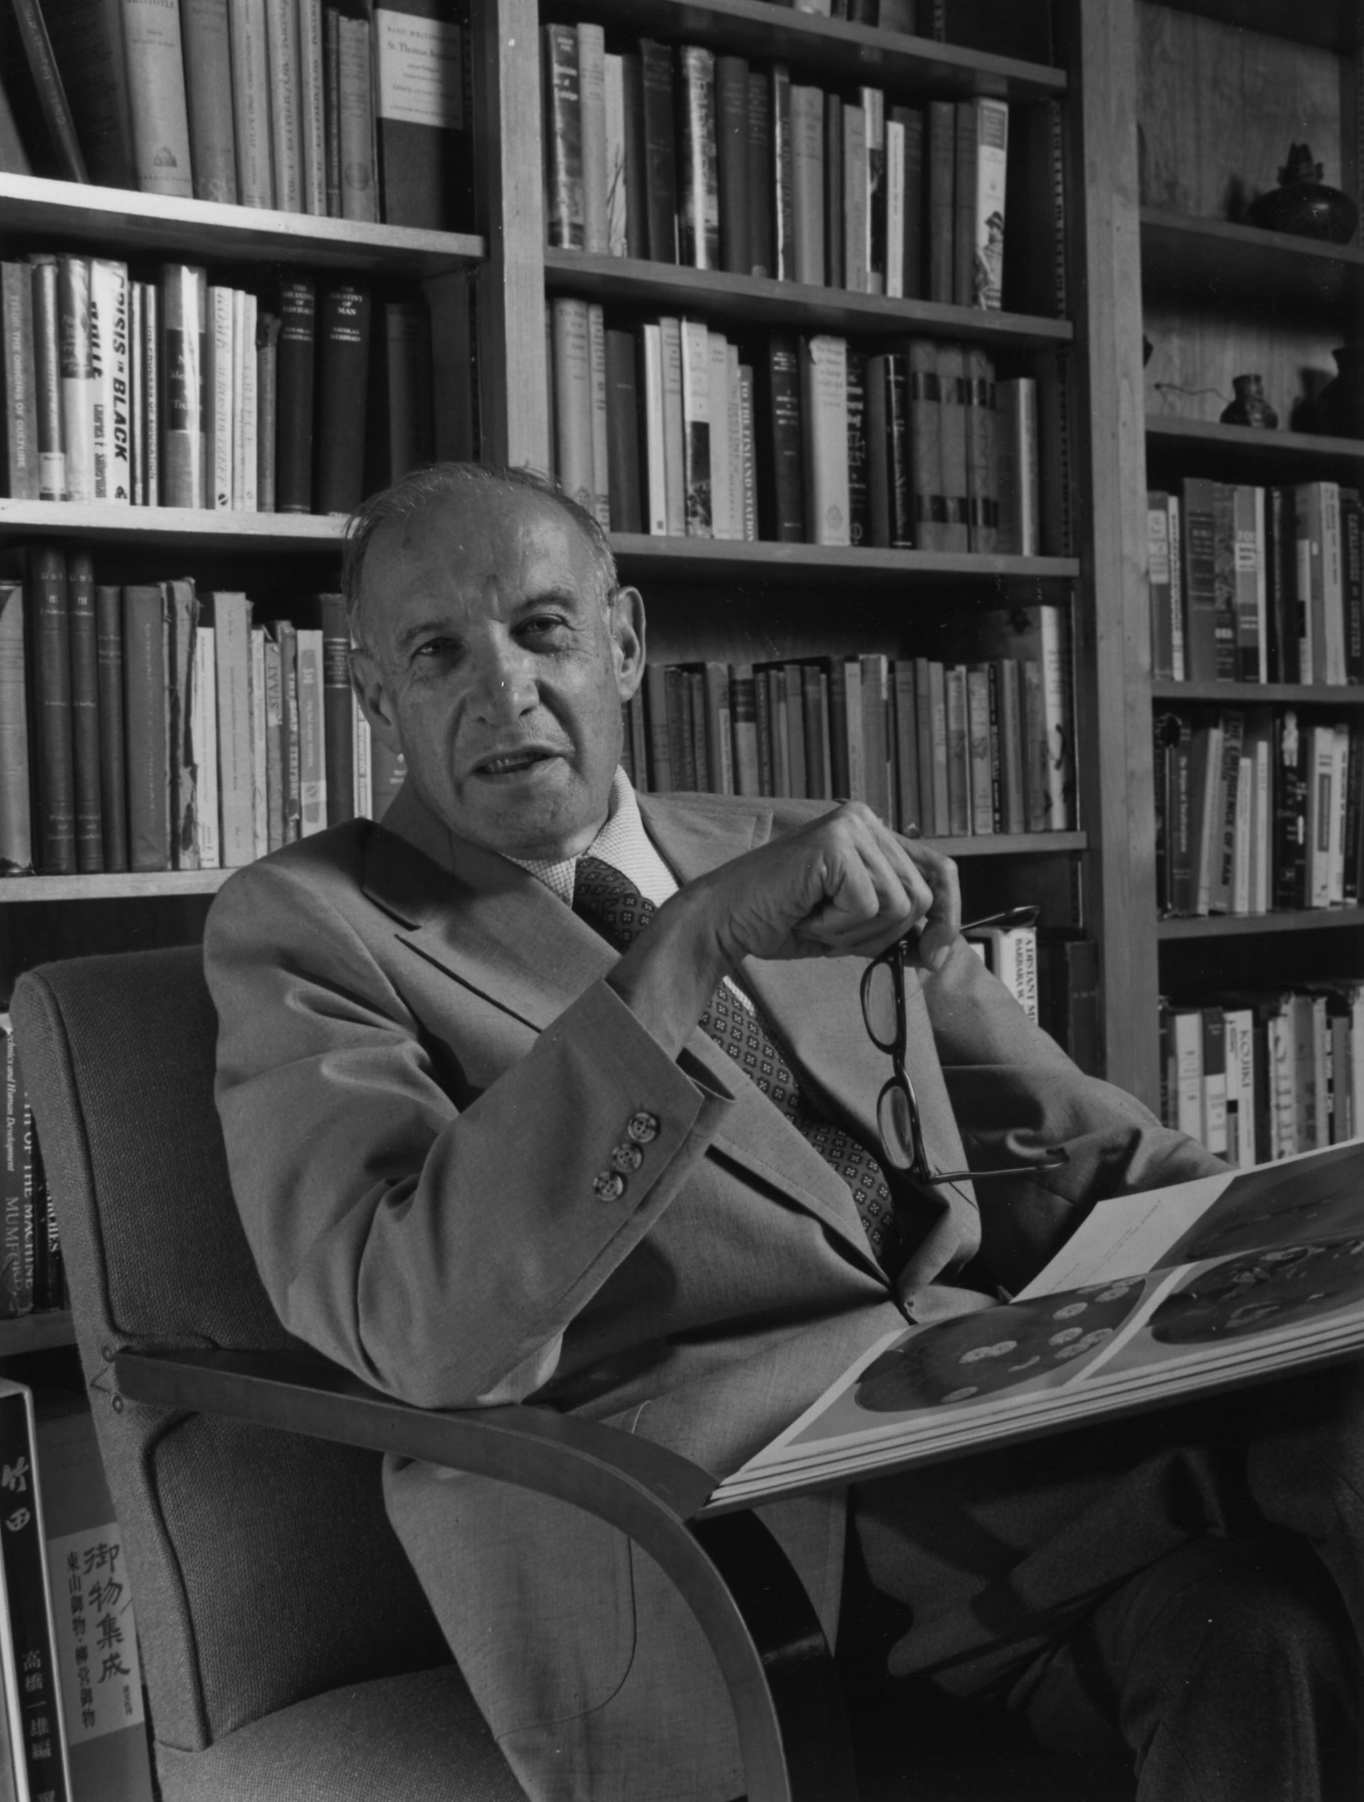
”
Culture eats strategy for breakfast
- Peter Drucker
”
Notes:
http://commons.wikimedia.org/wiki/File:Drucker5789.jpg

Slide 14
How have you established agile capabilities?
Notes:
Picture credit: https://www.flickr.com/photos/86530412@N02/7987532186/in/photolist-daQc3b-2sw1ZT-8idFK8-aWHxDz-aWHsjP-aWHqVX-5FsXUT-5FsY2k-fbVH7B-cosUHs-4w3QXv-cLFFFo-nnxSTH-6KxDww-4xT5Qg-5qf3gR-94uDkj-3proWu-6eW5eN-3pmUyn-4URjg1-7sNeCk-5pCqHE-4GW8S4-5Sitkd-mjEvm-9PskjK-aW9ayX-8GbLvP-4B283S-jxtJDh-pFvMp-9TKYq1-aQUzkH-8GTBtd-67aPmS-uoHZi-5E21kz-eR4doX-9EbLp7-aNktAp-aNks7Z-aNktA6-aNks7M-aNks7D-aNktAc-aNktzP-aNktA2-aNks8c-81nEKY/

