Slide 1
Costs & Benefits of International Collaboration CSPA - a platform for developing countries
WMSP – Geneva April 2015

Slide 2
Contents
Background
CSPA and the “Data Revolution”
A CSPA role for developing countries
An example: Dissemination needs
The long term vision
Your views !

Slide 3
Background
Background: developing countries had problems providing data to monitor progress of MDGs.
2015 is a crucial year for global development – MDGs come to an end and a new set of Sustainable Development Goals (SDGs) reflecting new priorities will be endorsed.
SDGs will require responsive statistical systems with the capacity to track and monitor the development progress of countries.
Call for a “Data Revolution” of new technology and data sources

Slide 4
CSPA and the Data Revolution
CSPA a global standard developed by the international statistical community under the lead of the High-Level Group for the Modernisation of Statistical Production and Services (HLG)
‘Plug and play’ approach so components and new innovative solutions can be more easily shared and adopted.
CSPA can provide basic infrastructure framework to meet needs identified in country studies (in particular in dissemination)
Based on standards – the enabler for modernisation
CSPA – a perfect fit for Data Revolution goals

Slide 5
CSPA and the Data Revolution – the
IDR Project
“Informing a Data Revolution” (IDR) Project, funded by the Bill and Melinda Gates Foundation was set up in 2014
Aim: to take stock of the current situation developing countries to identify the problems and bottlenecks producing and accessing data in national statistical systems.
IDR has catalogued a number of possible software and technology solutions.
IDR seeks innovative solutions that have been successfully implemented and can be reused by other countries throughout the developing world to help meet challenges
IDR will make recommendations for solutions – standards are a key enabler for modernisation

Slide 6
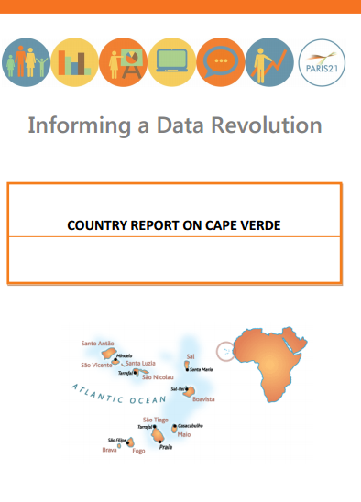
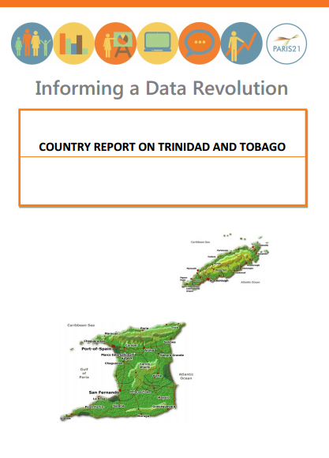
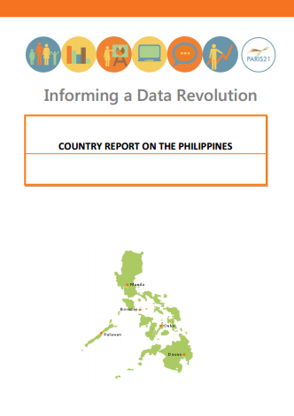
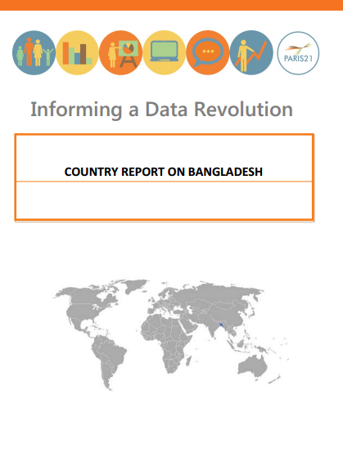
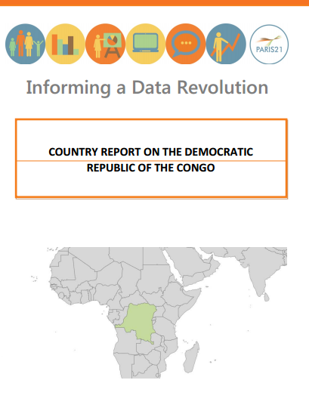
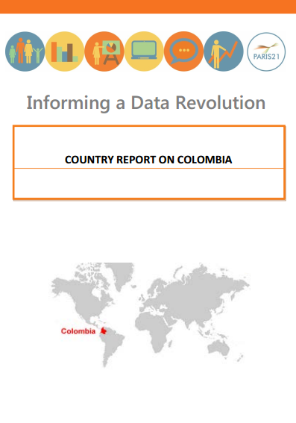
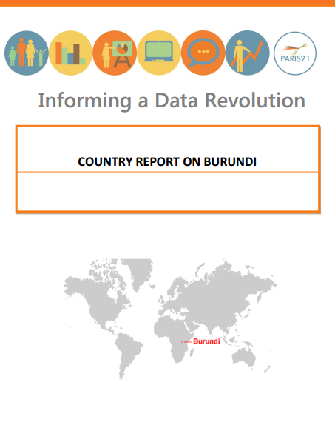
IDR Project – Developing Country needs

Slide 7
Bangladesh
BBS aspires to set up a data warehouse but the required equipment for this is yet to be procured
Bangladesh
Some limited description of concepts and definitions of the disseminated statistics are currently provided, but these are not adequate
Burundi
Currently managing process data does not follow a systematic way with international standards.
DR Congo
, the INS does not regularly publish data on its website
Trinidad & Tobago
Out-dated computer equipment, both hardware and software, is a serious problem.
Trinidad & Tobago
Outside the CSO database system was so limited and inflexible that each year it had to erase the previous year’s records in order to accommodate the new survey data.
Trinidad & Tobago
Access to CSO microdata is highly restricted, not least by the systems available. One respondent had, after a two-year process and the signature of an extensive legal document, obtained access to detailed data from the population census.
IDR Project
Cabo Verde
there are no formal processes for consulting with users, such as mechanisms that would allow the INE to: identify users’ needs ensure the integration of users’ expectations into plans for improving statistical products make products and services available within a framework that sets out delivery and dissemination schedules
DR Congo
non-timeliness of production, the absence of a publication schedule and the lack of regular publication metadata
Bangladesh
No data can be collected from BBS without physical visit to the head office.
Trinidad & Tobago
Constraints preclude a database-enabled CSO website; even downloadable data files are not regularly updated, leading to out of date statistics on the CSO website.
Burundi
There is no standard format for the dissemination of data and because of the lack of partnership with the media, the scope of the release of the SSN is very low.
Bangladesh
The website is yet to be made an effective platform for sharing and disseminating statistics.
Trinidad & Tobago
One of the most common complaints about CSO data dissemination refers to the Census data. The population census is available in pdf form from the CSO website. The remainder of the series of publications, referred to in the census preface, has not appeared.
Bangladesh
Long time required to give the final estimates of any statistics, especially the macro economic variables.
DR Congo
Without proper dissemination policy, any statistical production may not reach on time different users including national spheres of decision-makers. At this stage, the INS has not yet adopted a standard format for data dissemination and because of the lack of partnership with the media and general lack of policies for the dissemination of statistical data, the scope of the release of VMS is very low.
Philippines
1) Not all the staff have access to the internet 2) Problems with OCR machines
Bangladesh
BBS provides limited access to micro data.
Burundi
Data collected during surveys have not been fully exploited and the NHS is seeking support to exploit in terms of analysis and thematic studies.
Trinidad & Tobago
most interviewees were very critical about the timeliness of CSO’s data
Bangladesh
There is no guideline or principle followed in providing metadata.
DR Congo
The problem of equipment and infrastructure is acute in the NHS at the central, provincial and sectoral levels and that, due to insufficient budget. Arguably infrastructure available including the SSN INS are no longer adequate in terms of its mission.
Burundi
The problem of equipment and infrastructure is acute in the NHS at both central and sectoral levels.
Philippines
1.Some agencies selectively provide data to users/media practitioners 2.Lack of transparency in some government agencies.3.Service in some agencies of the PSA better than in others 4.PUFs users of the NSO have become more sophisticated in their data demands5.Users find it difficult to understand some methodologies such as for deriving estimates like the MMR 6.Data dissemination forums not as effective as could be because there are no presentors from the users side, only discussants/reactors.7.Some PSA agencies cannot commit to release dates for products needed by other government agencies8.With some agencies, it is very difficult to ask for data, with data users needing to talk from one person/unit to another, sometimes eventually getting nothing.
Trinidad & Tobago
Access to CSO’s statistics is the biggest problem identified consistently by interviewees from all parts of the national statistical system. restrictions in the amount of data available from Central Bank, were a source of complaint.
Bangladesh
Because of the inadequate ICT capacity, dissemination is still hardcopy dependent.
Cabo Verde
2011. Its objective is to ensure the application of various technologies in an integrated and coherent
way, and to modernise INE’s technological infrastructure so as to produce and disseminate official
statistical information efficiently.
Trinidad & Tobago
Lack of dissemination of CSO’s statistics is considered the most serious deficiency of the national statistical system of Trinidad and Tobago.
Burundi
The NSS does not yet have a quality assurance framework.
Bangladesh
Access to metadata (concepts, definitions, classifications, basis of data recording, data sources, compilation method, and explanatory note etc.) is yet to be provided
Burundi
non-timeliness of production, the absence of a publication schedule and the lack of regular publication metadata.
DR Congo
The NHS does not yet have a quality assurance framework but the Congolese SSN gives high priority to improving the quality of statistical supply.
DR Congo
Lacks of an archiving system for data and metadata. For example data from the General Census of Population, 1984 were not kept on computer.
Trinidad & Tobago
Most non-academic interviewees answered on archiving question by referring to physical storage of paper documents. This indicates that there is a lack of awareness of the opportunities for analysis of historical data.
Colombia
Improvements in data dissemination is one of the areas of greatest consensus amongst interviewees. The DANE publishes the data online pursuant to an official publication policy, shares them with all users at the same time and shares the metadata in a standard format.
Trinidad & Tobago
Data collection instruments have too many questions, which are too complicated. Hence, the cost of response to statistical questionnaires for business is too high.
Bangladesh
Problems currently faced include lack of technical knowledge on data migration and preparation of metadata
Burundi
Burundi SSN lacks an archiving system and metadata.

Slide 8
Bangladesh
BBS aspires to set up a data warehouse but the required equipment for this is yet to be procured
Bangladesh
Some limited description of concepts and definitions of the disseminated statistics are currently provided, but these are not adequate
Burundi
Currently managing process data does not follow a systematic way with international standards.
DR Congo
, the INS does not regularly publish data on its website
Trinidad & Tobago
Out-dated computer equipment, both hardware and software, is a serious problem.
Trinidad & Tobago
Outside the CSO database system was so limited and inflexible that each year it had to erase the previous year’s records in order to accommodate the new survey data.
Trinidad & Tobago
Access to CSO microdata is highly restricted, not least by the systems available. One respondent had, after a two-year process and the signature of an extensive legal document, obtained access to detailed data from the population census.
IDR Project
Cabo Verde
there are no formal processes for consulting with users, such as mechanisms that would allow the INE to: identify users’ needs ensure the integration of users’ expectations into plans for improving statistical products make products and services available within a framework that sets out delivery and dissemination schedules
DR Congo
non-timeliness of production, the absence of a publication schedule and the lack of regular publication metadata
Bangladesh
No data can be collected from BBS without physical visit to the head office.
Trinidad & Tobago
Constraints preclude a database-enabled CSO website; even downloadable data files are not regularly updated, leading to out of date statistics on the CSO website.
Burundi
There is no standard format for the dissemination of data and because of the lack of partnership with the media, the scope of the release of the SSN is very low.
Bangladesh
The website is yet to be made an effective platform for sharing and disseminating statistics.
Trinidad & Tobago
One of the most common complaints about CSO data dissemination refers to the Census data. The population census is available in pdf form from the CSO website. The remainder of the series of publications, referred to in the census preface, has not appeared.
Bangladesh
Long time required to give the final estimates of any statistics, especially the macro economic variables.
DR Congo
Without proper dissemination policy, any statistical production may not reach on time different users including national spheres of decision-makers. At this stage, the INS has not yet adopted a standard format for data dissemination and because of the lack of partnership with the media and general lack of policies for the dissemination of statistical data, the scope of the release of VMS is very low.
Philippines
1) Not all the staff have access to the internet 2) Problems with OCR machines
Bangladesh
BBS provides limited access to micro data.
Burundi
Data collected during surveys have not been fully exploited and the NHS is seeking support to exploit in terms of analysis and thematic studies.
Trinidad & Tobago
most interviewees were very critical about the timeliness of CSO’s data
Bangladesh
There is no guideline or principle followed in providing metadata.
DR Congo
The problem of equipment and infrastructure is acute in the NHS at the central, provincial and sectoral levels and that, due to insufficient budget. Arguably infrastructure available including the SSN INS are no longer adequate in terms of its mission.
Burundi
The problem of equipment and infrastructure is acute in the NHS at both central and sectoral levels.
Philippines
1.Some agencies selectively provide data to users/media practitioners 2.Lack of transparency in some government agencies.3.Service in some agencies of the PSA better than in others 4.PUFs users of the NSO have become more sophisticated in their data demands5.Users find it difficult to understand some methodologies such as for deriving estimates like the MMR 6.Data dissemination forums not as effective as could be because there are no presentors from the users side, only discussants/reactors.7.Some PSA agencies cannot commit to release dates for products needed by other government agencies8.With some agencies, it is very difficult to ask for data, with data users needing to talk from one person/unit to another, sometimes eventually getting nothing.
Trinidad & Tobago
Access to CSO’s statistics is the biggest problem identified consistently by interviewees from all parts of the national statistical system. restrictions in the amount of data available from Central Bank, were a source of complaint.
Bangladesh
Because of the inadequate ICT capacity, dissemination is still hardcopy dependent.
Cabo Verde
2011. Its objective is to ensure the application of various technologies in an integrated and coherent
way, and to modernise INE’s technological infrastructure so as to produce and disseminate official
statistical information efficiently.
Trinidad & Tobago
Lack of dissemination of CSO’s statistics is considered the most serious deficiency of the national statistical system of Trinidad and Tobago.
Burundi
The NSS does not yet have a quality assurance framework.
Bangladesh
Access to metadata (concepts, definitions, classifications, basis of data recording, data sources, compilation method, and explanatory note etc.) is yet to be provided
Burundi
non-timeliness of production, the absence of a publication schedule and the lack of regular publication metadata.
DR Congo
The NHS does not yet have a quality assurance framework but the Congolese SSN gives high priority to improving the quality of statistical supply.
DR Congo
Lacks of an archiving system for data and metadata. For example data from the General Census of Population, 1984 were not kept on computer.
Trinidad & Tobago
Most non-academic interviewees answered on archiving question by referring to physical storage of paper documents. This indicates that there is a lack of awareness of the opportunities for analysis of historical data.
Colombia
Improvements in data dissemination is one of the areas of greatest consensus amongst interviewees. The DANE publishes the data online pursuant to an official publication policy, shares them with all users at the same time and shares the metadata in a standard format.
Trinidad & Tobago
Data collection instruments have too many questions, which are too complicated. Hence, the cost of response to statistical questionnaires for business is too high.
Bangladesh
Problems currently faced include lack of technical knowledge on data migration and preparation of metadata
Burundi
Burundi SSN lacks an archiving system and metadata.

Slide 9
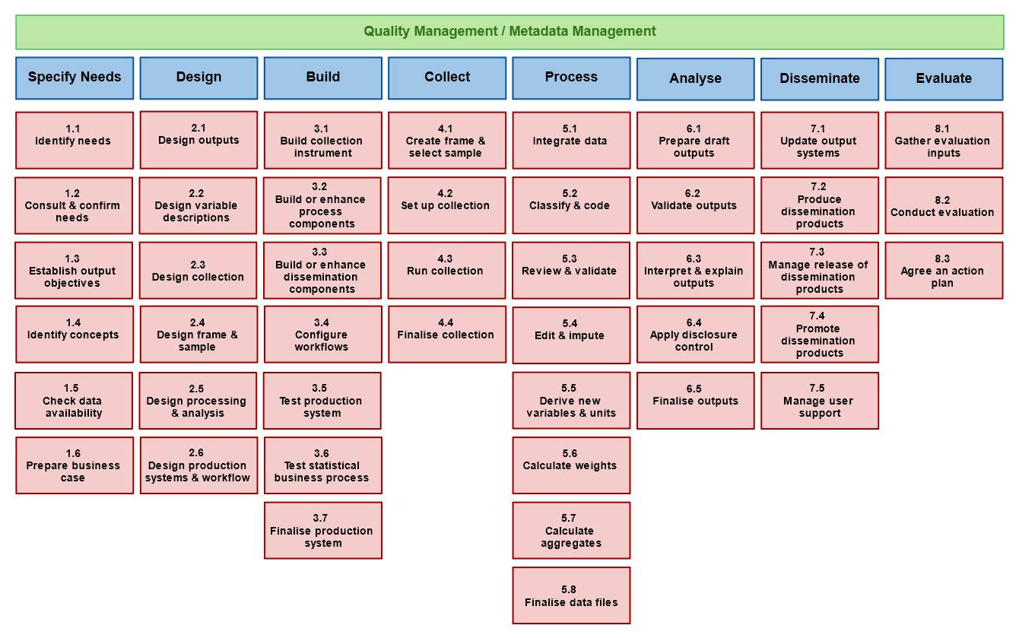
IDR Project – Developing Country needs

Slide 10
CSPA and dissemination needs – an example
.Stat dissemination platform meets many of the criteria for addressing challenges identified by IDR
Shareable - the platform is already used by a number of organisations,
Non-commercial and developed on a collaborative basis
Based around statistical standards such as SDMX and Open Data to further enable the sharing of data between statistical agencies and other organisations.
CSPA compatible .Stat could become a dissemination platform for developing countries
Great opportunity for CSPA to help in post-2015 development agenda in the years ahead

Slide 11
Your views…
Questions & answers

