Slide 1
ABS Tablebuilder and DataAnalyser
Session 7 UNECE Work Session on Statistical Data Confidentiality 28-30 October 2013
Daniel Elazar
daniel.elazar@abs.gov.au

Slide 2
Traditional Framework for Analysis of Microdata
Users' Environment
Basic CURFs on CD-ROM
Remote Execution - RADL
Remote access to Basic and Expanded CURFs for statistical analysis in SAS, SPSS and STATA.
On-site - ABSDL - Access to Expanded or Specialist CURFs
Special Data Service/Consultancies

Slide 3
ABS Analysis Services by “Market Segment”
ABS Data Lab
Most Sophisticated
Remote Access Data Lab
Special Data Service / Consultancies
CURFs
Analysis Service
Survey Table Builder
Publication Output
Less Sophisticated

Slide 4
Evaluation of Current Framework
Pluses
R Analysis of Confidentialised URF CD-ROM or RADL
R RADL supports SAS, SPSS or STATA
R ’Free’ coding suited to complex manipulations of data
R Variety of household survey datasets available for analysis
Minuses
T RADL protections not tight enough to enable analysis of more detailed data
T Limited to SAS, SPSS or STATA
T Very few Business CURFs
T Lengthy CURF creation process
T Metadata not searchable

Slide 5
Future ABS Tabulation Environment
MURF
Table Builder
Output
Future ABS Research Environment
User selects technique
Confidentiality Filters
Data
Transforms
Tabular
Filter 1
Confidentialised Outputs
Linear
Filter 2
MURF
Logistic
Filter 3
Output
Probit
Filter 4
Multinomial
Filter 5

Slide 6
TableBuilder Functionality
 | Weighted | RSEs
Counts | R | R
Estimates | R | R
Means | R | R
Quantiles | R | R

Slide 7
TableBuilder Protections
Protection | Description
Perturbation | Statistical noise added to values
Custom Ranges | min, max, min interval width
Field Exclusion Rules | Certain combinations of variable that increase identification risk are prohibited
Additivity | Restores additivity of inner cells to margins
Sparsity checks | Tables with too high a proportion of cells with a small number of contributors are not released
RSEs | Further adjusted; quality cutoff

Slide 8
DataAnalyser Functionality
Exploratory
Data Analysis
Transformations
/ Derivations
Analysis
Procedures
/Specifications
Output
Formats
Outputs
Logical derivations
Categorical/ Dummy variables
Category collapsing
Expression Editor for categ. vars
Drop variables / records
Action List
Robust Linear Regression
Binomial logistic
Probit
Multinomial
Poisson
Diagnostics
Weighted Analysis
R-squared
Pseudo R-squared
Coefficients
Standard errors
Other Diagnostics
CSV
Storage of intermediate datasets
Summary statistics
(sums, counts)
Summary Tables
Graphics
(side-by-side box plots)
Summary statistics
(count)
Graphics
Written in R
Full User Authentication
Audit System
Workflow Control
Data Repository Interface
Metadata Handler

Slide 9
DataAnalyser Protections (additional to TB)
Perturbation | Statistical noise added to regression score function
Linear Robust | Huber Mallows robustness incorporating perturbation for outliers and leverage points
Hex Bin Plots | Replaces scatter plots
Coverage and scope based Perturbation | Perturbation controlled by the specific units included in scope and the definition of scope
Drop k units | One record is dropped for each category of each explanatory categorical variable
Explanatory Only Variables | Demographic variables not allowed in the response variable field
Sparsity | Regressions based on to few units are not released
Leverage | Regressions on data containing units with excessive leverage are not released

Slide 10
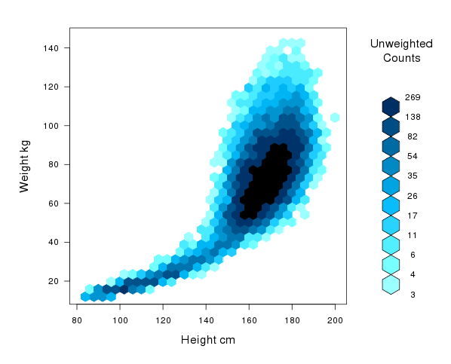
Hex-bin plots

Slide 11
Future Directions
1 | Collaborations with other NSIs
2 | Enhancements to TableBuilder and DataAnalyser: - hierarchical datasets - better performance with large datasets / high loads - linked datasets - sophisticated metadata handler
3 | Conduct user consultation → More advanced functionality for DataAnalyser - e.g. multilevel models
4 | Business data
5 | Single ABS publication system (single source of truth – consistency of confidentialised outputs)
6 | Measures of utility – information loss

Slide 13
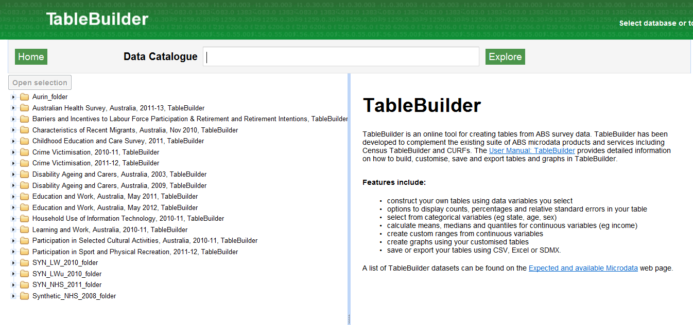

Slide 14
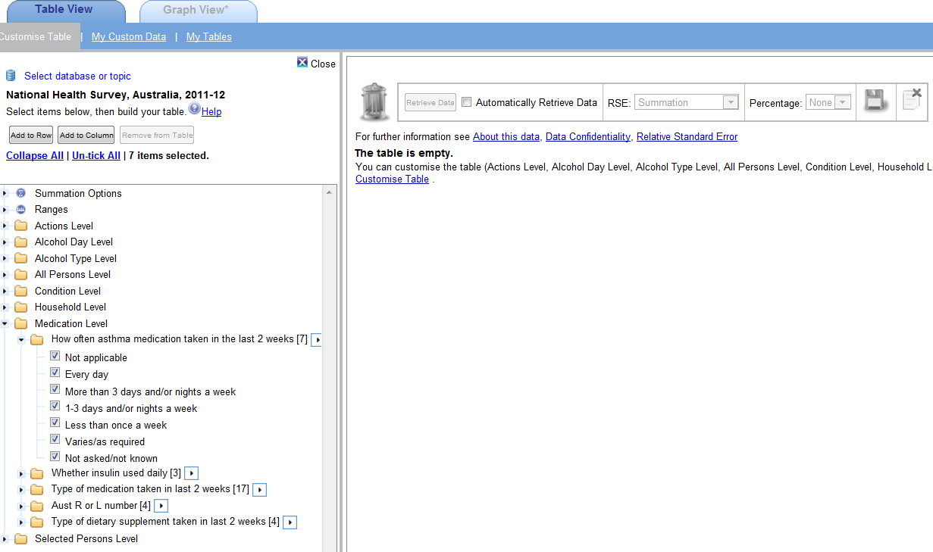

Slide 15
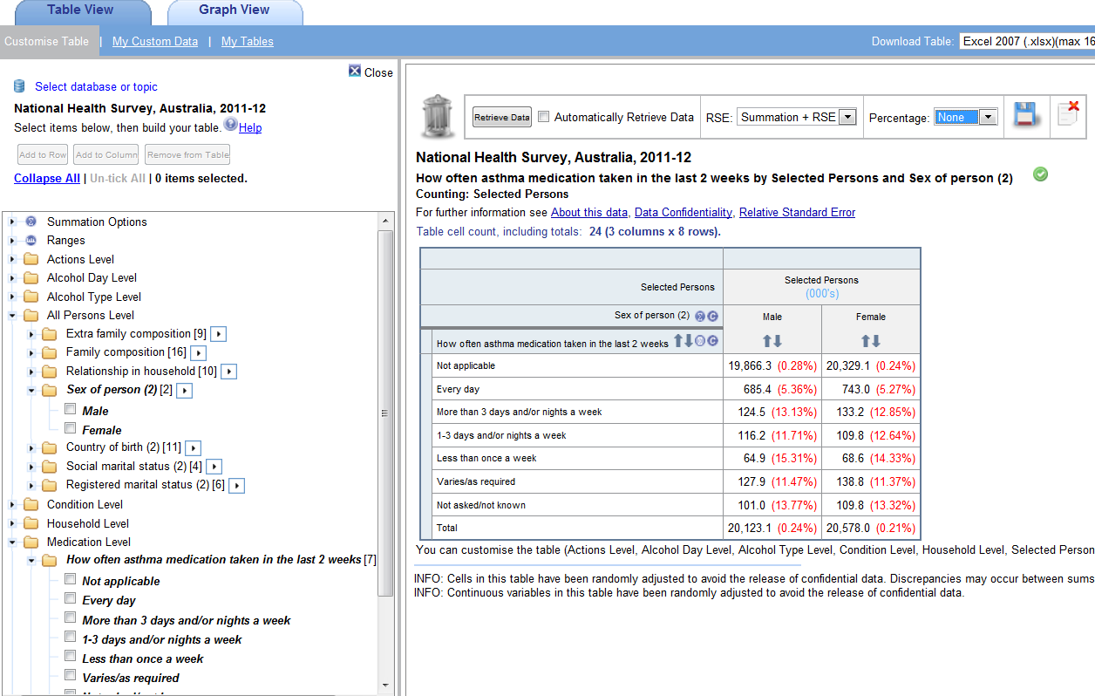

Slide 16
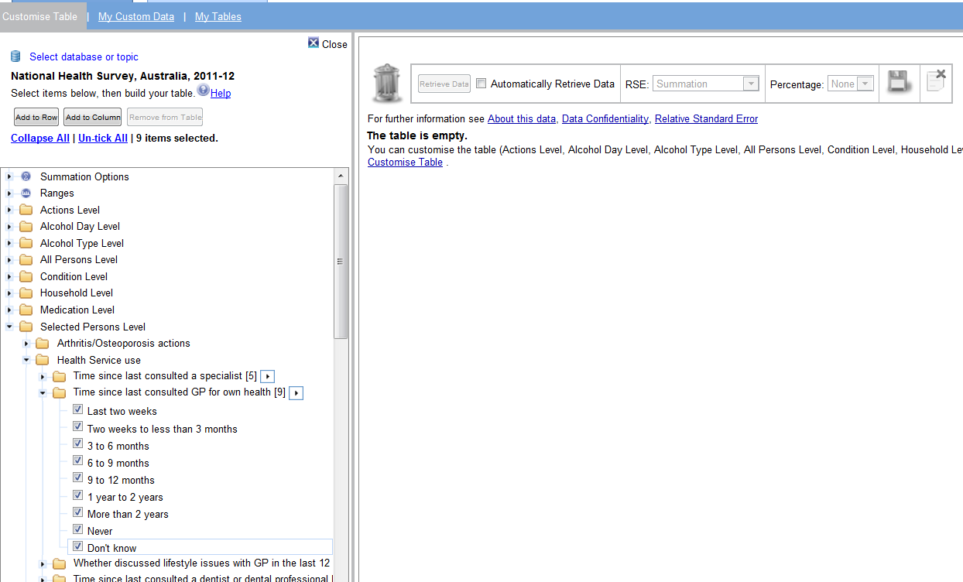

Slide 17
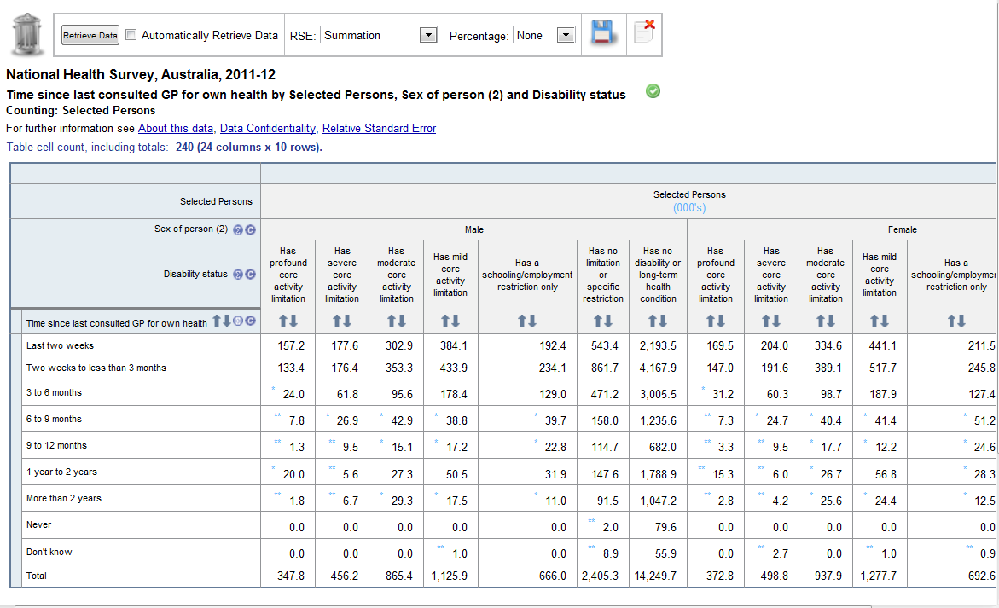

Slide 18
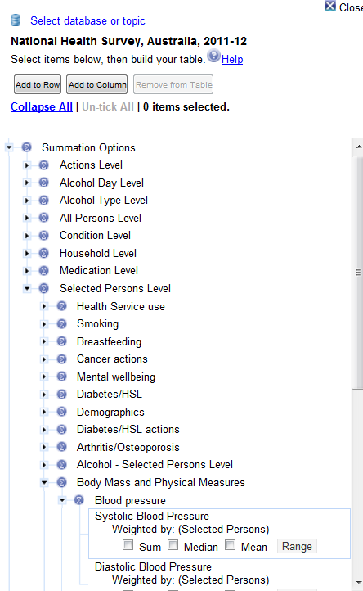

Slide 19
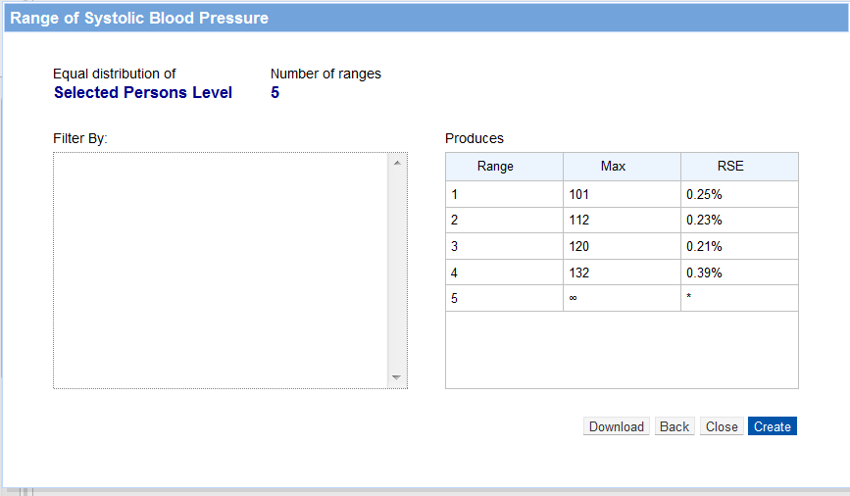

Slide 20
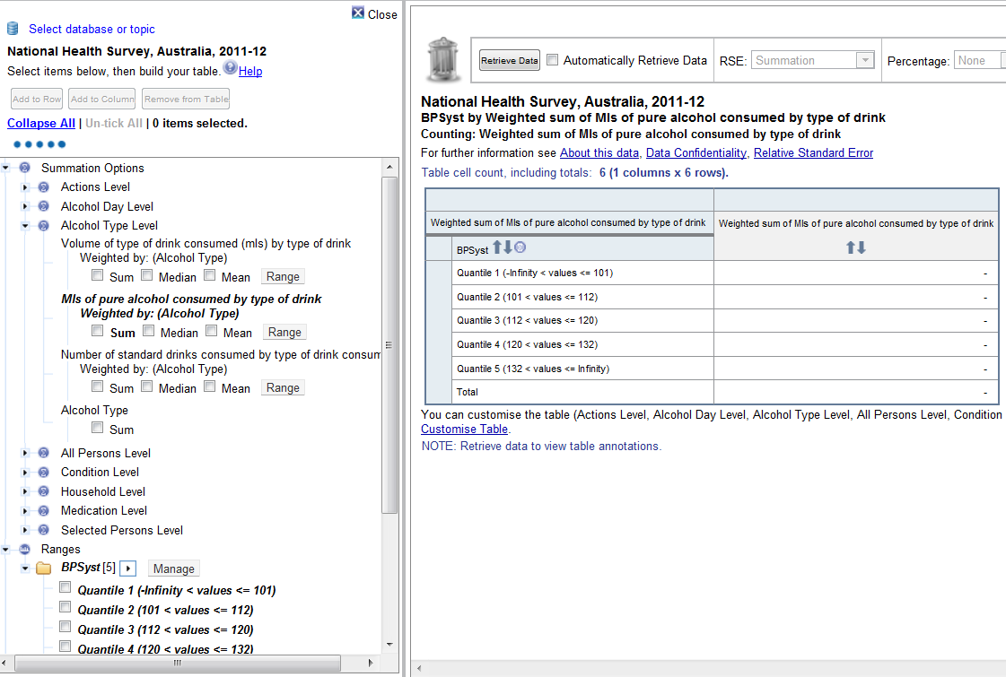

Slide 21
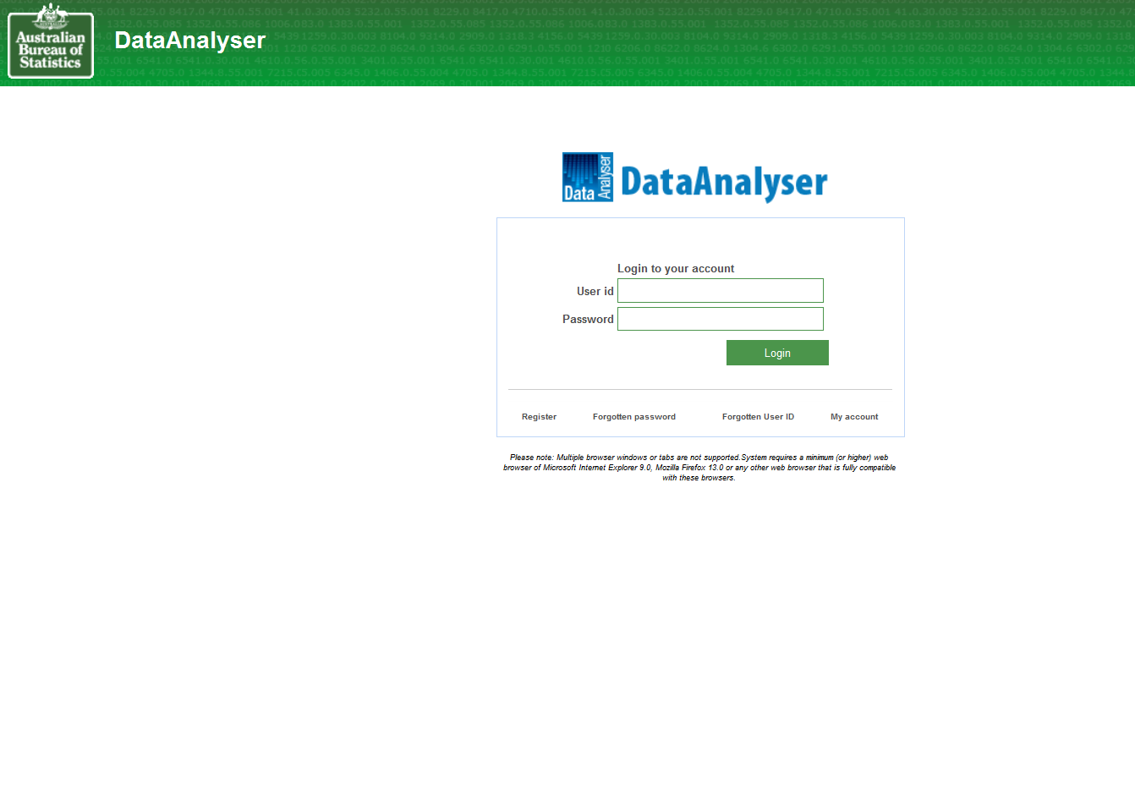

Slide 22
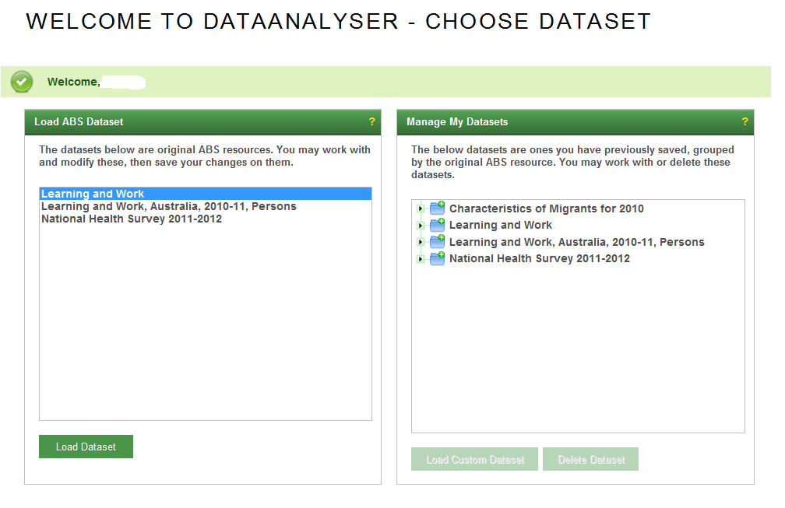

Slide 23
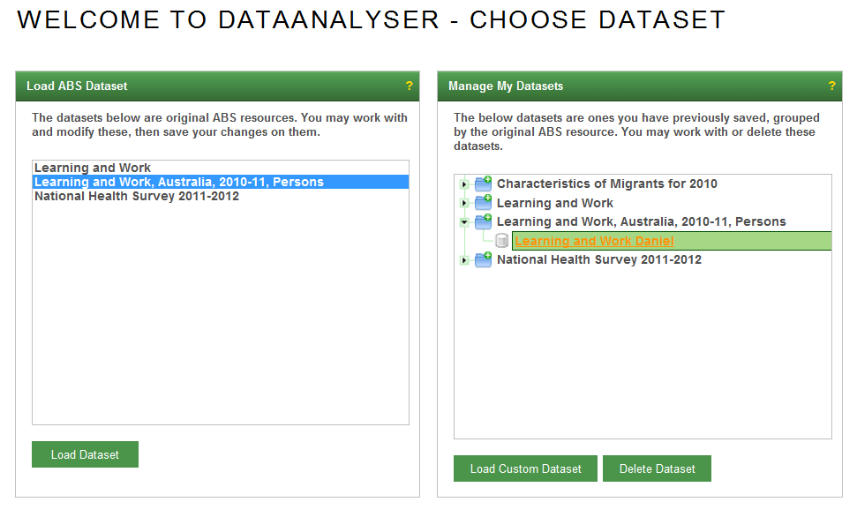

Slide 24
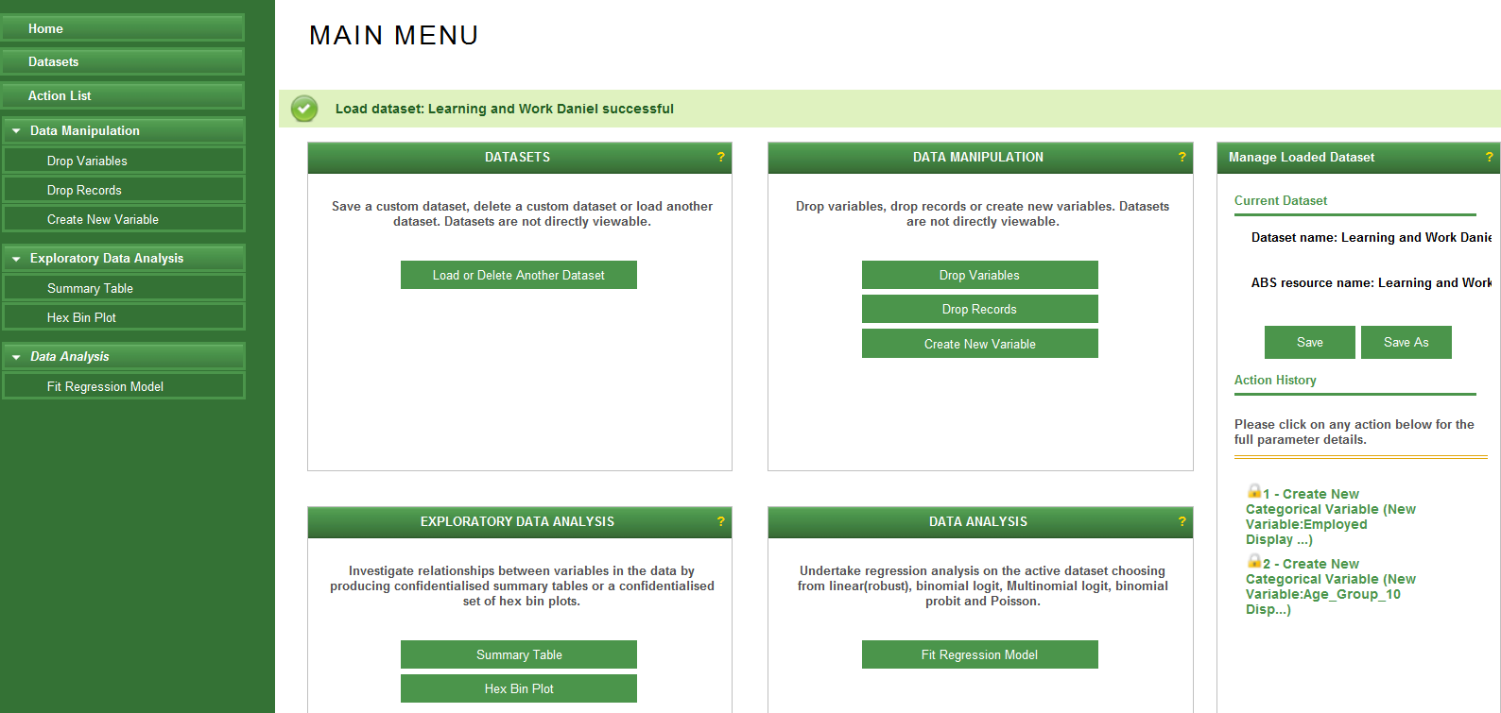

Slide 25
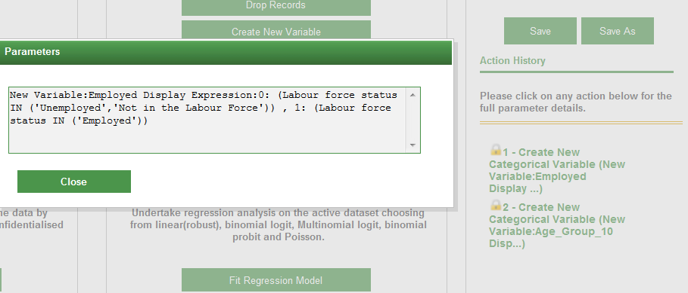

Slide 26
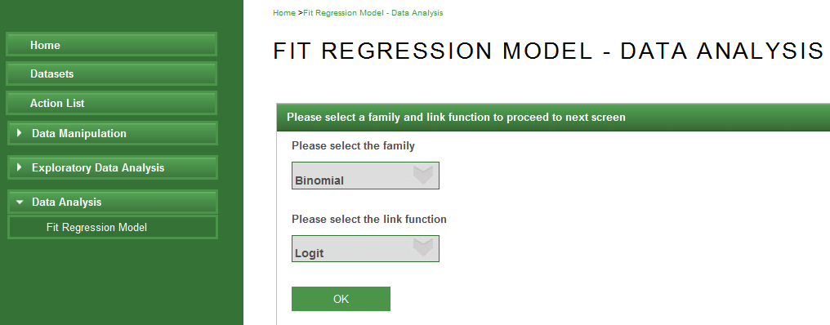

Slide 27
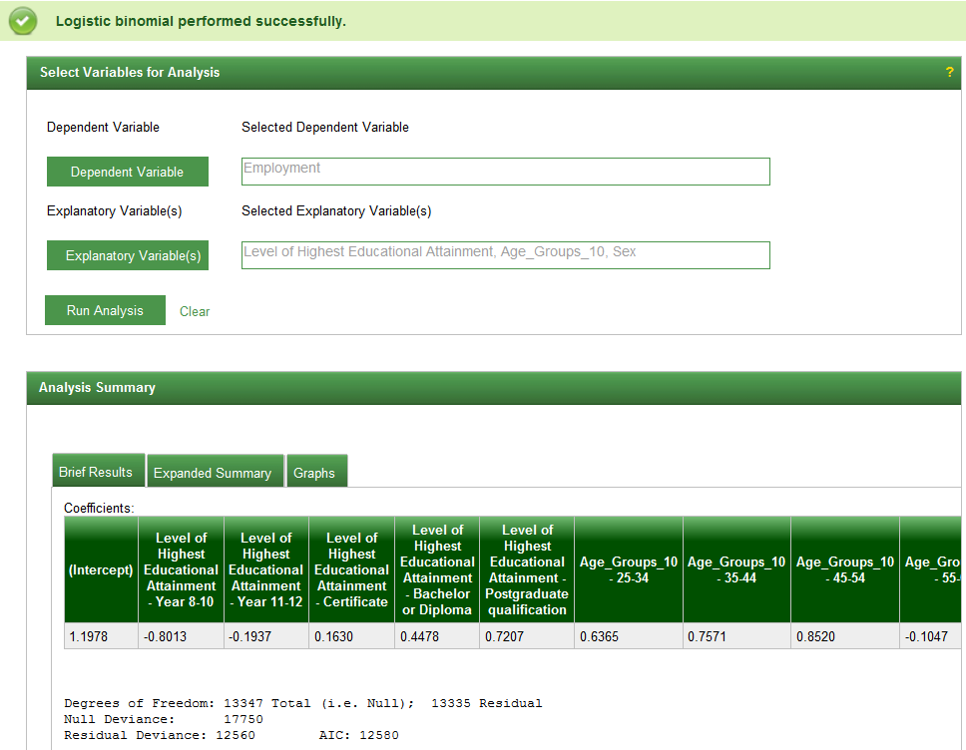

Slide 28
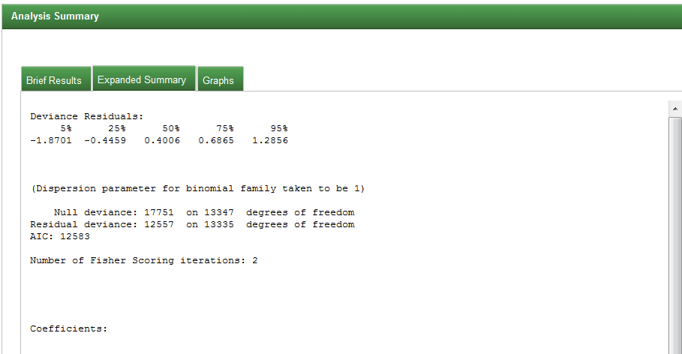

Slide 29
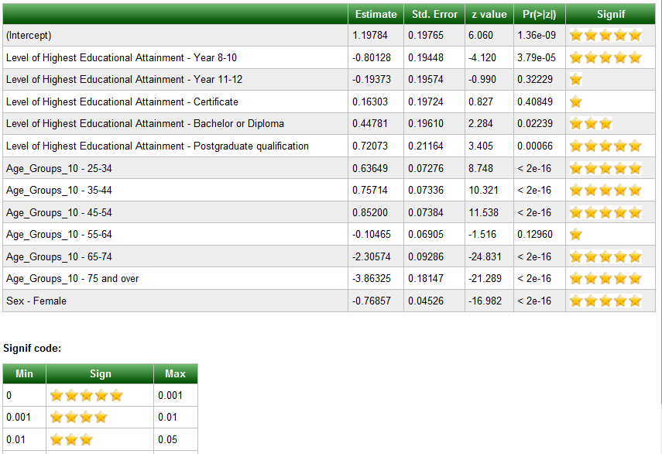

Slide 30
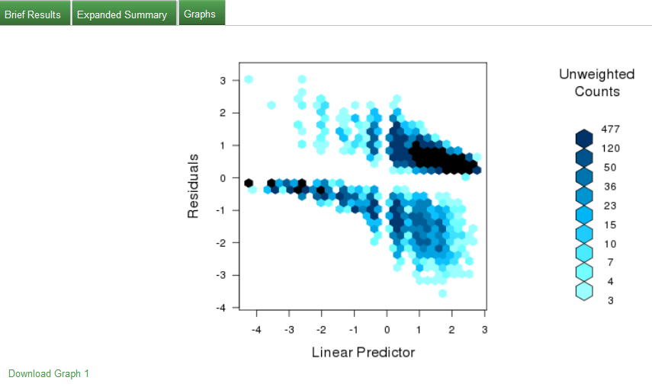

Slide 31
