Slide 1

Controlled shuffling experiment: detailed
10% sample of 2011 census of Ireland -
Risk, confidentiality and utility
Presenter: Robert McCaa, rmccaa@umn.edu
Co-authors:
Krish Muralidhar
Rathindra Sarathy
Michael Comerford
Albert Esteve

Slide 2
Outline
The challenge: disseminate high precision household census samples with minimum risk and maximum utility
    Test case: Ireland 2011 – 10% sample, 60 variables, 1,500 unique codes, including single years of age, relationship to head, 3 digit occupation and industry, etc.
Risk – although anonymized, a highly risky sample
Controlled shuffling – 5 variables,
Utility – after 3 experiments, amazingly good utility
Next steps
    Re-do the experiment to increase precision
    Apply the IPUMS suite of disclosure controls
    Submit the sample to CSO-Ireland for testing and approval
    Integrate and disseminate—for launch July 2014
    Other candidates? Canada, Italy, Netherlands, South Korea, UK?

Slide 3


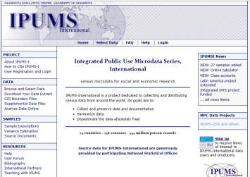


NSI entrusts census metadata and anonymized microdata to MPC
MPC integrates metadata and confidentializes microdata samples
NSI 1
MPC
MPC
….
IPUMS-International manages access and entrusts researchers with custom-tailored <ddi> , SAS, STATA, and SPSS metadata and microdata extracts for any combination of countries, censuses, sub-populations, and variables
NSI 100+
….
Trusted researcher
Trusted researcher
Trusted researcher
IPUMS-International microdata dissemination:
Trusted researchers download customized extracts

Slide 4
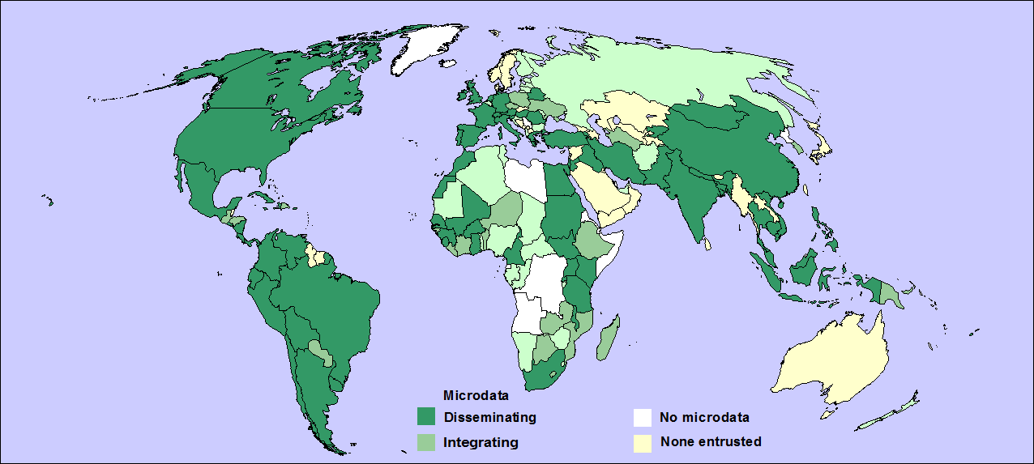
IPUMS-International: 2013
IPUMS-International
dark green = 74 countries, 238 samples, 544 millon person records confidentialized, harmonized and disseminating
medium green = integrating (25 countries, 75 censuses, 100 mill.)
light green = negotiating
Mollweide projection

Slide 5
238 samples, 74 countries, 544 million person records
(2014: ~260 samples, 80 countries—Ireland 2011!)
Africa |  |  | Americas |  |  | Asia |  |  | Europe
Burkina Faso | 2 |  | Argentina | 5 |  | Armenia | 1 |  | Austria | 4
Cameroon | 3 |  | Bolivia | 3 |  | Bangladesh | 3 |  | Belarus | 1
Egypt | 2 |  | Brazil | 6 |  | Cambodia | 2 |  | France | 7
Ghana | 1 |  | Canada | 4 |  | China | 2 |  | Germany | 4
Guinea | 2 |  | Chile | 5 |  | Fiji | 5 |  | Greece | 4
Kenya | 5 |  | Colombia | 5 |  | India | 5 |  | Hungary | 4
Malawi | 3 |  | Costa Rica | 4 |  | Indonesia | 9 |  | Ireland | 8
Mali | 2 |  | Cuba 2002 | 1 |  | Iran | 1 |  | Italy | 1
Moroco | 3 |  | Ecuador | 6 |  | Iraq | 1 |  | Netherlands | 3
Rwanda | 2 |  | El Salvador | 2 |  | Israel | 3 |  | Portugal | 3
Senegal | 2 |  | Haiti | 3 |  | Jordan | 1 |  | Romania | 3
Sierra Leone | 1 |  | Jamaica | 3 |  | Kyrgyz Republic | 2 |  | Slovenia | 1
South Africa | 3 |  | Mexico | 7 |  | Malaysia | 4 |  | Spain | 3
South Sudan | 1 |  | Nicaragua | 3 |  | Mongolia | 2 |  | Switzerland | 4
Sudan | 1 |  | Panama | 6 |  | Nepal | 1 |  | Turkey | 3
Tanzania | 2 |  | Peru | 2 |  | Pakistan | 3 |  | United Kingdom | 2
Uganda | 2 |  | Puerto Rico | 5 |  | Palestine | 2
 |  |  | Saint Lucia | 2 |  | Philippines | 3
 |  |  | United States | 7 |  | Thailand | 4
 |  |  | Uruguay | 5 |  | Vietnam | 3
 |  |  | Venezuela | 4
More countries
and samples
added yearly

Slide 6
2010 round of censuses pose increased confidentiality risks, yet the demand for data is greater than ever
Risks:
Big Data: vast troves of electronic information in the cybersphere
Data mining – large numbers of highly motivated geeks wanting to be the next Bill, Steve, or … Ed (Snowden)
Public anxiety about identity theft
Demands:
Huge challenges the environmental, economic, social, cultural, and political foundations of nations, populations, …
Researchers demand/need more, higher quality data
Population census microdata constitute one of the greatest treasures of official statistics

Slide 7
Ireland: first to entrust 2011 census sample challenge, opportunity
Initial 2011 sample of Ireland for IPUMS, drained of detail:
5 year age bands: single year suppressed
Household, but relationship variable suppressed!
Geography, but only for 8 regions, no counties, etc.
Meanwhile IPUMS is seeking a sample for a confidentiality test
CSO agreed to entrust a second, high precision sample with:
single years of age, relationship, geography… 60 variables, 1,500 unique codes, every 10th household
Test controlled shuffling (Muralidar & Sarathy agreed)
2 challenges for Muralidhar & Sarathy:
Persuade IPUMS of data utility (and precision)
Convince IPUMS & CSO that confidentiality is protected

Slide 8

k-Anonymity Disclosure Risk Assessment
A standard k-anonymity approach used to assess disclosiveness of records:
Test parameters drawn from the data environment, sensitivity and characteristics.
Different configurations of quasi-identifiers were used.
Variables flagged and ranked by number of records effected.
We aim to provide some degree of ground truth on the relative uniqueness of records to inform later experiments.
Results show that the variables age, education, occupational group, industry classification and geographic identifiers in that order of priority should be considered in the implementation of any disclosure control methods.

Slide 9
Data shuffling (see Muralidhar & Sarathy, 2006)
Shuffling is ideal for nominal data with hierarchical structure, such as age, education, occupation, industry, etc.
Shuffling is a multivariate procedure where values are re-assigned based on rank order correlation.
Data shuffling offers the following advantages:
  The shuffled values Y have the same marginal distribution as the original values X. Hence, the results of all univariate analyses using Y provide exactly the same results as that using X.
  The rank order correlation matrix of {Y, S} is asymptotically the same as the rank order correlation matrix of {X, S}. Hence, the results of most multivariate analysis using {Y, S} should asymptotically provide the same results as using {X, S}.
“Controlled” shuffling - disclosure protection specified by data administrator

Slide 10
Confidential Protections are considered strong
3 of 4 person records were modified:
  Age – 50.1% of records
  Sex – 13.6%
  Educational attainment – 8.1%
  Industry – 13.7%
  Occupation – 12.4%
Multiple shuffles for adults, couples and household
  Adults – 80% with at least 1 shuffled value; 25% with 2 or more
  Couples – 50% of couples with both ages perturbed; 91% with at least one age perturbed
  Perturbations at the individual level are compounded for households.
Note: we do not intend to provide this information unless requested by the data provider.

Slide 11
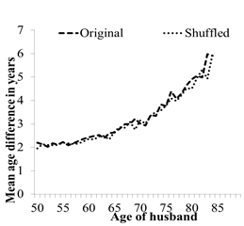

Analytical Utility: 3 tests
A. Age gap between spouses (Husband’s age – wife’s)

Slide 12
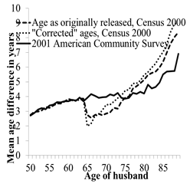

Analytical Utility: 3 tests
B. Perturbations gone wrong (US 2000 census PUMS):

Slide 13
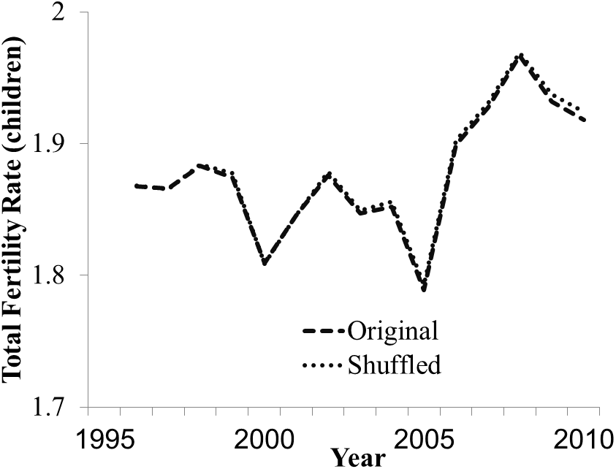
Analytical Utility: Test # 2: Own-Child Fertility
2. Matches mothers with children to construct annual birth series by single year of age of mothers. Note: CSO confirmed Age-specific and Total Fertility estimates against vital registration figures.

Slide 14
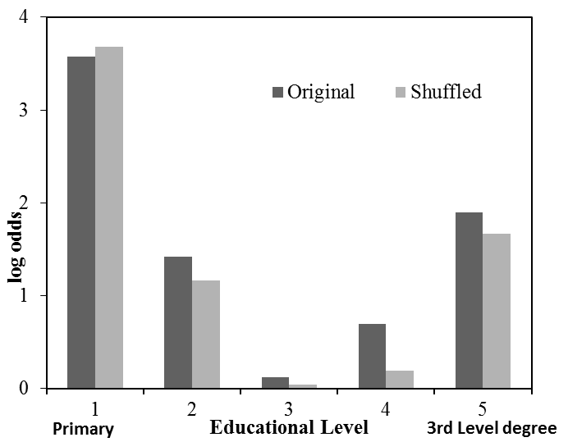
Analytical Utility: Test # 3: Educational Homogamy
3. Log-odds of similarity in educational attainment of husbands with wives
Not so good—
but the difference may be due to an error in linking couples—discovered after shuffling

Slide 15
Conclusions, 1: Refinements to be made
Precision: more closely approximate frequencies in the unperturbed data
Fine-tune controlled shuffling:
  When shuffling sex for unmarried children aged 0-19, take into account educational attainment
  For industry, take into account 23 first level groups instead of only 10
  For occupation and industry, maintain associations with other social variables: segment, social class and disability
  For educational attainment, take into account the joint characteristics of spouses, and associate with field of study

Slide 16
Conclusions, 2: Refinements to be made
Apply the classic technical protections for all datasets entrusted to IPUMS:
  Top/bottom/group codes for sparse categories
  Convert large households to “group quarters” removing household identities.
  Swap a fraction of households across places of residence
Take into account lessons learned, criticisms and suggestions.
Additional protections required by CSO
    Invite others: Canada, Italy, Netherlands, South Korea, UK?

Slide 17


Thank you!
www.ipums.org/international

