Slide 1
Metadata driven application for aggregation and tabular protection
Andreja Smukavec
SURS

Slide 2
Practice at SURS
More than once tabulated data for each survey:
Standard error estimation
Statistical disclosure control
Tabulation
Tabular protection (cell suppression) is quite a time-consuming operation.
Applying precision requirements and safety rules are two separate processes.

Slide 3
Project Standardization of Data Treatment
Started in 2011
Internal project
Composed of two major parts:
editing and imputations
aggregation, tabulation, sampling error estimation and confidentiality treatment
Final aim: construction of metadata driven application (MetaSOP).

Slide 4
Metadata driven application
All the parameters for the particular survey will be provided in a metadata database (MS Access, transfer to Oracle by the end of 2013).
The general code (SAS) will read from metadata database and execute required processes.
The dissemination of the data will be carried out.

Slide 5
Metadata database
It consists of
Table of derived and dummy variables
Table of demanded statistics
Table of domains
Metadata for safety rules
Metadata for sampling error estimation
Metadata for tabulation
Still missing
Metadata for tabular data protection (input files for Tau Argus, SAS-Tool)
Metadata for publication

Slide 6
Boundaries table in the metadata database
Metadata for precision requirements:
Boundaries for distinction between precise, less precise and imprecise data
Type of sample
Metadata for safety rules:
Parameters for dominance rule, p% rule, threshold
Holding indicator
Safety margin for threshold

Slide 7
Types of statistics and corresponding safety rules
Type | Description | Safety rules
01 | Number of reporting units with specific property | threshold
02 | Proportion of reporting units with specific property | threshold
03 | Sum of continuous variable | threshold, dominance rule, p%-rule, zero unsafe
04 | Average of continuous variable | threshold, dominance rule, p%-rule, zero unsafe
05 | Ratio of sums of two continuous variables | A sum in numerator or denominator is unsafe according to the rules for statistic type 03.

Slide 8
Precision requirements - safety rules
We included four possibilities:
Precision requirements and safety rules are used.
If the statistic is imprecise (CV > 30%) and primary sensitive, then we set its status to safe.
If the statistic is less precise and primary sensitive, then it is still primary sensitive.
Only precision requirements are used.
Only safety rules are used.
Neither precision requirements nor safety rules are used.

Slide 9
General SAS code
It consist of 3 SAS macros:
Preparation of the micro-data file
Computation of all needed statistics, determination of the primary sensitive ones and attribution of the corresponding standard error and coefficient of variation
Tabulation into Excel
Still missing:
SAS macros for confidentiality treatment (preparing Tau Argus input files, code from SAS Tool for creation of safe tables with method Cell Suppression)
SAS macros for preparing files for publication on our data portal

Slide 10
Table with statistics
Metadata database + general code table with statistics
SAS environment, transfer to ORACLE planned by the end 2013
It consists of
Statistic‘s value for each domain
CV and standard error of statistic
Primary sensitivity status
Still missing:
Final confidentiality status (SAS-Tool)
Final dissemination status

Slide 11
Metadata driven application

Slide 12
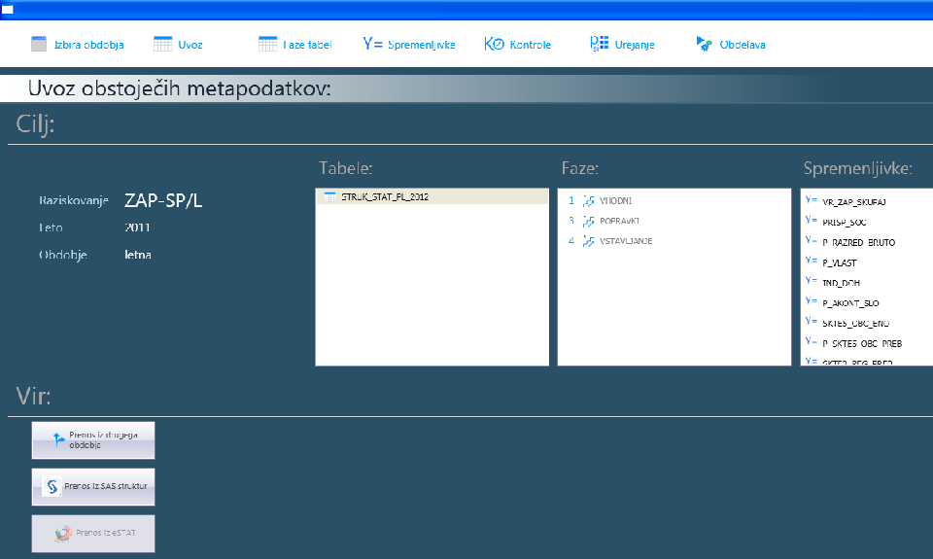
MetaSOP

Slide 13
Drawbacks and benefits
Drawbacks:
Not all surveys are appropriate (only a part will be possible to use)
Better suppression pattern is usually found individually
Lot of work for the first reference period
Benefits:
Better transparency (all metadata available in one place)
Survey methodologist controls the whole process
Risk for errors will decrease
Small amount of work for the next reference periods

Slide 14
Future plans
Missing parts of the metadata database, table with statistics and general code have to be added
The MetaSOP application has to be upgraded
A system for all the corresponding code lists has to be developed

Slide 15
Thank you for your attention!
andreja.smukavec@gov.si

