Slide 1
SESSION ON BUSINESS REGISTERS FOR DEVELOPING AND TRANSITION ECONOMIES “THE CHALLENGES IN STRENGTHENING MALAYSIA BUSINESS REGISTER”
WAN MOHD SHAHRULNIZAM
DEPARTMENT OF STATISTICS MALAYSIA

Slide 2
PURPOSE OF PRESENTATION
To briefly explain about Malaysia Business Register
To share the efforts undertaken in strengthening the Register

Slide 3
Introduction
OUTLINE
OF THE
PRESENTATION
Malaysia Business Register (MBR)
Strengthening the MBR
Conclusion

Slide 4
What is MBR?
ROLE OF MBR
For The Detection And Construction Statistical Units
It is a comprehensive master list of businesses and companies operating in Malaysia.
As A Tool For The Preparations And Coordination Of Surveys
As A Source Of Information For Analysis Of The Business Population
Basic pillar in the system of Malaysia Economic Statistics which facilitate the collection, interpretation and dissemination.
As A Tool For Mobilisation Of Administrative Data
As An Integration And Dissemination Tool.

Slide 5
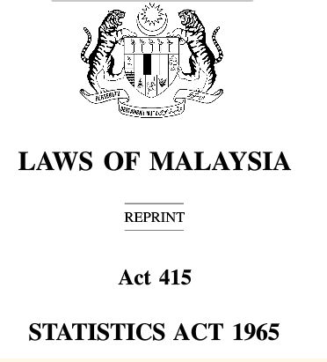
THE EVOLUTION OF MBR
It is governed by the Statistics Act 1965 (Revised 1989) and the Department‘s Strategic Plan 2010-2014.
Only internal user with specific ID is allowed to access the register.
2010
Onward
Enterprise Establishment (EE Frame) National Enterprise Wide Statistical System (NEWSS)
CRS upgraded with Wide Area Network (WAN)
2002
CRS upgraded with Local Area Network (LAN)
1996
The CRS was set in a PC based using Dbase IV
1994
Central Register System (CRS) was initiateds
1988

Slide 6
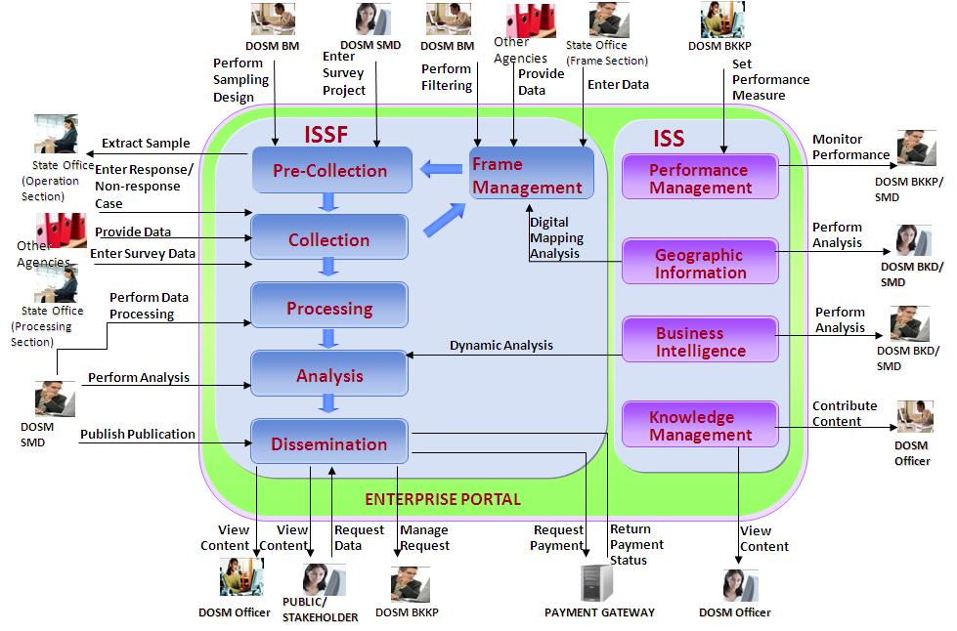
Conceptual Framework
Foundation are driven by System of National Account
Inline with Generic Statistics Business Process Model (GSBPM)
Designed under Integrated Statistical Systems Framework (ISSF)

Slide 7
Conceptual Framework
FUNCTION
Maintenance through list information from administrative sources.
Maintenance of establishment and enterprise information
To generate monitoring reports and analysis tools
To monitor the number/type of establishments in an enumeration block
MODULE
Screening Agency information Business Profiles
Establishment/Enterprise Duplicate Data Collection Respondent Management Control
Report Business Intelligence (BI)
Geographical Information System (GIS)

Slide 8
Defining Statistical Units
Coverage Of MBR
The industry classifications based on MSIC 2008 version 1.0 (comparable to ISIC 4 of the United Nations)
Register comprises all of establishments/enterprise operating in Malaysia
Classifications by the principal activity of the unit (e.g value added/output/sales by the goods produced or services rendered)

Slide 9
Data Items In EE Frame
Serves as the primary identifiers
Unique ID number
Created by source of agencies
Company/ establishment ID number
Such as business name, postal and location address and others
Contact information
Legal status and equity structure
Basic financial information
Activity and industry classifications
Company and establishment organisation structure
Censuses/ surveys control status indicators

Slide 10
Updating The EE Frame
The main objective of MBR is to provide
censuses/surveys frame accurate, reliable and timely
Administrative Data Source – Annual Updates
Central agency (HQ) and Non-central agency (14 States Offices)
Annual Screening Survey
Industries which are not covered in any censuses/surveys
Censuses/Survey Feedbacks
Operational Information Control System

Slide 11
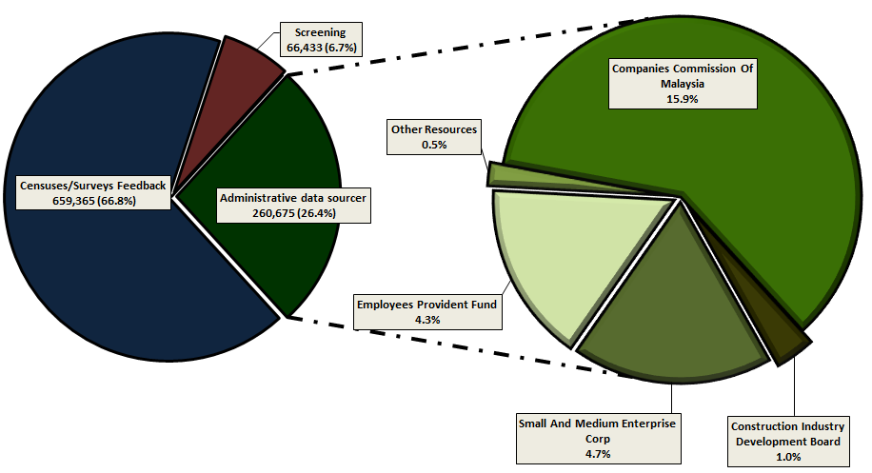
There are about
986 thousand active establishments,
912 thousand active enterprises and
1,485 complex enterprises
Companies Commission of Malaysia (CCM) accounted for the largest portion.
Censuses/Survey Feedback is the largest constituted of 66.8%

Slide 12
STRENGTHENING THE MBR
The DOSM is responsive to the various challenges related to the National Development Policies/Vision and drastic change in Malaysia Economy
The register as the backbone to the Malaysia economic statistics should be responsive and sensitive

Slide 13
Strengthening The Business Process Model
Generic Statistical Business Process Model (GSBPM)
BR maintenance is continuous activity
DOSM has taken step to strengthen the processes and quality assurance
To ensure the BR is comprehensive, accurate, reliable and timely
IMPROVE THE QUALITY
OF THE REGISTER
SOURCES
COLLECTION PROCESS
OUTPUT
To ensure the sources are relevant to the user requirement and aligned with the changes in Malaysia business landscape
These will involve identifying the units and running the collection process according to suitable formats which can be integrated with the register.
It will prepare the output to be validated and made ready for the release.
Finally the evaluation phase will provide the information to improve the quality of the register.
The benefit applying the GSPBM is the standardisation of terminology between processes and organisations

Slide 14
Enhancing The Use Of Administrative Data Sources
Strong collaboration with the tax offices and registrar of companies & businesses in Malaysia
Strong collaboration with the local council /authority as a main source to the non-central agency
Strong relationship with professional bodies, businesses associations, cooperatives and registrar of society
Future platform for coordinating and tapping data from agencies using MyCOID (Malaysia Company Identification Number)
Recent information and structure of companies and businesses
EE Frame
All these efforts in future will make DOSM as the gateway for bringing all administrative data relating to businesses

Slide 15
Keeping The MBR Up To Date
Perfect frame
Applying GSBPM
Balance the need for accuracy, timeliness and stability of the registered data
Minimise the effects on time series of shocks arising from the updating process
A perfect frame should reflect the real business world in term of structures; classifications; linkages; data contents; availability status and contact information
Operational Control Information Module
These assist the field enumerators at state offices to access and provide survey feedback in real time which it improves the timeliness and the efficiency of the updates.
Integrated Listing Module (InLis) through Household Module
To accommodate the listing process for establishment/enterprises using maps and enumeration blocks beside the normal exercise for household

Slide 16
REDUCE RESPONDENT BURDEN
An integrated system designed for data collection and assist the department to improve its respondent relation
Access to the recent information in the register will increase the efficiency of data collection
Improving respondent relation will lead to greater quality responses and data collected.

Slide 17
STRENGTHENING THE SAMPLING ROLES
Completeness, consistency, reliability and up to date frame are important as it is going to be used as sample selection, stratification, imputation and estimation
The register will provide the latest number of active population that is used to calculate the weights for blow-up process for variables of interest
It should minimize the number of frame defect to avoid the gap between the estimated figures and the actual population

Slide 18
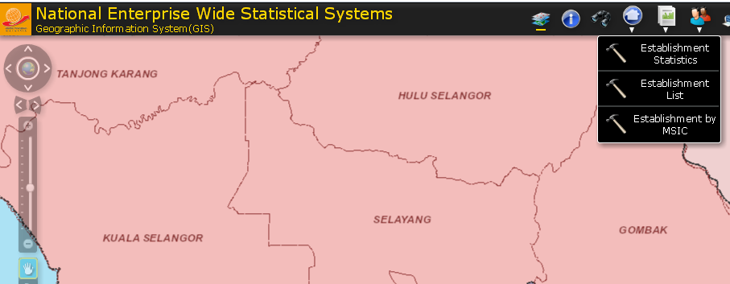
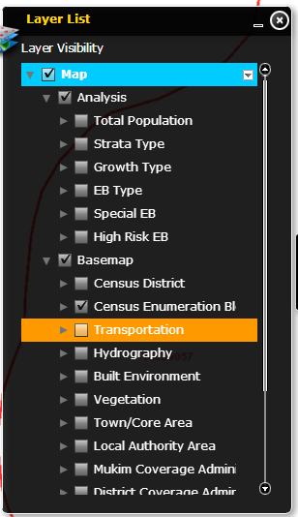
In future the update will be visualized and analyzed through Geographic Information System Module. This will enhance the accuracy and quality of the register.

Slide 19
Establishing Business Demography Statistics And Business Profiling
BUSINESS DEMOGRAPHY
Business Demography is a growing demand and most NSOs are using this platform to update the register (birth, death, survival and growth)
Information about units on the register must be kept up to date to produce such statistics
BUSINESS PROFILING
Business profiling is the method to analyse the legal, operational and accounting structure of an enterprise and enterprise group
Profiling can be viewed as part of a broader, coordinated strategy for improving agency’s economic statistics
DOSM has taken step by creating enterprise module in the NEWSS system which can facilitate the profiling activity

Slide 20
CONCLUSION
DOSM has taken active response to the challenges ahead and the need from the policymakers and planners through implementation of The Strategic Plan 2010 -2014
The plan is to ensure DOSM remains relevant with the function as outlined in the act and to achieve the vision to be the leading statistical agency internationally by the year 2020.
To further nation’s progress, policymakers and users need economic and social statistics
The business register is vital component in the censuses/surveys process

Slide 21
THANK YOU

