Slide 1
Population and Housing Census 2014 in Moldova
Valentina Istrati, head of demography statistics and population census division
valentina.istrati@statistica.md
Workshop on Population and Housing Censuses
(Geneve, Switzerland 28-29 September 2015)

Slide 2
Content
Introduction
Legal frame
Innovations in 2014
Administrative territorial organization of the country
Communication campaign
Post enumeration survey
Preliminary results
Lessons learnt

Slide 3
Introduction
Period: 12 – 25 May 2014;
Method: traditional
Reference period: 00:00 12 May 2014;
It was the second population census since our independency and first housing census;
4 types of questionnaires;
1CL -for households and dwellings
2P -for person
3SCL -collective living quarters
4S -person with temporary presence, under 12 months

Slide 4
Enumerated units at PHC 2014
Person
household
dwelling
building

Slide 5
Legal frame
Law about official statistics from 2004
Law No. 90 on 2014 population and housing census in the Republic of Moldova of 26.04.2012
Government Decision no. 967 of 21.12.2012
Conference of European Statisticians, Recommendations for the 2010 Censuses of Population and Housing

Slide 6
Administrative territorial organization of the country
3 municipalities:
Chisinau
Balti
Bender
1 Autonomous Territorial Unit of Gagauzia
1 territorial unit of Transnistria
32 rayons

Slide 7
Innovations in 2014
The implementation for the first time of the “usual residence” notion
The data will be possible to be disaggregated to the lowest civil division
Were enumerated for the first the dwellings
New methods in mapping
More questions on migration
The question on voluntary were included
New questions on disability

Slide 8
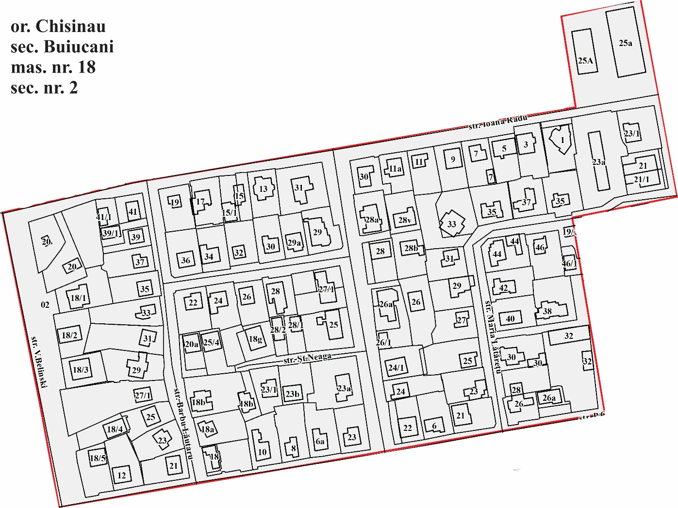
Census mapping
For the census were used for 930 localities address and cadaster plans

Slide 9
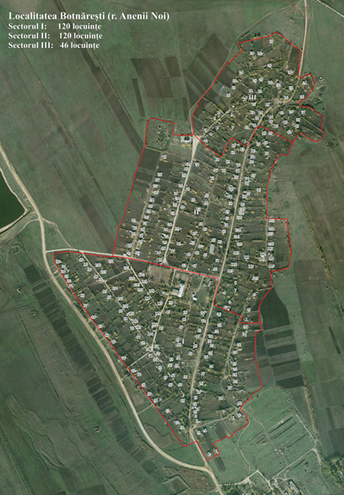
For 600 localities we had ortophoto plans from 2007
All the maps were printed and distributed in territory to draw the enumeration areas before the activity of Creating the lists of buildings and dwellings
After receiving all the maps back, a specialist from population and housing census division drew and coded all enumeration areas for all localities.

Slide 10
Communication campaign
TV
20 interventions in TV shows
Radio
15 programs with the participation of both the DG as well as specialists NBS
Media
6 vast interviews in the press
5 channels with national and regional coverage:
ÎMeetings with local authorities
In 2 municipalities and 32 rayons
20 telephone interventions at radio also with DG and CS
Several press-conferences

Slide 11
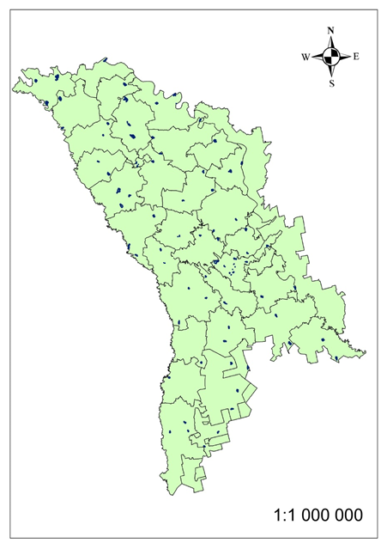
Post Enumeration Survey
PES was conducted between 16 – 29 June 2014
Same methodology as at the census
The same reference day
Covered 90 sectors that is 0,8% of all sectors of the census

Slide 12
Preliminary results of 2014 Population and Housing Census
Dwellings total – 1,259,207
Occupied – 1,044,095
Unoccupied – 215,112
Households – 1,062,615
Persons total – 2,913,281 (including 329,108 persons being outside of the country)
Men – 1,410,578
Women – 1,502,703
Persons absent abroad, of total – 329,108
Persons with temporary residence (up to 12 months) - 368

Slide 13
The share of occupied and unoccupied dwellings, by regions

Slide 14
Population distribution by area of residence

Slide 15
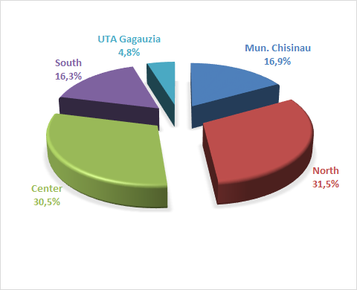
Distribution of enumerated population by development regions, %

Slide 16
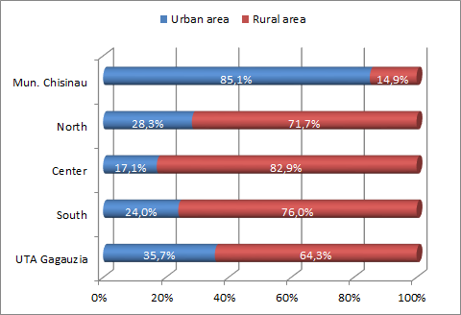
Rate of enumerated population by area of residence per development regions

Slide 17
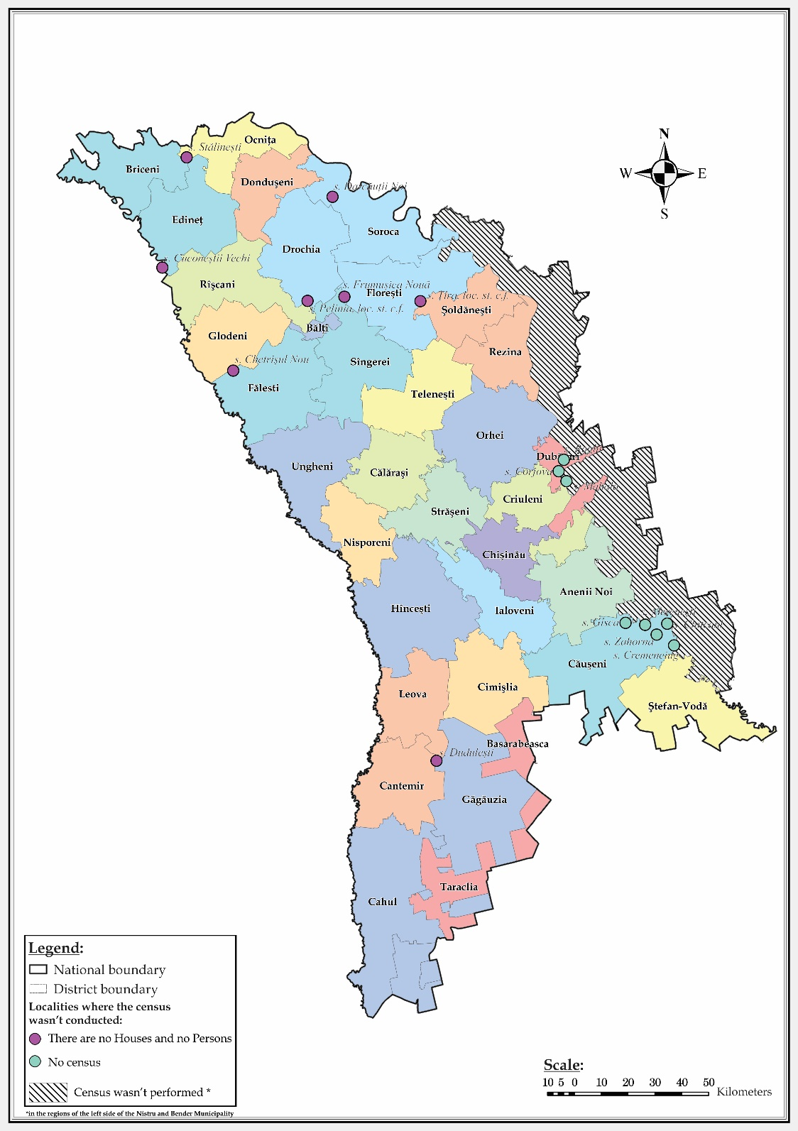
Localities where the census did not take place

Slide 18
Lessons learnt
Improve legal frame
To start the preparation for the next census earlier
Improve communication campaign
Extend the days for training the temporary staff
To continue developing census mapping
To have a better communication with different NGO’s
To shorten the questionnaire for person

Slide 19
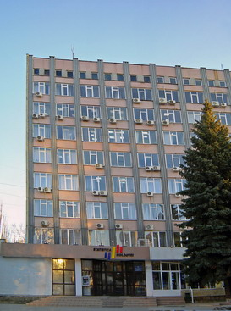
THANK YOU FOR YOUR ATTENTION!

