Slide 1
Deriving labour force status in the register-based census Case of Slovenia
Danilo Dolenc
UNECE Meeting on Censuses, Geneva, 2 October 2015

Slide 2
Basic concepts
Current activity status (2011) = Labour force status (2020)
Based on ILO 1 hour criterion / last week
At least three questions needed
Work or not
Looking for work or not
Available to start work or not
Usual activity status (2011) = Self-declared labour status (Eurostat core social variable)

Slide 3
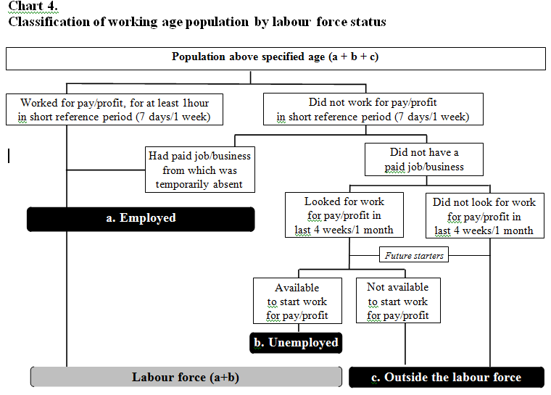
Source: Draft Recommendations for the 2020 Censuses, paragraph 504

Slide 4
Implementation in 2011 Census
UNECE Census Wiki page as source
If census form available (in English)
33 countries
10 countries UAS only
5 countries UAS +CAS
7 countries CAS only
11 countries CAS only + outside LF categories

Slide 5
Register-based LF status - Slovenia
The only ‘problematic’ is 1 hour criterion
Paragraph 513 f) from Draft Recommendations
Employment Register using similar definitions
Methodology
Linkage databases using PIN
Hierarchy of sources
Hierarhy of LF status in case of source provided different statuses
Health Insurance records
More than 100 schemes avaialble to be insured

Slide 6
Priority of sources by quality (1)
High Quality sources
1 - Statistical Register of Employment (last week before reference day)
2 - Registered unemployment (1 January)
3 - Student enrolment in tertiary education (current academic year – as of 1 October)
4 - Scholarships (1 January)
5 - Pension recipients(1 January)

Slide 7
Priority of sources by quality (2)
Lower Quality sources
6 - Health insured persons under specific schemes (1 January)
7 - Family members of insured persons (1 January)

Slide 8
Priority of sources by quality (3)
Outdated source – Lower quality
8 - Recipients of social transfers (previous calendar year)
Outdated source – High quality
9 - Income taxation (previous calendar year))
Data produced annually
11 months after reference date
Completely automated process

Slide 9
Records by LF status and source
Labour force status (para. 503) | Nr.(1,000) | HQ (%) | LQ (%) | IMP (%)
Working age pop. | 1,760 | 85.5 | 13.2 | 1.3
Employed (1.1) | 800 | 97.1 | 1.7 | 1.2
Unemployed (1.2) | 126 | 96.2 | 2.7 | 1.1
Schooling (2.1) | 173 | 53.1 | 45.8 | 1.1
Pension recip. (2.2) | 537 | 95.4 | 4.1 | 0.5
Others (2.4) | 124 | 2.0 | 92.2 | 5.8

Slide 10
Some quality indicators
Half of records available in one source
All sources (2+) indicated:
Same LF status (75%)
Different but acceptable (5%)
Different and not acceptable (20%)
Number of duplicates in Employment / Unemployment Register – only 1,867
0,24% / 1.5%

Slide 11
Linking Census and LFS data
Census - 1 January 2014+1 January 2013
LFS - Q4/2013 + Q1/2014
Total number of records 31,379
Preparation of analytics database (exlusion criteria):
Younger than 15 as of 1 January 2014 - 2,851
Duplicate LFS records - 8,763
Unlinked to population database - 177
PIN’s with low probability - 410

Slide 12
Outcomes
Database consists of 19,205 records (1.1 of working age population)
Overestimation of retired persons
Lower refuse rate in surveys
Underestimation of students
Excluded from sample if live in student dormitory
Homemakers are not relevant for the labour market in Slovenia

Slide 13
Comparing concepts
Register-based vs. LFS self-declared status
90% exact match using census classification
95.4% for HQ sources (87% of records)
54.5% for LQ sources (12% of records)
Register-based vs. LFS ILO status
87% exact match using census classification
The main contributers to employed are not unemployed persons
Students working via a special scheme
Retired persons working at the own agricultural holding

Slide 14
Conclusion
Very good quality of sources for producing register-based labour force status
Register-based labour force status important indicator of over-registration
Differances between register-based concepts and both main LFS concepts (self-declared, ILO) much lower than expected in advance
Should census reflects stable structure of labour force and LFS up-to-date labour market situation?

