Slide 1
FAMILY GENERATION BY REGISTERS –
APPROVED METHODS AND IMPROVEMENTS FOR THE AUSTRIAN CENSUS 2021
Group of Experts on Population and Housing Censuses
Christoph Waldner
Registers, Classifications
and Methods Division
Geneva
30 Sept – 2 Oct 2015

Slide 2
Definitions
  Household-dwelling concept
  Family nucleus

Slide 3
Data sources
  Households
    Central Population Register (CPR)
    Buildings and dwellings register (BDR)
    IHL (Institutional households list)
  Relationships (archived since 2006)
    Central social security register (CSSR)
    Child allowance register (CAR)
    Tax register (TR)
  Demography
    Mulitple data sources (CPR, CSSR, CAR, TR, …)

Slide 4
Household generation
  Categorise in private- and non-private households
  linking the CPR with the BDR via address codes
  (door number ←→ dwelling)
  dwelling (92.6%)
  missing dwelling, but door number (5.5%)
  remaining persons: 1.9% of the population
    (relationships or/and demographic rules)
  further plausibility checks → new institutional households?

Slide 5
Relationships
  Administrative (plausible) Relationships
  (direct and derived)
Typ of relation | Notation | Frequency 2011 | Frequency 2012
parent-child | P/C | 5,556,198 | 5,801,793
sibling | SIB | 1,844,060 | 1,943,448
grandparent-grandchild | GP/GC | 312,644 | 400,691
couple | COU | 2,128,068 | 2,210,064
foster parent | FOS | 12,724 | 17,942

Slide 6
Households and Relationships
  Relationships ⇨ household relationship matrix
  Example: A,B,C,D,E
  Problem:
  missing entries
  implausible relationship matrix
Start\Goal | A | B | C | D | E
A | - | P/C | GP/GC | - | -
B | C/P | - | P/C | - | -
C | GC/GP | C/P | - | - | -
D | - | - | - | - | COU
E | - | - | - | COU | -

Slide 7
Households and graphs I
  Example: A,B,C, A→ B: P/C, B→ C: P/C, A→ C:?
  A→ C: P/C * P/C = ?
A
Start\Goal | A | B | C
A | - | P/C | ?
B | C/P | - | P/C
C | ? | C/P | -
P/C
?
B
C
P/C

Slide 8
Households and graphs II
  Example: A,B,C, A→ B: P/C, B→ C: P/C
  A→ C: P/C * P/C = GP/GC
  Aim: (A→ B) * (B→C) = (A→ C)
A
Start\Goal | A | B | C
A | - | P/C | GP/GC
B | C/P | - | P/C
C | GC/GP | C/P | -
P/C
GP/GC
B
C
P/C

Slide 9
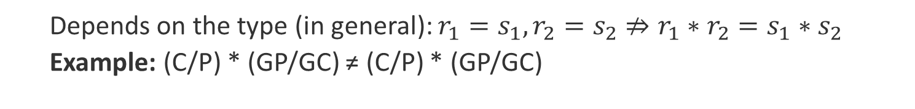
Households and graphs III
  Depends on the type (in general): $r_{1}=s_{1},r_{2}=s_{2}⇏r_{1}∗r_{2}=s_{1}∗s_{2}$
  Example: (C/P) * (GP/GC) ≠ (C/P) * (GP/GC)
E
B
P/C
C/P
C/P
G
D
GP/GC
A
GP/GC
P/C
F
C
aunt, uncle
P/C
So: admissible values for “*“
(C/P) * (GP/GC) has the adm. values. {P/C, missing}

Slide 10
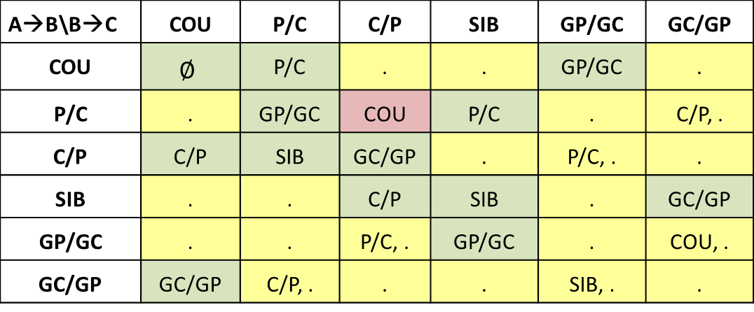
Algebraic structure of relations
  Table of relationships operations
A→B\B→C | COU | P/C | C/P | SIB | GP/GC | GC/GP
COU | $$∅$$ | P/C | . | . | GP/GC | .
P/C | . | GP/GC | COU | P/C | . | C/P, .
C/P | C/P | SIB | GC/GP | . | P/C, . | .
SIB | . | . | C/P | SIB | . | GC/GP
GP/GC | . | . | P/C, . | GP/GC | . | COU, .
GC/GP | GC/GP | C/P, . | . | . | SIB, . | .
  Derive new relations and check the admissible values
  Check the admissible values
Check: Sex, Age, marital status

Slide 11
Plausible households
  Plausible?
  Number of Sources
  Last date of delivery
  private three or more persons households in the census 2011: 1.244.911
  Therefrom implausible: 0.05 % → remove one or more relations
A
3
D
COU
E
COU
F
2
P/C
P/C
1
1
B
C
  ✗
  ✓
2008
2010
1
COU
  ✓

Slide 12
Estimation of Relationships I
    Compare pairwise each element of each component with each element of a different component. (Age, Sex,…)
A
B
P/C
P/C
C
D

Slide 13
Estimation of Relationships II
    Estimate (random number) if or not a new relation (COU, P/C) should be integrate.

Slide 14

Improvements and outlook I
  Quality measure: $μ= \frac{\text{original} \text{relations}}{\text{all} \text{r}\text{elations}}∈[0,1]$
  $$μ= \frac{\text{3}}{\text{6}}$$
A
B
C
D

Slide 15
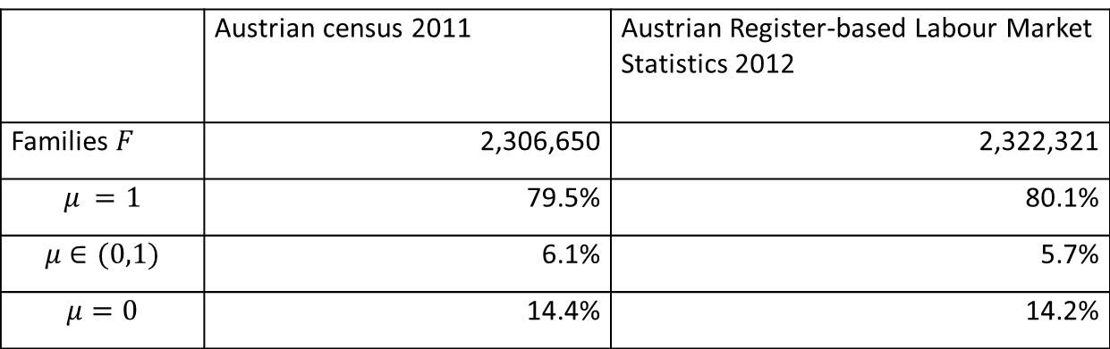
Improvements and outlook II
  archived data on relations
 | Austrian census 2011 | Austrian Register-based Labour Market Statistics 2012
Families $F$ | 2,306,650 | 2,322,321
$$μ =1$$ | 79.5% | 80.1%
$$μ∈(0,1)$$ | 6.1% | 5.7%
$$μ=0$$ | 14.4% | 14.2%

Slide 16
Improvements and outlook III
  missing relations:
  Data sources
  Adult children
  Consensual union couples without resident children
  ✓
-> new source: central civil status register
  ✓
-> archived relationships (since 2006)
  ✗

Slide 17
Please address queries to:
Christoph Waldner
Contact information:
Guglgasse 13, 1110 Vienna
phone: +43 (1) 71128-7322
christoph.waldner.@statistik.gv.at
FAMILY GENERATION BY REGISTERS –
APPROVED METHODS AND IMPROVEMENTS FOR THE AUSTRIAN CENSUS 2021
Group of Experts on Population and Housing Censuses

