Slide 1
Shirin Ahmed Acting Assistant Director for Decennial Census Programs U.S. Census Bureau
Reducing the Cost for the 2020 Decennial Census
of the United States
United Nations Economic Commission for Europe Conference of European Statisticians Group of Experts on Population and Housing Censuses Palais des Nations, Geneva 30 September – 2 October 2015

Slide 2
The Decennial Census Program Background
The Decennial Census has been conducted since the birth of the Nation
Provides the official population counts for determining the allocation of seats each state occupies in the United States House of Representatives
Over $400 billion in federal funding allocated annually using information from the decennial census
Required by the United States Constitution, Title 13, United States Code, and Public Law (P.L.) 94-171
Two components to the Decennial Census
The 2020 Census (Every 10 years)
The American Community Survey (National sample every year)
The Decennial Census and the American Community Survey (ACS) provide demographic information about the people living in the United States
Determines federal allocations to states, tribal, and local governments; and,
Critical to America’s economic growth

Slide 3
The 2020 Census Overview
The 2020 Census is designed to cost less per housing unit than the 2010 Census (when adjusted for inflation), while continuing to maintain high quality
The Census Bureau plans to achieve this by conducting the most automated, modern, and dynamic decennial census in history.
The 2020 Census includes design changes in four key areas of innovation:
New methodologies to conduct address canvassing
Optimizing self-response
Use of administrative records to reduce the Non-Response Follow-Up (NRFU) workload
Use of technology to reduce the time spent on tasks traditionally conducted by people during field operations

Slide 4
The 2020 Census Reducing the Undercount
Percentage Net Undercount, U.S. Total, 1980 – 2010

Slide 5
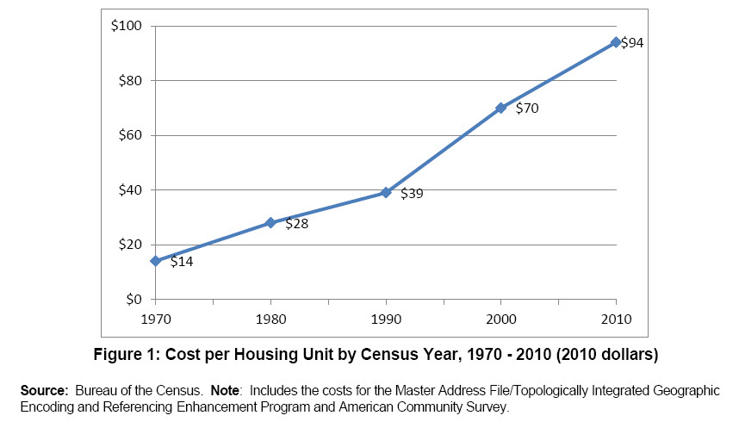
The 2020 Census Cost per Housing Unit from 1970 – 2010
5

Slide 6
The 2020 Census Cost Drivers
Increased diversity of the population
Demand for the Census Bureau to improve accuracy over previous censuses
Lack of full public participation in the self-response phase of the Census
Challenges managing major acquisitions, schedule and budget
Substantial investments in updating the address list prior to enumeration

Slide 7
The 2020 Census Critical Path for the 2020 Census

Slide 8
The 2020 Census Four Major Innovation and Research Areas
Reengineering Field Operations
Optimizing Self-Response
Utilizing Administrative Records
Reengineering Address Canvassing
Up to
$5 Billion*
in Savings
Through:
*This estimate is based off of the 2014 Census Lifecycle cost estimate.

Slide 9
The 2020 Census Reengineering Address Canvassing
Goal: Reduce the need for a nationwide in-field address canvassing operation
In-Office Canvassing
Use data from partners and commercial vendors
Use aerial imagery
In-Field Canvassing
When addresses cannot be obtained
Rapid changing addresses

Slide 10
The 2020 Census Optimizing Self-Response
Goal: Communicate the importance of the 2020 Census to the population to generate the largest possible self-response
Provide an internet-response option
Use targeted digital advertising
Allow respondents to submit a response without a unique identification number

Slide 11
The 2020 Census Utilizing Administrative Records
Goal: Use administrative and other information to reduce nonresponse follow-up
Use data already collected by the government to inform frame development, response processing, and post-data collection activities
Reduce Non-Response Follow-Up
Vacants
Validation of household composition

Slide 12
The 2020 Census Reengineering Field Operations
Goal: To use technology to more efficiently and effectively conduct and manage the 2020 Census fieldwork
Operational Control System
COMPASS Mobile Application
Field Organizational Structure

Slide 13
2020 Census Operational Plan
2010 vs. 2020
Knowledge Mgmt.
Documents the major design decisions for the 2020 Census, which includes:
2020 Census Concept of Operations
Four Key Innovation Areas
Thirty-four 2020 Census Operational Areas
Supporting documentation, including:
Lifecycle Cost Estimates
IT Architecture
Acquisition Strategy
Communication materials
Description of Operations
Key Decisions
Milestones
Research
Cost & Quality
IT Capabilities
2020 Census Operational Plan
Policy and/or Legal Implications
Risks

Slide 14
The 2020 Census What’s Next?
Studying the quality impact of 2020 Census innovation will also be important.
Different ways to assess accuracy/quality:
Compare census counts to "the truth;" that is, some benchmark
Directly measure the quality of the counts for the 50 states and D.C.
Analyze where we miss people—e.g, in the inner city; in the rural parts of the country
Analyze the specific demographic characteristics of people we miss—e.g., do we miss more renters than homeowners? more Hispanics than non-Hispanics?
Analyze the extent we count some people twice, or tabulate them in the wrong place because of an error in determining their usual residence as of Census Day.
Examine operational characteristics of operations that are correlated with quality of counts—e.g., the percentage of questionnaire data obtained from self-response

Slide 15
The 2020 Census What’s Next?
Stakeholder and Oversight Activities:
Monthly Status Report
Quarterly Program Review Meetings
Advisory Committees
Meetings of Other Groups

Slide 16
Questions?
For more information on the 2020 Census visit:
www.census.gov/2020census

