Slide 1
Transformation of Australian People Statistics
Presented by: Kate Bond

Slide 2
Outline of presentation
Current situation
A new model
Solution centred model
Transforming people statistics (TPS)
Census and the TPS

Slide 3
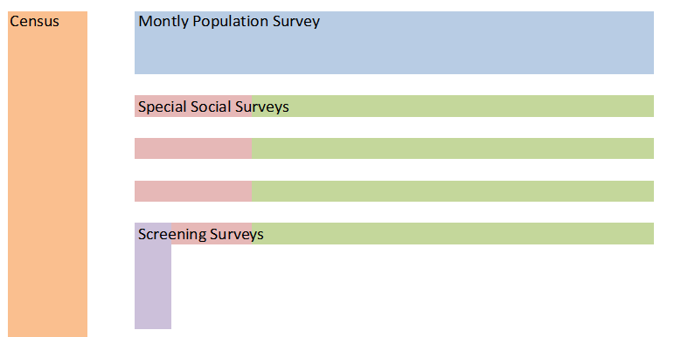
Current survey program

Slide 4
Increasing concerns about:
Sustainability of the ABS household survey program
Unrealised potential of Census and administrative data
Constrained ability for agile and responsive statistical solutions.

Slide 5
A new model for Population and Social Statistics
Solution-centred design and culture
Maximising the effective use of all available data
Wider range of methods and statistical solutions
Aligning ABS resources to high value-add activities
Improving the overall integration and coherence of ‘people statistics’

Slide 6
Desired outcomes of Transforming People Statistics (TPS)
Higher value statistics
Increased responsiveness
Long-term sustainability

Slide 7
Solution orientation

Slide 8
TPS Program
Transforming Statistical Leadership of People Statistics
Transformed Statistical Solutions
Australian Population Survey Implementation

Slide 9
1. Transforming Statistical Leadership
Information requirements map
Framework for making decisions on what and how requirements will be met
Design and develop statistical program

Slide 10
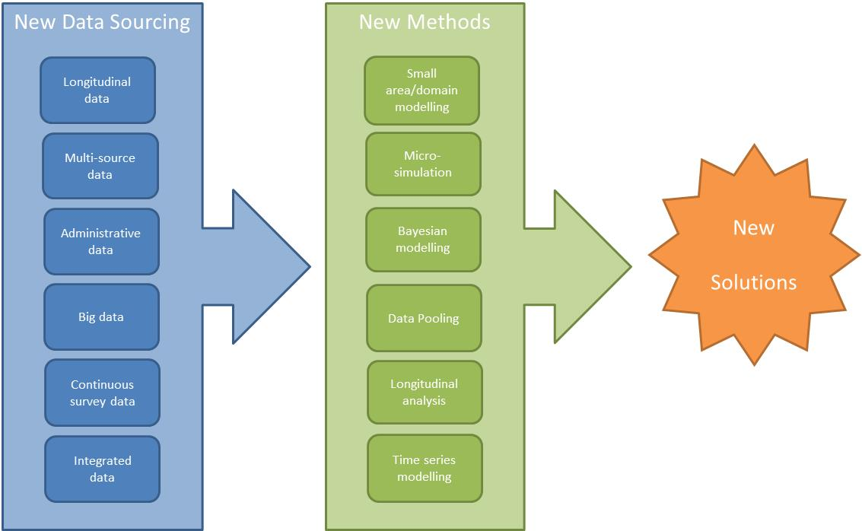
2. Transformed Statistical Solutions

Slide 11
3. Australian Population Survey Implementation
Design and implement a single, integrated and affordable household survey.
Manage statistical impact of methodology changes.
Develop capability for rapid response and longitudinal panels.
Shift towards continuous rather than point in time measures.
Develop a cost effective and coherent approach to collecting data from the Aboriginal and Torres Strait Islander population.

Slide 12
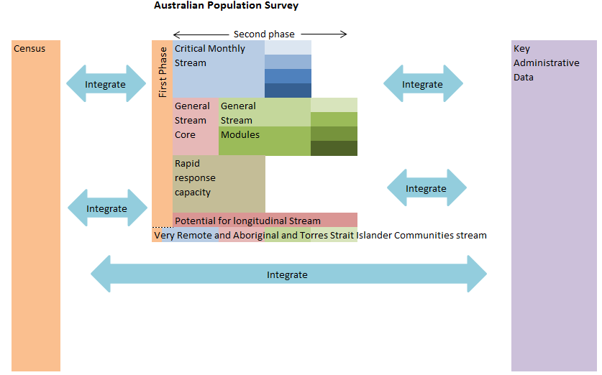
Australian Population Survey
Recap: The Australian
Population Survey

Slide 13
Census and the TPS
Maximising use of Census data
Solution-focused model to meet statistical requirements
Census is integral to the introduction of the Australian Population Survey
Foundational infrastructure from the digital Census

Slide 14
Maximising use of Census data through statistical solutions
New sources
New methods e.g. modelling, pooling, microsimulation
Census-like estimates on a more timely basis

Slide 15
Census and survey data
Census
Content Rich
Modelled small area data
Census
Modelling
Sample
Sample
Sample
Sample
Sample
Modelling

Slide 16
Census and admin data
Census
Modelled small area
Intercensal data
Census
Enrich Census
Increase content
Longitudinal view
Census enriched
Improve coverage
Impute/model
Longitudinal view
Modelled admin data
Modelled longitudinal intercensal data

Slide 17
TPS and future Censuses
Holistic, national view of social and population statistics
Broader view used for future revisions of Census nature and content

Slide 18
Summary
Australia is transforming its people statistics.
We are moving from collection-centred model to solution-centred model.
2016 Census will underpin this transformation.
Holistic view of information requirements will influence Census 2021 and beyond.

