Slide 1
From the 2010 to the 2020 census round in the UNECE region – Plans by countries on census methodology and technology
UNECE-Eurostat Meeting on Population and Housing Censuses (Geneva, 20 September – 2 October 2015)
Paolo Valente
United Nations Economic Commission for Europe

Slide 2
Content of presentation:
Update on new CES Rec. for 2020 round
Census methods – Evolution and plans for 2020
Internet response – Evolution and plans for 2020
Demand for support by countries for 2020 round

Slide 3
1. Update on new CES Rec. for 2020 round
April 2015: Electronic consultation with CES members
June 2015: Adoption by CES, subject to amendments
Sep. 2015: Final version with amendments (Eng., Rus.)
Dec. 2015: Printed versions expected to be available

Slide 4
2. Census methods Evolution and plans for 2020 Number of UNECE countries by census method

Slide 5
2. Census methods Evolution and plans for 2020 UNECE countries possibly changing method
From traditional to combined census (8 countries):
- Canada - Luxembourg
- Cyprus - Montenegro
- Czech Republic - Romania
Italy - United Kingdom
From combined to register-based census (5 countries):
- Estonia - Spain
- Latvia - Turkey
- Lithuania

Slide 6
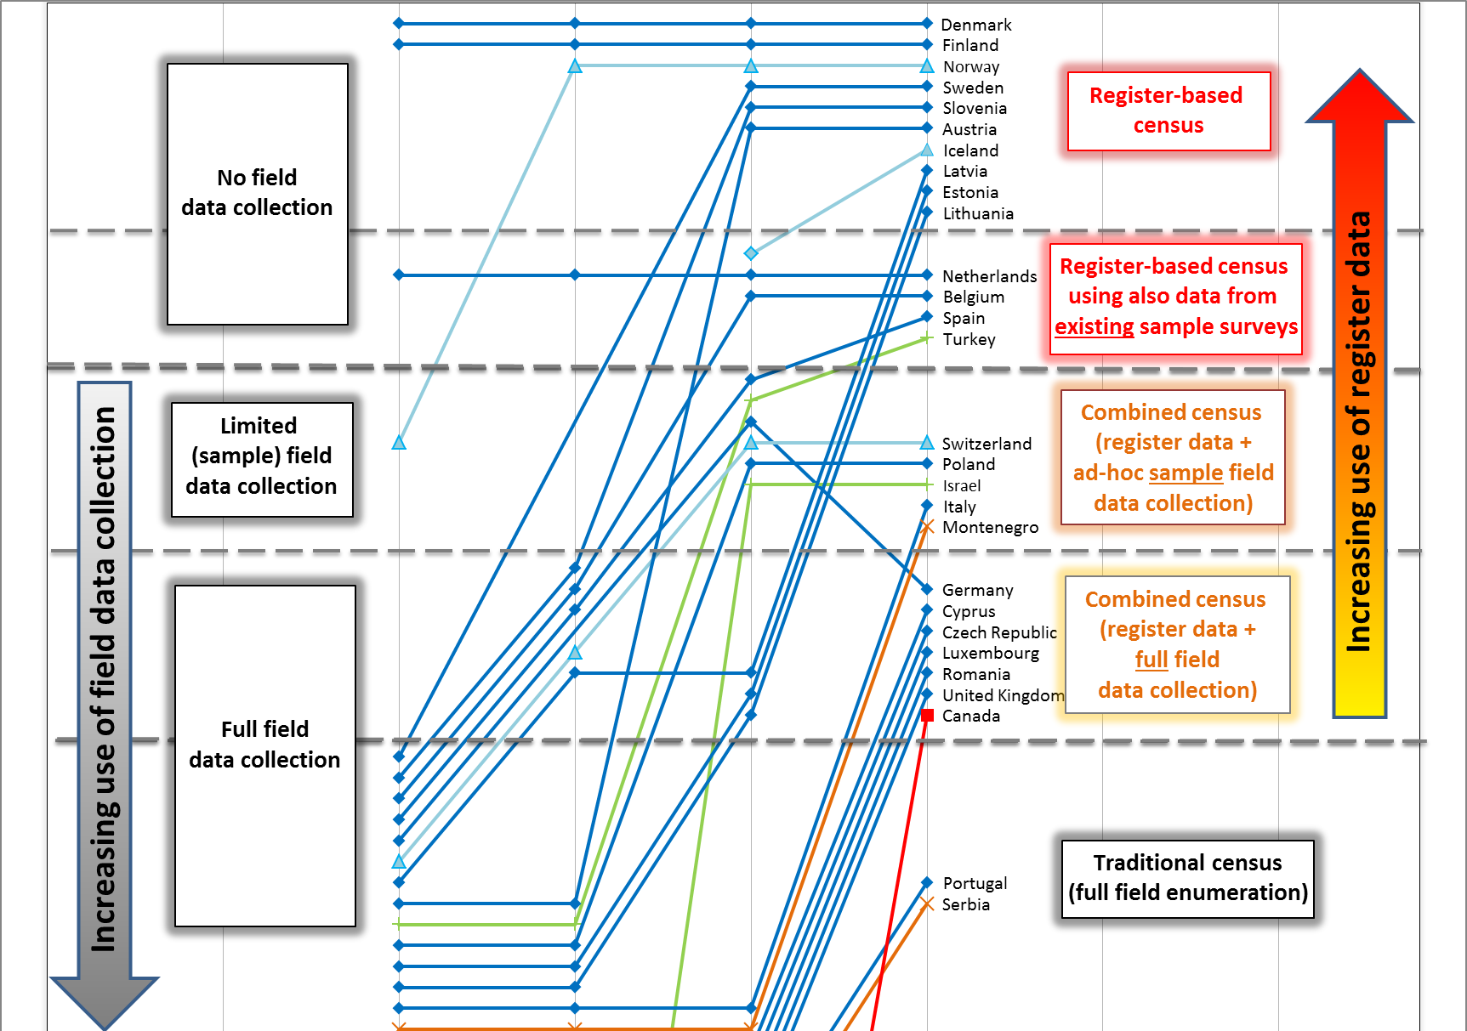
2. Census methods - Evolution Trajectories of countries (figure 6 in WP.24)

Slide 7
2. Census methods – Trajectories (fig. 6, WP.24) “Early adopters” of register-based census

Slide 8
2. Census methods – Trajectories (fig. 6, WP.24) From traditional to combined to register-based

Slide 9
2. Census methods – Trajectories (fig. 6, WP.24) Directly from traditional to register-based census

Slide 10
2. Census methods – Trajectories (fig. 6, WP.24) Combined censuses in 2010 and 2020 rounds

Slide 11
2. Census methods – Trajectories (fig. 6, WP.24) From traditional to combined in 2020 round

Slide 12
2. Census methods – Trajectories (fig. 6, WP.24) Countries planning traditional census in 2020

Slide 13
3. Internet response Number of UNECE countries using internet response

Slide 14
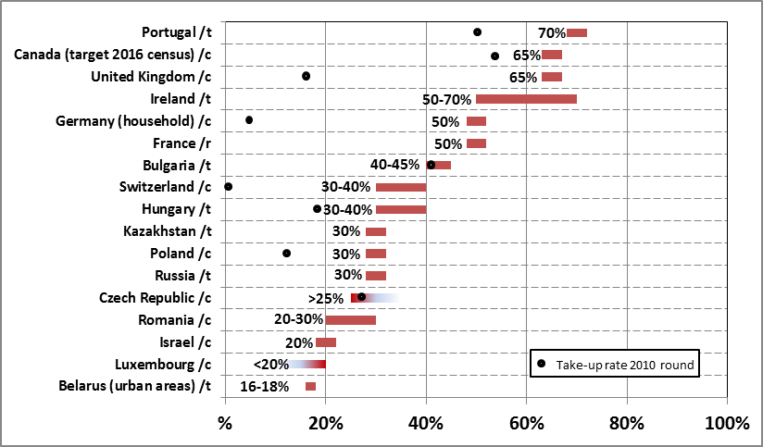
3. Internet response Assumptions about internet take-up rates, 2020 round

Slide 15
5. Demand for support for 2020 round Topics indicated by most countries
Methodology
Use of registers and admin data for census (10 countries)
Small area estimation (2 countries)
Sample surveys (2 countries)
Technology
Internet response (8 countries)
Use of GIS (4 countries)
Use of GPS and mobile devices (3 countries)

Slide 16
5. Demand for support for 2020 round Topics indicated by most countries (cont.)
Operational aspects
Assess quality of data from admin sources (7 countries)
Statistical disclosure control (SDC) methods and confidentiality (3 countries)
Publicity/information/communication (2 countries)
Information content
Migration (3 countries)
Disability (2 countries)

