Slide 1
Measuring Sustainable Development The Swiss Experiences in Measuring Sustainable Development
UNECE High-level Workshop on follow-up to Rio+20: Measuring sustainable development and implementing the System of Environmental-Economic Accounting (SEEA)
Geneva | 12.06.2013 | André de Montmollin

Slide 2

§

Slide 3
Rationale and objectives
Rio 1992, Agenda 21, chapter 40
Federal Constitution of the Swiss Confederation
Pilot study 1999
Monitoring sustainable development in its three dimensions economy, social et environment
Information intended to citizens, stakeholders, policy makers

Slide 4
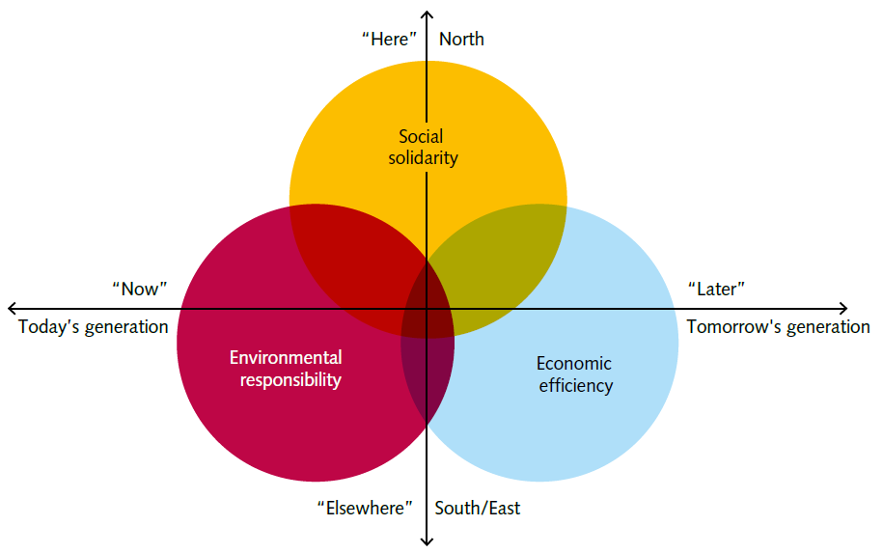

Slide 5
Definition
Sustainable Development
Qualitative objectives
Social
solidarity
Economic
efficiency
Environmental responsibility
Principles on:
Objective and subjective living conditions
Fairness of distribution, equality of opportunities
Social cohesion
Development of human capital
International solidarity
Principles on:
Economic system
Efficiency and competitiveness
Flexibility/stability
Production/cons-
umption
Employment
International trade
Principles on:
Consumption of resources
Materials and waste
Risks
Rate of change
Natural and cultural landscape
Principles
Selection of indicators
Indicators

Slide 6

The MONET typology
Satisfaction of needs, well-being
Input/Output
Efficiency
Distribution
Response
Social
Human
Economic
Natural
Capital stocks

Slide 7
The conceptual categories
1 | Satisfaction of needs, well-being (12)
2 | Stocks of capital (20)
3 | Input/output (16)
4 | Distribution (16)
5 | Efficiency (13)
6 | Response (3)

Slide 8
The 12 thematic categories
1 | Living conditions (7) | 7 | Work (5)
2 | Health (5) | 8 | Economic system (5)
3 | Social cohesion (7) | 9 | Production and consumption (7)
4 | International cooperation (6) | 10 | Mobility and transport (7)
5 | Education and culture (8) | 11 | Energy and climate (7)
6 | Research and technology (3) | 12 | Natural resources (12)

Slide 9
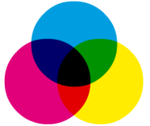
Target System
Monitoring
Sustainable Development in Switzerland
Definition Sustainable Development
Assessment
45 Principles
Selection of indicators
Typology
75
Indicators
(in 12 topics)
Selection process
Selection criteria

Slide 10
MONET and the SEEA
Indicators | Topics | Conceptual category
Total Material Requirement | Production and consumption | Input/output
Material Intensity (TMR/GDP) | Production and consumption | Efficiency
Material requirement abroad for imports | Production and consumption | Capital
Environmental taxes | Economic system | Response

Slide 11
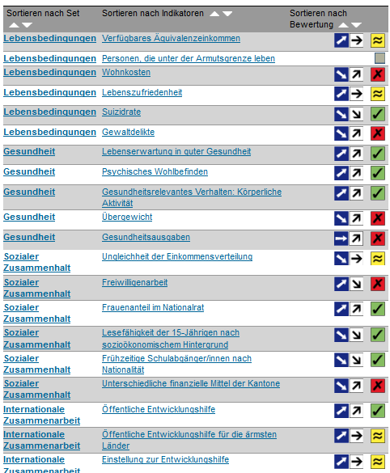
Usage of the MONET Indicators
17 key indicators
Pocket Statistics
Global
dimension of SD
Base: 75 indicators
Monitoring SD-Strategy
(50 indicators)
Dashboard of the SD-Strategy
Report on SD 2012

Slide 12
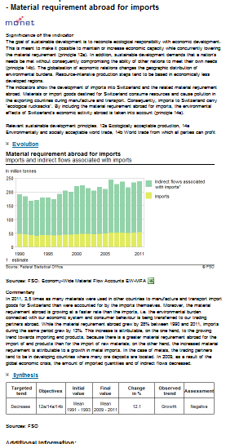
Presentation of an indicator
Signification of the indicator
Figure
Data (download)
Comments on data
Synthesis
Metadata

Slide 13
Fairness – How well are resources distributed?
Decoupling – How efficiently are we using our natural resources ?
Social solidarity
Capital stock
Environmental responsibility
Economic efficiency
Preservation of resources – What are we leaving behing for our children?
Capital stock
Capital stock
Meeting needs – How well do we live today?
Notes:
13

Slide 14
Monitoring the Swiss federal Council SD-Strategy
Dashboard of sustainable development

Slide 15
MONET, more than 10 years measuring SD
Integrated view of SD
Sound conceptual framework
Importance of participation and safeguards
Possibility to have both conceptual and thematic categorisation
Global dimension
Importance of good communication tools

Slide 16

Thank you
for your attention
www.monet.admin.ch
andre.montmollin@bfs.admin.ch

Slide 17
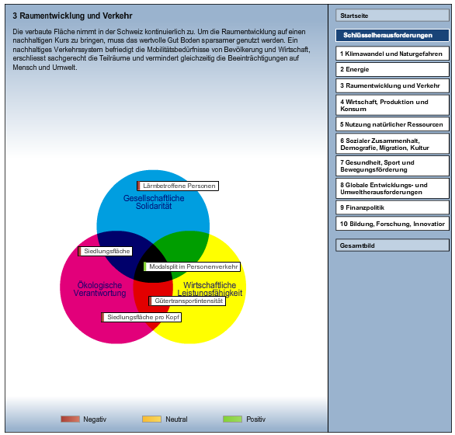
Key-challenges
Indicators

Slide 18
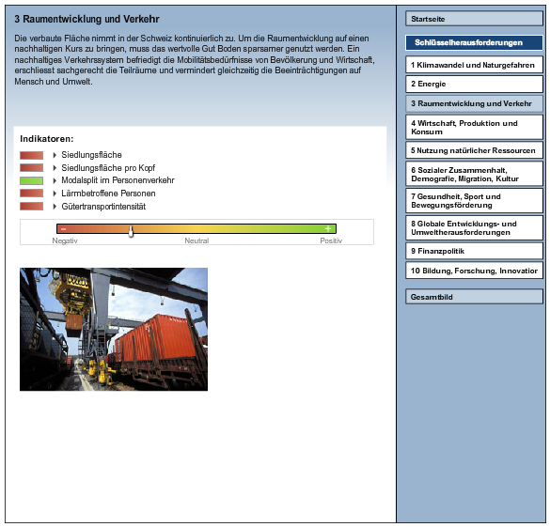
Trend assessment
Indicators
Synthesis

Slide 19
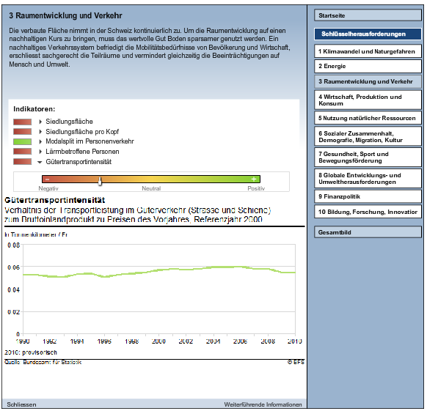
Click!
Figure

Slide 20
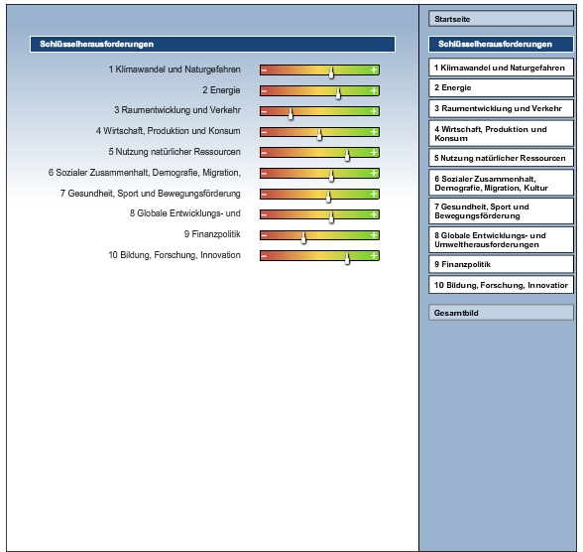
Overall view of the
10 Key-challenges

