Slide 1
Implementing the System of Environmental-Economic Accounting (SEEA)
Peter Harper Chair United Nations Committee of Experts on Environmental-Economic Accounting
High-Level Workshop
Conference of European Statisticians
Economic Commission for Europe
Geneva, Switzerland, 13 June 2013

Slide 2
Outline of presentation
Background
Current initiatives
Objective
Flexible and modular approach
Implementation activities
Coordination
Strategy for funding
Experimental ecosystem accounting

Slide 3
Background
SEEA CF adopted by UNSC in 2012
SEEA implementation should be a long-term program, to be implemented flexibly and incrementally, giving full consideration to national circumstances and requirements
Requested UNCEEA to develop an implementation strategy
Implementation strategy endorsed by 2013 UNSC
Practical actions that can be taken by international organizations and national statistical systems to maximise the extent to which SEEA is implemented in the short to medium-term
International conference on SEEA implementation in New York 17-19 June 2013

Slide 4
Current state of play
At the national level, many countries already have extensive environmental-economic accounting programs
Eg Australia, Canada, China, Colombia, Italy, Mexico, Norway, Philippines, South Africa, Sweden
There are also a range of international initiatives relevant to environmental-economic accounting
WAVES (Wealth Accounting and the Valuation of Ecosystem Services) – World Bank
Green Growth Strategy – OECD
Green Economy Initiative – UNEP
EU strategy for Environmental Accounting – European Commission

Slide 5
Objective
To assist countries in the adoption of the SEEA Central Framework as the measurement framework for environmental-economic accounts and supporting statistics, and
To establish incrementally the technical capacity for regular reporting on a minimum set of environmental-economic accounts with the appropriate scope, detail and quality

Slide 6
Flexible and modular approach
Countries differ in terms of their specific environmental-economic policy issues and their level of statistical development. Accordingly, countries may prioritise the accounts they want to implement over the short to medium-term based on the most pressing policy demands
The flexible and modular approach is operationalised by a number of phases

Slide 7
Four phases
First phase – establish national institutional arrangements
Second phase – self assessment using diagnostic tool
Third phase -- data quality assessment
Fourth phase – preparation of strategic development plan
These phases would be supported by international activities

Slide 8
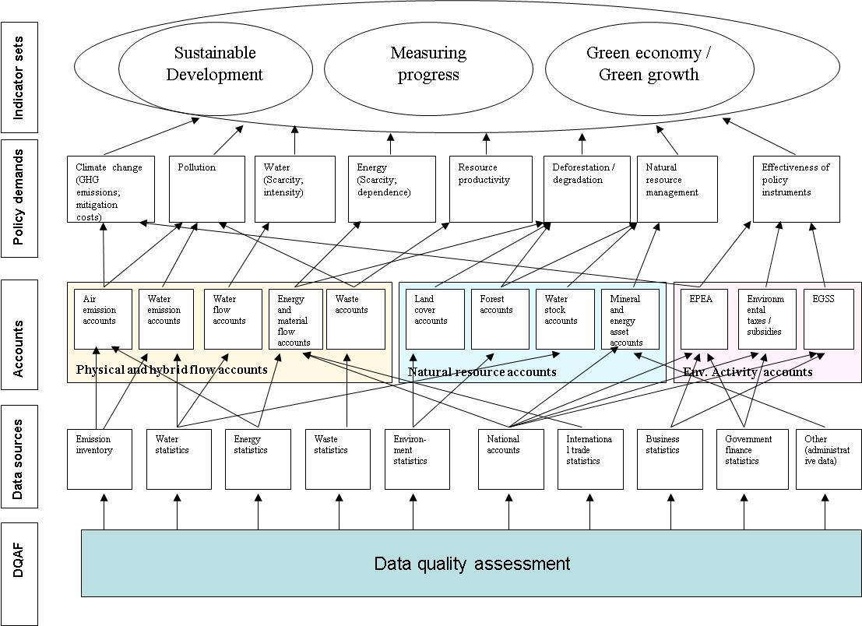
Diagnostic tool

Slide 9
Example – energy flow accounts
Data sources: energy statistics, national accounts, international trade statistics, traffic statistics
Accounts: Physical supply and use tables for energy
Indicators: Net domestic energy use, energy intensity for industries, energy dependency ratios etc.
Analyses: Decoupling energy use economic growth, structural decomposition analyses for energy use, energy or carbon footprint, etc.
Policy areas served: Energy dependence, energy scarcity, energy efficiency, climate change etc.

Slide 10
Implementation activities
Training and technical assistance
Manuals and other training materials
Cooperation with the research communities
Advocacy

Slide 11
Coordination
Mechanism for coordination, monitoring progress and facilitating cooperation
Proposed Partnership Group, overseen by UNCEEA and supported by trust fund
Information structure for coordination, monitoring and reporting
Project management
Stakeholder communication
Information system for monitoring and reporting

Slide 12
Strategy for funding
SEEA implementation should be included, as appropriate in national statistical development plan and actively funding should actively sought for this work
International agencies will be encouraged to provide technical assistance and financial support, including for the development of basic environmental statistics
Donors will be approached to provide funding for the trust fund
SEEA implementation should build on synergies with other programs of work (eg PARIS 21)

Slide 13
Experimental ecosystem accounting
SEEA Experimental ecosystem accounting is not an international standard, rather it is handbook setting out the current ‘state of the art’
Nonetheless countries are encouraged, where possible, to test and experiment in this new field of statistics
Where this is done, it should complement the implementation of the SEEA Central Framework

