Slide 1
Non-profit Institutions Serving Households in the Canadian System of National Accounts
May 2014

Slide 2
Canadian System of National Accounts Institutional Sectors
Under 1993 SNA
Persons and Unincorporated Businesses
Households
Non-profit Institutions Serving Households
Aboriginal General Government
Quasi-corporations
Some Financial Corporations
Corporations
Government
Federal Government
Provincial and Territorial Governments
Local Governments
Non-Residents

Slide 3
Canadian System of National Accounts Institutional Sectors
Under 2008 SNA
Households
Some quasi-corporations
Some investment funds
Non-profit Institutions Serving Households
Financial Corporations
Non-Financial Corporations
General Government
Federal General Government
Provincial and Territorial General Governments
Local General Governments
Aboriginal General Government
Non-Residents

Slide 4
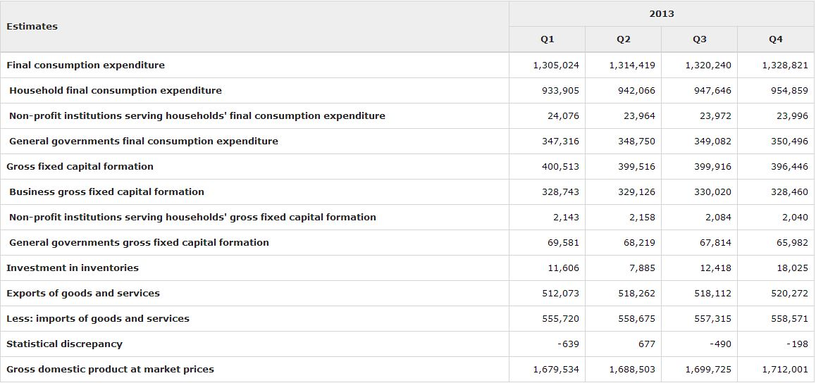
Non-profit Institutions Serving Households Gross Domestic Product

Slide 5
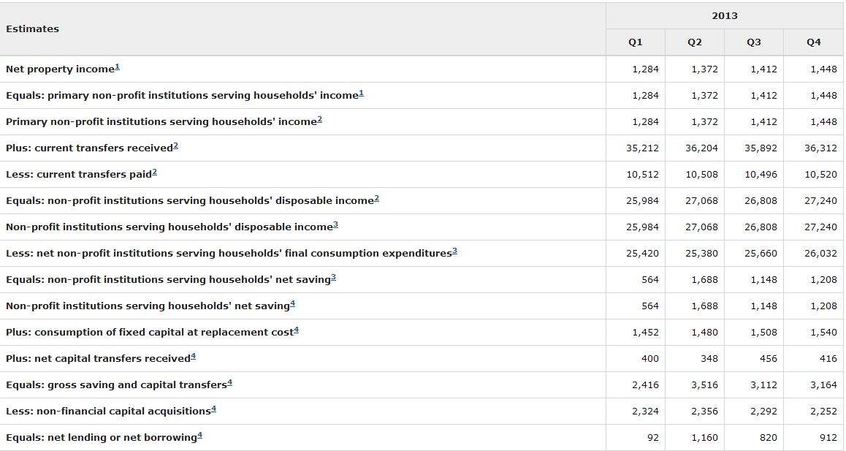
Non-profit Institutions Serving Households Current and Capital Accounts

Slide 6
Non-profit Institutions Serving Households Balance Sheet

Slide 7
Canadian System of National Accounts Data Sources
In Canada, there is no single comprehensive source of administrative data on non-profit institutions serving households from which an entire sequence of accounts can be constructed. Rather, they are identifiable in a range of data files, none of which is exhaustive. These files include:
The Registered Charity Information Return (T3010);
Non-profit Organisation Information Return (T1044);
Summary of Remuneration Paid (T4 Summary and Supplementary)
Income Tax and Benefit Return (T1)
Tax-exempt corporations (from T2 Corporate Income Tax returns and the Generalized Index of Financial Information); and
Public sector bodies eligible for rebates under the Goods and Services Tax system (the GST Public Sector Bodies Rebate File).

Slide 8
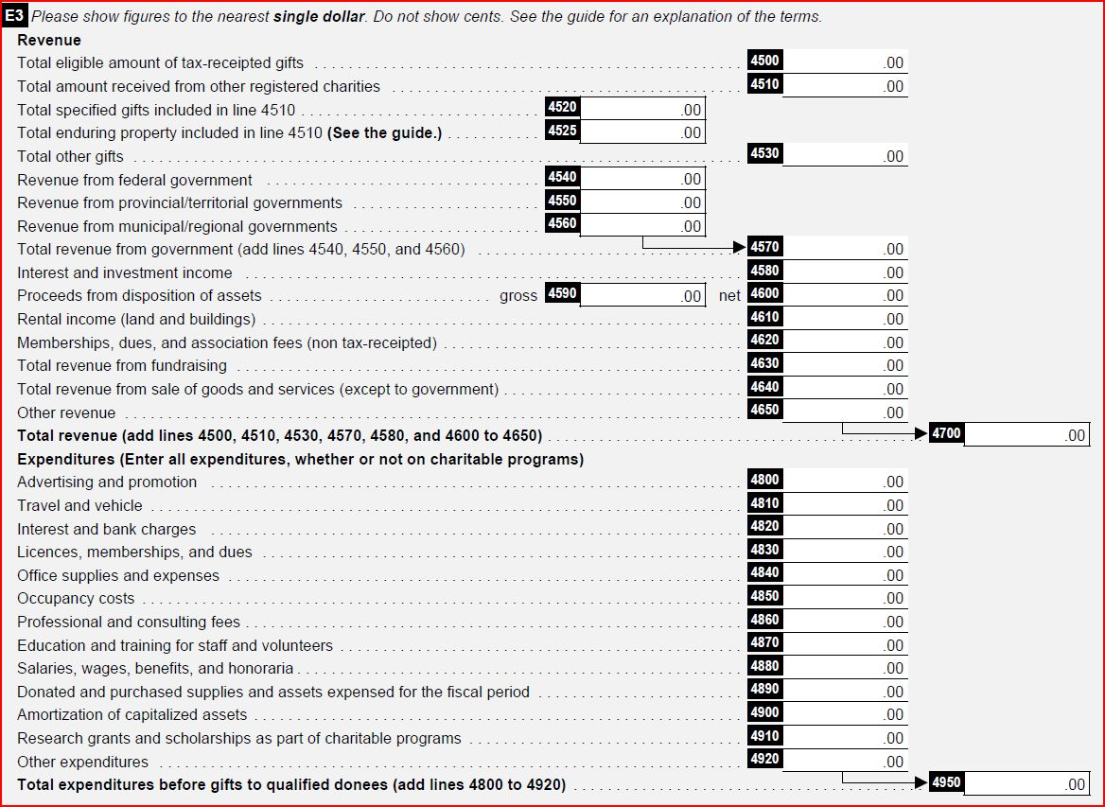
Canadian System of National Accounts Data Sources – T3010 (Charities File)
Notes:
Charities can fill out the complete T3010 electronically but currently they cannot submit it online.
A current T3010(13) consists of the core form (which comprises Section D: financial information) plus all applicable schedules, appendices and financial statements.
T3010 schedules
Schedule 1 – Foundations
Schedule 2 – Activities outside of Canada
Schedule 3 – Compensation
Schedule 4- Confidential data
External fundraisers
Donors not resident in Canada (for gifts over $10,000)
Schedule 5 – Gifts in Kind
Schedule 6 – Detailed financial information
Starting with reference year 2009, as part of the Small and Rural Charities Initiative, CRA has simplified financial reporting for charities under a certain revenue and asset level, while everyone else is required to fill out a detailed financial information section.
excerpt from the T3010(13) core form
‘If any of the following applies to your charity, proceed to Schedule 6, Detailed Financial Information, and do not complete Section D below. If none of the following applies, complete Section D.
a) The charity's revenue exceeds $100,000.
b) The amount of all property (e.g., investments, rental properties) not used in charitable programs exceeds $25,000.
c) The charity currently has permission to accumulate funds during this fiscal period’

Slide 9
Canadian System of National Accounts Data Sources – T3010 (Charities File)

Slide 10
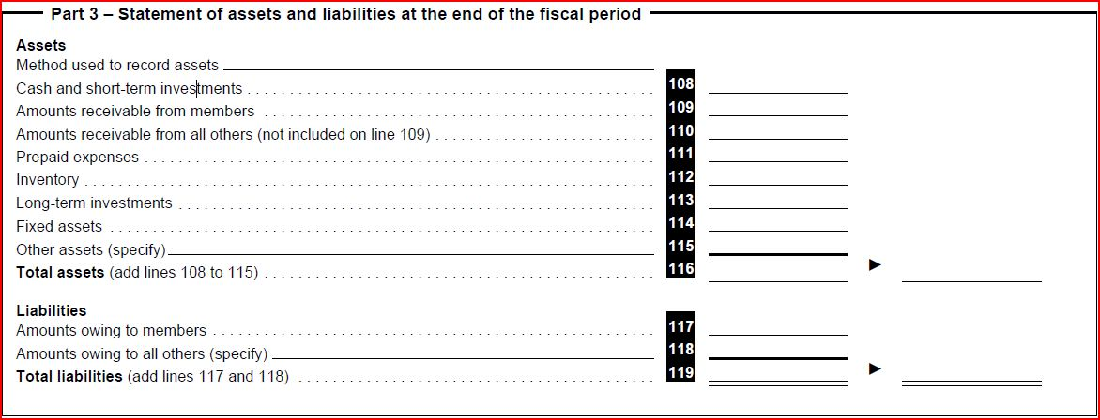
Canadian System of National Accounts Data Sources – T1044 (NPO File)
Notes:
The T1044 return is for:
. non-profit organizations (NPOs) described in paragraph 149(1)(l) of the Income Tax Act; and
. organizations described in paragraph 149(1)(e) of the Act (agricultural organizations, boards of trade or chambers of commerce).
An organization may have to file the T1044 return if:
. it received or is entitled to receive taxable dividends, interest, rentals or royalties of more than $10,000
in the fiscal period;
. it owned assets valued at more than $200,000 at the end of the immediately preceding fiscal period; or
. it had to file a NPO return for a previous fiscal period.

Slide 11
Canadian System of National Accounts Counterparty Data Sources
In a number of specific cases, either for particular variables or key segments of the non-profit universe, alternate data sources are available. The most significant cases are summarized below. As a general rule, elements of the NPISH account not listed here are estimated using the non-profit tax records described above.
Transfers (gifts) from households to NPISH: The tax-receipted portion of household transfers is built from the point of view of the payer, using tax returns of individuals (the T1 data file) while the non-tax receipted portion is based on non-profit tax filer information.
Transfers from governments to NPISH: These are built from the point of view of the payer, using federal and provincial public accounts information, surveys of municipalities, and financial statements of government special funds and government agencies.
Transfers from corporations to NPISH: These are based on corporate donations recorded on T2 corporate tax returns. It is important to note that only amounts recorded as corporate donations are included and any support to non-profit institutions that is recorded as a business expense is excluded as it cannot be separately identified.
Trade unions dues: Trade union dues are reported on the T4 Statement of Remuneration and Benefits.

Slide 12
Canadian System of National Accounts Data Sources – Quarterly Data
There is very little quarterly information available for non-profit institutions serving households.
Most of the quarterly movements and estimates rely on monthly wage and salary information obtained from Statistics Canada’s monthly Survey of Employment, Payrolls and Hours. This survey provides information on wages and employment by industry. Given that the main expenditure category for NPISH is wages, this provides a good estimate of the quarterly expenditure movement.
Quarterly information on transfers from government to NPISH is available from government accounting records. Property income flows, both paid and received, are modeled along with transfers from households to NPISH and from NPISH to households.
Quarterly financial flow and balance sheet information are derived by dividing the annual values by 4 and projecting the benchmark series using the same model used to derive the property income flows.

Slide 13
Some Results

Slide 14
Figure 1. Non-profit institutions serving households’ final consumption expenditure as a share of gross domestic product

Slide 15
Figure 2. Growth in real expenditures, NPISH, general government and gross domestic product (1998=100)

Slide 16
Figure 3. Current transfers as a share of total income

Slide 17
Figure 4. Current transfers by source – NPISH

Slide 18
Figure 5. NPISH saving, net lending and non-financial capital acquisitions

Slide 19
Figure 6. Composition of NPISH assets

Slide 20
Figure 7. Net financial assets as a share of net worth – NPISH

Slide 21
Benefits
The inclusion of a NPISH sector in the Canadian System of National Accounts has been a major step forward in our understanding of the important contribution of this sector to the Canadian economy.
The notable accomplishments in compiling this account include the fact that the entire set of source data are taken from administrative tax data records supplied by the Canadian Revenue Agency.
While much of the source data only go back to 1997, Statistics Canada was able to push the time series back to 1981, using a series of modeling and proxy data sources.
In addition to providing a measure of the NPISH economic activity, the CSNA also have a clearer picture of the Canadian household sector—an added benefit of this exercise.

Slide 22
Next Steps
The CSNA will continue to work towards improving the overall quality of the NPISH sector account. Work needs to be done in improving the process for delineating the NPISH universe for all survey programs within Statistics Canada, so that NPISH organizations can be easily identified on survey files.
Also, the mapping of NPISH expenditure data on the Classification of the Purposes of Non-profit Institutions serving households (COPNI) basis is necessary in order to provide more accurate measures of household actual consumption expenditure.
Finally, improvements can be made in identifying, in more detail, the assets and liabilities of NPISH organizations within the CSNA financial account and balance sheet.

