Slide 1
WORLD BANK POVERTY MONITORING IN EUROPE AND CENTRAL ASIA High Frequency Data
UNECE CONFERENCE OF EUROPEAN STATISTICIANS
The way forward in poverty measurement
December 2-4, 2013
CAROLINA SÁNCHEZ PÁRAMO and JOÃO PEDRO AZEVEDO
Sector Manager Senior Economist
The World Bank

Slide 2
OVERVIEW
The Situation
The Challenge
The Background
The Solution
Moving Forward

Slide 3
THE SITUATION
Collection of detailed consumption or income data can be very time-consuming, costly, and difficult.
As a result…
Some data have lags in reporting time of up to several years
Some data do not exist or are not accessible
Some data are not comparable
The median frequency of poverty microdata in the last 10 years in the World Bank World Development Indicators (WDI) is 13 countries per year in ECA.
World Bank Poverty Monitoring In Europe And Central Asia : High Frequency Data

Slide 4
THE CHALLENGE
Policy makers need to understand the consequences of time sensitive economic developments in order to design appropriate responses.
FOOD
CRISIS
ENVIRONMENTAL
SHOCK
FINANCIAL
CRISIS
How can we do this given data constraints?
World Bank Poverty Monitoring In Europe And Central Asia : High Frequency Data

Slide 5
THE BACKGROUND
Western Balkans Programmatic Poverty Assessment
DG EMPL- World Bank
Joint Technical Workshop on
High Frequency Welfare Monitoring
June 2013
One day workshop to take stock of ongoing efforts to address this problem by the European Commission, Eurostat, Academics, Member States, and the World Bank.
World Bank Poverty Monitoring In Europe And Central Asia : High Frequency Data

Slide 6
THE SOLUTION
Improve timeliness of existing data
Leverage existing data to create new data
Collect new data or collect old data in new ways
World Bank Poverty Monitoring In Europe And Central Asia : High Frequency Data

Slide 7
IMPROVE TIMELINESS OF EXISTING DATA
World Bank Poverty Monitoring In Europe And Central Asia : High Frequency Data

Slide 8
NSO CAPACITY BUILDING
Collecting
Processing
Archiving
Disseminating
Current initiatives
Best practices
Resources for NSOs
World Bank Poverty Monitoring In Europe And Central Asia : High Frequency Data

Slide 9
LEVERAGE EXISTING DATA TO CREATE NEW DATA
World Bank Poverty Monitoring In Europe And Central Asia : High Frequency Data

Slide 10
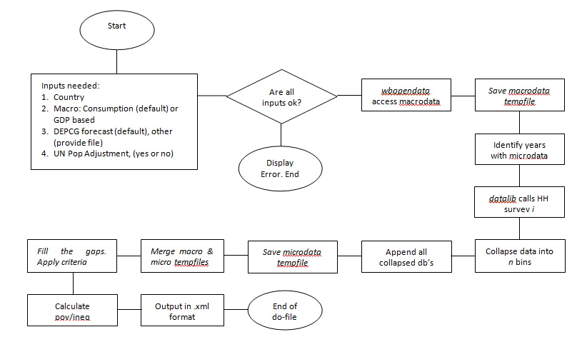
POVERTY PROJECTIONS: AGGREGATE
Backcasting, nowcasting, & forecasting to fill in missing surveys according to macroeconomic and population historical figures and projections.
SUSTAINABLE
OPEN
MODULAR
World Bank Poverty Monitoring In Europe And Central Asia : High Frequency Data

Slide 11
POVERTY PROJECTIONS: MICRO
Baseline
Simulation
Assessment of impacts
Input
Micro data
Macro projections
Price data
estimate
predict
adjust
LF status model Earnings equation Migration/remittances
∆ in LF status (ind)
∆ real earnings (ind)
∆ remittances (HH)
Population
Income and consumption
(individuals and HH)
Output
Results
Population growth
Income/consumption distributions
Poverty and inequality measures
Rule: Best fit to micro data
Rule: Replicate macro proportional changes at micro level
World Bank Poverty Monitoring In Europe And Central Asia : High Frequency Data

Slide 12
SURVEY TO SURVEY IMPUTATIONS
Household Budget Survey
More frequent and simple surveys, like Labor Force Survey
C
X
X
Ĉ=F(X)
Develop imputation model
Regress C on X
C: Consumption
X: Other indicators like employment, education Ĉ=F(X): Imputed (or predicted) Consumption
C=F(X)
World Bank Poverty Monitoring In Europe And Central Asia : High Frequency Data

Slide 13
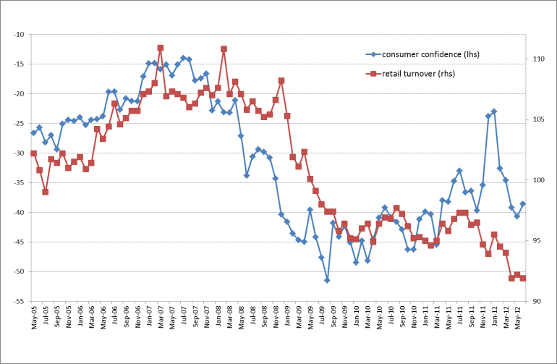
EXPECTATIONS DATA
Predicting welfare using small area estimation techniques to create a model of consumption based on a large household survey and applying parameter estimates to Consumer Expectations Survey data.
Source: Kuzmanović and Sanfey (2012).
World Bank Poverty Monitoring In Europe And Central Asia : High Frequency Data

Slide 14
INTERNET-BASED DATA
Using web-search query data to model real world phenomena and “nowcast” current welfare indicators.
Prepare the time series of interest (e.g. poverty rates)
Segment the time series (training data & validation data)
Upload to Google Correlate and obtain related search terms
Factorial algorithm
Best model with smallest RMSE
Country 1
Use Granger Causality Test to choose predictors
Stepwise Regression
Country 2
Create the baseline model
(ARIMA; Seasonal ARIMA)
Compare two selected models
World Bank Poverty Monitoring In Europe And Central Asia : High Frequency Data

Slide 15
COLLECT NEW DATA OR COLLECT OLD DATA IN NEW WAYS
World Bank Poverty Monitoring In Europe And Central Asia : High Frequency Data

Slide 16
MOBILE PHONES: NEW DATA
Conducting mobile phone surveys to generate new data.
Probabilistic sampling
Panel survey
Pilot testing impact of incentives on the response rate and the actual answer
Pilot testing reliability and attrition rates of different survey modes
F2F Initial
Wave 1
…
Wave 6
F2F Final
Incentives
Free phones
(for those that needed)
Methodologies
(i.e. SMS, IVR, CATI)
World Bank Poverty Monitoring In Europe And Central Asia : A Harmonization Effort

Slide 17
MOBILE PHONES: AUGMENTING DATA
With simplified questions, cell phones and tablets can be used to collecting data quickly and produce poverty estimates in existing frequent household surveys, like LFS.
HBS can be used to create a model: $Y=F(X)$
$X$ can be collected by telephone interview
A critical assumption of the survey-to-survey imputation is: $X_{HBS}=X_{T}$
Experiment in Serbia to test whether responses to questionnaire changes based on the interview mode
World Bank Poverty Monitoring In Europe And Central Asia : A Harmonization Effort

Slide 18
MOVING FORWARD
‘Best practice’ methodologies
Innovation and experimentation
Working with NSOs
Knowledge sharing
Training
Capacity building
World Bank Poverty Monitoring In Europe And Central Asia : A Harmonization Effort

Slide 19
THANK YOU.
CAROLINA SÁNCHEZ PÁRAMO
csanchezparamo@worldbank.org
JOÃO PEDRO AZEVEDO
jazevedo@worldbank.org
World Bank Poverty Monitoring In Europe And Central Asia : High Frequency Data

