Slide 1
WORLD BANK POVERTY MONITORING IN EUROPE AND CENTRAL ASIA An Ex-Post Harmonization Effort
UNECE CONFERENCE OF EUROPEAN STATISTICIANS
The way forward in poverty measurement
December 2-4, 2013
JOÃO PEDRO AZEVEDO
Senior Economist
The World Bank

Slide 2
OVERVIEW
The Problem
The Actors
The Solution
Moving Forward
World Bank Poverty Monitoring In Europe And Central Asia : A Harmonization Effort

Slide 3
THE PROBLEM
World Bank Poverty Monitoring In Europe And Central Asia : A Harmonization Effort

Slide 4
DATA COMPARABILITY
Microdata is the result of many different surveys with varying methodologies. Comparability of data is essential for informing sound policy making and for monitoring progress in poverty reduction and shared prosperity.
How do we ensure consistency and comparability of quality data across time and countries?
World Bank Poverty Monitoring In Europe And Central Asia : A Harmonization Effort

Slide 5
THE ACTORS
World Bank Poverty Monitoring In Europe And Central Asia : A Harmonization Effort

Slide 6
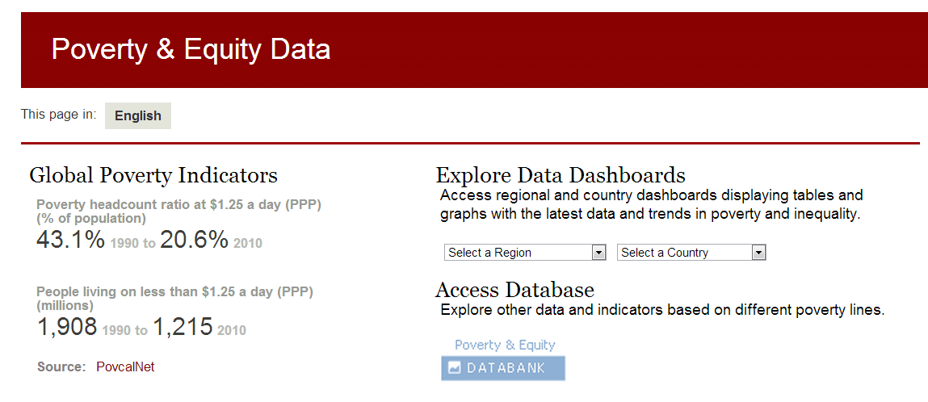
GLOBAL POVERTY WORKING GROUP
GPWG helps to ensure that the poverty and inequality data generated, curated, and disseminated by the World Bank Group are up to date, meet quality standards, and are well documented and consistent across dissemination channels.
World Bank Poverty Monitoring In Europe And Central Asia : A Harmonization Effort

Slide 7
ECA TEAM FOR STATISTICAL DEVELOPMENT
ECATSD seeks to provide internal and external World Bank clients timely access to high quality data, analytics and storytelling that can be used to measure, monitor and understand welfare developments across the region.
World Bank Poverty Monitoring In Europe And Central Asia : A Harmonization Effort

Slide 8
ECATSD: PARTNERSHIPS
Internal
Development Economics (DEC)
Other regions
External
ICP exercise (2011 pending release)
National Statistical Offices
International organizations
World Bank Poverty Monitoring In Europe And Central Asia : A Harmonization Effort

Slide 9
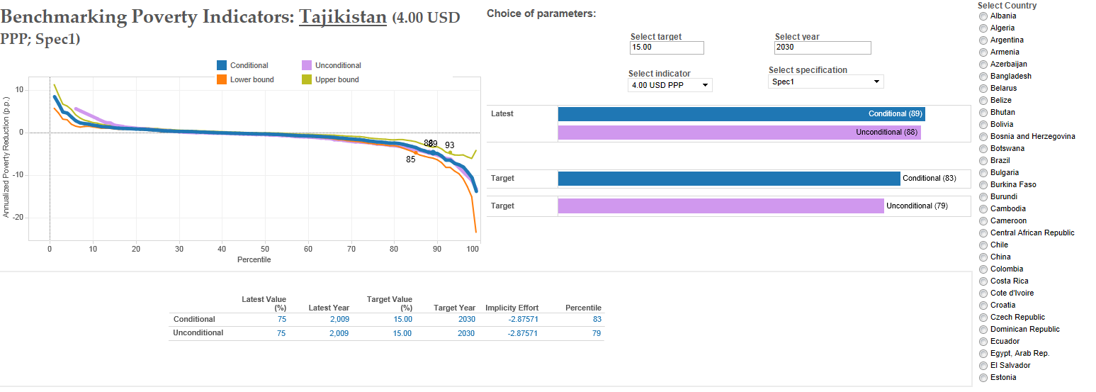
ECATSD: RESOURCES FOR NSOs
World Bank Poverty Monitoring In Europe And Central Asia : A Harmonization Effort
How can we help?
Facilitating access to data (MOUs)
Harmonized data for regional comparability and benchmarking
Capacity building (data & analytics)
World Bank Poverty Monitoring In Europe And Central Asia : A Harmonization Effort

Slide 10
THE SOLUTION
World Bank Poverty Monitoring In Europe And Central Asia : A Harmonization Effort

Slide 11
PART 1: NATIONAL POVERTY STATISTICS
Initiative to document each country’s
national official poverty methodology.
Currently available for….
7 countries in the ECA region
(and 68 in the whole world)
World Bank Poverty Monitoring In Europe And Central Asia : A Harmonization Effort

Slide 12
PART 2: ECAPOV EX-POST HARMONIZATION
ECAPOV is an ex-post harmonization effort for ECA countries based on available household budget surveys (HBS) and Living Standard Measurement surveys (LSMS). There are multiple versions depending on the exercise and the period of analysis.
Currently available for….
MODULES & VARIABLES
232 Expenditure
85 Income
222 Household Characteristics
29 countries.
236 surveys.

Slide 13
ECAPOV: ADVANTAGES
Comparable concepts
In ECA not only is the consumption aggregate harmonized, but also income, and household characteristics.
Economies of scale
Harmonized results are readily available for all staff to be used in the research and policy dialogues.
Easy access
A ado command in STATA was created (Datalib) to make the harmonized data easily accessible
World Bank Poverty Monitoring In Europe And Central Asia : A Harmonization Effort

Slide 14
ECAPOV: DISADVANTAGES
Components of the harmonization are not strictly comparable in the ECA region because…
Countries have different systems
i.e. Years of required primary education range from 4 to 6.
Surveys are not kept unchanged through time
i.e. In MDA 2006 the HBS was substantially modified. Main changes came from sampling frame, sampling areas, and questionnaires.
Surveys do not have the same modules
i.e. HBS reports expenditure on health but not prevalence. Only 9 HBS surveys had a health section.
Questions are not asked in the same way
i.e. In BIH 2010 the reference period for expenditure during holidays or vacations had changed from “last month” to “12 months.”
Questions do not have the same categories
i.e. In BIH 2010 the labor status question had a detailed category non-existing in previous years. Employment had been divided into full-time and part-time employment and unemployment into previously unemployed and seeking first time employment.
World Bank Poverty Monitoring In Europe And Central Asia : A Harmonization Effort
Countries have different systems | For example: Years of required primary education range from 4 to 6.
Surveys are not kept unchanged through time | For example: In MDA 2006 the HBS was substantially modified. Main changes came from sampling frame and sampling areas, and questionnaires.
Surveys do not have the same modules | For example: HBS reports expenditure on health but not prevalence. Only 9 HBS surveys had a health section.
Questions are not asked in the same way | For example: In BIH 2010 the reference period for expenditure during holidays or vacations changed from “last month” to “12 months.”
Questions do not have the same categories | For example: In BIH 2010, the labor status question has a detailed category non-existing in previous years. Employment has been divided into full-time and part-time employment and unemployment into previously unemployed and seeking first time.

Slide 15
ECAPOV: COMPROMISES
Prioritize country–time comparison more than cross-country comparison
The first priority is comparability within all years of available data for each country.
Harmonized variables might be different from the NSO definitions.
This means that indicators could be different and can presents a challenge for discussing policy implication, for example when the poverty rates are different. Transparency is our main remedy.
Harmonization is done with available surveys Most available surveys in ECA region are HBS surveys design to gather information about expenditure, not consumption.
World Bank Poverty Monitoring In Europe And Central Asia : A Harmonization Effort

Slide 16
ECAPOV: AUDIENCE
ECAPOV data is meant to complement and not substitute national official poverty estimates.
For internal use
Informing World Bank knowledge and operations.
For external use
World Development Indicators (POVCALNET)
World Bank Poverty Monitoring In Europe And Central Asia : A Harmonization Effort

Slide 17
ECAPOV: ACCESS
Harmonized data can be accessed online through the internal World Bank’s Microdata Library.
Documentation
Metadata documented using DDI standard
Access Control
All users must submit request to access microdata (terms of use of original data producer are kept).
The WB has been providing Technical Assistance and transferring this technology to our countries.
World Bank Poverty Monitoring In Europe And Central Asia : A Harmonization Effort

Slide 18
ECAPOV: TERMS OF USE
ECAPOV is available for poverty, inequality and shared prosperity monitoring in the region and follows the NSO guidelines for terms of use.
World Bank Poverty Monitoring In Europe And Central Asia : A Harmonization Effort

Slide 19
ECAPOV: ANONYMITY
All of our data is anonymous. Terms of use explicitly forbid any attempt to de-anonymize data.
The World Bank has been providing Technical Assistance on microdata anonymization.
World Bank Poverty Monitoring In Europe And Central Asia : A Harmonization Effort

Slide 20
ECAPOV: CHALLENGES
Coding of expenditure (COICOP)
Standardization and norms are very important.
Durables
HBS surveys only gather information about the durables acquired in the reference period. Neither information about the stock of durables nor information about how long households keep their durables is reported. So far, the harmonized welfare aggregate included the total amount paid for the durables acquired in the reference period.
Rent Imputation
Most surveys do not have a self-reported rent question (implicit rent, and when they do, they do not always ask this question in the same way). Not all HBS gather household characteristics that can be used in a hedonic model. Another challenge is that not all countries have a developed dwelling rental market, which makes the imputation more difficult (i.e. in KSV 2011, only 23 households pay a rent).
Health expenditure
A decision whether or not to include health expenditure has to be made. The elasticity of the expenditure in health with respect to the total expenditure differs among countries.
World Bank Poverty Monitoring In Europe And Central Asia : A Harmonization Effort

Slide 21
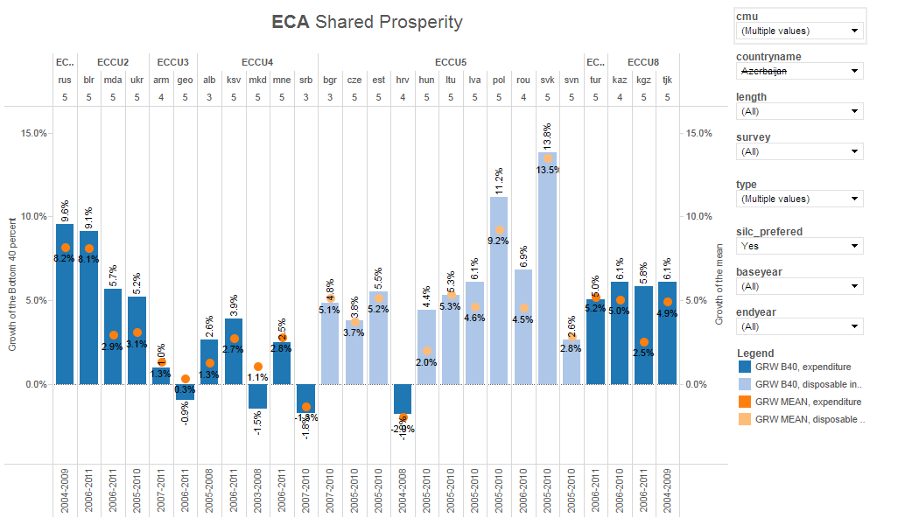
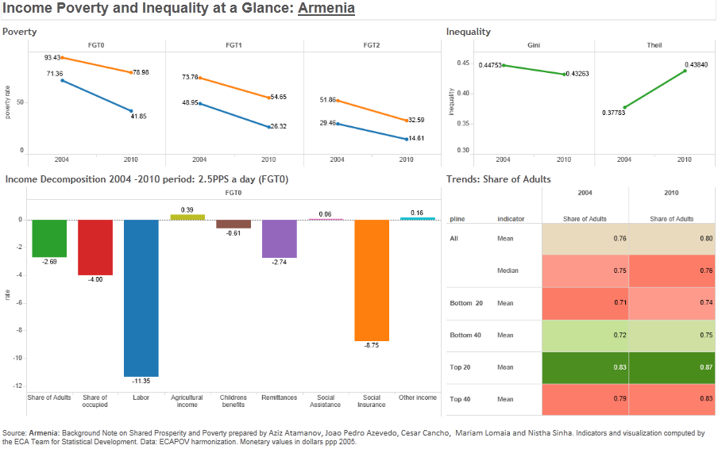
HOW IS THE HARMONIZED DATA USED?
Monitoring trends and levels
World Development Indicators (POVCALNET)
Poverty projections
Shared prosperity*
*Income growth of the bottom 40%.
Digging Deeper
Decompositions
Profiles (exploring heterogeneity)
World Bank Poverty Monitoring In Europe And Central Asia : A Harmonization Effort

Slide 22
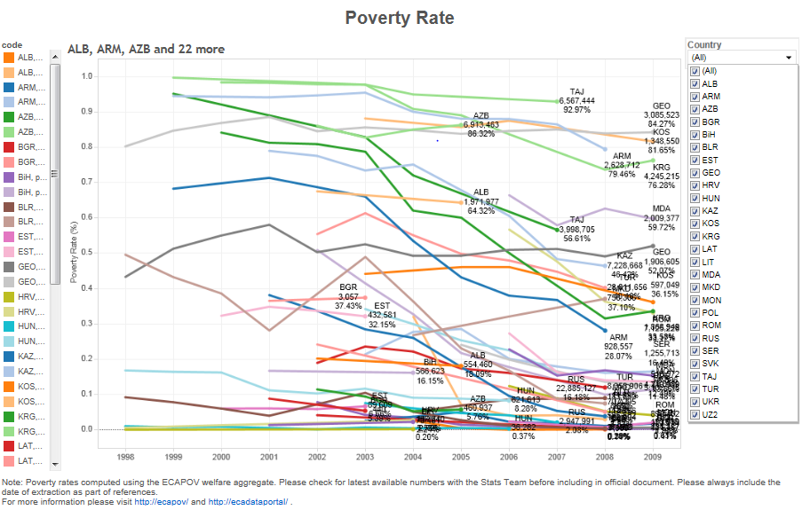
PRESENTATION MATTERS
Presentation should not be an afterthought. It can be essential to how we understand, use, and share data.
DASHBOARDS
APIS
(WORLD BANK API)
World Bank Poverty Monitoring In Europe And Central Asia : A Harmonization Effort

Slide 23
MOVING FORWARD
World Bank Poverty Monitoring In Europe And Central Asia : A Harmonization Effort

Slide 24
FOR CONSIDERATION
How to best develop a standardized response to data challenges?
How to best present and share data?
How to best work with NSOs?
Capacity Building
Knowledge Sharing
Access to Data
World Bank Poverty Monitoring In Europe And Central Asia : A Harmonization Effort

Slide 25
THANK YOU.
JOÃO PEDRO AZEVEDO
jazevedo@worldbank.org
World Bank Poverty Monitoring In Europe And Central Asia : High Frequency Data

