Slide 1
Reflections on the MDGs, and post-2015, from Europe and Central Asia
Ben Slay, Elena Danilova-Cross
Regional Poverty Reduction Practice
UNDP, Europe and Central Asia
December 2013

Slide 2
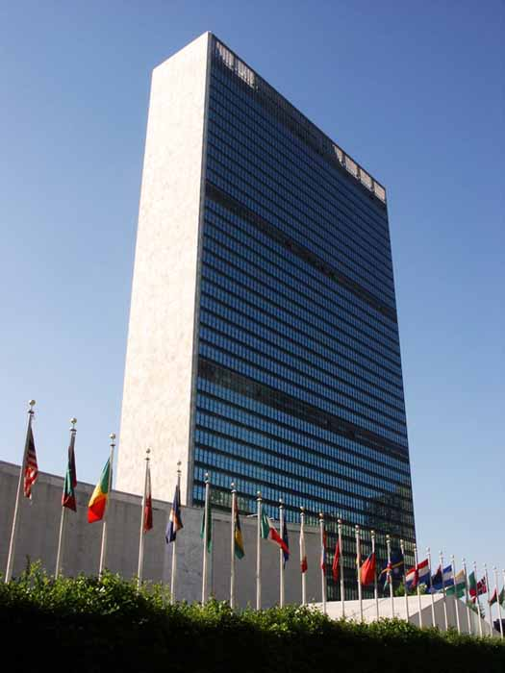
MDGs: General sources of controversy
Not directly linked to the Millennium Declaration
Focus on:
National aggregates, not vulnerable groups
Extreme poverty, not sustainable development
Tensions between:
Targets, indicators for the same goal
Data: International, national sources

Slide 3
MDGs in Europe and Central Asia: Particularly rough sledding
Many middle-income countries
Weak identification with the “South”
Inequality, exclusion as important as poverty
Data issues (inadequate statistical capacity)
ODA relatively unimportant
MDGs nationalized, localized
Certain problems solved . . .
. . . Others created

Slide 4
Income poverty in the region: Relatively unimportant
World Bank 2008 POVCALNET data (in PPP terms).

Slide 5
Remittances matter more than ODA
Four of the world’s eight largest remittance recipient economies are in the region
For most LICs, LMICs, remittances are much larger than ODA inflows
World Bank, IMF, OECD data; UNDP calculations.
* As per UNSC resolution 1244 (1999).

Slide 6
Is the region an exception? Or is it the post-2015 future?
Middle-income countries?
Most of the world’s poor are in MICs
Inequality, exclusion, as well as poverty?
Broad support for inequality-related post-2015 GDGs
ODA is relatively unimportant?
Global ODA: stagnant at best
Nationalization and localization?
If post-2015 SDGs are made universal, they will be nationalized and localized, in order to be relevant

Slide 7
Possible lessons from the region (I)
Nationalization ➔ comparability issues
Pay attention to nationalized SDGs
Don’t just report on global targets
Details of nationalization, localization processes matter
Needed: national ownership
Ideally, nationalized SDGs should be codified in national legislation, policy documents
Needed: Guidelines, best practice descriptions
Designation of SDG targets/indicators should be aligned with national statistical capacity
Capacity building agenda?

Slide 8
Possible lessons from the region (II)
Inequalities, vulnerabilities:
They matter
They should be better measured
Go beyond the Gini coefficient
Examples from UNDP’s work in this region:
Social exclusion:
2011 regional HDR adapted, applied EC social exclusion indicators to developing economies in the region
Decade of monitoring Roma vulnerability indicators
Sustainability: Armenia’s “affordable human development index”

Slide 9
Thank you very much!
Questions? Comments?
For a copy of the paper from which this presentation is drawn, please be in touch with:
ben.slay@undp.org, elena.danilova-cross@undp.org

