Slide 1
Employment QUALITY INDICATORS. NATIONAL DEFINITIONS AND DATA SOURCES MAY CHANGE A LOT. CENTRAL STATISTICAL OFFICE pOLAND
Radoslaw Antczak | Geneve, 13.09.2013

Slide 2
Introduction
Quality of life – job quality.
Job quality - subject to national regulation (minimum wages, work time, anti-discrimination).
3 approaches to job quality:
Wages and working conditions,
Education, training, skills,
Subjective well being of employees.
Job quality and employment level: positive correlation. (Job quality and labour market performance, CEPS, 2010.)
Background for Poland to produce employment quality indicators for the 1st time.

Slide 3
Excersise
Indicators
As agreed by EG
Translation into Polish
Possible definition change
Data source
More than 1 per indicator possible
Time series & groups

Slide 4
Content of the presentation
Focus on areas where possible difficulties may arise.
Definition,
Data sources
Example of the results using different definition and data sources
Few suggestions on changes

Slide 5
AREA 1a. Safety at work Example of definitional problems
Fatal occupational injury rate
National statistics: per 1000,
Eurostat requirements: per 100.000
Non-fatal injury rate
All non-fatal?
Only resulting in work absence (1-day, 4-days)?
Share of employed persons working in „hazardous” industries/occupation.
Definition of hazardous .
No data for: „persons who feel significant levels of stress due to employment activities”.

Slide 6
AREA 1b. Child labour and forced labour
Sensitive subject
No data source for child labour indicators in Poland
Possibility to use Time Use Survey:
2013 TUS in Poland – respondent’s age: 10+
Limited information (mainly work in agriculture, family business, household chores)
No earlier data (TUS 2003 – respondents aged 15+).

Slide 7
AREA 1c. Fair treatment of employment
Subjective decision which (demographic, social) groups should be included
No data which groups should be included
No comparability across countries
Specific issue for Poland (not only?):
married women aged 25-35 without children
fair treatment could be an issue for them
common belief – employers do not want to hire them, but won’t confirm that officially.

Slide 8
AREA 2a. Income and benefits from employment
Average earnings
in Poland: per month or per hour (not weekly).
Gross / net / pension / healthcare contributions
Between years and Between countries comparison subject to several adjustments
E.g. income with healthcare contributions: In Poland after 1998
Real & nominal change / Currency.
„Making comparisons of wage rates, earnings or labour costs over time and between countries is probably one of the most difficult tasks for the users of the information presented in this publication.” ILO Key Indicators of Labour Market

Slide 9
AREA 2a. Income and benefits from employment
Low pay
PROPOSAL: On top of this indicator, include information on minimal wage:
Either: Share of employed with minimal wage Or: level of minimal wage (to compare with median / low pay).
Distribution of earnings:
Average / median of each quintile / decile
Inequality measures: Gini, S80/S20

Slide 10
AREA 2b. Non-wage peniculary benefits
Share of employees entitled to annual leave / sick leave
All employees with contract for above 6 months
Average number of days of annual leave / sick leave employees are entitled to use
Limited use of this indicator – no of days is appropriate to seniority and type of contract.
Instead – no of days actually used (not entitled to use).
Share of employees with supplemental medical insurance
Share of employees using medical services paid out-of the pocket.

Slide 11
AREA 3b. Working time arrangements
Available data, relevant information
Data source: LFS
Share of employed persons who usually work on bank holiday:
LFS – only Saturday and Sunday: is it the same?
LFS module „working time” 2004 (next – 2015) can give further information

Slide 12
AREA 3c. Balancing work and non-working life
Highly depending on country legislation
Some indicators differ from the definition agreed by the Group
Share of persons receiving family leave benefits
All persons during maternity leave receive salary,
Additional benefits for families with low income
Average duration of commuting
Only range is available (below 30 minutes, 31-60 etc.)
LFS and Census

Slide 13
AREA 3c. Balancing work and non-working life
Duration of commuting
Based on LFS 2010
Duration in minutes | Share of employees commuting
Up to 30 | 71%
31 – 60 | 22%
61 – 120 | 5%
Above 120 | 2%

Slide 14
AREA 4b. Social protection
Unemployment insurance (share of employees, insurance payment)
No unemployment insurance in Poland
Unemployment benefit is paid during short period of time after being unemployed
2012: only 17% of unemployed receive benefit, the rest rely on family and / or social benefits
Problems with calculation of share and average (only those who receive unemployment benefit?).

Slide 15
AREA 4b. Social protection
Public social security expenditure as share of GDP
Social security is a task of national and local government
National government spendigs: 12,5 bln PLN
Local governments spendigs: 23,6 bln PLN
Share of economically active contributing to a pension fund.
All with work contract
Private owners pay only minimum amount

Slide 16
AREA 6. Skills development and training
Important indicator, difficult to measure (the relationship between education and labour market)
Data sources: LFS, Adult Education Survey
Share of employed people who received job by type of job training
Adult Education Survey 2011:
persons 18-69 who attended non-formal education
reasons for attending: to receive or change the job | 27,4%
actually received new job | 4,4%

Slide 17
AREA 7. Workplace relationship & work motivation
No data source in national statistics – the area was not analyzed yet.
Available data source: EWCS
The issue is too small sample size for robust analysis (1500 for Poland)
Other possible sources: social surveys produced by national statistics (e.g EU-SILC, in Poland – Social Cohesion Survey)
Well-being of employees
However – more focused on general well-being than workplace relationship.

Slide 18
Composite indicator
+
Ability to attract audience
Easy to analyse, especially dynamics
-
Reduces multidimensionality
Methodological controversy
Composite indicator complimentary to set of indicators (HDI type).

Slide 19
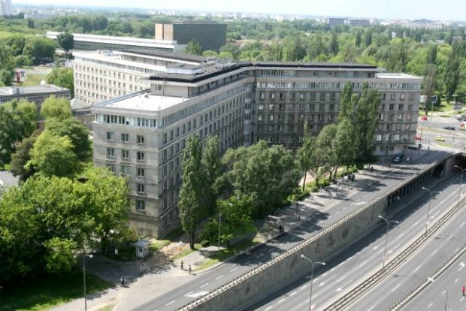
Thank you

