Slide 1
Workplace relationships and work motivation: contributors to quality of employment
Some findings from the European Working Conditions Survey
Greet Vermeylen
Research manager, working conditions & industrial relations unit
UNECE/ILO/Eurostat meeting on
measurement of quality of employment
Geneva 12 September 2013

Slide 2
Dimension 7:
Workplace relationships & work motivation
Looks at more ‘job’ and ‘workplace/work environment’ characteristics which have an important impact on quality of employment
  Workplace relationships
    -Relationships with co-workers and with boss
    -Avoidance of adverse social behaviour at the workplace
    (discrimination, bullying and harassment)
  Work motivation
    -individual motivational characteristics : intrinsic nature of job?
    -room and space to do the job (time pressure/autonomy), feedback on the work, feeling of doing useful work and of doing valuable work

Slide 3
Why are workplace relationships and workplace motivation important elements of quality of employment?
From an individual point of view (worker):
  Health and well being
  Sustainability of work
    keep workers fit and avoiding premature exit of labour market
  Motivation? Engagement?
From a corporate point of view (organisation/company):
  Performance / profitability of companies
    link between engagement and better performance of workers?
  Sustainability of the workforce (avoid unnecessary turnover)
From a societal point of view
  Health and wellbeing
    cost of health and mental health problems
  Sustainability of workforce
    cost of premature exit of labour market
  Productivity of companies
    cost of a less motivated or less productive workforce on overall productivity of the country
  Social cohesion

Slide 4
Diving in the theories
Disciplines: epidemiology, occupational psychology, …
Quality of employment :
  More than being in employment, having a (relatively steady) contract, fysical risks, containment of working hours…
  Mental health and health : main theories:
    - Job demands/control model (Karasek)
    - Effort / reward inbalance (Siegrist)
    - Organisational justice (Greenberg)
    - Job characteristics model (Hackman and Oldman)

Slide 5
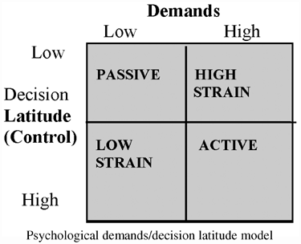
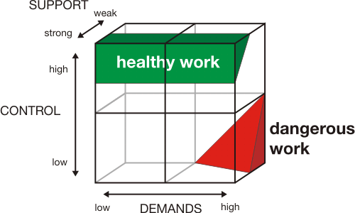
Job demands/control(/support) model (JDC)
(Karasek and Theorell)
Job demands:
  fysical, psychological, social, or organizational aspects of the job, that require sustained fysical and/or psychological effort or skills.
  associated with certain fysiological and/or psychological costs.
  Examples : work load, work pressure, emotional demands
Job resources (/job control):
  physical, psychological, social, or organizational aspects of the job that are
    - functional in achieving work goals;
    - reduce job demands and the associated physiological and psychological cost;
    - stimulate personal growth, learning, and development.
  Examples : career opportunities, supervisor coaching, role-clarity, and autonomy.
Social support
  Of colleagues and boss
Outcomes:
  Health impairment process: poorly designed jobs or chronic job demands -> exhaust employees’ mental and physical resources -> might lead to burnout and other health problems.
  Motivational process: job resources and social support exert their motivating potential and lead to high work engagement, low cynicism, and excellent performance.

Slide 6
Job demands resources and outcomes (Van den Broeck, De Witte)

Slide 7
Job demands control model:
EWCS: Autonomy versus Work intensity, by sector and occupation

Slide 8
Effort-reward inbalance (Siegrist)
Efforts:
  Demands and obligations in work, psychological and fysical work effort
  Quantitative/qualitative load/increase in load
Rewards:
  Wage, salary / esteem /promotion, security/ low work support
  Eg salary, adequate support, fair treatment, respect, promotional prospects, undesirable change, job security, status consistency
Inbalance:
  No alternatives (stuck(/acceptance for strategic reasons/ motivational patterns present leading to overcommitment
  Structural and personal characteristics
  Related to increased risk of reduced health (OR : 5.09-18.55)
  Cfr Maslow’s need hierarchy : safety needs/social needs
    High effort / low rewards:
    esteem as reward: most adverse effect on employee health
    salary as reward: moderate effect on employee health
    job security: least profound effect on employee health

Slide 9
Organisational justice (Greenberg)
Different forms of justice related to psychological well being at work:
  Distributional justice
    Relation to decision outcomes and distribution of resources
  Procedural justice
    Fairness of processes that lead to outcomes: voice and/or processes that are consistent, accurate, ethical and lack bias
  Interprofessional justice
    Treatment of individual with regard to decisions (respect, politeness and dignity)
  Informational justice
    Adequacy of explanations with regard to decisions taken
Outcomes (Sweeney and McFarlin)
Distributional justice related to person level outcomes (eg pay satisfaction)
Procedural justice related to organisational level outcomes (organisational commitment)
Related to employee participation, communication, (quality of communication, trust), justice climate
Linked with trust, performance, job satisfaction, organisational commitment, counterproductive work behaviours, absenteism, turnover and emotional exhaustion

Slide 10
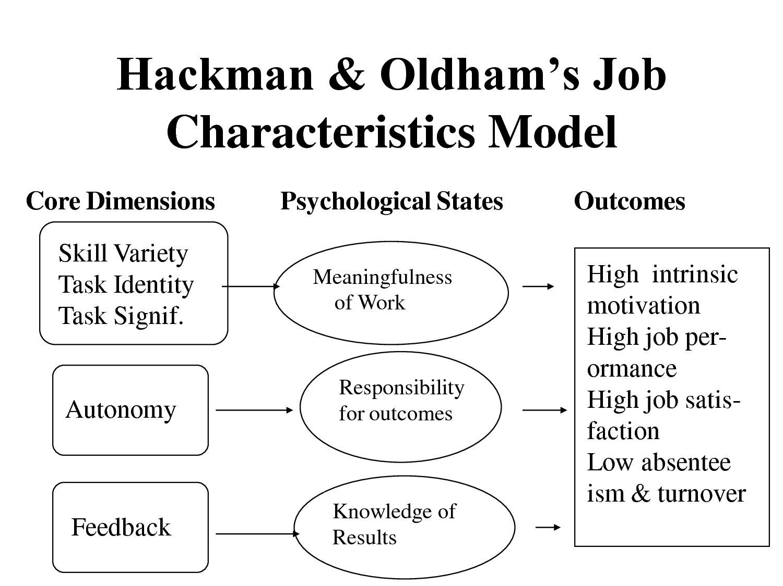
Job characteristics model (Hackman and Oldman)

Slide 11
Survey sources
To some extend:
ISSP (1989/1997/2005)
  I can work independently, My job is useful to society, job satisfaction
EWCS (1991/1995/2000/2005/2010)
  Cfr underneath
  Missing: organisational justice, engagement/motivation (as outcome)
LFS ad hoc module on working time and work organisation
  Job autonomy
COPSOQ (Copenhagen Psychosocial Questionnaire) (COPSOQ network, 16 countries,15 languages), since 2004, developed by Tage Kristensen, tool for employers and employee to measure psychosocial work environment,
  Quantitative, cognitive, emotional demands, influence at work, degrees of freedom at work, meaning of work, commitment, role clarity, role conflicts, quality of leadership, social support, feedback at work, job satisfaction, trust, justice and respect
National surveys

Slide 12
Why are these factors important?
Association with outcomes -> quality of employment:
  Health
  Mental health
  job strain
  (absenteism, presenteism)
  Work sustainability (able and willing to work until retirement)
  Motivation and engagement (versus burnout)
  Eurofound : work in progress on questions for 6th EWCS (2015) re motivation and engagement (as outcomes)

Slide 13
Sustainable work some findings from EWCS
being able and willing to do the job until 60
Important determinants:
autonomy plays its protective role, work intensity its deterrent role.
  Karasek is important (job strain - / active jobs +)
work-life balance
  Incl working time autonomy
cognitive dimensions of work
involvement in workplace organisation/innovation
social support from colleagues and managers
But also important : intrinsic rewards
violence and harassment, exposure to ergonomic risks, job insecurity associated with lower levels of job sustainability

Slide 14
Health and mental health?
Trends in job quality: 4 indices developed by Francis Green
For all indices, clear positive relationship between well-being and quality. As some effects are linked to dose exposure effect, the effect can be delayed and different according to individual.
The aspects more effective in shaping workers’ well-being are the intrinsic job quality as well as prospects. These aspects of quality are not monetary.
Negative relationship between quality and variability of well-being: variability decreases when quality improves. Once very good working conditions are achieved individuals have consistent levels of well-being. It is facing bad job quality conditions that differences in the individual and/or collective capacity to cope emerge: there are clearly many individuals who are capable of compensating their situation and people with worryingly low levels of well being.

Slide 15
Index | Brief description of content | Items Used In Construction *
Earnings | Hourly earnings | EF10, EF11, Q18
Prospects | Job security, career progression, contract quality | Q77A, Q77C, Q6, Q7
Intrinsic Job Quality | Skill Use and Discretion (0.25) skills and autonomy | Q61A, Q61C, Q49C, Q49E, Q49F, Q50A, Q50B, Q50C, Q51C, Q51E, Q51I, Q51O, Q24H, ef1_isced, isco_08_2
 | Good Social Environment (0.25) social support, absence of abuse | Q51A, Q51B, Q58A, Q58B, Q58C, Q58D, Q58E, Q77E, Q70A, Q70B, Q70C, Q71A, Q71B Q71C
 | Good Physical Environmental (0.25) low level of physical & posture-related hazards | Q23A to Q23I, Q24A to Q24E
 | Work Intensity (0.25) pace of work, work pressures, & emotional/value conflict demands | Q45A, Q45B, Q46A to Q46E, Q51G, Q51L, Q51P & Q24G
Working Time Quality | Duration, scheduling, discretion, and short-term flexibility over working time | Q18, Q32, Q33, Q34, Q35, Q39, Q40, Q43

Slide 16
Coming back to the Quality of Employment framework: dimension 7
Workplace relationships: social characteristics of work
  Share of employed people who feel they have a strong or very strong relationship with co-workers
  Share of employees who feel they have a strong or very strong relationship with boss
  Absence of asocial behaviour (discrimination / bullying and harassment) :
    - Share of employed people who feel have been victim of discrimination at work
    - Share of employed people who feel they have been harassed at work
  Work motivation : Individual motivational characteristics -> intrinsic nature of job
  Autonomy (+ work demands?)
    Share of employees who are able to choose order of tasks or methods at work
  Share of employed people who receive regular feed back from their supervisor
  Able to apply own ideas in work
    Share of employed people who feel they are able to apply their own ideas in work
  Share of employed people who feel they do useful work
  Share of employed people who are satisfied with their work (?)

Slide 17
Breakdowns
Sex
Age
Employment status
  some make no sense for self-employed, other do
  Non permanent contracts
Occupation
Economic activity
Educational background
Potentially : groups who might be discriminated against
  Sex, age, religion, sexual orientation, ethnicity, disability…

Slide 18
Job quality : a trusting social environment
 |  | Poor general health (fair, bad, very bad) |  | Mental health at risk (WHO 5) |  | Absenteeism (>5 days)
 |  | men | women | men | women | men | women
Was subjected to bullying or harassment | no | 19% | 21% | 16% | 20% | 21% | 23%
 | yes | 29% | 30% | 27% | 32% | 33% | 32%
Participation in workplace changes | low | 18% | 20% | 14% | 17% | 21% | 24%
 | high | 23% | 25% | 22% | 26% | 27% | 27%
Having a good manager | no | 22% | 24% | 20% | 24% | 28% | 28%
 | yes | 15% | 16% | 11% | 14% | 22% | 24%
EWCS, 2010

Slide 19
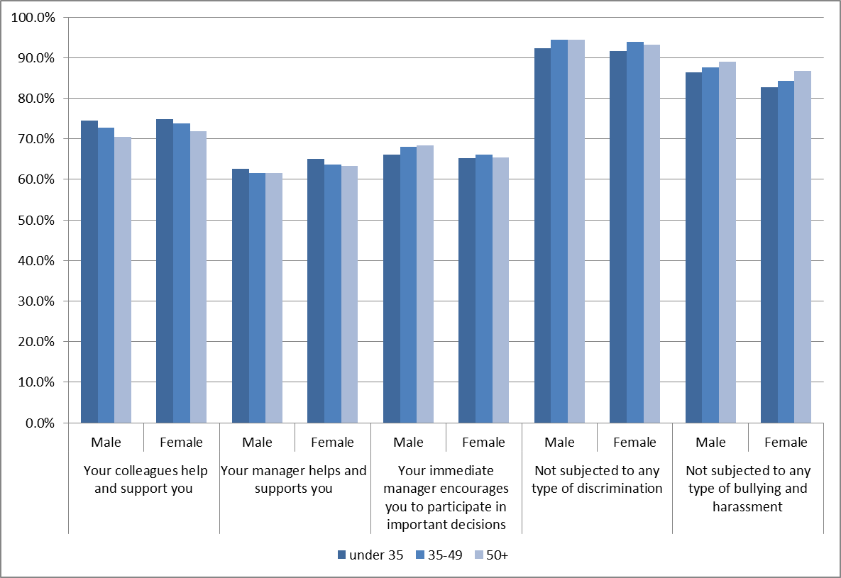
Workplace relationships by age group and gender

Slide 20
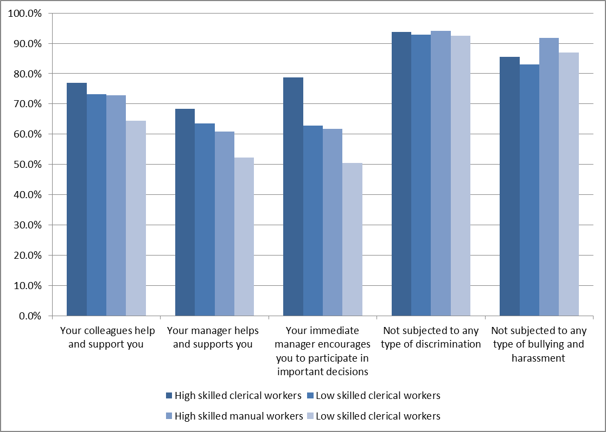
Workplace relationships (white/blue collar, high and low skilled)

Slide 21
Workplace relationships

Slide 22
Job quality : skills development and intrinsic satisfaction and well-being
 |  | Poor general health (fair, bad, very bad) |  | Mental health at risk (WHO 5) |  | Absenteeism (>5 days)
 |  | men | women | men | women | men | women
Received training paid for by employer | no | 23% | 24% | 19% | 23% | 22% | 23%
 | yes | 16% | 19% | 16% | 21% | 24% | 27%
Job gives feeling of work well done | no | 30% | 37% | 35% | 45% | 32% | 30%
 | yes | 20% | 22% | 17% | 21% | 22% | 24%
Scope for applying own ideas at work | no | 25% | 27% | 24% | 29% | 29% | 29%
 | yes | 19% | 21% | 16% | 20% | 21% | 23%

Slide 23
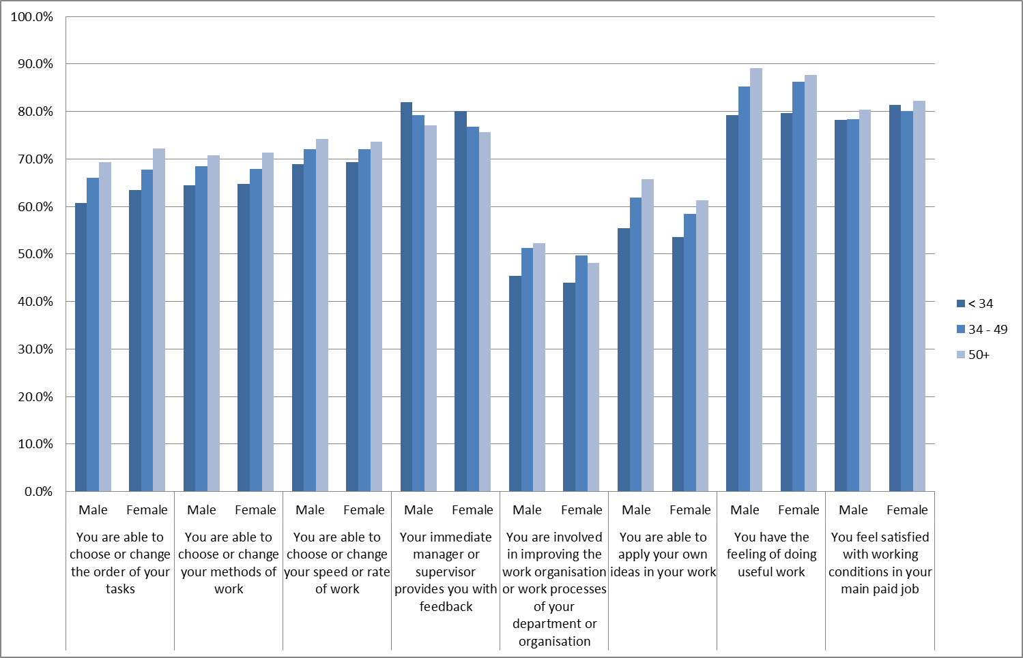
Work Motivation (by age group and gender)

Slide 24
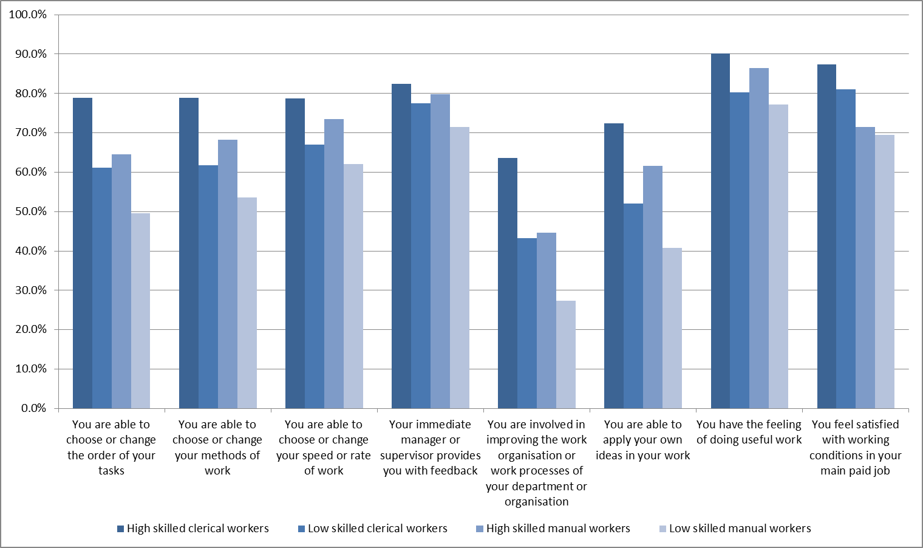
Work motivation (white/blue collar, high/low skilled)

Slide 25
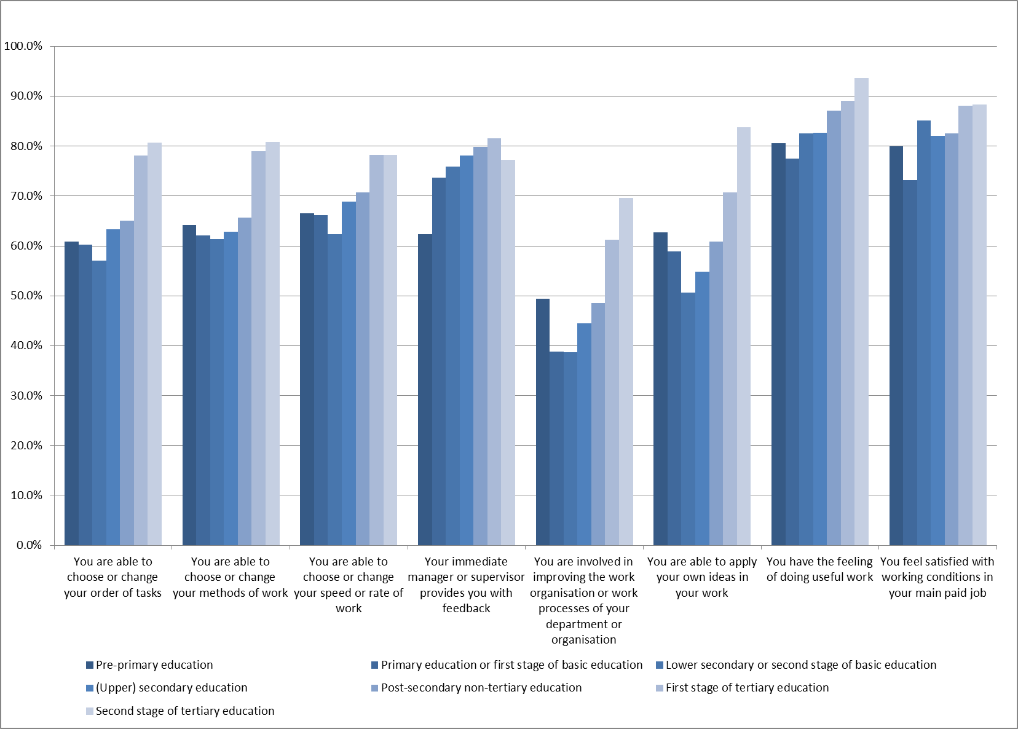
Work motivation (by educational background)

Slide 26
Some issues
Intrinsic elements of work: important to kept and developed further in the framework
Issues: -
  Some elements already in other dimensions: how to disentangle? / data?
  Can we agree upon some indicators?
    Workplace relationships
    -social relationships? (+ leadership styles?)
    -adverse social behaviours? / discrimination?: sensitive issues but with heavy impact
    Work motivation
    -autonomy
    - index or one indicator?
    do we add work demands? (work intensity, work load, emotional demands?) / active jobs? / job strain
    creativity : apply own ideas in work ? / involved in improvement of products & processes?
    useful work
    - feedback (esteem)
    - work satisfaction: does it add something? (also mixing up job satisfaction, work satisfaction, satisfaction with working conditions)

Slide 27
.
Thank you

Slide 28
Work intensity on the increase
Working to tight deadlines,
EC12, EU15 and EU27, 1991-2010 (%)
Notes:
Q45b Does your job involve working to tight deadlines? → at least a quarter of the time

Slide 29
Differences in autonomy, 2000 – 2010, EU27 (%) being able to change or choose work methods

Slide 30
Knowing what is expected in the job, and feeling of doing useful work, always or most of the time, by sector

Slide 31
Contact met cliënten…

Slide 32
Job sustainability and working conditions
 |  | Male | Female |  |  | Male | Female
Autonomy | Low | 48 | 46 | Posture related index | Low | 77 | 69
 | High | 72 | 67 |  | High | 39 | 35
Work intensity | Low | 64 | 61 | Career development possibilities | Low | 49 | 49
 | High | 51 | 50 |  | High | 66 | 64
Worker participation | Low | 46 | 47 | Work life balance | unfit | 47 | 42
 | High | 70 | 65 |  | fit | 62 | 62
Work well done | Never | 43 | 44 | Learning new things | Low | 49 | 49
 | Always | 63 | 60 |  | High | 63 | 60

Slide 33
Threats and harassment by sector

Slide 34
Feeling of one’s work well done, by job satisfaction, 2010, EU27 (%)
Notes:
q76. On the whole, are you very satisfied, satisfied, not very satisfied or not at all satisfied with working conditions in your main paid job? * q51h. Select the response which best describes your work situation - Your job gives you the feeling of work well done

Slide 35
Involvement in improving work organisation
Notes:
35

