Slide 1
Introduction and key issues identified in the papers
UNECE Conference of European Statisticians
June 2015
Second Seminar, Session I.

Slide 2
Driving forces behind modernisation in NSIs
User needs
Quality, with emphasis on timeliness
Data revolution
Technological change
Alternative producers
Resources, efficiency

Slide 3
Range of modernisation issues raised in the papers
Portugal: management of integrated respondent communication
US: innovation and improved efficiency in vital statistics
Turkey: ICT-based innovation in production and services
Slovenia: from domain oriented to process oriented production
Sweden: common production environment for the production process
Poland: modernisation of surveys production
Norway: business driven improvenets of an overarching nature

Slide 4
How
Step by step vs one major overhaul of the entire production process and enterprise architecture
Integrated processes
Standardisation of methods and tools
Modular solutions to ensure future flexibility
Lean approach (or other systemic management approaches) in order to optimise entire value streams rather than separate technologies

Slide 5
Internationally developed models at work
GSBPM, GSIM, CSPA, architecture related acitvities, …
Developed a common language and a common approach for official statistics worldwide
Enable statisticians to raise traditional international cooperation to new levels in practice

Slide 6
Similar aims, various stages of modernisation, different solutions
Modernisation is not a one-off exercise, it has been an ongoing process of varying intensity over the last 15 (?), 20 (?), 100 (?) years and will continue as long as official statistics exist
The nature of the modernisation process depends e.g.
on the national statistical system (on a scale from highly centralised to highly decentralised)
on the current level of integration and standardisation in the NSI
on the availability of resources that can be allocated to developing and implementing modernisation projects – while business goes on as usual
on the human resources, on the availability of staff with new skills and knowledge

Slide 7
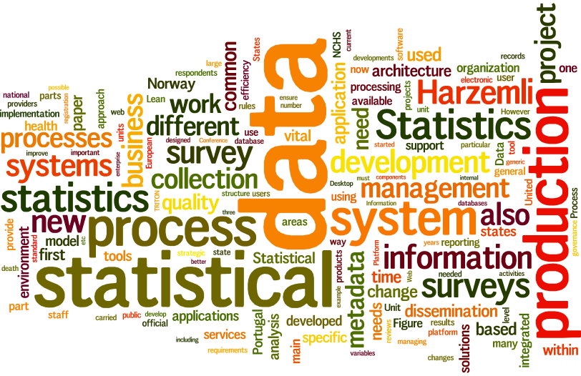
Courtesy of Steve Vale and Marjo Bruun

Slide 8
Keywords
Strategic management
Process orientation
Organisational change
Integration
Standardisation
Metadata
Modular solutions
Flexibility
Managing change
HR-related challenges

Slide 9
Common features and highlights of the papers
Modernisation needs to be backed up by strategic governence
Developments are all focusing on integrated solutions
Standardisation of methodologies and the supporting IT tools is identified to be of importance in the modernisation process in most papers
Process oriented approaches are highlighted, in some cases accompanied by explicit reorganisation from domain-oriented to process-oriented setting

Slide 10
Some issues that are mentioned but more info would be of practical use
Exchanging experience about the communication of modernisation to the outside world and inside the NSIs
While user needs are mentioned as driving force of modernisation, immediate and substantial benefits for policy is only documented in one paper (US, modernisation of vital statistics)
With few exceptions, there is not much emphasis in the papers about the
HR implications of modernisation
Need for changing the institutional culture (in some cases it may be a well-established practice, in some NSIs the institutional culture may be less favourable)
Exchange of experience in project portfolio management in NSIs would of practical benefit to other NSIs

Slide 11
Questions to authors

Slide 12
Norway
There are several references in the paper to standardisation as a of the precondition of modernisation. How was standardisation achieved in order to establish the integrated production platforms?
How do you develop and implement common methods to support the integrated platforms?

Slide 13
Poland
When you identified the new basic units based on the ISBPM, how did you define methods and IT tools that support these units? How are the IT tools connetcted to eachother?
When moving from the stovepipe model to the new organiational model, how did you identify what and how to standardise?

Slide 14
United States
In addition to timeliness issues, what other quality concerns were raised about vital statistics? How did you integrate these concerns into the modernisation process?
A current inflow of data as opposed to the previous regime of batches of data received, is a significant change in the production process. How did this influence the underlying and related processes of the NCHS? What modernistion was undertaken to face these challenges?

Slide 15
Turkey
Apart from the standard image and the generic applications, the Harzemli Platform provides a standard coding approach. How do you ensure the standardisation of coding methods (both in terms of development and implementation)?
How are the application platforms integrated into the statistical business processes of TurkStat? How are they connected and how do they work together with other integrated IT systems?

Slide 16
Portugal
The metadata system is a key element of the collection component of SiGINQ. How does the metadata system support the integration of the SIGINQ into the business processes of Statistics Portugal?
What is the level of integration of the Integrated Survey management System with the other IT tools supporting other business process phases?

Slide 17
Slovenia
The building blocks of the statistical process are based on harmonised and widely accepted methodological principles. How did you develop these principles? How do you develop the generealised solutions for data editing, aggregation and standard estimation?
The paper describes that the integrated statistical production system comes with a generic metadata driven system of the whole cycle of statistical data processing. How is this metadata system integrated with other IT tools of business process phases other than production?

Slide 18
Sweden
In what sense are the IT tools developed and implemented under the Triton project integrated with other IT tools of Statistics Sweden?
How was the development and integration of common methods and common IT tools realised in practice? What was the process of standardisation of methods?

